Slide 1
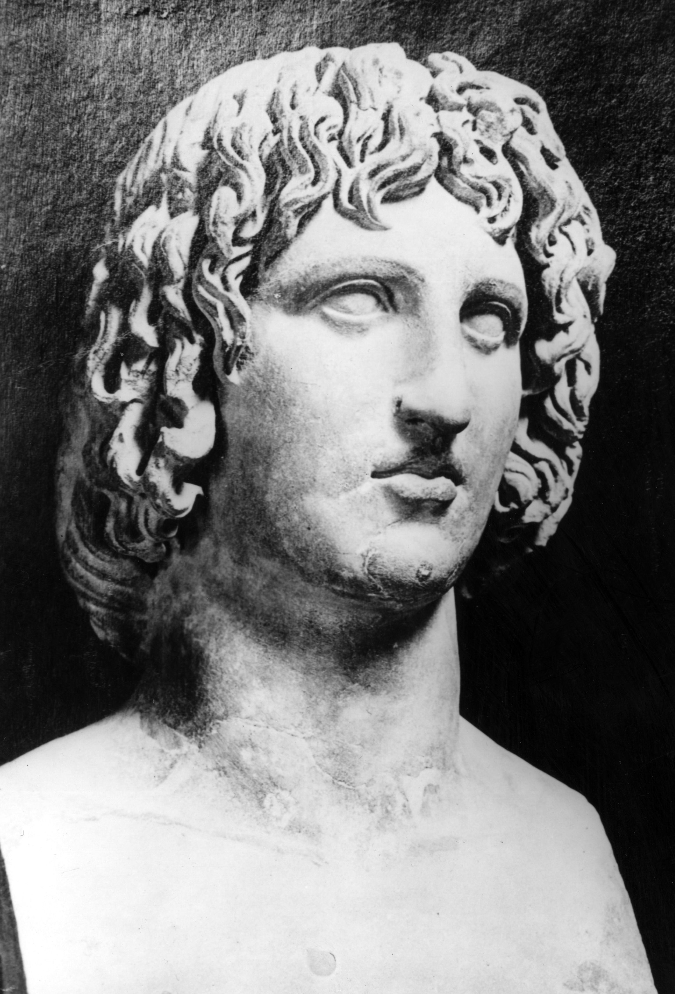
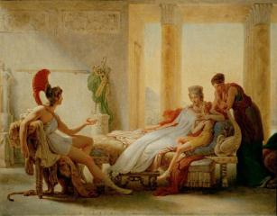
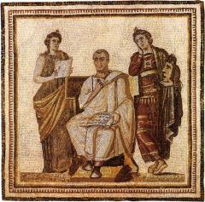
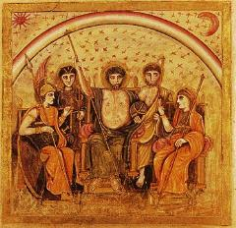
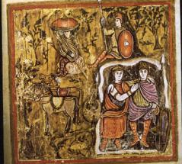
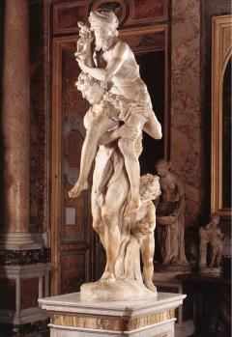
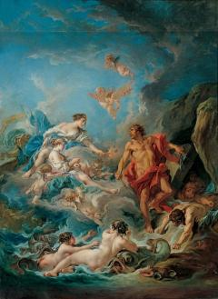
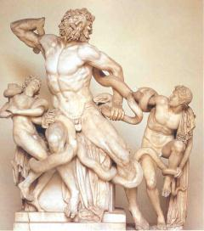
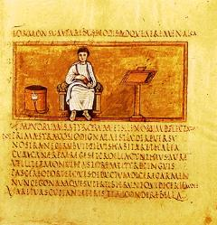
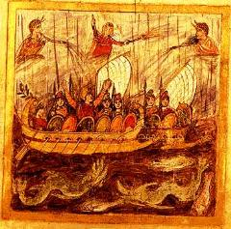
Vergil’s Aeneid
Book VI

Slide 2
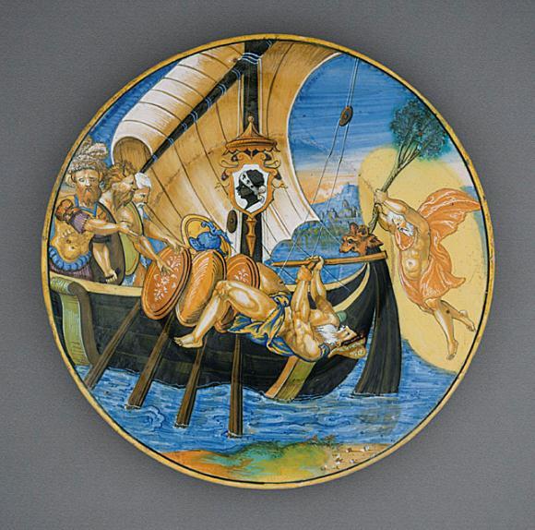
Francesco Xanto Avelli da Rovigo (Italy, Urbino)
Charger from the Pucci Service: 'Palinurus Falling Overboard', 1532
Ceramic, Tin-glazed earthenware (maiolica), Diameter: 11 3/8 in. (28.9 cm)
William Randolph Hearst Collection (50.9.28)
Decorative Arts and Design Department. Los Angeles Co. Museum of Art (LACMA)

Slide 3
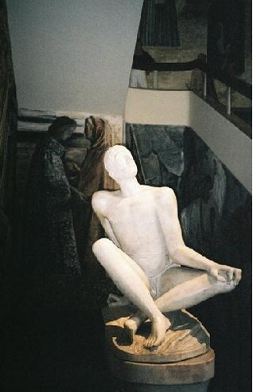
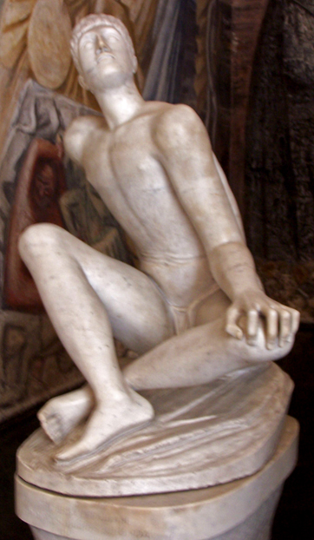
Palinurus Statue Bo University Padua, Italy
This is the last work of the sculptor Arturo Martini. The statue is dedicated to Primo Visentin, who was nicknamed Massaccio.
He was a partisan commander, who was a graduate of Padova University, and was decorated with a gold medal for his work and his contribution in the Resistance movement.
The statue depicts Palinurus, Aeneas' helmsman, who died within sight of the coastline of Italy, after a painful journey from Troy.
Visentin similarly died at the end of the war, when there was a glimmer of liberation of Italy- the cause he had fought and died for.

Slide 4
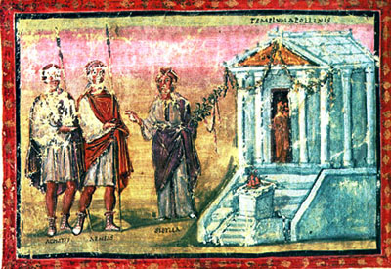
Vatican Vergil c.400

Slide 5
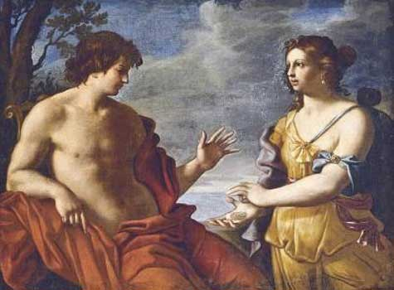
Apollo and the Cumaean Sibyl, Giovanni Domenico Cerrini, (1609-1681)
after 1666, 102 x 135 cm

Slide 6
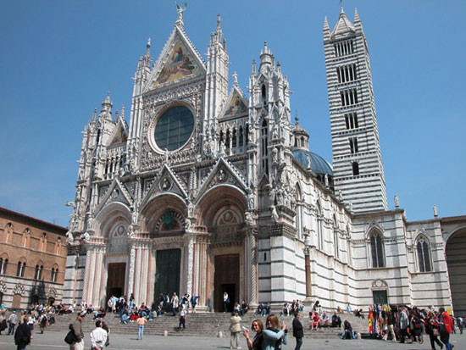
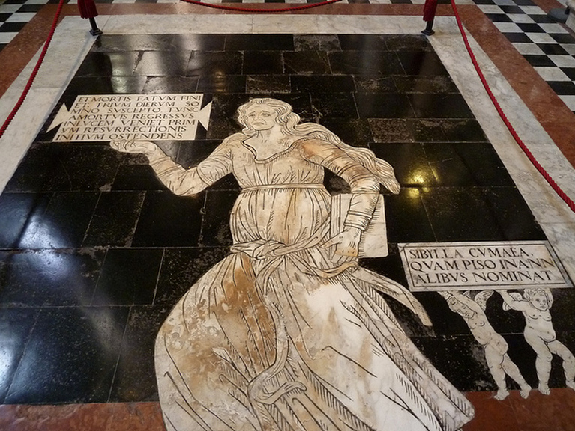

Slide 7
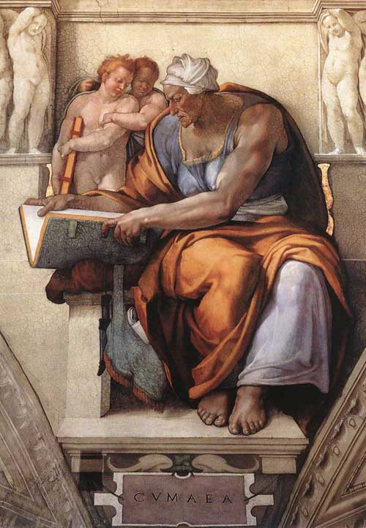
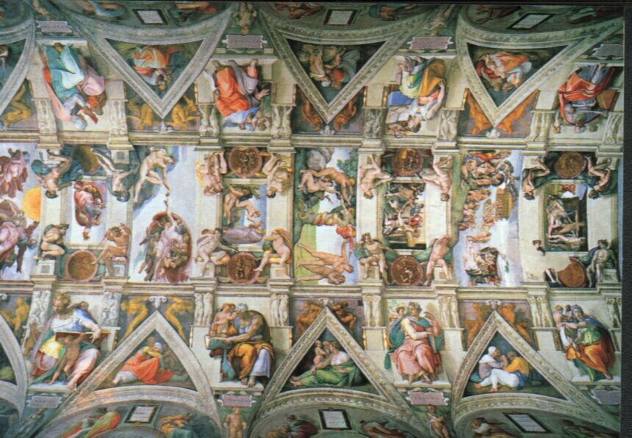
Michelangelo's rendering of the Cumaean Sibyl

Slide 8
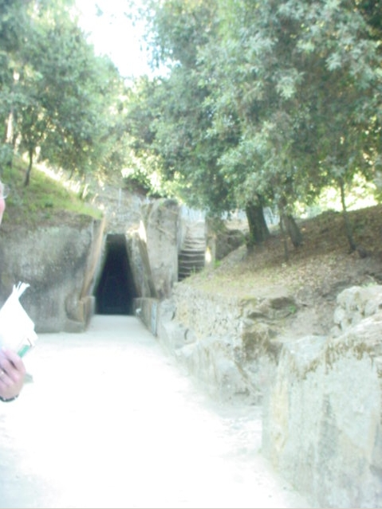
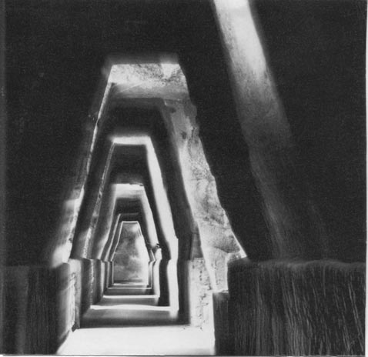
Sibyl’s Cave (Cumae)

Slide 9
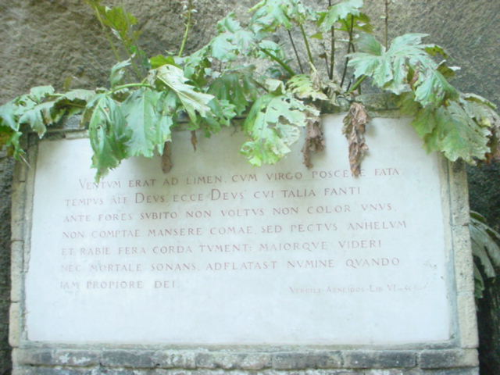

Slide 10
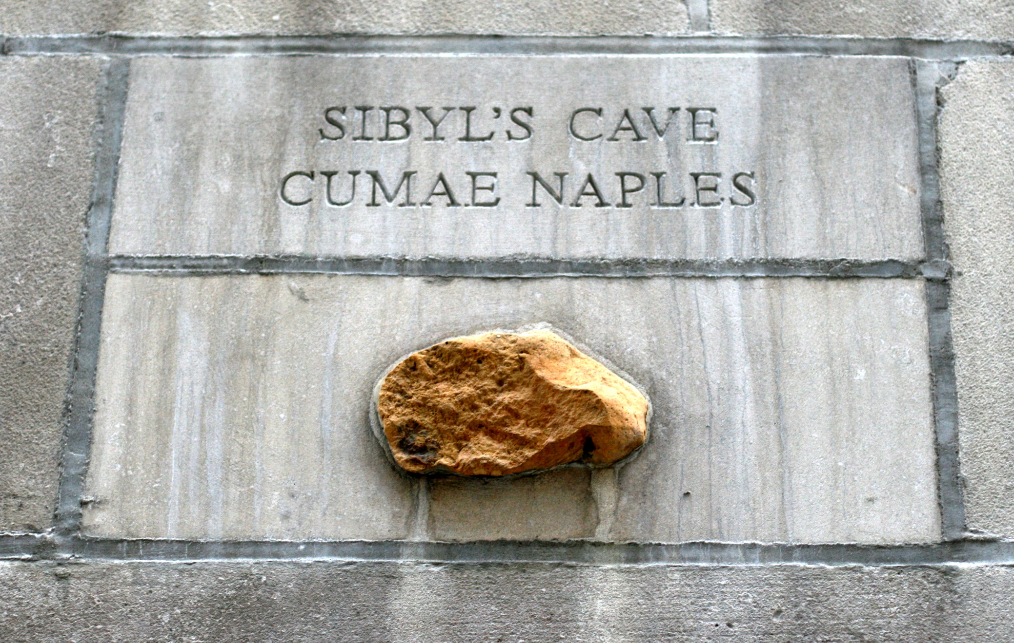
Cityfront Center, Chicago, IL, US,

Slide 11
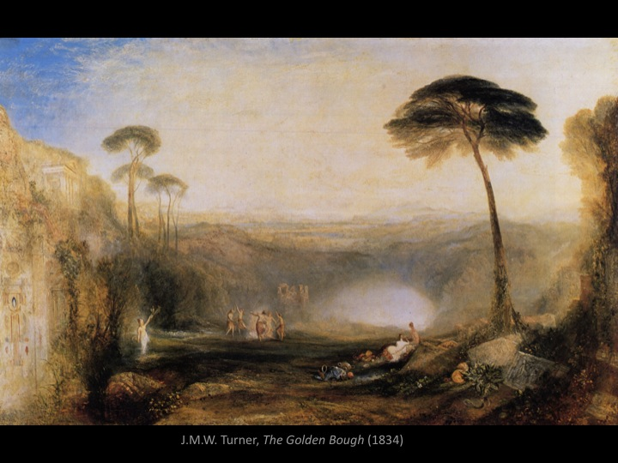

Slide 12


Slide 13
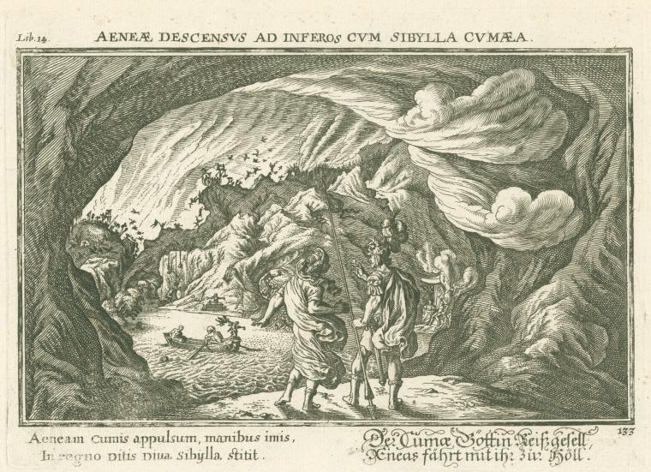
The Sibyl of Cumae guides Aeneas through the Underworld (Aeneae descensus ad inferos cum Sibylla Cumaea)
Baur, Joh. Wilhelm (Johann Wilhelm), 1600-1642 : Engravings
: 1 print : b&w ; 18.6 x 24.8 cm.
Includes additional text in Latin and German. Written on border: "The Sibyl of Cumae guides Aeneas around Hell ; 'Metamorphoses' by Ovid (Book 14) ; Engr. after J.W. Baur, 17th cen."
: From Publii Ovidii Nasonis metamorphoseon, libri XV, oder, fünfzehn Bücher der Verwandlungen des römischen Dichters Publius Ovidius Naso. Ovid (43 B.C.-17 or 18 A.D.), Author. Baur, Joh. Wilhelm (Johann Wilhelm) (1600-1642), Artist.
: Mid-Manhattan Library / Picture Collection

Slide 14
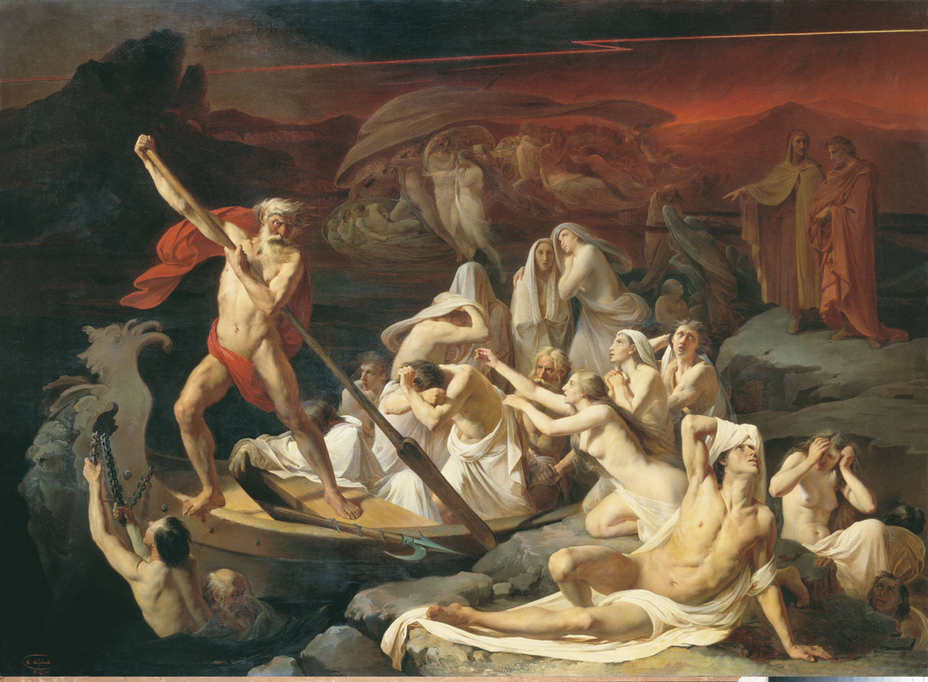
Alexander Dmitrievich Litovchenko ( 1835 - 1890)
Charon carries souls across the river Styx
Oil on canvas, 1889
The State Russian Museum, St. Petersburg, Russia

Slide 15
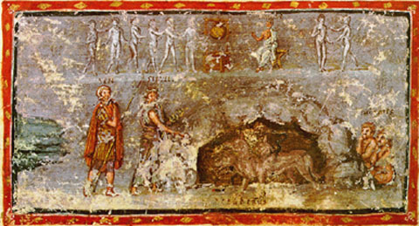
Vatican Vergil c.400

Slide 16
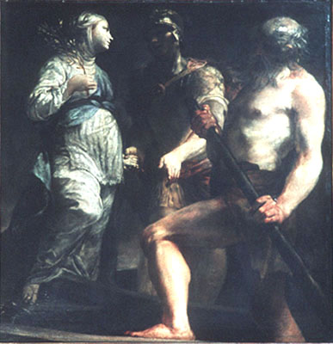
Giuseppe Maria Crespi
Aeneas, the Sibyl and Charon
1700

Slide 17
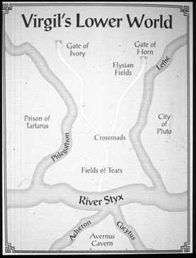
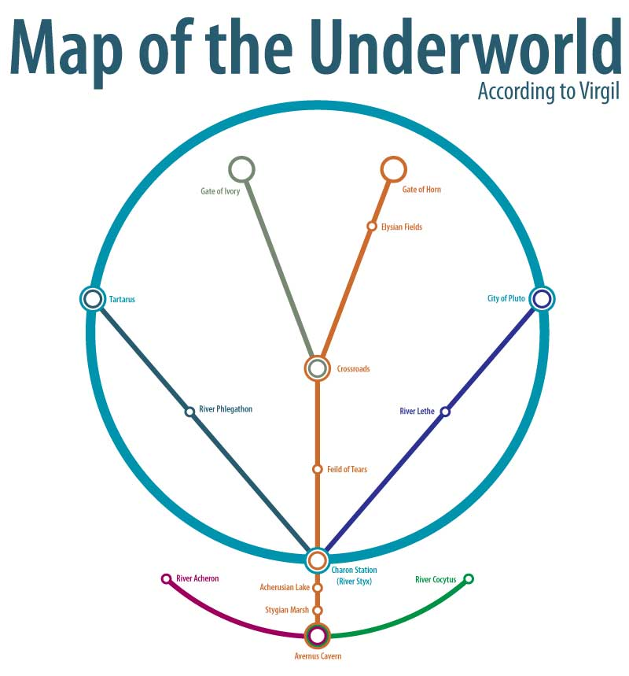

Slide 18
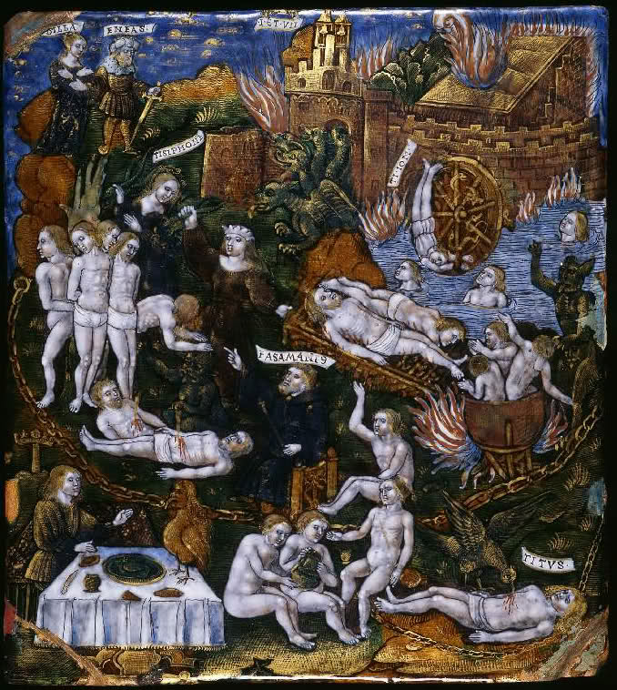
Master of the Aeneid
c.1530
Fitzwilliam Museum

Slide 19
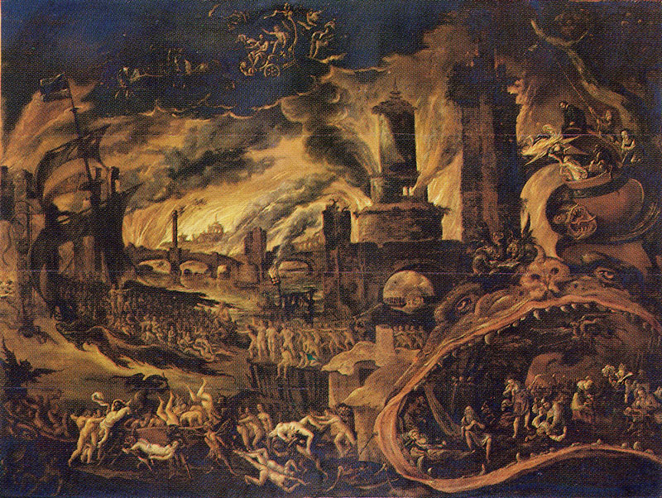
Jacob van Swanenburg
The Sibyl showing Aeneas the Underworld
93.5 x 124 cm Oil on panel
Stedelijk Museum De Lakenhal, Leiden

Slide 20
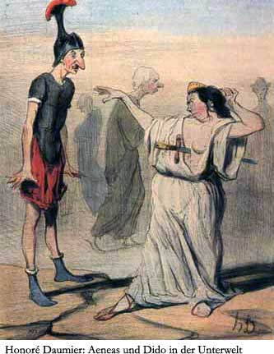

Slide 21
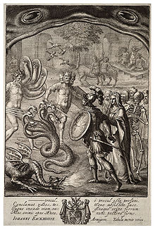
Aeneas in the Underworld
Wenzel Hollar
Before 1677

Slide 22
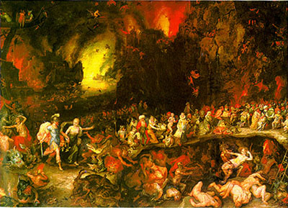
Jan Brueghel the Elder, Aeneas and Sibyl in the Underworld, 1600

Slide 23
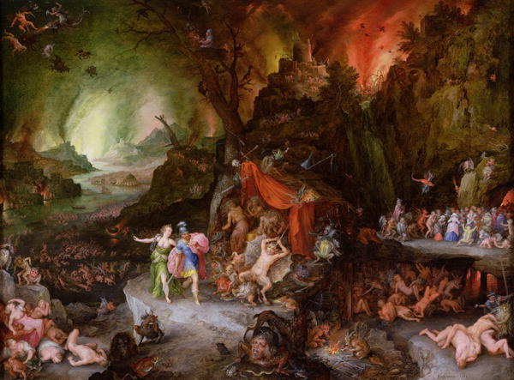
Aeneas and the Sibyl in the Underworld (Jan Brueghel the Younger, 1601–1678)

Slide 24
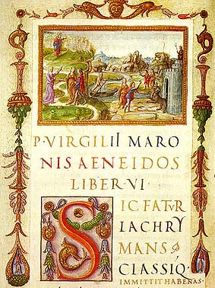

Slide 25
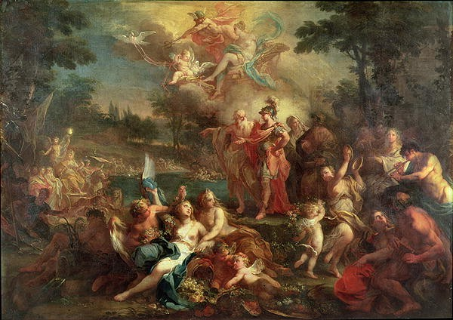
THE VISION OF AENEAS IN THE ELYSIAN FIELDS
Sebastiano Conca Italian 1680-1764
SN 168 Oil on Canvas 1735-40

Slide 26
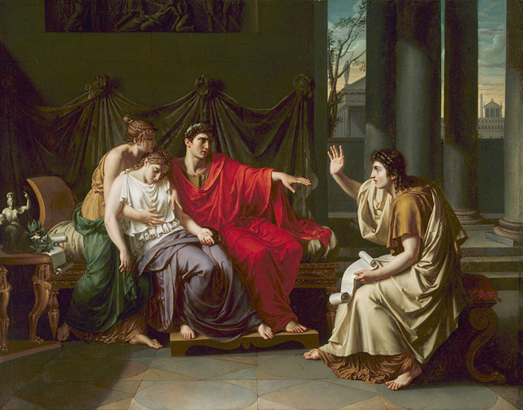
"Virgil Reading the 'Aeneid' to Augustus, Octavia, and Livia," by Jean Baptiste Joseph Wicar, French,1762–1834, oil on canvas [detail]; The Art Institute of Chicago®, www.artic.edu/aic

Slide 27
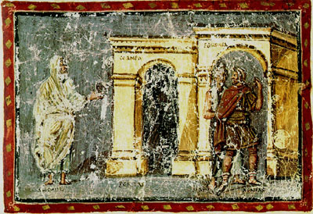
Vatican Vergil c.400

