Slide 1
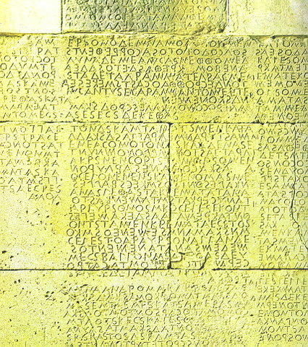
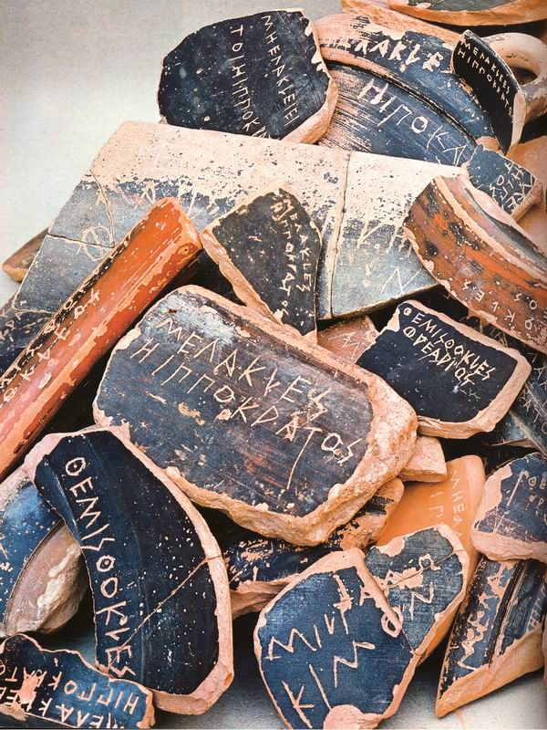
Citizenship and Government in Ancient Greece

Slide 2
Citizenry
Who were and were not citizens in the Greek world? How were citizens organized? Explain the terms phyle, phratry, demos and atimia.
What are some of the basic characteristics of citizen life in Sparta? Explain the terms agoge, syssita and kleros.
What does xenia mean and why was it so important in Greek society?
Describe the political status of each of the following groups: women, slaves, serfs, helots, perioikoi and metics.

Slide 3
Government
Describe the chief characteristics of each of the following types of government found in the Greek world and give an example of each: monarchy, satrapy, aristocracy, tyranny, oligarchy and democracy.
Describe the political organization of the following: prehistoric government (Bronze Age); poleis; Athens; Sparta; and Boeotia.
Describe the responsibilities and/or purposes of each of the following: boule; Areopagus; gerousia; ekklesia (assembly); ostracism; archon; strategoi; ephor.
How did Greeks develop their system of laws? What one thing was instrumental in removing aristocratic control of law?
Describe some important features of the Athenian trial system.

Slide 4
Government
How did Greeks develop their system of laws? What one thing was instrumental in removing aristocratic control of law?
Describe some important features of the Athenian trial system.
Gortyn law code, Crete
http://traumwerk.stanford.edu:3455/archaeopaedia/223
http://www.fordham.edu/halsall/ancient/450-gortyn.html

