Slide 1
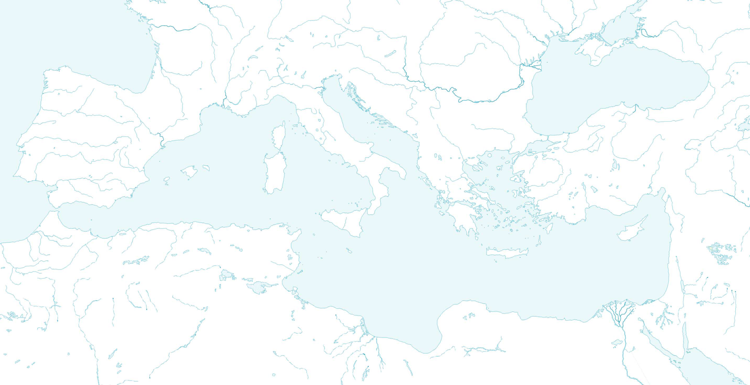
The Geography of the Roman Empire
in an historical context

Slide 2
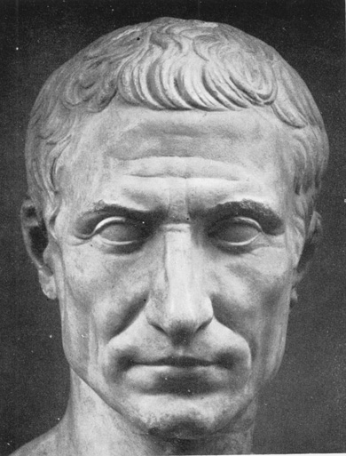
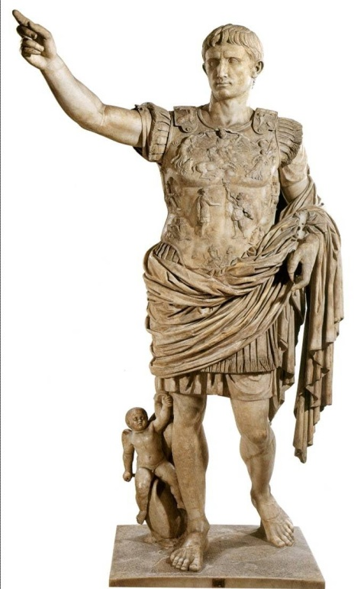
Roman History: Major Periods
753-509 MONARCHY
509-29 REPUBLIC
29 B.C.- 476 A.D. IMPERIAL AGE

Slide 3
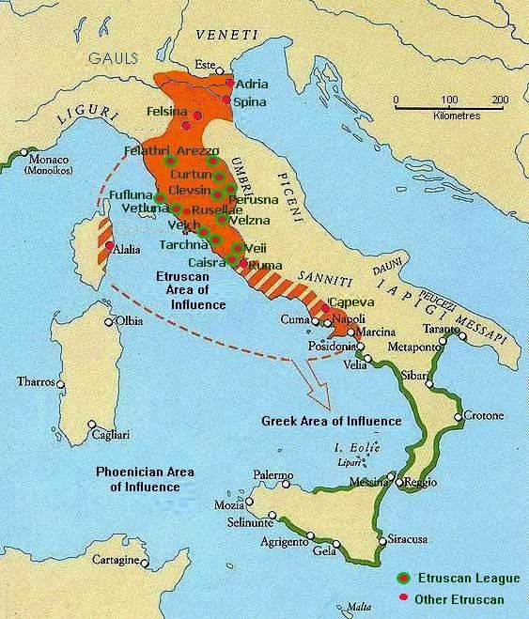
Monarchy (the Etruscan Period)
ETRURIA
ROME

Slide 4
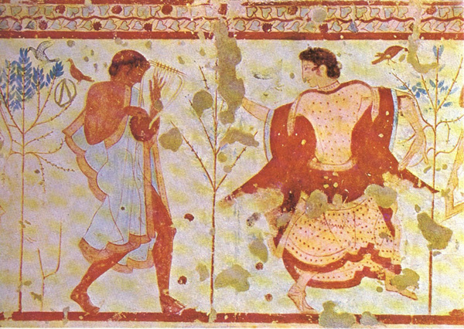
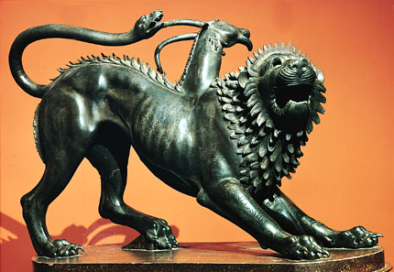
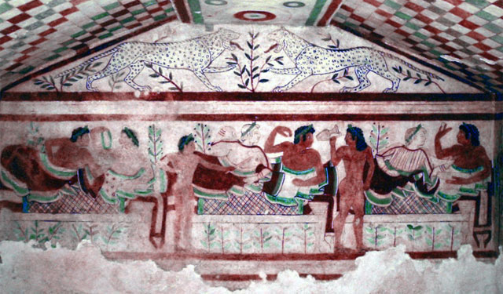
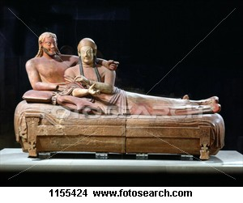
Etruria (modern Tuscany)

Slide 5
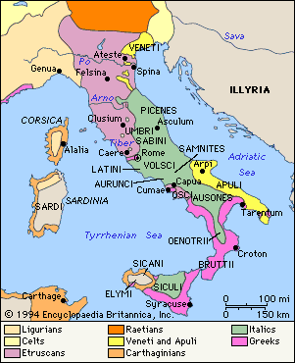
509-29 REPUBLIC Italic Wars 509-290
LATIUM
SABINES
PAESTUM MAGNA GRAECIA

Slide 6
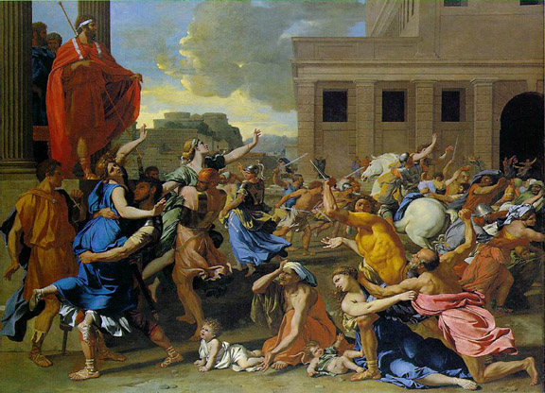
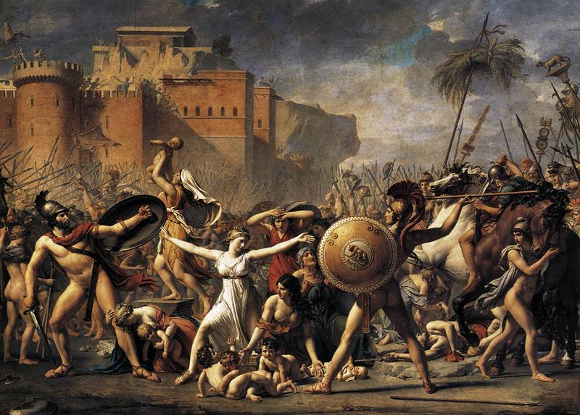
SABINES
Rape of the Sabines Nicholas Poussin, 1636-37
Jacques Louis David
Intervention of Sabine Women, 1799

Slide 7
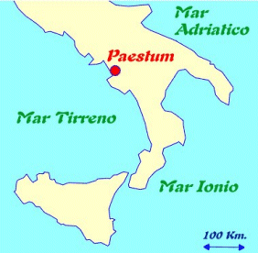
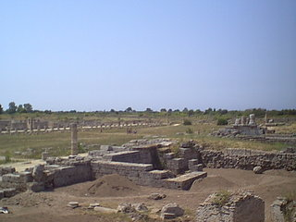
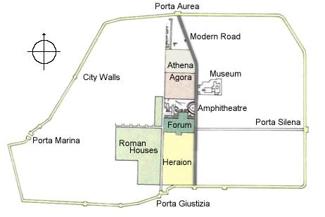
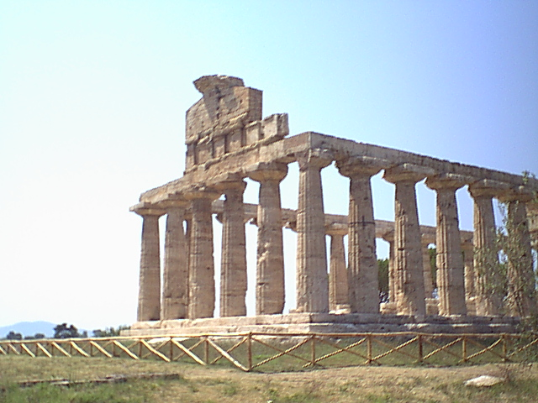
Paestum
View of the Forum from the Amphitheatre
Maison Carree
Nimes (Nemausus)
Temple of Athena at Paestum
http://sights.seindal.dk/sight/86_Paestum-all.html

Slide 8
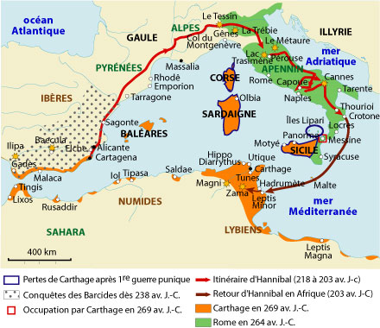
509-29 REPUBLIC Punic Wars 264-146
HISPANIA
CARTHAGO AFRICA
SICILIA

Slide 9
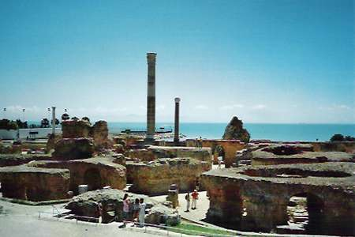
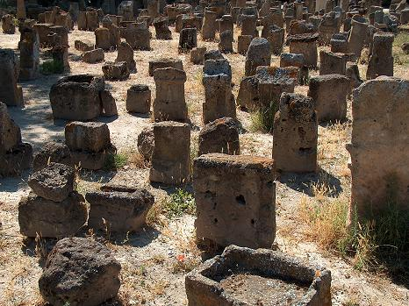
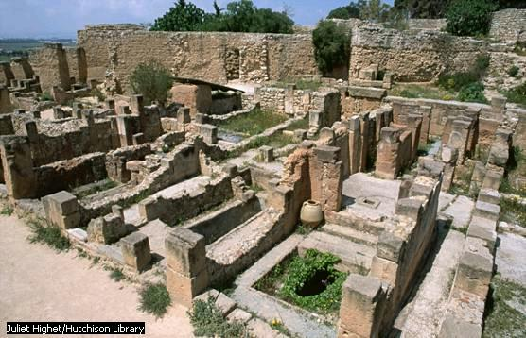
Carthage
TOPHET

Slide 10
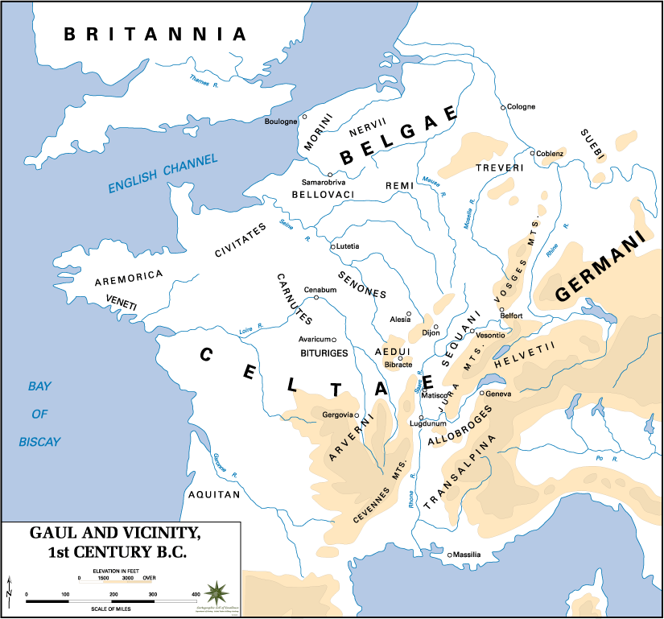
509-29 REPUBLIC Gallic Wars 51-58
LUTETIA
GALLIA
LUGDUNUM
MASSILIA

Slide 11
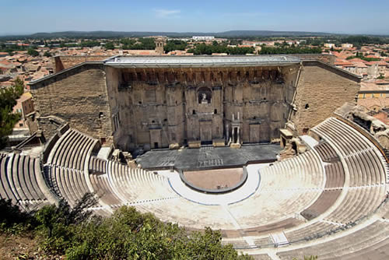
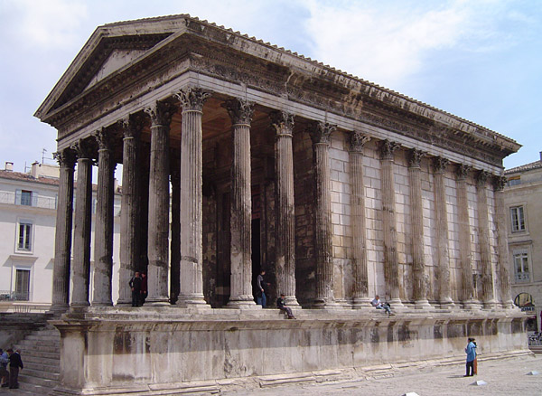
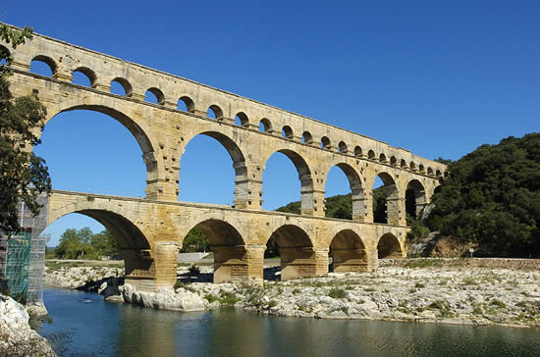
Roman Gaul
Theatre
Orange (Arausio)
Maison Carree
Nimes (Nemausus)
Pont du Gard

Slide 12
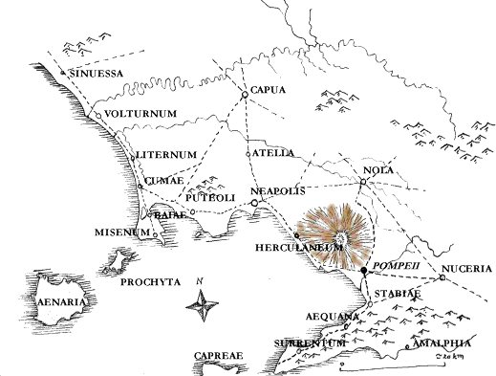
29 B.C.- 476 A.D. IMPERIAL AGE Eruption of Vesuvius (Aug. 24-25, 79 A.D.)
Mediolanum
Pompeii

Slide 13
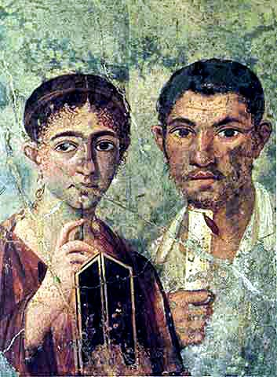
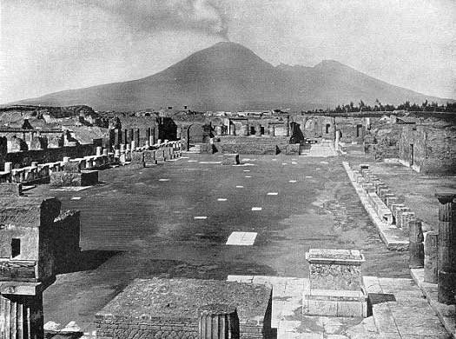
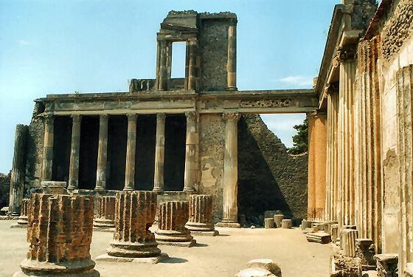
Pompeii

Slide 14
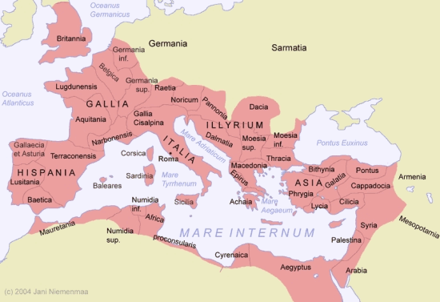

Slide 15
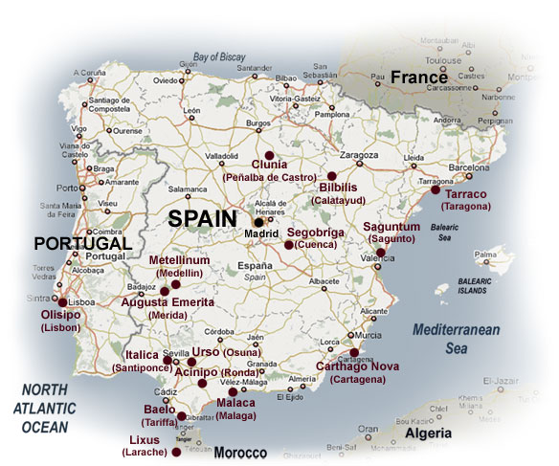

Slide 16
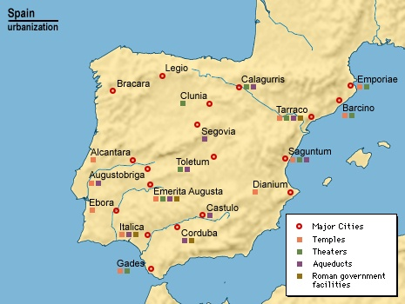
Roman Spain
Bilbilis

Slide 17
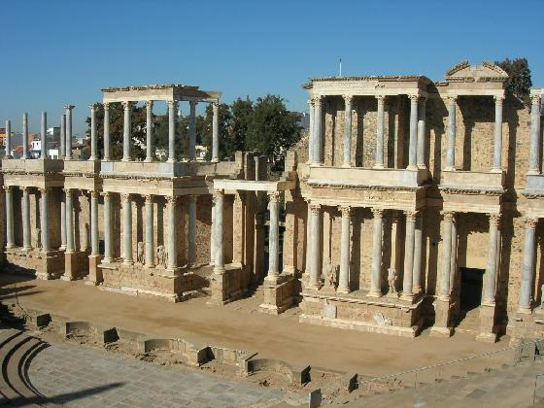
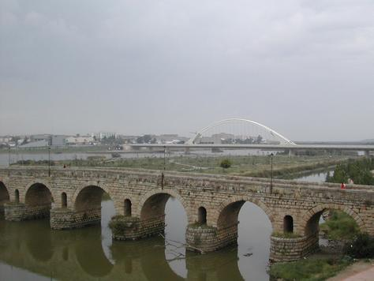
Roman Spain
Merida

Slide 18
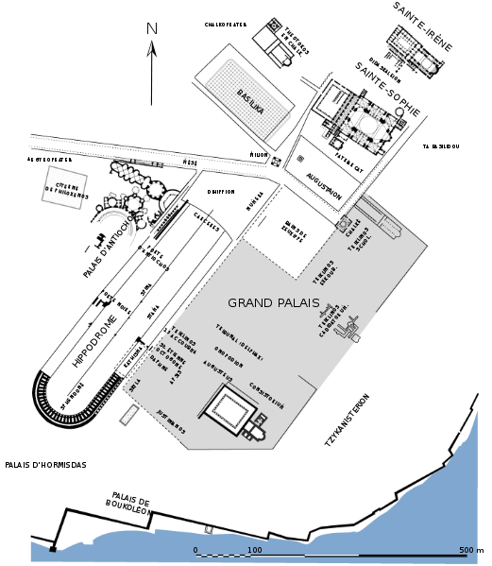
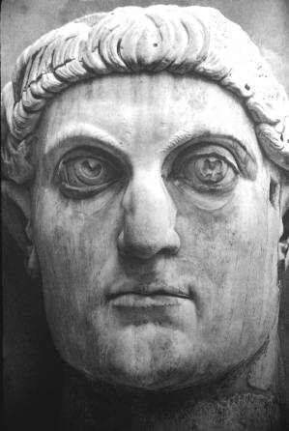
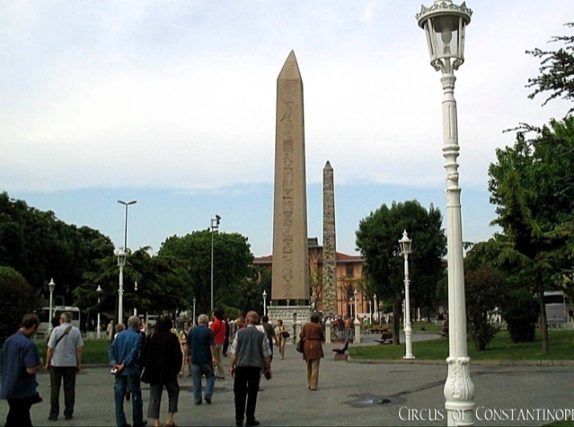
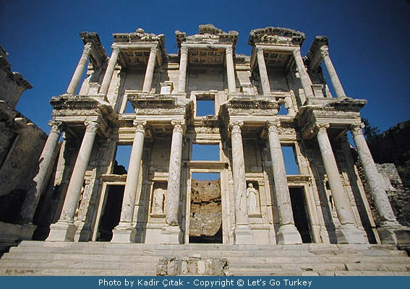
Constantinopolis
BYZANTIUM = CONSTANTINOPLE
EPHESUS

Slide 19
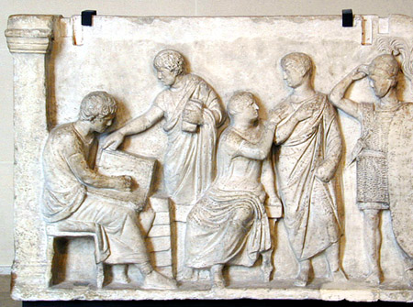
Census
Established by King Servius Tullius
Two censors
Citizenship, wealth, military duty, taxes, and morality

Slide 20
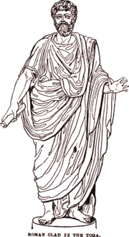
Orders by Wealth
Senators: 800000 sesterces
Equites (Knights): 400000 sesterces
1st, or classici: 100,000 sesterces in assets
40 centuries of men 45 and older,
40 centuries of men 17-45, prospective soldiers.
2nd: 75,000 sesterces in assets
10 centuries of older men
10 of younger.
3rd: 50,000 sesterces in assets
10 of older
10 of younger.
4th: 25,000 sesterces
10 older
10 younger.
5th: 11,000 sesterces
30 centuries of specific types of workmen, such as 3 of carpenters.
6th, or proletarii: No estate.
One century.

