Slide 1
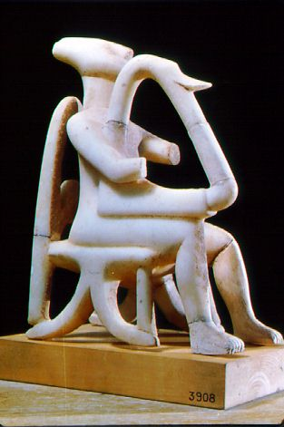
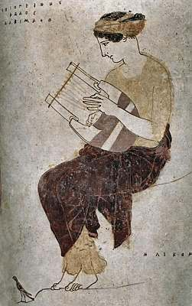
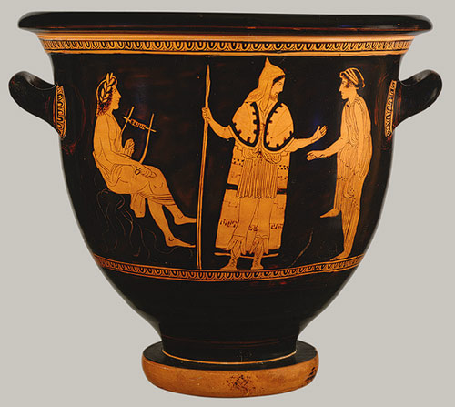
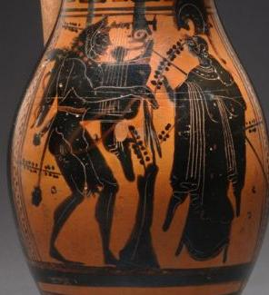
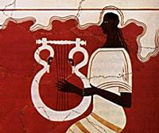
Greek Lyres over Time
Heilbrun Timeline of Art History

Slide 2
GREEK CIVILIZATION: GENERAL CHRONOLOGY
2800-1100 B.C. THE BRONZE AGE
1100-700 B.C. THE DARK AGES
700-500 B.C. THE ARCHAIC PERIOD
500-300 B.C. THE CLASSICAL AGE
338-31 B.C. THE HELLENISTIC PERIOD
31 B.C.- A.D. 565 THE ROMAN PERIOD
565-1453 THE BYZANTINE PERIOD
1453-1829 THE TURKISH OCCUPATION
1829-present MODERN GREECE

Slide 3
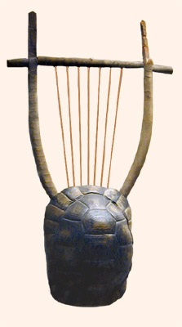
Lyre
This reconstruction of a fifth-century B.C. lyre is in the British Museum.
What is it made of?
History of the Lyre:
http://www.etana.org/abzu/abzu-displayentry.pl?RC=15860

Slide 4
Cycladic
di

Slide 5
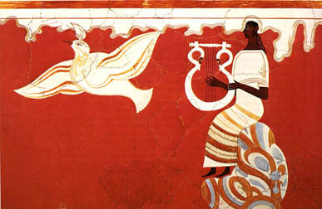
Minoan / Mycenaean
lyre player fresco from Pylos
c.1300 B.C. http://hubpages.com/hub/Bronze-Age-Pylos

Slide 6
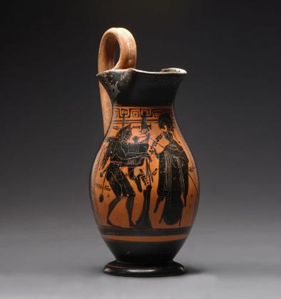
Archaic Black-Figure

Slide 7
Classical Red-Figure
Scene from the Myth of Orpheus Bell-krater, ca. 440 b.c.; red-figure Attributed to the Painter of London E 497 Greek, Attic Terracotta http://www.metmuseum.org/toah/hd/grmu/ho_24.97.30.htm

Slide 8
Classical
Detail from a Greek pot painted by the Achilles Painter, c. 450-440 B.C.

Slide 9
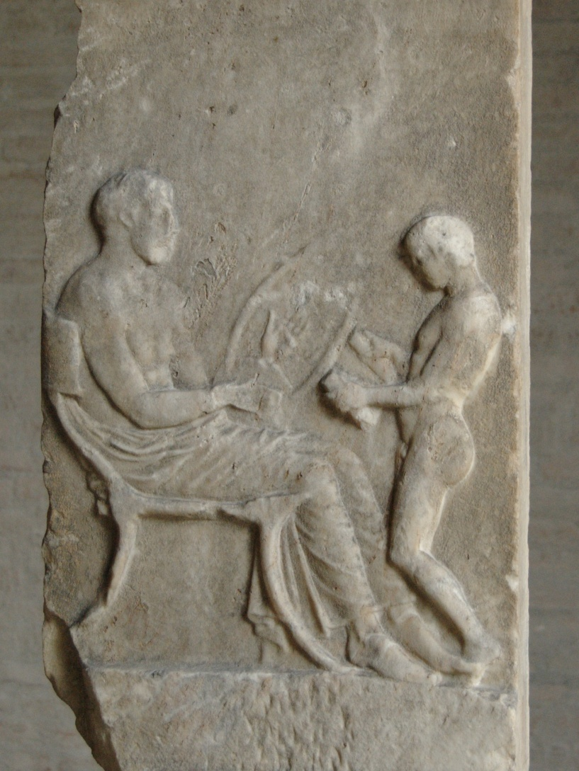
Classical 5th century, South Italian

Slide 10
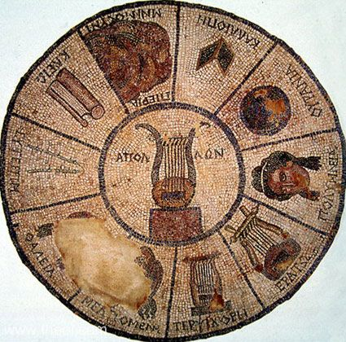
Hellenistic
THE NINE MOUSAI
Museum Collection: Archaeological Museum of Elis, Elis, Greece Catalogue Number: TBA Type: Mosaic Context: Elis Date: C1st BC Period: Hellenistic Greek
http://www.theoi.com/Gallery/Z20.4.html

Slide 11
Rulers and Leaders Why is each important?
Alcibiades
Alexander the Great
Antigonus (3)
Antiochus (10)
Attalus (3)
Berenice (3)
Cimon
Cleisthenes
Cleon
Cleopatra (7)
Croesus
Demosthenes (orator)
Draco
Hieron I
Lycurgus
Leonidas
Mausolus and Artemisia
Mithridates (2)
Miltiades
Nicias
Olympias
Peisistratus
Pericles
Pheippides (or Philippides)
Philip II
Philip V
Polycrates
Ptolemy (13)
Pyrrhus
Seleucus (3)
Solon
Themistocles

Slide 12
Group the Rulers and Leaders
The Athenians
The Spartans
The women
The tyrants
The generals
The successors of Alexander
The lawgivers
The kings
The Fifth-century Club

