Slide 1
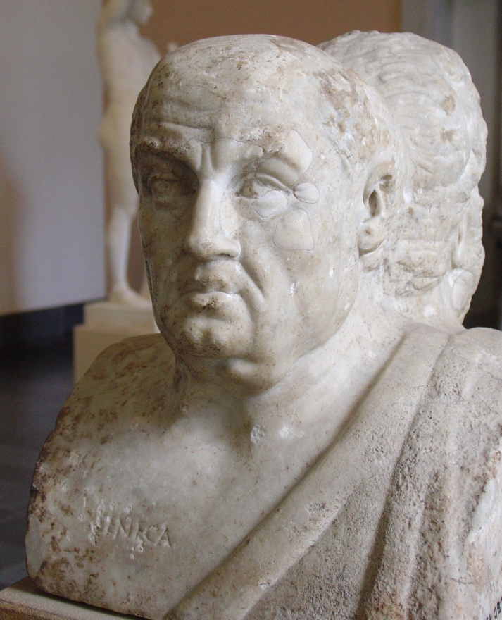
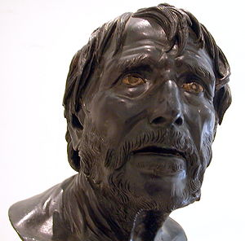
Lucius Annaeus Seneca
Seneca the Younger
c.4 B.C.—65 A.D.
Corduba, Spain

Slide 2
Seneca’s Family
Father: Seneca the Elder
Mother: Helvia
Older Brother: Galliio
Younger Brother: Annaeus Mela
Nephew: Lucan (poet)
Aunt, wife of Gaius Galerius
Wife: Pompeia Paulina (50 A.D.)
Caligula 37-41
Claudius 41-54
Nero 54-68

Slide 3
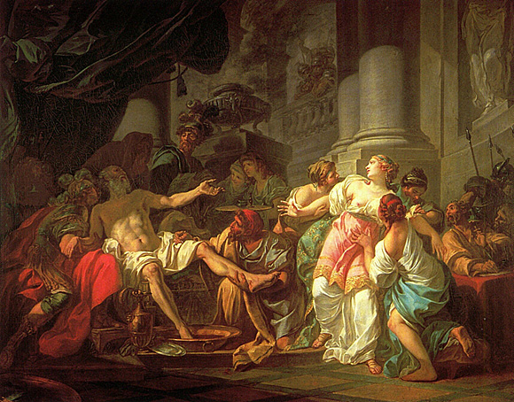
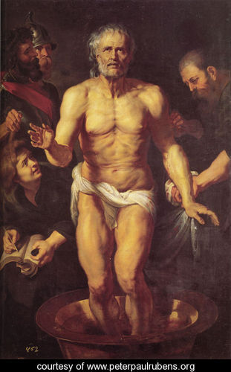
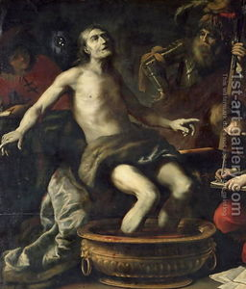
Death of Seneca
Peter Paul Rubens, 1615
Jacques-Louis David
1748 - 1825
Claude Vignon 1633

Slide 4
Seneca’s Works
Tragedies
Philosophical Essays
Moral Letters
Satire (Apocolocyntosis)
Meterological Study

