Slide 1
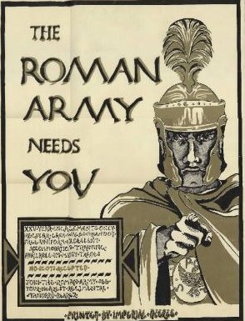

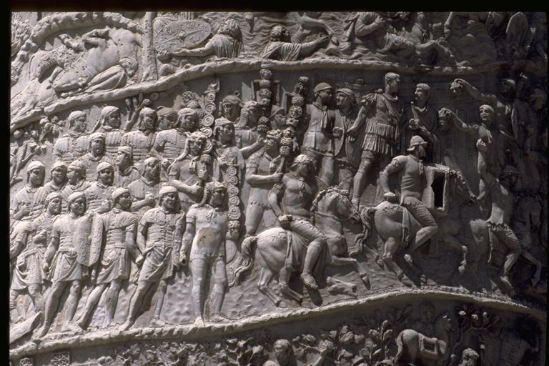
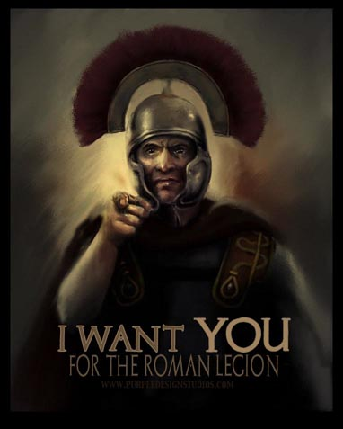
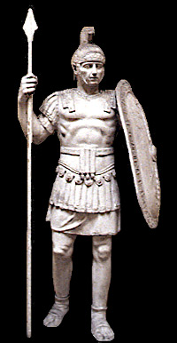
Roman Army

Slide 2
Citizen Army
Free-born citizen, 17-46
Auxilia (native forces)
Praetorian guard (emperor’s body guards)
Cohortes Urbani (police), led by praefectus urbi (senatorial rank)
Vigiles (fire brigade and night watch) led by praefectus vigilium (equestrian)
7 cohorts

Slide 3
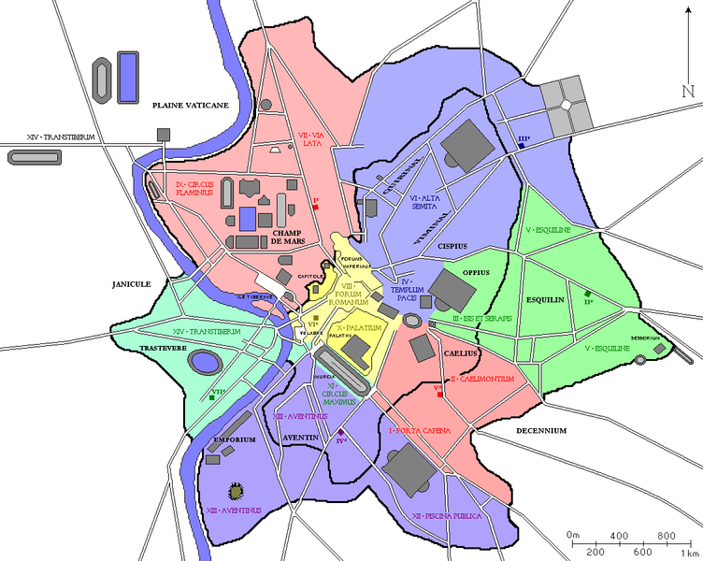

Slide 4
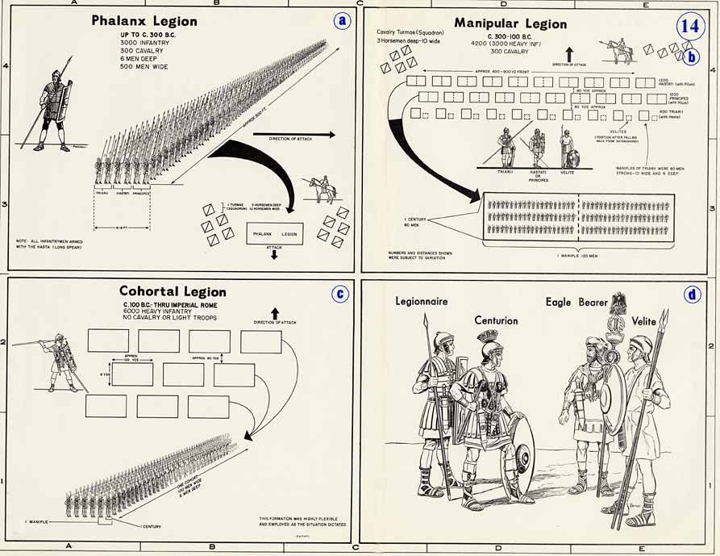
Structure
Conturbium (tent of 8 men)
Centuria = 10 conturbia
led by a centurion
Cohort = 6 Centuries
Legio = 10 centuries
led by a legatus
Several legions led by an imperator (general)
70 legions in the time of Augustus

Slide 5
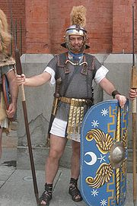
Personal Gear
Lorica (chainmail or cuirass)
Gladius (short sword)
Pugio (small dagger)
Hasta (thrusting spear, two)
Scutum (rectangular shield)
Galea (helmet)
Leggins or greaves
Apron
Caligula (marching sandals)
Woolen tunic
Cingulum (belt)

Slide 6
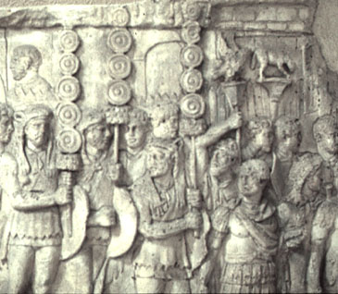
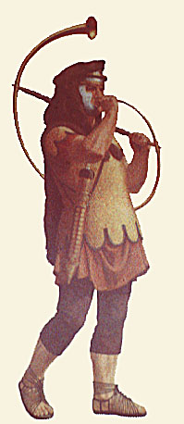
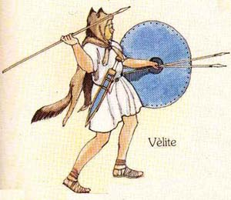
Ranks
Signifer (standard bearer)
Velite (light infantry
Conicen

Slide 7
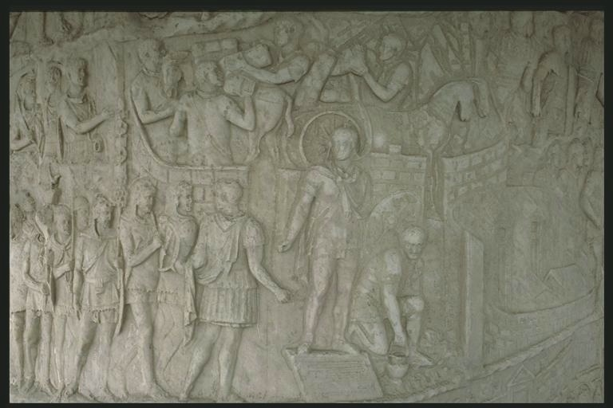
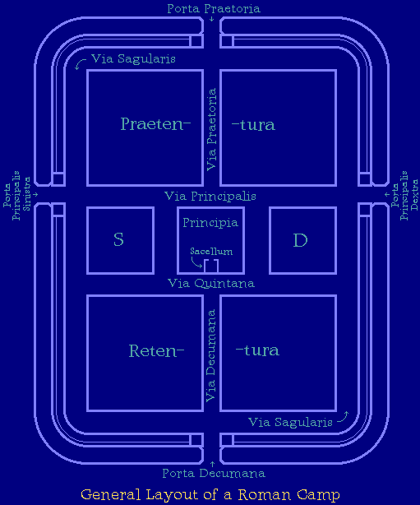
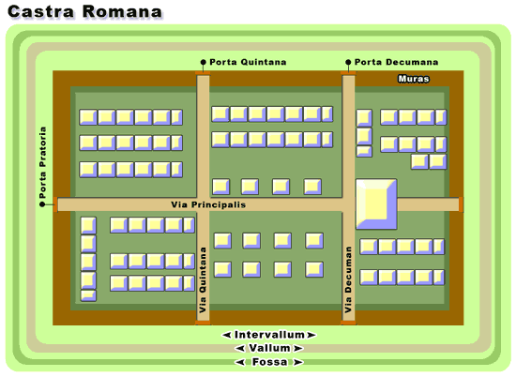
Roman Camp

Slide 8
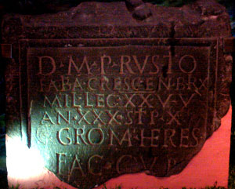
Life of a Soldier
Enlistment between 17 and 23
16 years enlistment (20 for retirement bonus)
Stipendium (living allowance) + plunder
No (legal) marriage until 197 A.D.
D:M P:RVSTO
FABIA:CRESCEN:BRIX
MIL:LEG XX VV
AN XXX STIP X
GROMA HERES FAC CVR
'To the spirits of the departed and to Publius Rustius Crescens of the Fabian voting tribe from Brixia, Soldier in the twentieth legion Valeria Victrix. He Lived for 30 years and served for 10 years. Groma his heir had this stone made.(

Slide 9
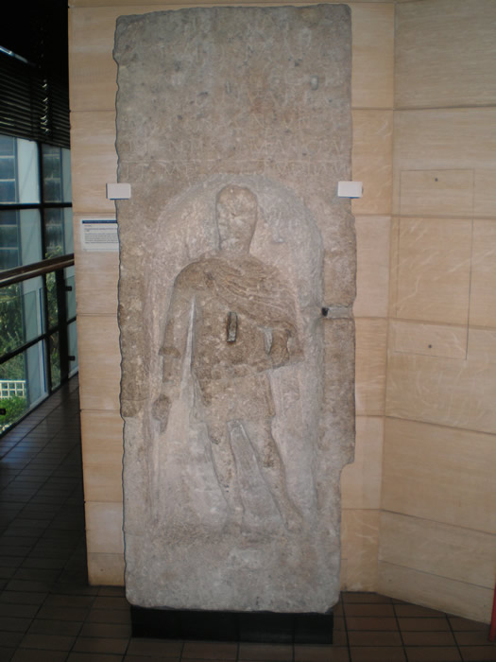
D M VIVIO MARCIANO LEG II AVG IANVARIA MARTINA CONIVNX PIENTISSIMA POSVIT MEMORAM
"To the spirits of the departed and Vivius Marcianus of Legio Secundae Augusta. Januaria Martina his most faithful wife placed this in his memory."
(RIB 17; tombstone)

Slide 10
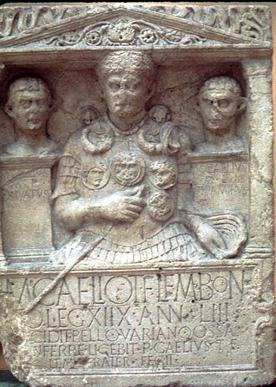
Military Monuments
M(arcus) Caelius M(arci) l(ibertus) Privatus
M(arcus) Caelius M(arci) l(ibertus) Thiaminus
M(arco) Caelio T(iti) f(ilio) Lem(onia) Bon(onia)
(centurioni) leg(ionis) XIIX ann(orum) LIII
[ce]cidit bello Variano ossa
[i]nferre licebit p(onendum) c(uravit) Aelius T(iti) F(ilius)
Lem(onia) frater fecit
(The first two lines record the names of Marcus Caelius' freedmen, Marcus Caelius Privatus and Marcus Caelius Thiaminus) To Marcus Caelius, son of Titus, of the voting tribe Lemonia, from Bononia, first centurion of the eighteenth legion. At the age of 53 he fell in the Varian War, the bones (of his freedmen) may be interred here. His brother Caelius, son of Titus, of the tribe Lemonia, erected (this tombstone)

Slide 11
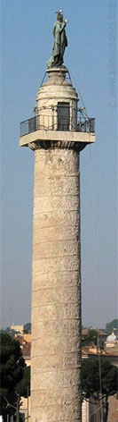
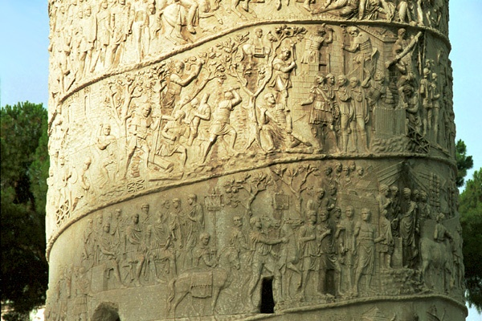
Trajan’s Column
http://www.stoa.org/trajan/
http://penelope.uchicago.edu/Thayer/E/Gazetteer/Places/Europe/Italy/Lazio/Roma/Rome/Trajans_Column/home.html

