Slide 1
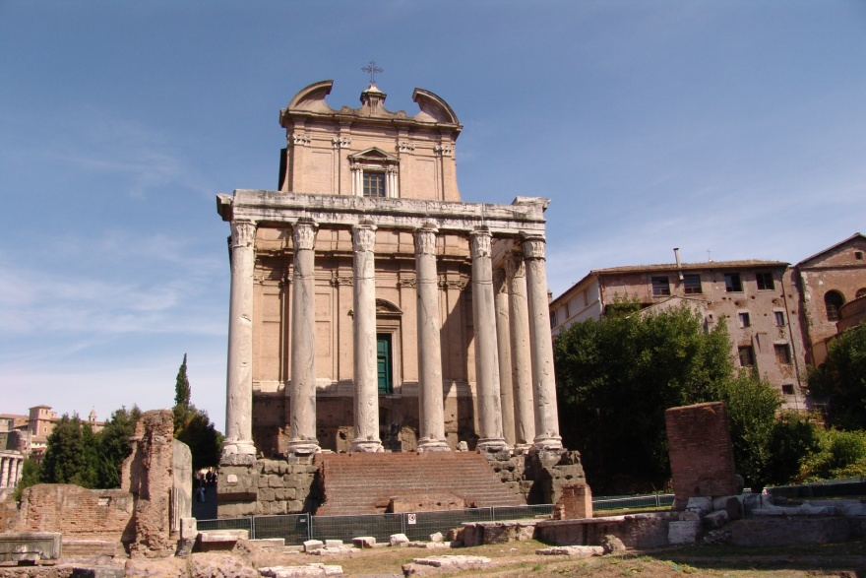
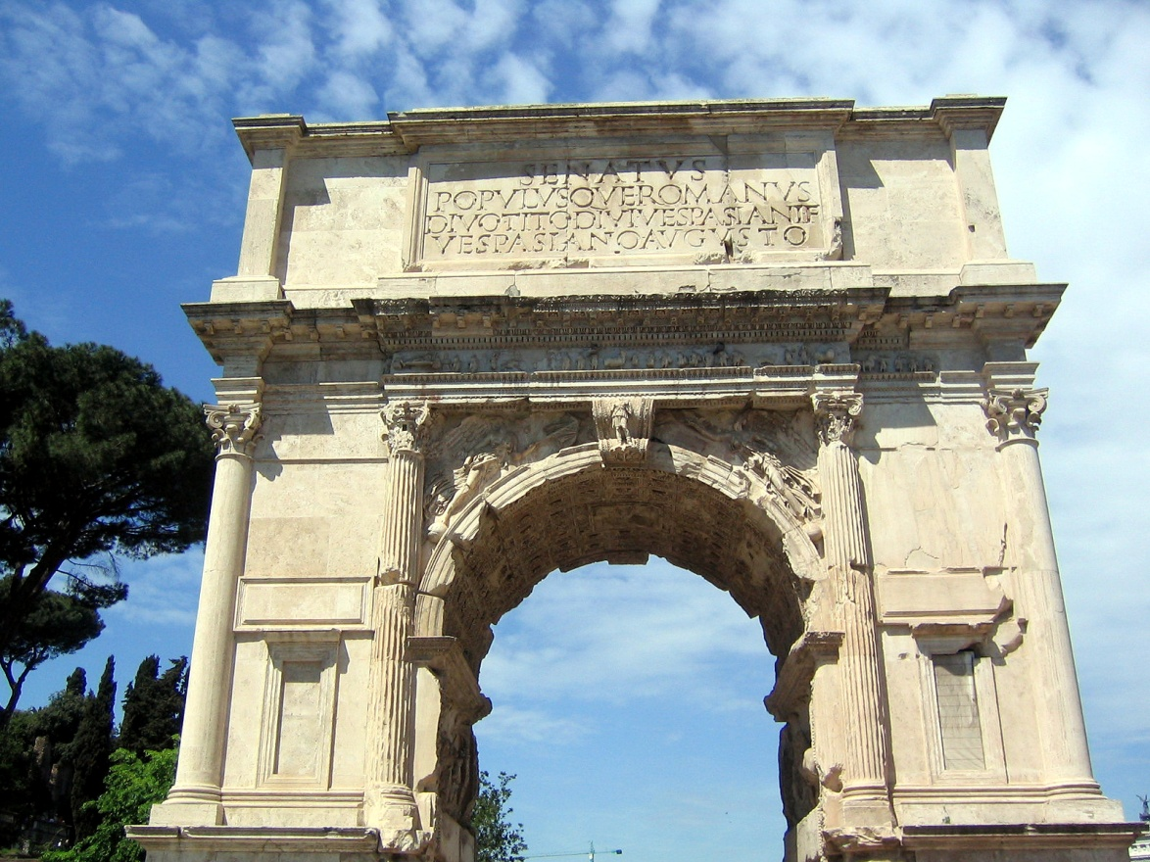
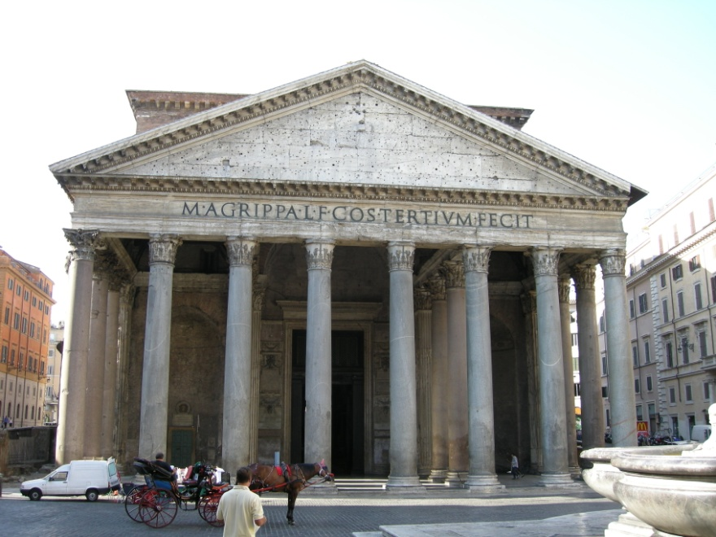
Roman Inscriptions

Slide 2

M·AGRIPPA·L·F·COS·TERTIUM·FECIT
Pantheon c. 120 A.D.

Slide 3

SENATUS
POPULUSQUEROMANUS
DIVOTITODIVIVESPANSIANIF
VESPASIANOAUGUSTO
Arch of Titus, c.80 A.D.

Slide 4
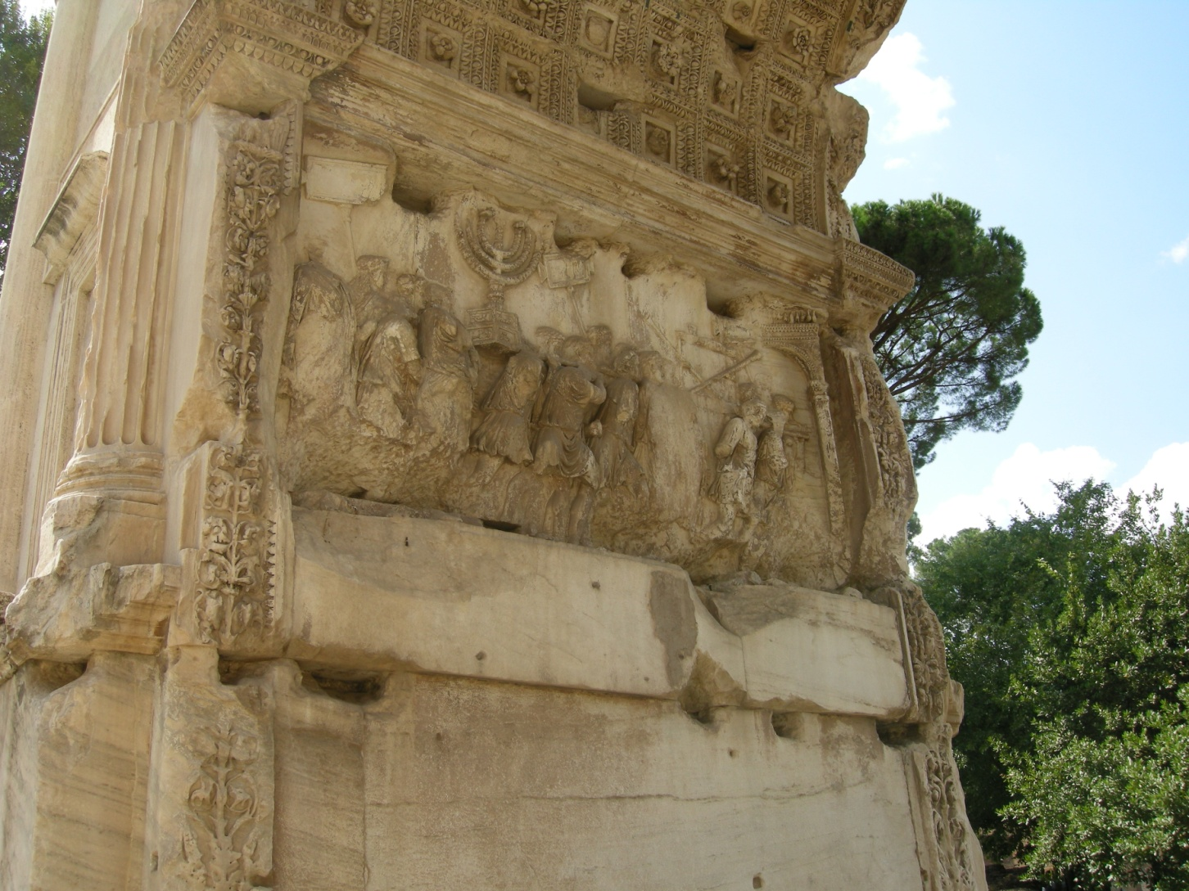
T. Vespasianus Augustus
Praenomen Nomen Cognomen

Slide 5
Roman Names
Praenomen Nomen Cognomen
C. Iulius Caesar
C. Iulius Caesar Octavianus Augustus
Titus Flavius Vespasianus Augustus

Slide 6
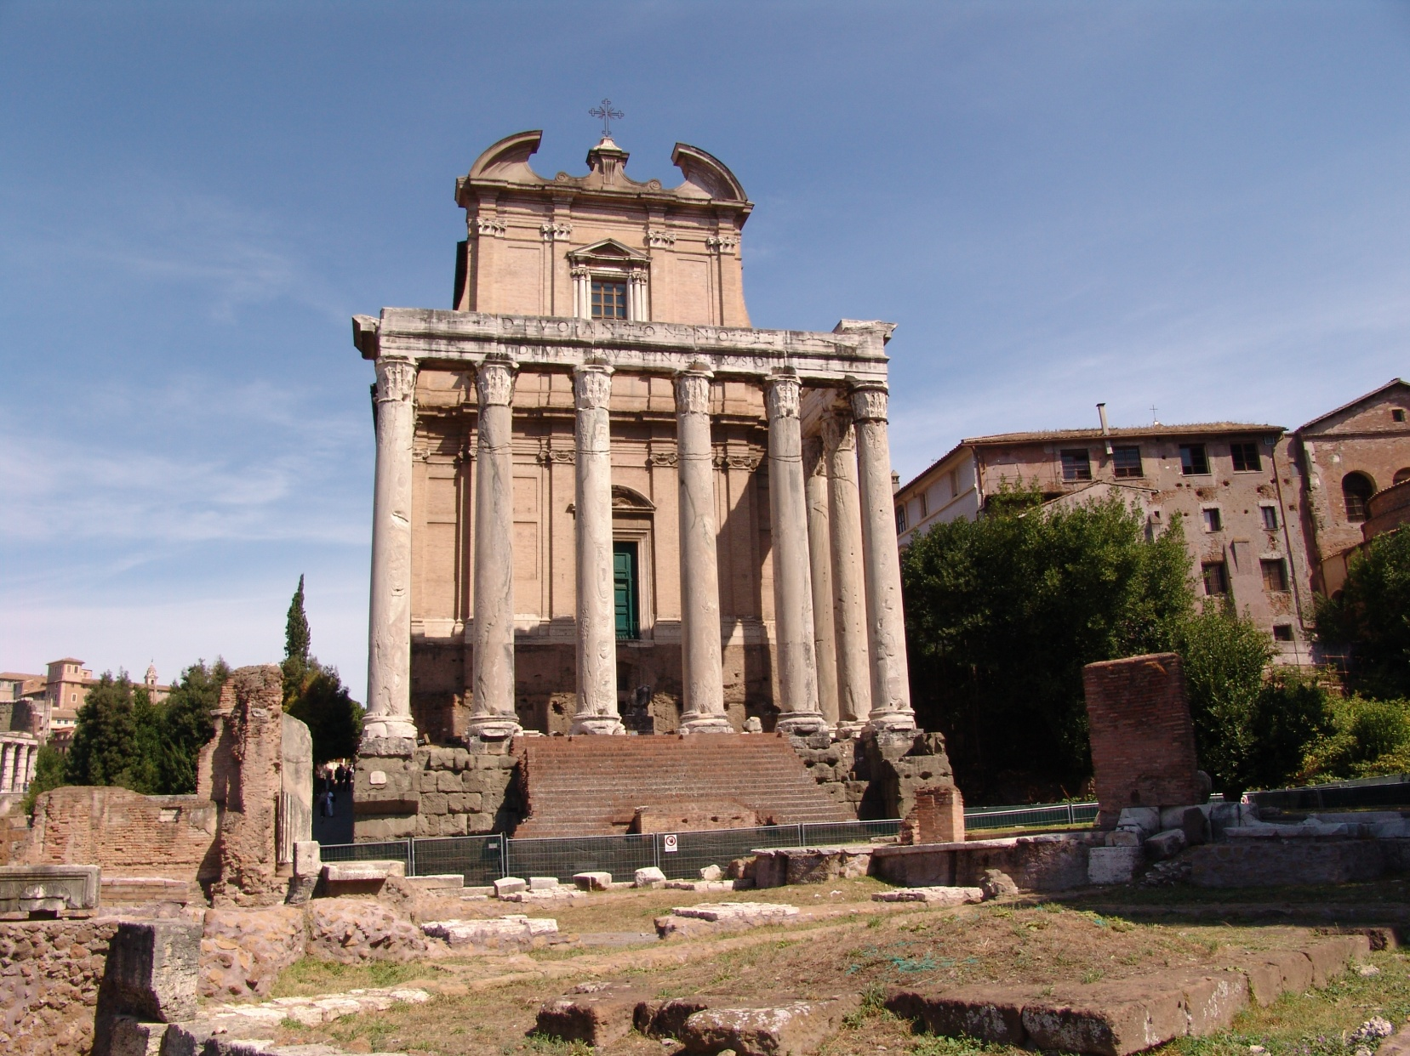
DIVO·ANTONINO·ET
DIVAE·FAUSTINAE·EX·S·C
Temple of Antonins Pius
and Faustina
c. 141 A.D.

Slide 7
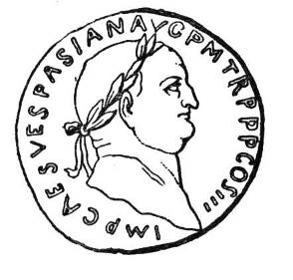
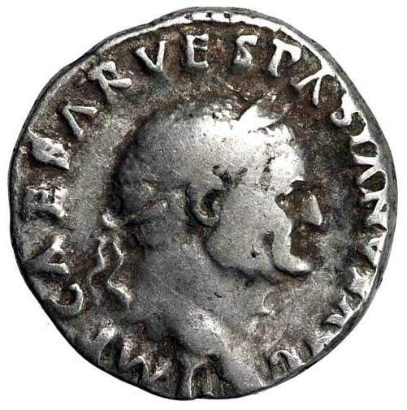
Roman Coins
IMPCAESARVESPASIANAUGPMTRPPPCOSIII
Imp(erātor) Caesar Vespāsiān(us) Aug(ustus) P(ontifex)M(aximus) Tr(ibūniciā)
P(otestate) P(ater) P(atriae) Co(n)s(ul) III

Slide 8
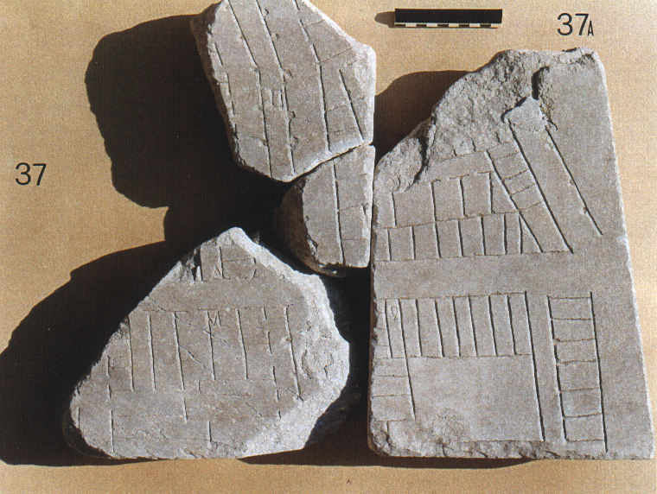
Forma Urbis Romae

Slide 9
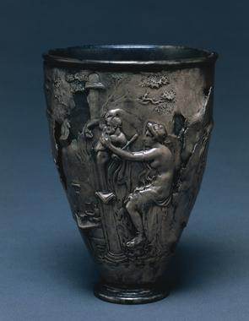
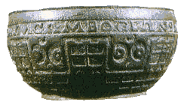
Dura Europus shield
Vases Apollinaires
(vicarello silver goblets)
Rudge Cup

