Slide 1
Roman Medicine

Slide 2
Roman Writer Who Wrote the Natural History
Julius Caesar
Augustus
Pliny the Elder
Martial

Slide 3
Roman cures for ailments were often associated with
Medicinal treatments
Bathing
Exercise
Fasting

Slide 4
Much of the surviving material culture from the Roman era is concerned with
Death and burial
Feasting
Politics
Spectacle and entertainment

Slide 5
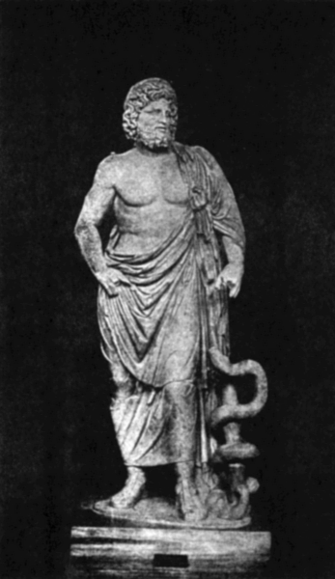
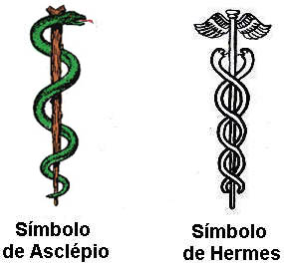
Roman Medicine
Asclepius

Slide 6
Pliny the Elder on Doctors
Natural history Book 29
VI. In fact this is the time to review the outstanding features of medical practices in the days of our fathers. Cassius Hemina, one of our earliest authorities, asserts that the first physician to come to Rome was Archagathus, son of Lysanias, who migrated from the Peloponnesus in the year of the city 535, when Lucius Aemilius and Marcus Livius were consuls. He adds that citizen rights were given him, and a surgery at the crossway of Acilius was bought with public money for his own use. They say that he was a wound specialist, and that his arrival at first was wonderfully popular, but presently from his savage use of the knife and cautery he was nicknamed 'Executioner,' and his profession, with all physicians, became objects of loathing. The truth of this can be seen most plainly in the opinion of Marcus Cato, whose authority is very little enhanced by his triumph and censorship; so much more comes from his personality. Therefore I will lay before my readers his very words.
VII. I shall speak about those Greek fellows in can their proper place, son Marcus, and point out the result of my enquiries at Athens, and convince you what benefit comes from dipping into their literature, and not making a close study of it. They are a quite worthless people, and an intractable one, and you must consider my words prophetic. When that race gives us its literature it will corrupt all things, and even all the more if it sends hither its physicians. They have conspired together to murder all foreigners with their physic, but this very thing they do for a fee, to gain credit and to destroy us easily. They are also always dubbing us foreigners, and to fling more filth on us than on others they give us the foul nickname of Opici. I have forbidden you to have dealings with physicians.

Slide 7
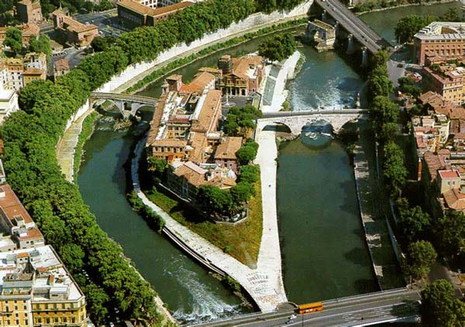
Hospitals = Sanctuaries of Asclepius Tiber Island in Rome
http://romereborn.frischerconsulting.com/ge/TS-015.html

Slide 8
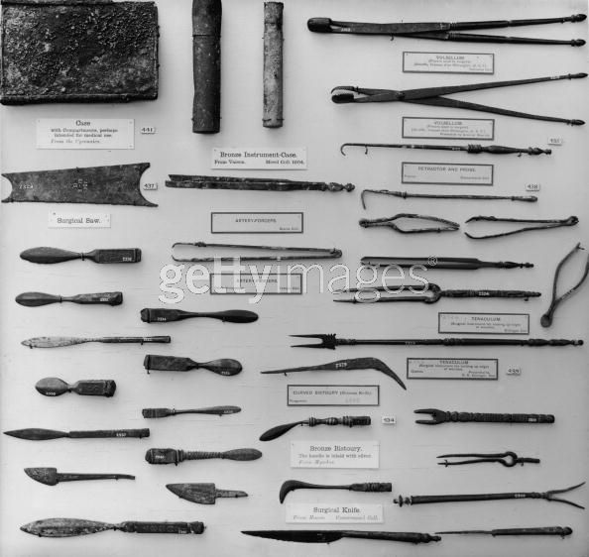
Medical Equipment
An array of ancient Roman surgical instruments at the British Museum, circa 1910. Originating from all over the Roman Empire, the collection includes a surgical saw, artery forceps, bronze instrument case, bistoury (abscess knife), vulsellum (surgical pincers) and tenaculum (for closing the edges of a wound). (Photo by Hulton Archive/Getty Images)

Slide 9
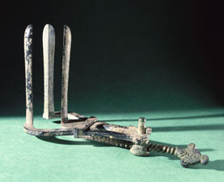
Medical Tools For what medicial purpose was this used?

Slide 10
Medical Tools For what medicial purpose was this used?
vaginal speculum
surgical drill
muscle strengthener
dental spacer
bone splint

Slide 11
Bronze vaginal speculum, probably Roman, found in the Lebanon, made c. 100BC to 400AD, although the screw part is modern. It comprises a priapiscus with dovetailing valves which are opened and closed by a handle with a screw mechanism. It shows the relatively sophisticated instruments that were sometimes in use in Roman medicine. Vaginal specula were used in the diagnosis and treatment of vaginal and uterine disorders.
For more examples see: http://www.sciencemuseum.org.uk/objects/classical_and_medieval_medicine/1979-327.aspx

Slide 12
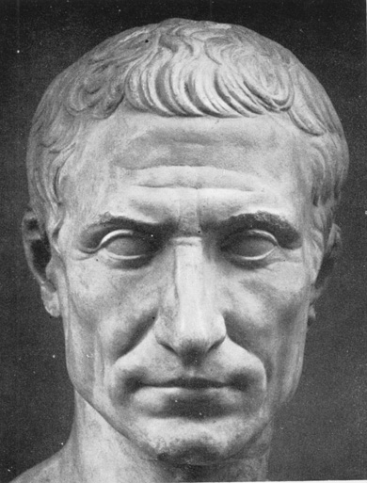
Caesarian Section? Lex Caesarea
The Roman Lex Regia (royal law), later the Lex Caesarea (imperial law), of Numa Pompilius (715–673 BCE), required the child of a mother dead in childbirth to be cut from her womb.
perhaps began as a religious requirement that mothers not be buried pregnant
evolved into a way of saving the fetus, with Roman practice requiring a living mother to be in her tenth month of pregnancy before resorting to the procedure, reflecting the knowledge that she could not survive the delivery.

Slide 13
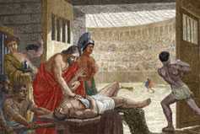
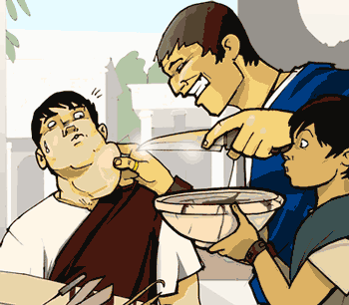
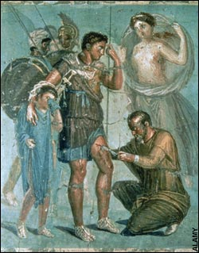
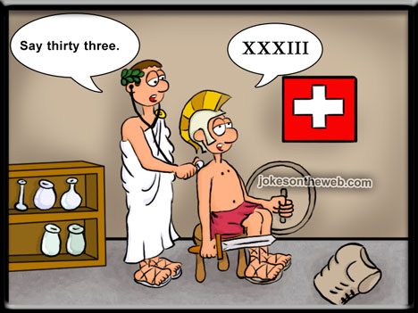
Roman Physicians
Galen
Aelius Galenus or Claudius Galenus (September AD 129 – 199/217) from Pergamon
http://campus.udayton.edu/~hume/Galen/galen.htm

Slide 14
Galen. On the Natural Faculties http://www.earlychristianwritings.com/text/galen.html
IV
The so-called blood-making faculty in the veins, then, as well as all the other faculties, fall within the category of relative concepts; primarily because the faculty is the cause of the activity, but also, accidentally, because it is the cause of the effect. But if the cause is relative to something—for it is the cause of what results from it, and of nothing else—it is obvious that the faculty also falls into the category of the relative; and so long as we are ignorant of the true essence of the cause which is operating, we call it a faculty. Thus we say that there exists in the veins a blood-making faculty, as also a digestive faculty in the stomach, a pulsatile faculty in the heart, and in each of the other parts a special faculty corresponding to the function or activity of that part. If, therefore, we are to investigate methodically the number and kinds of faculties, we must begin with the effects; for each of these effects comes from a certain activity, and each of these again is preceded by a cause.

Slide 15
Martial on Doctors
Until recently, Diaulus was a doctor; now he is an undertaker. He is still doing as an undertaker, what he used to do as a doctor.
–Martial, Epigrams 1.47
You are now a gladiator, although until recently you were an ophthalmologist. You did the same thing as a doctor that you do now as a gladiator.
–Martial, Epigrams 8.74
I felt a little ill and called Dr. Symmachus. Well, you came, Symmachus, but you brought 100 medical students with you. One hundred ice cold hands poked and jabbed me. I didn’t have a fever, Symmachus, when I called you, but now I do.
–Martial, Epigrams 5.9

