Slide 1
What areas competed with Italian wine trade from the end of the 1st cent. B.C.?
Where did most of Rome’s olive oil come from?
What was the grain supply of Rome called? How did Rome get most of its grain?
What was the main problem for Rome regarding its grain supply?
How did lighthouses function? Where was the most famous lighthouse in antiquity?
How were liquids such as wine, oil and fish sauce transported?
Where did most spices in Rome come from?
Where was most of Roman glassware made?
How was most Roman glassware transported?
Where did Rome get much of its building stone?
What kinds of animals were important trade items? From where?
What kinds of animals did Romans import? Why?
How did Rome meet the work needs of its large rural estates?
What methods did Romans use to obtain slaves?
What was the Roman tax on imports and exports called? What purpose did it serve?
How was the Roman import tax collected?
What was the harbor of Rome called? Where was it located?
Which emperors built Rome’s harbor?
Where was the main pirate base in the Mediterranean?
What were Roman anchors made of?
What means of power did Roman merchant ships use?
What method of constructing merchant ships did the Romans prefer?
What means of land travel were used by the Romans?
What kinds of construction techniques did Romans use to build bridges?
What were Roman milestones called? What did they look like?
What is the Roman word for mile? What does it mean?

Slide 2
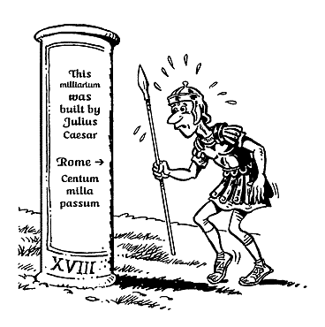
Millaria

Slide 3
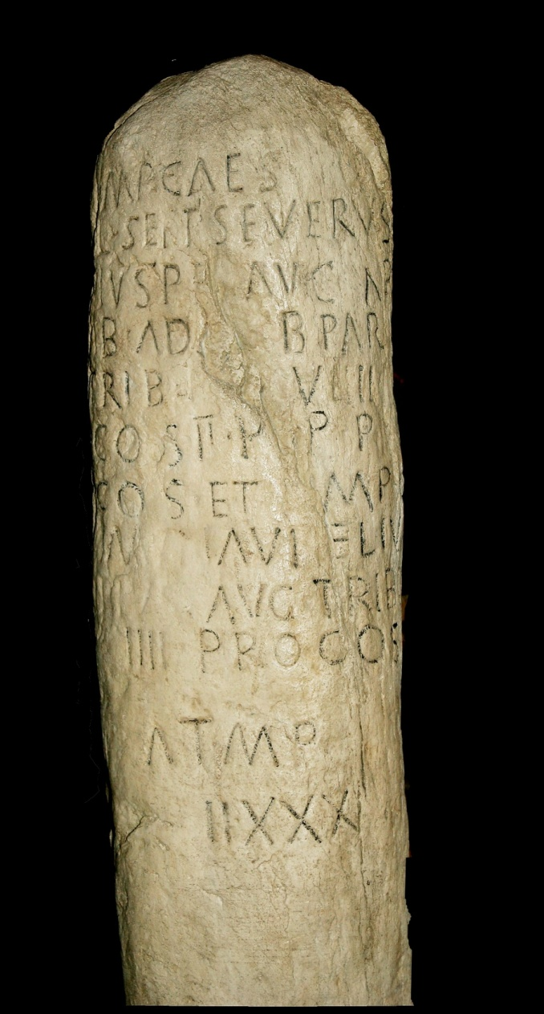
Roman milestone 201 aC in St. Margarethen Austria
CIL III 5714, CIL III 11834
Imp(erator) Cae(sar)
L(ucius) Sep(timius) Severus
Pius Per(tinax) Augu(stus) Ar
ab(icus) Adiab(enicus) Parthicus max(imus) pon(tifex)
trib(unicia) po(testate) VIIII Im(perator) VII
c(o)n(sul) II p(ater) p(atriae) pro
c(o)n(sul) et imp(erator) Caes(ar)
Mar(cus) Aurelius
Pius Aug(ustus) trib(unicia) pot(estate)
IIII proco(n)s(ul)
a T(eurnia) m(ilia) p(assuum)
IIXXX

