Slide 1
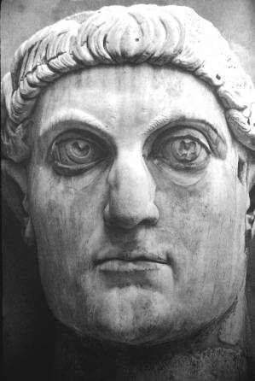
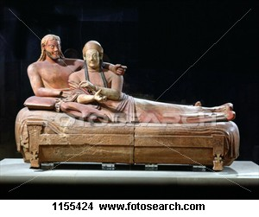
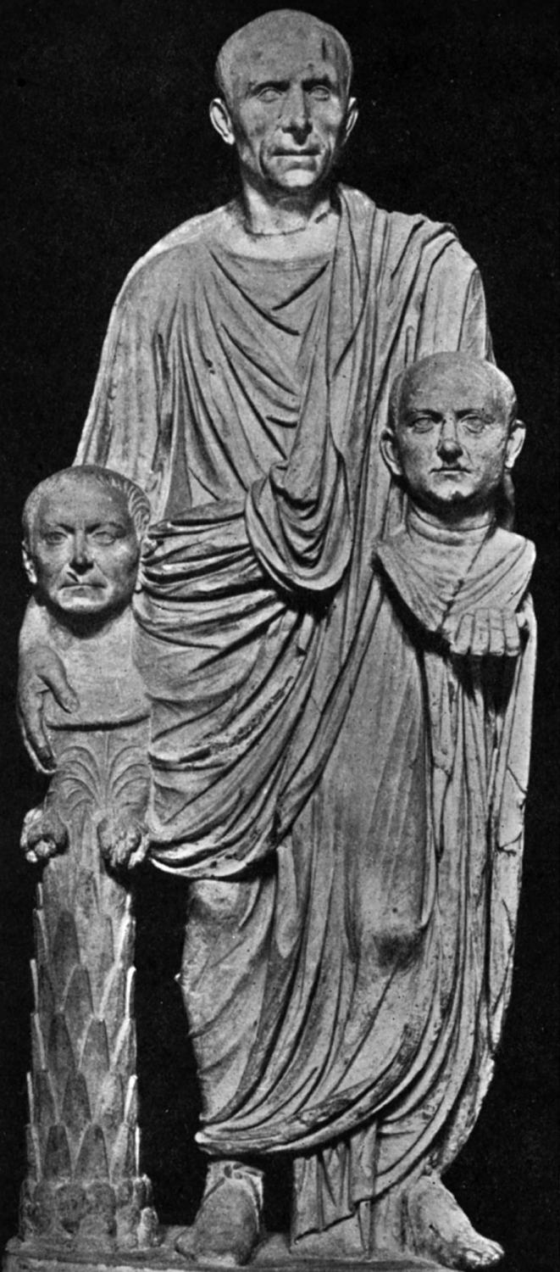
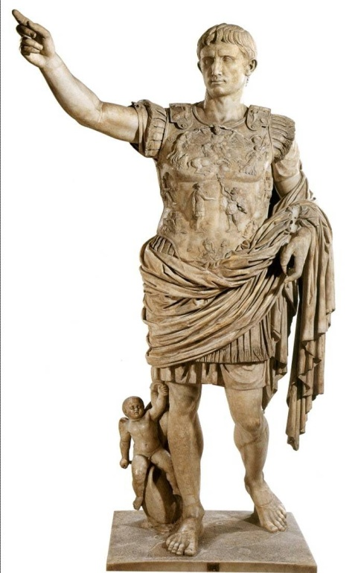
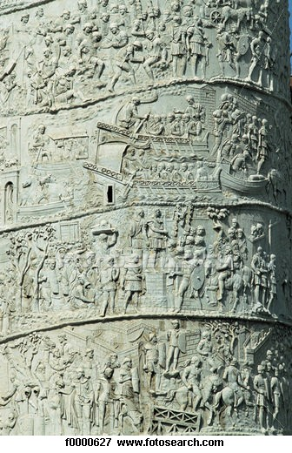
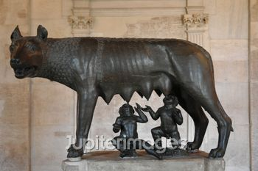
Timeline of Roman History

Slide 2
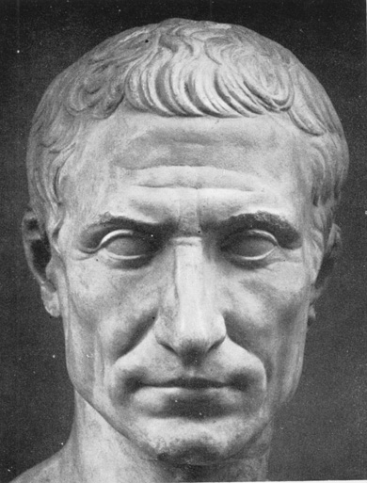
Roman History: Major Periods
753-509 MONARCHY
509-29 REPUBLIC
29 B.C.- 476 A.D. IMPERIAL AGE

Slide 3
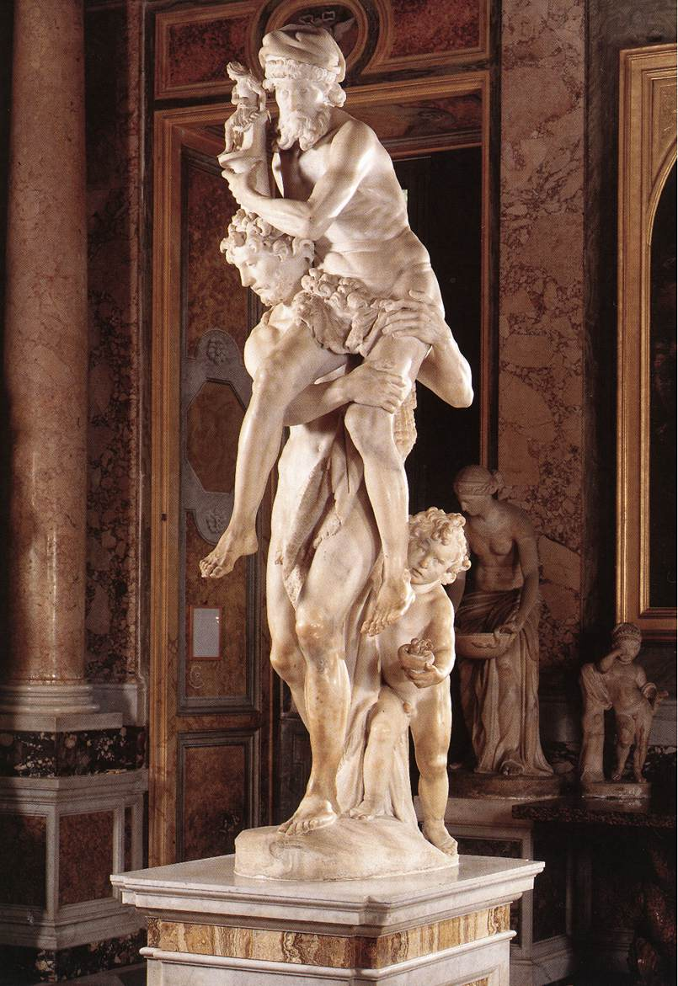
April 21, 753 Founding of Rome
Bernini, Aeneas, Anchises and Ascanius, 1618-1619

Slide 4
753-509 MONARCHY
Romulus
Numa Pompilius
Tullus Hostilius
Ancus Marcius
Tarquinius Priscus
Servius Tullius
Tarquinius Superbus
Etruscan Sarcophagus
Villa Giulia, Rome

Slide 5
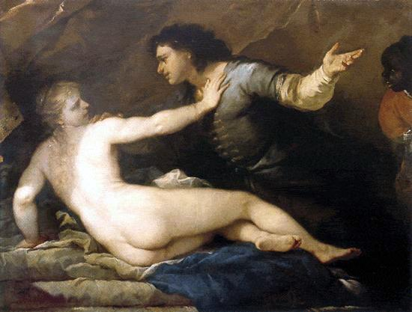
From Monarchy to Republic
Rape of Lucretia
Luca Giordano 1634–1705

Slide 6
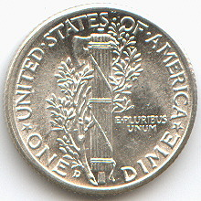
509-29 REPUBLIC
Patricians and Plebeians
Senate and Assemblies
Magistrates and Cursus Honorum
Consuls
Praetors
Quaestors
Aediles
Censor
Dictator

Slide 7
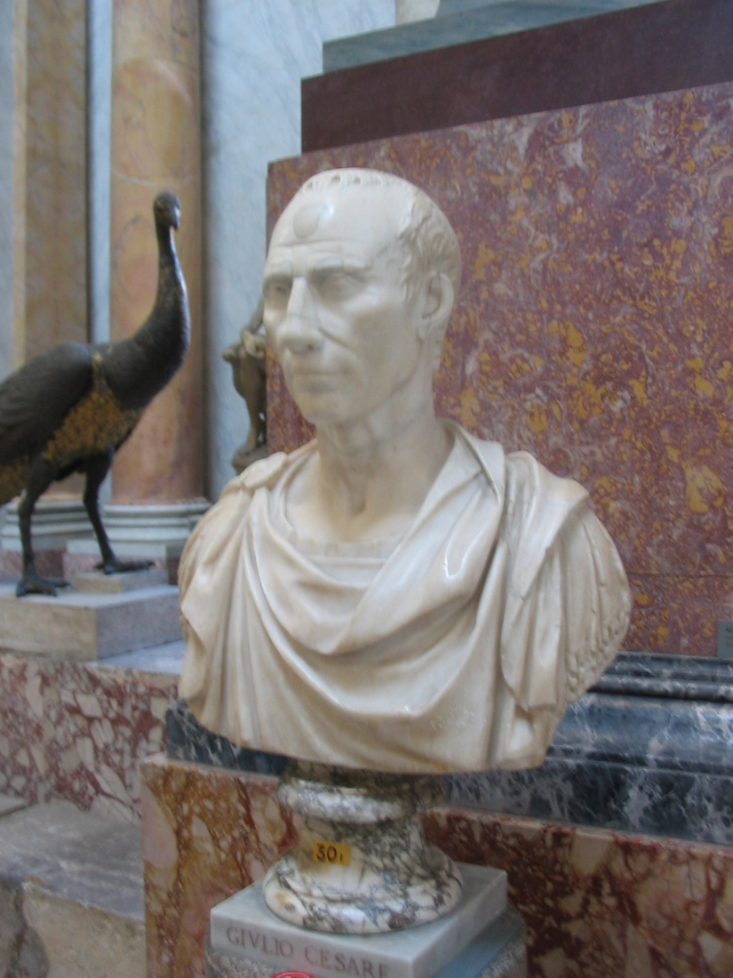
509-29 REPUBLIC
509-290 Italic Wars
264-146 Punic Wars with Carthage
201 Sicily becomes first Province
214-148 Macedonian Wars
146 Greece becomes Roman province
133-121 Tiberius and Gaius Gracchus
90-88 Social War
88-82 Civil War (Marius vs.Sulla)
82-80 Sulla’s dictatorship
63 Cicero’s consulship
60 First Triumvirate (Pompey, Crassus, Julius Caesar)
58-51 Caesar’s Conquest of Gaul (France)
49 Caesar crosses Rubicon
49-45 Civil War
March 15, 44 Caesar assassinated
44-30 Civil War
43 Second Triumvirate (Octavian, Marc Antony and Lepidus)
31 Battle of Actium (defeat of Antony and Cleopatra)
Julius Caesar
Vatican Museum

Slide 8
29 B.C.- 476 A.D. IMPERIAL AGE
29 B.C – 69 A.D. Julio-Claudian Emperors
69 – 98 Flavian Emperors
98-193 Antonine Emperors
193-235 Severan Dynasty
236-284 Age of Military Anarchy
284-312 Tetrarchy
312-326 Reign of Constantine
Trajan’s Column, Rome
Detail

Slide 9
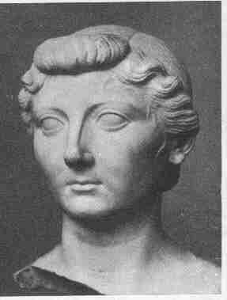
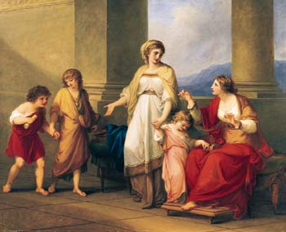
Women in the Roman World
Lucretia
Cornelia (mother of the Gracchi)
Clodia
Octavia
Livia
Boudicca
Julia Domna
Helena
Cornelia, Mother of the Gracchi, Pointing to her Children as Her Treasures
circa 1785
Angelica Kauffman (Swiss, 1741-1807;

Slide 10
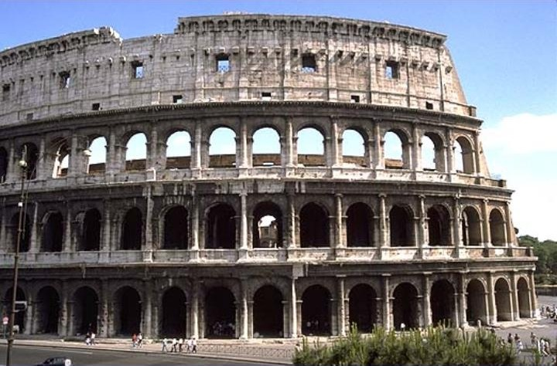
Illustrious Roman Men and Women Why is each important? What information do we have about their family life? Find a portrait (ancient or modern) and explain context.
Romulus
Numa Pompilius
Tullus Hostilius
Ancus Marcius
Tarquinius Priscus
Servius Tullius
Tarquinius Superbus
Agrippa
Agrippina (2)
Antoninus Pius
Augustus (Octavian)
Brutus
Caligula
Cato the Elder
Cicero
Cincinnatus
Claudius (emperor)
Constantine
Diocletian
Fabius Cunctator
Gaius Gracchus
Hadrian
Julian the Apostate
Julius
Caesar
Justinian
Mark Antony
Marcus Aurelius
Marius
Nero
Pompey
Scipio Aemilianus
Scipio Africanus
Septimius Severus
Spartacus
Sulla
Theodosius I the Great
Tiberius
Tiberius Gracchus
Titus
Trajan
Vespasian
Lucretia
Cornelia (mother of the Gracchi)
Clodia Julia (daughter of JC)
Octavia
Livia
Boudicca
Julia Domna
Helena (mother of Constantine)

