Slide 1
Towns:
Public and Private Buildings

Slide 2
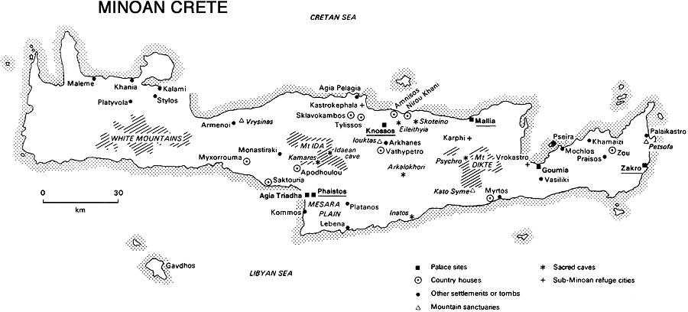
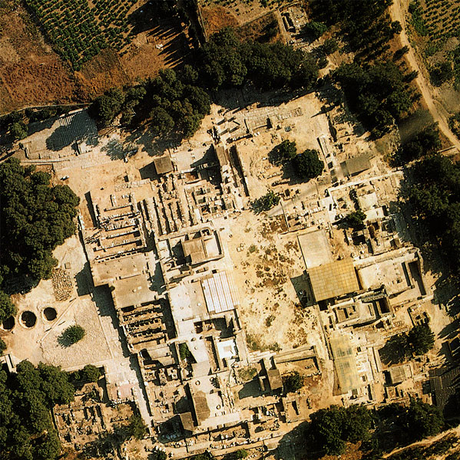
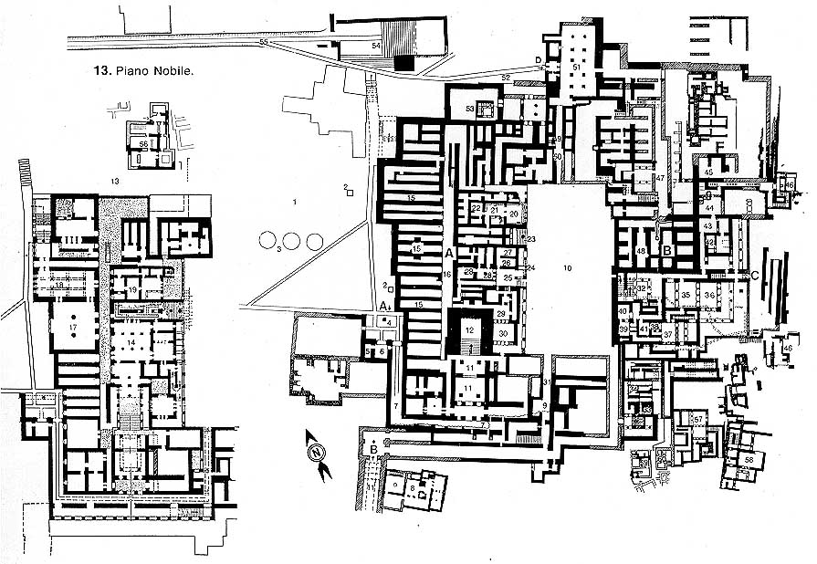
KNOSSOS

Slide 3
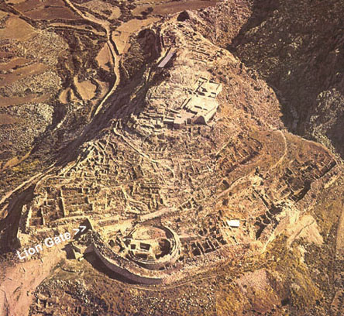
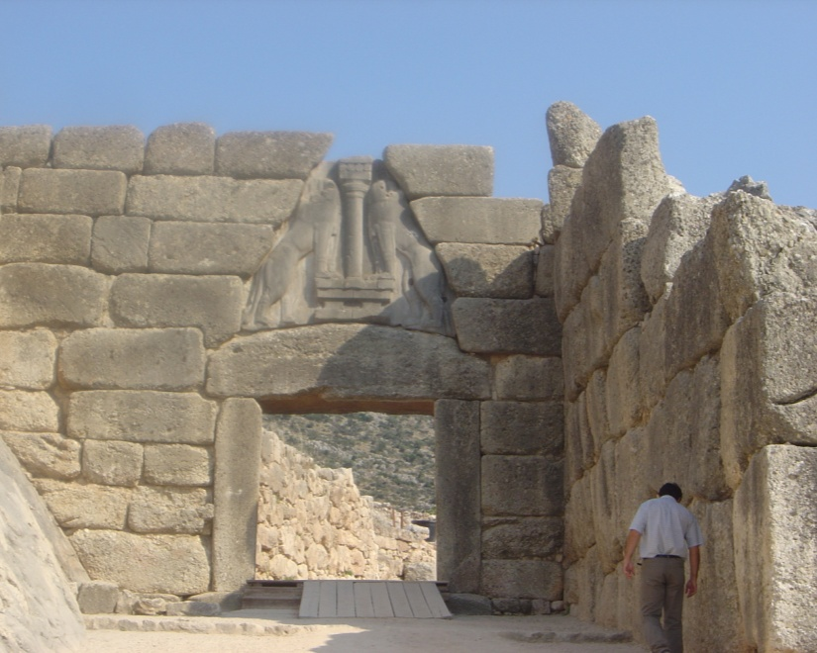
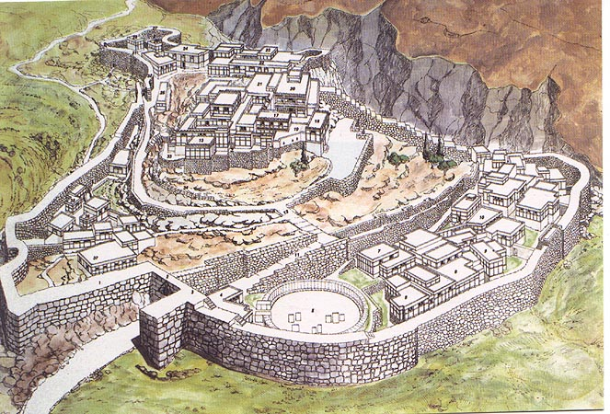
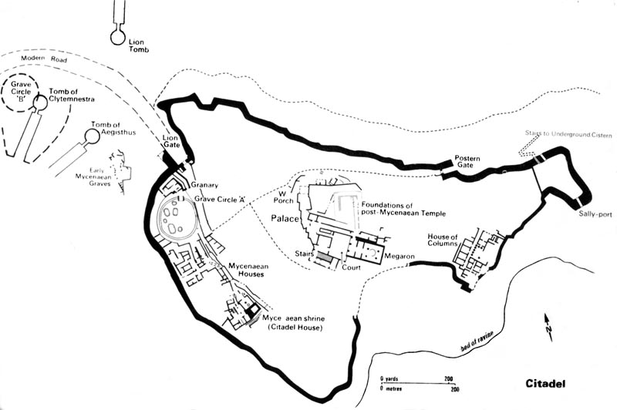
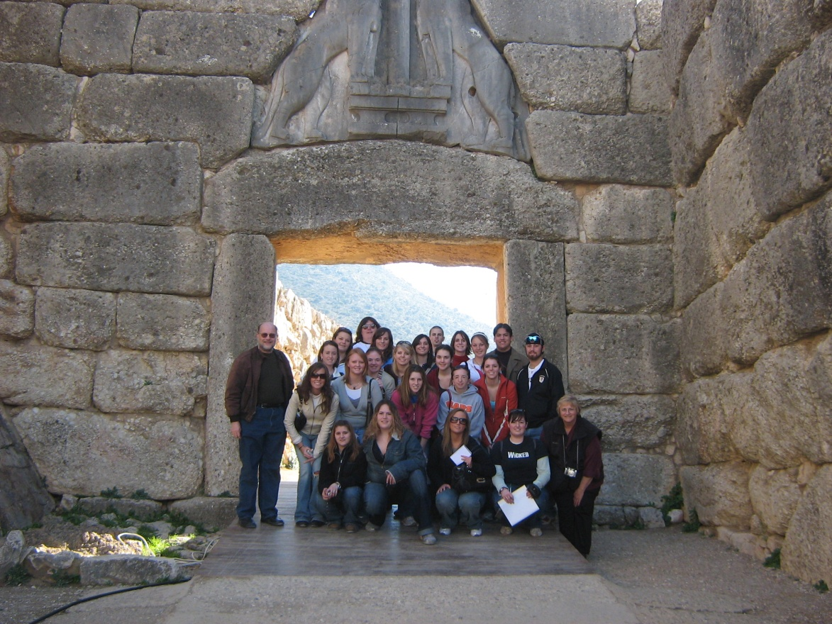
Mycenae

Slide 4
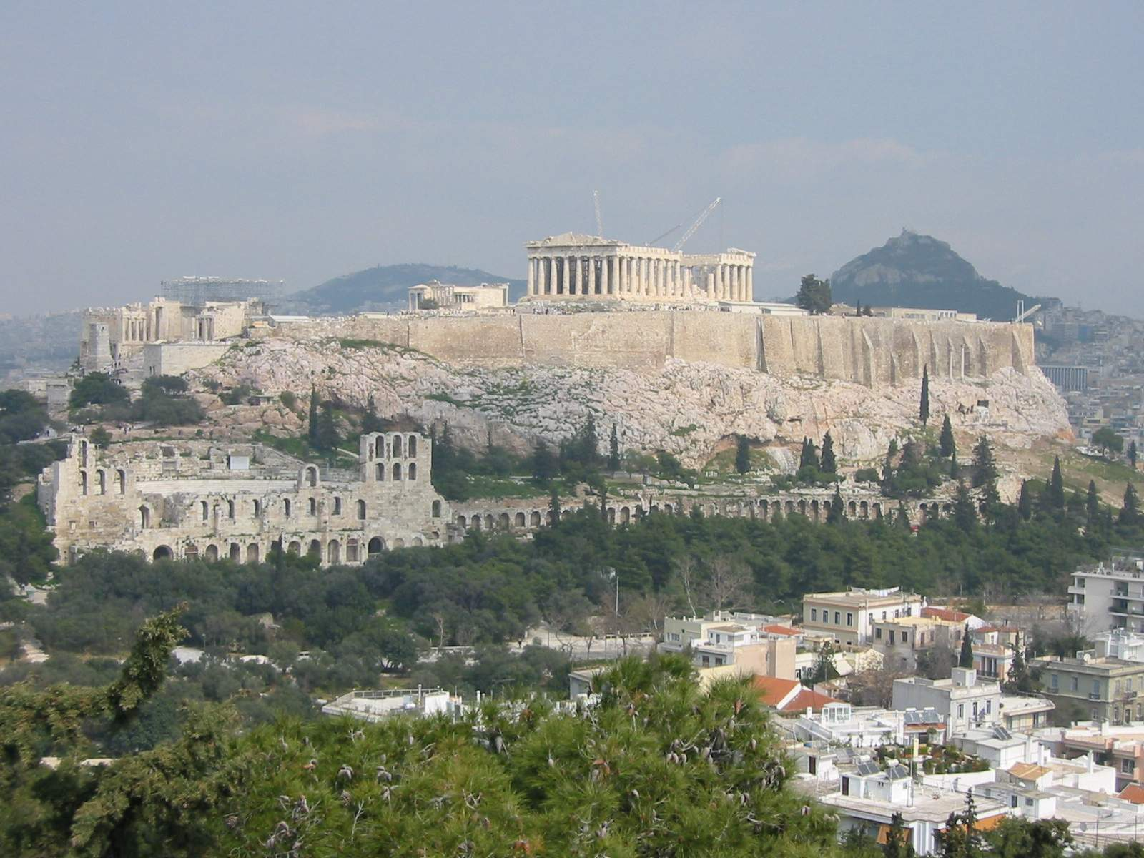
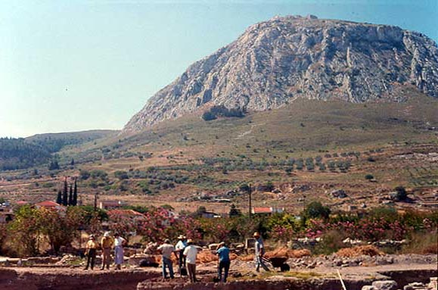
Acropolis: Athens and Corinth

Slide 5
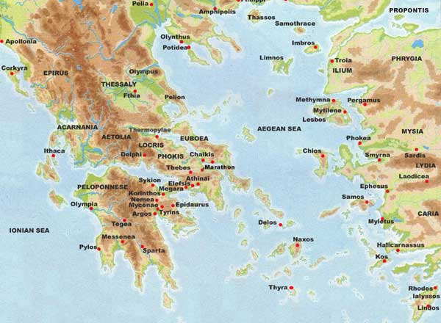
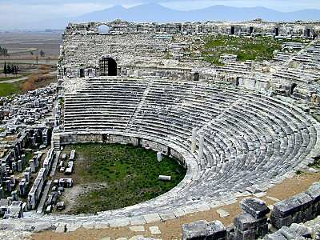
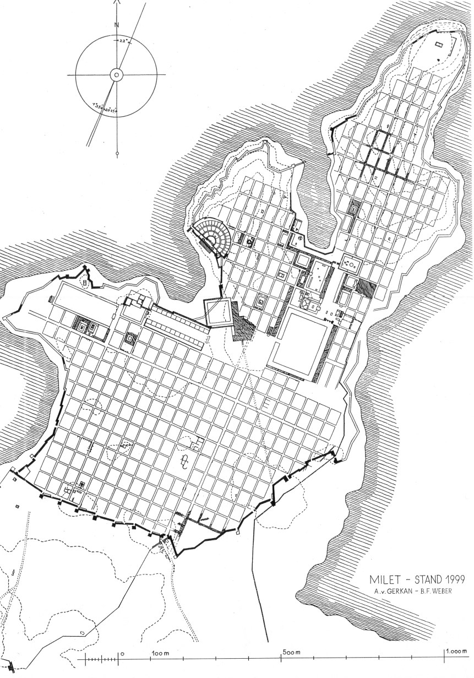
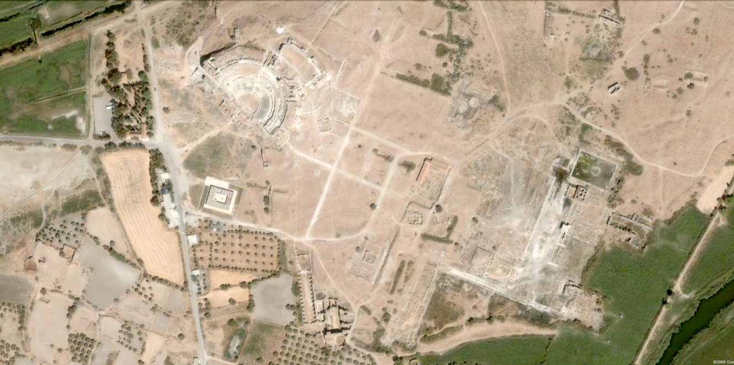
Miletus

Slide 6
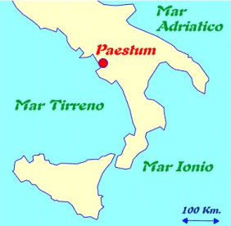
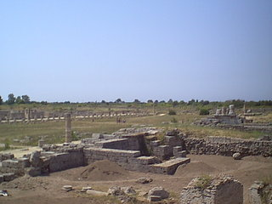
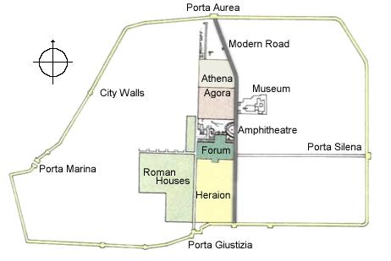
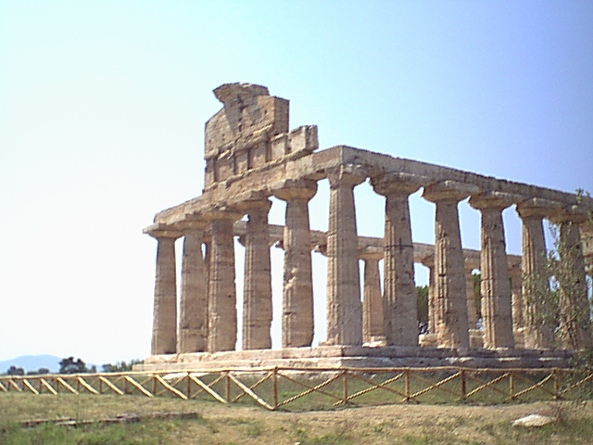
Paestum
View of the Forum from the Amphitheatre
Temple of Athena at Paestum
http://sights.seindal.dk/sight/86_Paestum-all.html

Slide 7
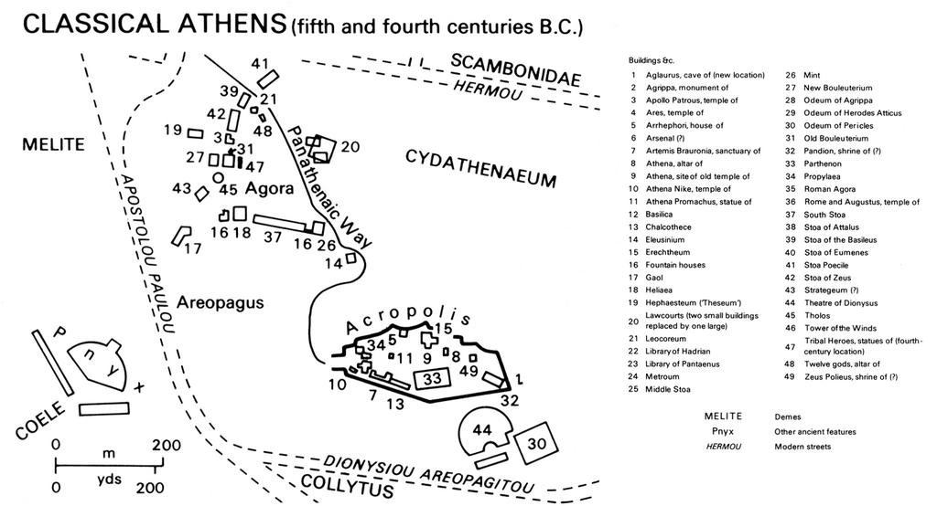

Slide 8
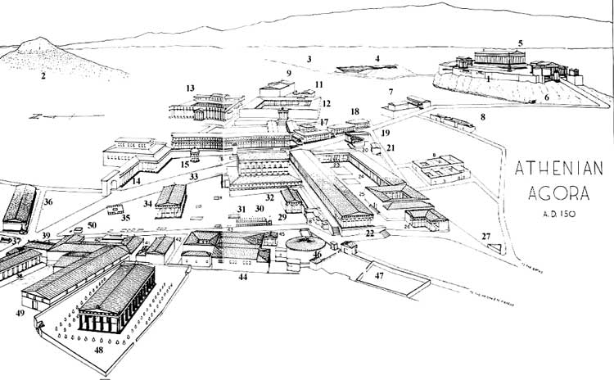
Athenian Agora
1 Acropolis , The Acropolis fom Space (wait a few seconds for loading )
2 Lycabettos
3 Ilissos River
4 Stadium
5 Parthenon
6 Clepshydra Springhouse
7 Eleusinion
8 Houses
9 Pantheon
10 Tower of the Winds
11 Agoranomion
12 Roman Agora
13 Library of Hadrian
15 Monopteros
16 Stoa of Attalos
17 Southeast Temple
20 Nymphaion
21 Southwest Fountain House
22 Middle Stoa
23 East Building
24 South Stoa II
25 Heliaia The building where the chief law-court of Athens, the Heliæa, met and trials of its jurisdiction were held. It is here that the trial of Socrates took place in 399 BC
26 Southwest Fountain House
27 Triangular Shrine
28 Civic Offices
29 Southwest Temple
30 Eponymous Heroes This monument included a statue of each one of the ten eponym heroes of the ten tribes instituted by Cleisthenes : Erechtheus, Aegeus (Theseus' father), Pandion, Leos, Acamas (one of Theseus' sons), Oeneus, Cecrops, Hippothoon, Ajax and Antiochus (a son of Heracles). It is on this monument that official decrees and announcements were posted.
31 Altar of Zeus Agoraios?
32 Odeion Built by Agrippa in 15 BC (auditorium with a seating capacity of about 1000 people, and a two-storeyed portico. Destroyed by fire in AD 267 and in about A.D. 400 the Gymnasium was erected in this area. Its north side was adorned by four colossal figures of Giants and Tritons set up on massive pedestals, salvaged from the debris of the Odeion.
33 Panathenaic Way
34 Temple of Ares
35 Altar of the 12 Gods Altar (bômos) in the center of the agora dedicated to the twelve great gods of Greece. It was the point from which distances were reckoned
36 Poikile Stoa Greek for "Painted Porch". This is the porch were the Greek philosopher Zeno of Citium used to teach, toward the beginning of the 3rd century BC, the first principles of what would become known as a result as "Stoic" philosophy, from the Greek word "stoa", meaning "porch". It included paintings of Micon of the Battle of Marathon
37 Altar
38 Roman Stoa
39 Royal Stoa This porch (stoa in Greek) was the seat of the King-Archon
40 Stoa of Zeus Eleutherios
41 Temple of Zeus Phratrios and Athena Phratria
42 Temple of Apollo Patroos Under the epithet "Patrôos" (meaning "from the fathers"), Apollo was worshiped as the protector of families
43 Metroon Building erected in the 2nd century BC It accommodated both the sanctuary of the Mother of the Gods and the state archives, including the proceedings of the meetings of the Council of 500 and various official documents, protected by the goddess.
44 Bouleuterion
This was the meeting room of the Council of Five-Hundred, in Greek boulè ("council"), hence the name "bouleuterion. When Cleisthenes reformed the boulè in 508 BC, he also had a new meeting room built next to the older one.
45 Propylon to Bouleuterion
46 Tholos The round residency of the prytanes, or presidents of the boulè, during their tenure
47 Strategeion The meeting room of the 10 strategoi
48 Hephaistion The temple of Hephaestus, god of craftsmen.
49 Arsenal ?
50 Cross-Road Sanctuary

Slide 9
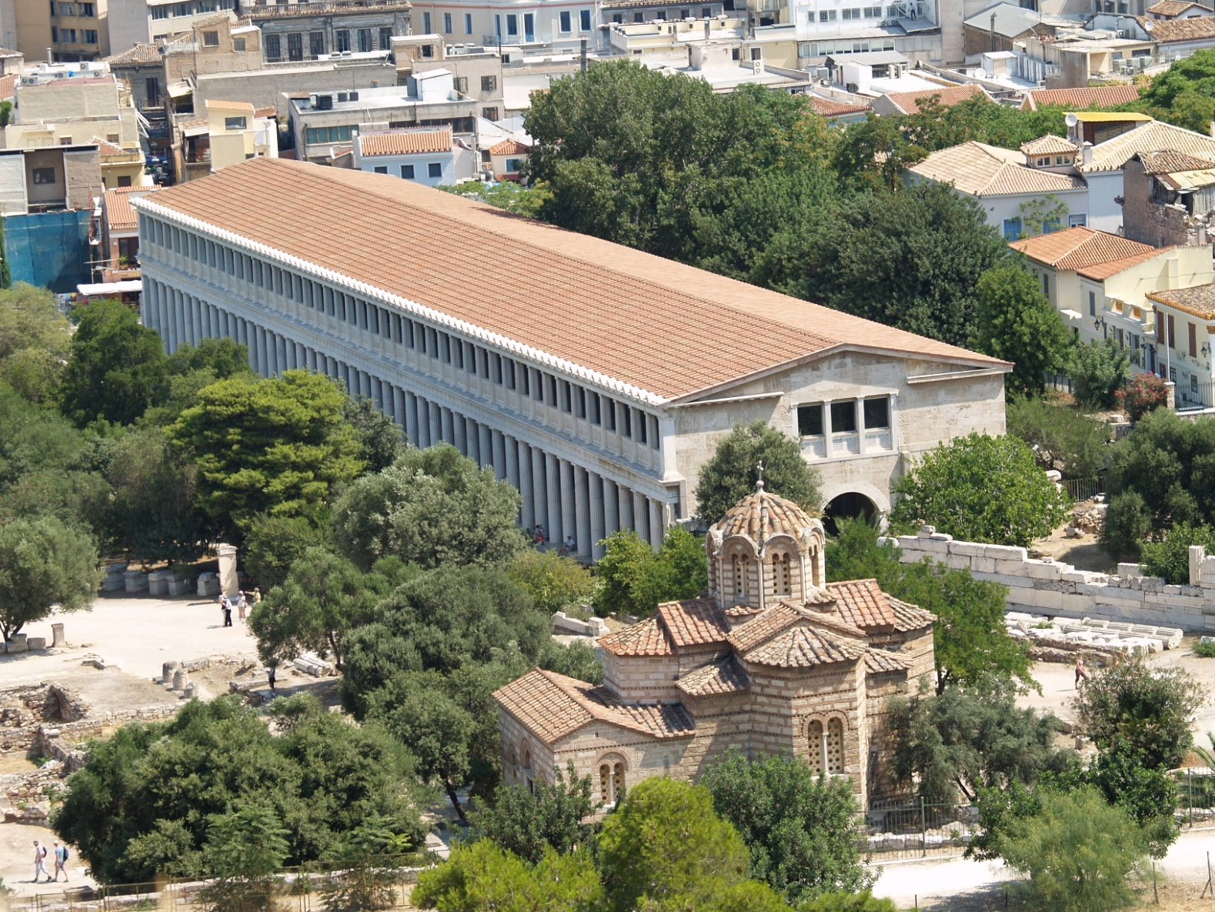
Stoa
(Stoa of Attalos from Space)

Slide 10
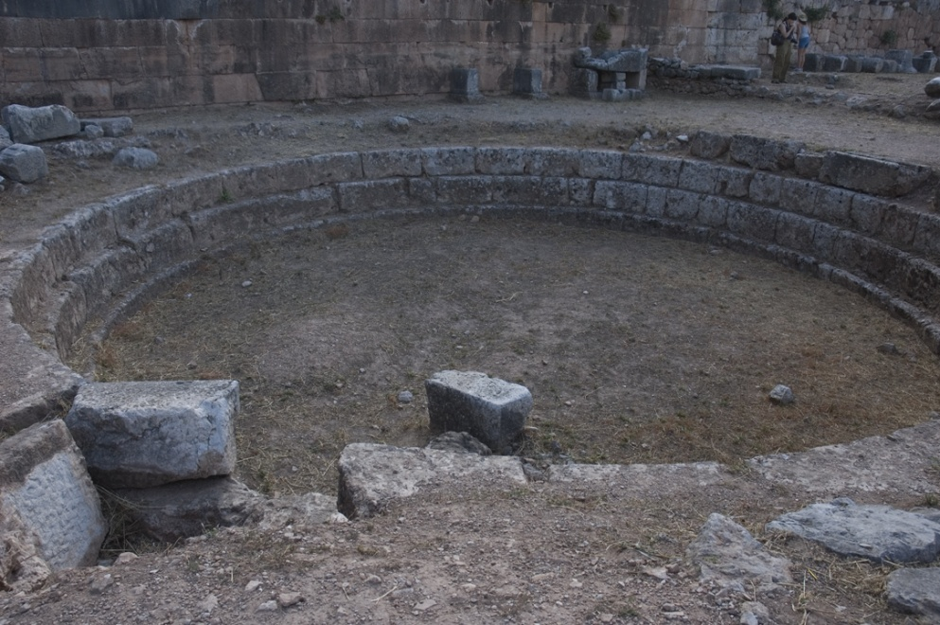
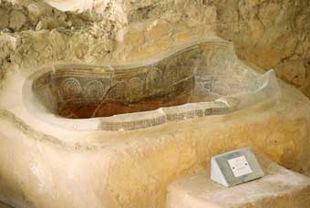
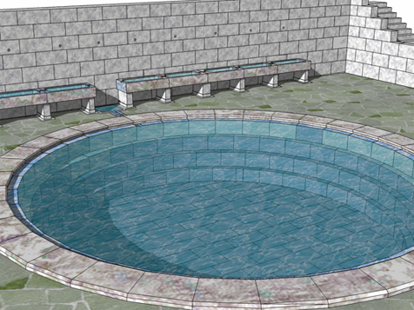
Balaneia
Bronze Age hip bath from "Nestor's palace” (Pylos)
http://www.clt.astate.edu/digitaldelphi/BathOverview2.html

Slide 11
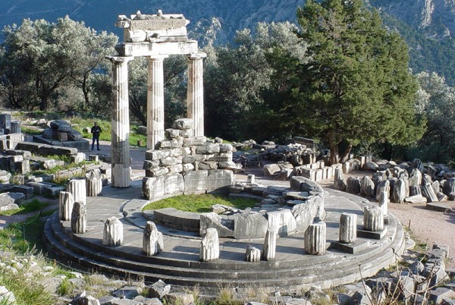
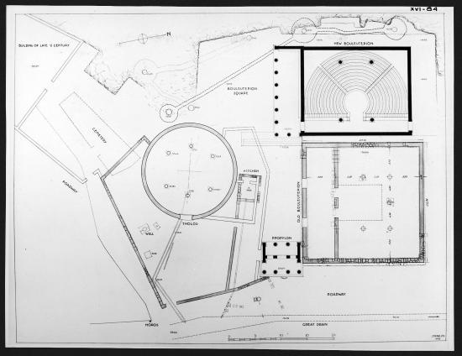
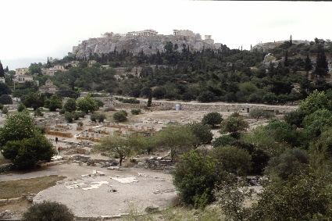
Tholos
http://traumwerk.stanford.edu:3455/Archaeopaedia/193

Slide 12
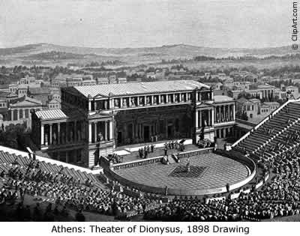
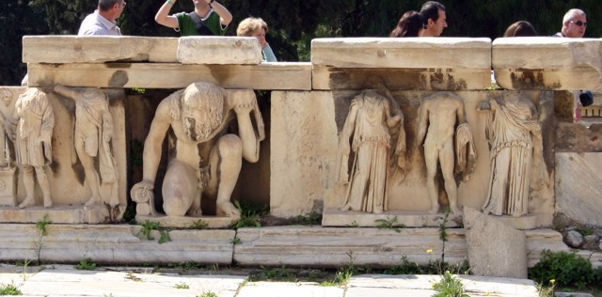
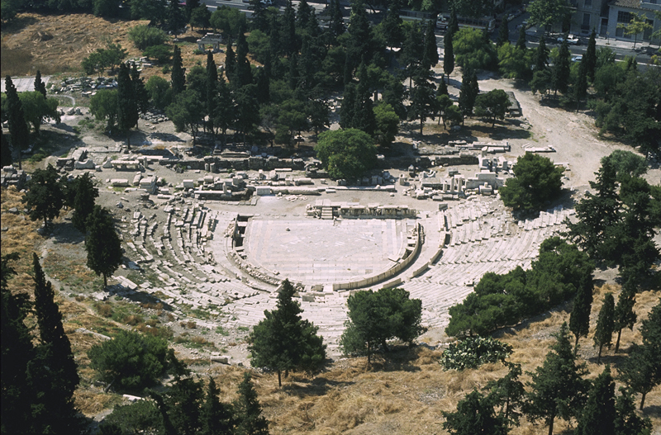
Theatre

Slide 13
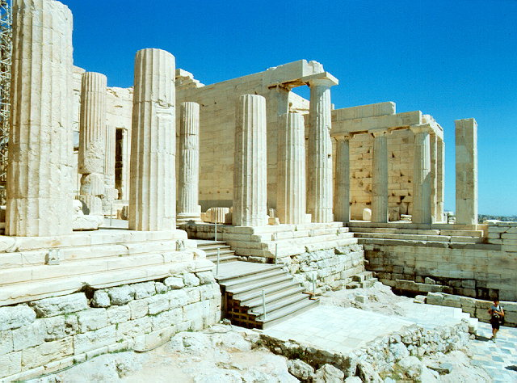
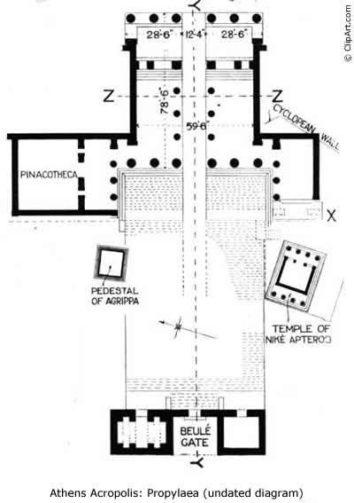
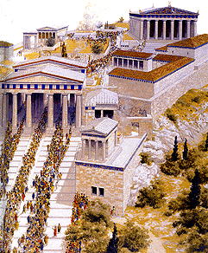
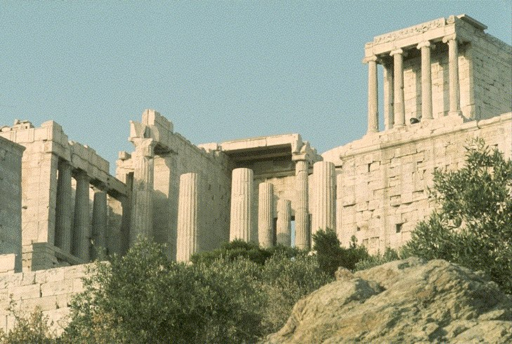
Gateway (Propylaia)

Slide 14
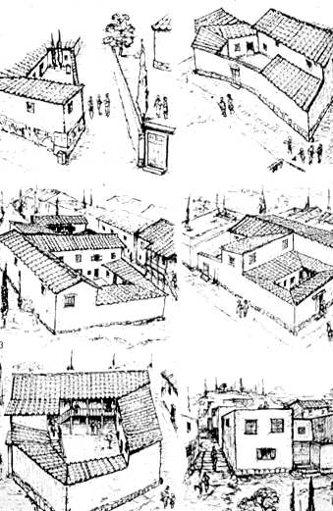
http://www.mlahanas.de/Greeks/Furniture/Furniture.htm

