Slide 1
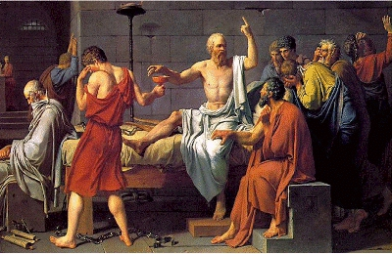
The Trial of Socrates
"The Death of Socrates"
by Jacques-Louis David (1787)
http://www.law.umkc.edu/faculty/projects/ftrials/socrates/socrates.HTM

Slide 2
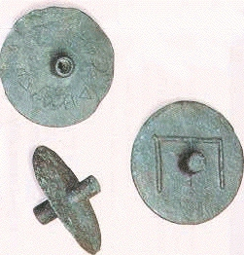
B
Ballot disks from 4th century
Solid: Acquittal
Pierced: Conviction

Slide 3
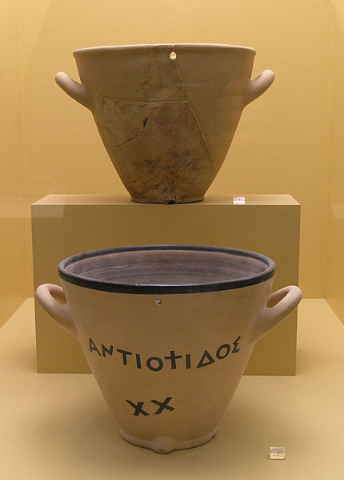
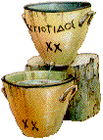
Waterclock (Clepsydra)

