Slide 1
Classical Mythology in 20th-Century Art
Judith E. Bernstock

Slide 2
20th-century artists:
Draw on Classical Mythology for humanistic reasons
Less concerned with illustrating narrative content
More concerned with symbolic interpretation
Based upon personal experience
Symbolic representation of contemporary events
Responses to social stresses
Deeper, more remote experience
Use of mythology to illuminate the present
legends of violence and struggle
Mythological subjects as thinly disguised metaphors for disturbing events and political conflicts
Tragic consequences of nationalism
Revive ancient myths in their search for common ground accessible to all
Reflect a need to connect contemporary history with age-old human urges and motivations

Slide 3
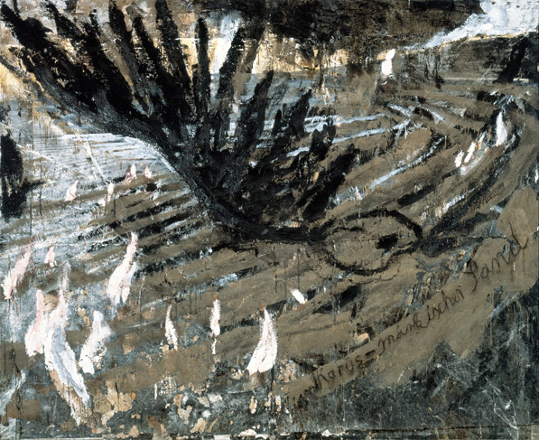

Slide 4
Anselm Keifer (1945-- )
Ikarus - märkischer Sand [Icarus - Sand of the Brandenburg March] 1981 Oil, emulsion, shellac, sand and photograph on canvas 290 x 360 cm 114¼ x 14

Slide 5
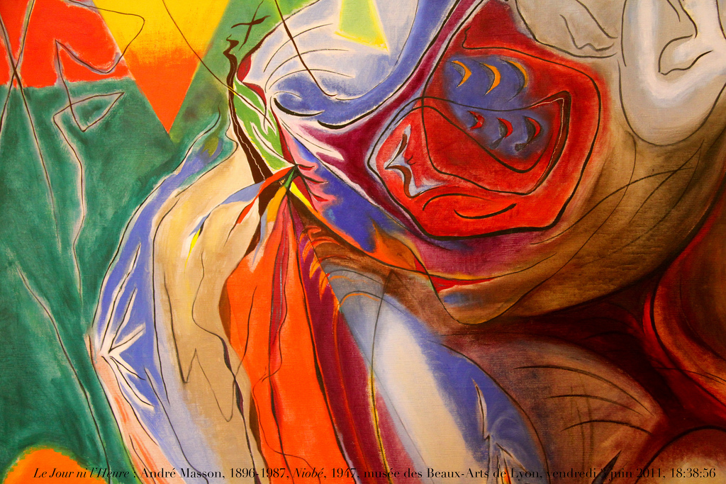

Slide 6
Masson's Niobe of 1947 (Musee des Beaux-Arts, Lyon)
A moving memorial to the suffering of woman and children during the war

Slide 7
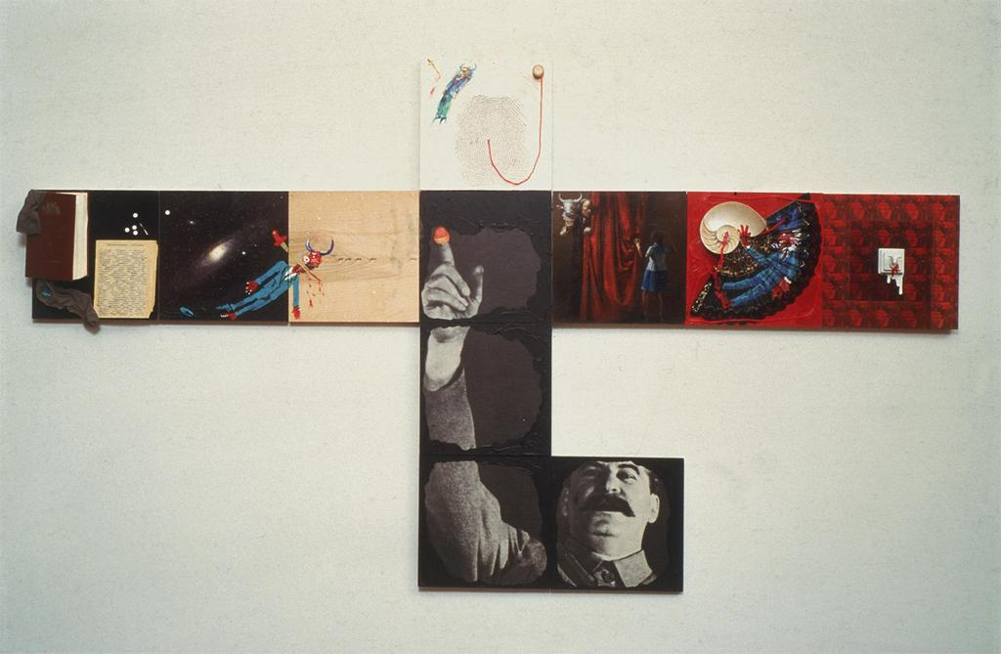
Alexander Komar and Vitaly Melamid (http://awp.diaart.org/km/)
The Minotaur as a Participant in the Yalta Conference, 1984-85
mixed media on 11 panels
13 1/2 x 11 inches each; 40 1/2 x 93 3/4 x 3 inches overall

Slide 8
A satirical identifcation of 2oth-century tyrants with mythological creatures

Slide 9
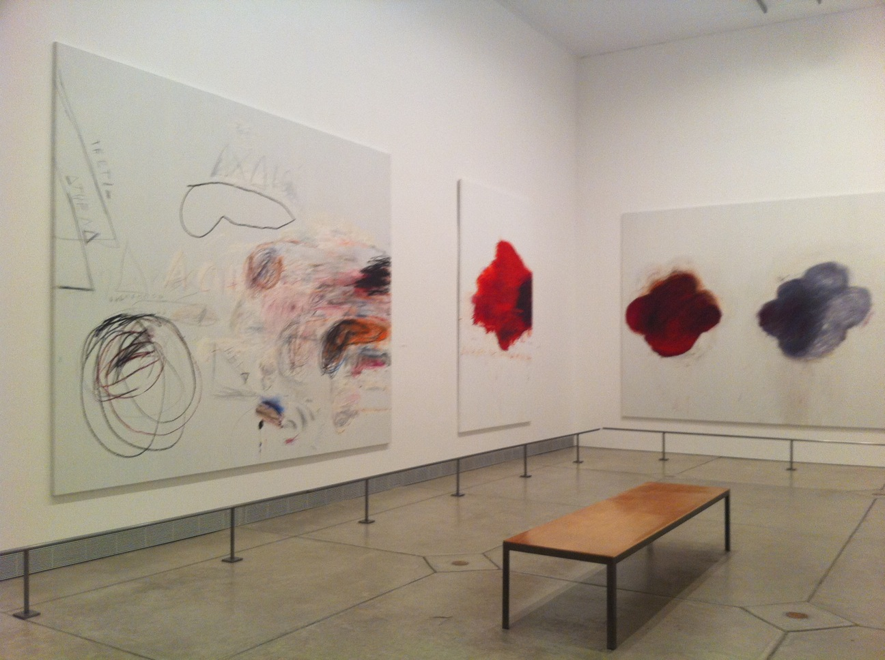
Twombly. “Fifty Days at Iliam” http://www.philamuseum.org/collections/permanent/85709.html

Slide 10
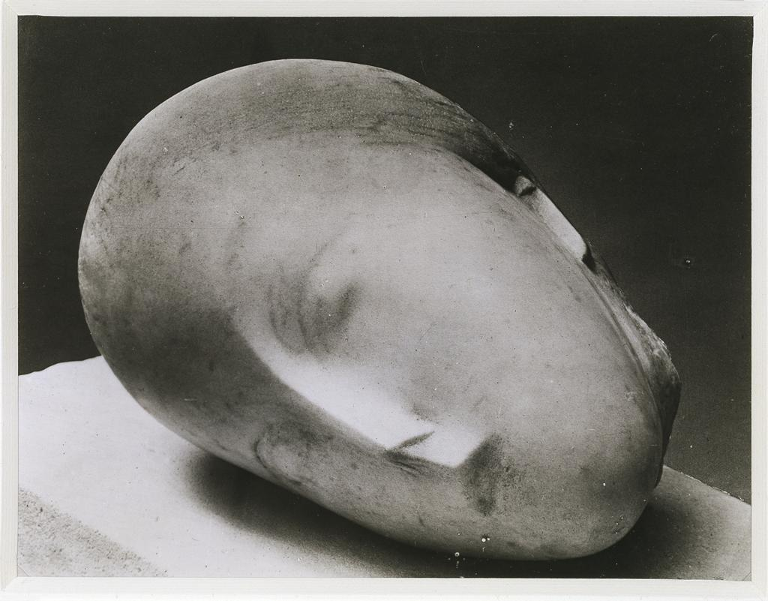
Return to Origins
Events taking place in primordial times
Regression
Unconscious desire for death
Death instinct
Constantin Bancusi
Sleeping Muse (1910)
Miraculous aspect of life
Potential awakening of artistic creativity

Slide 11
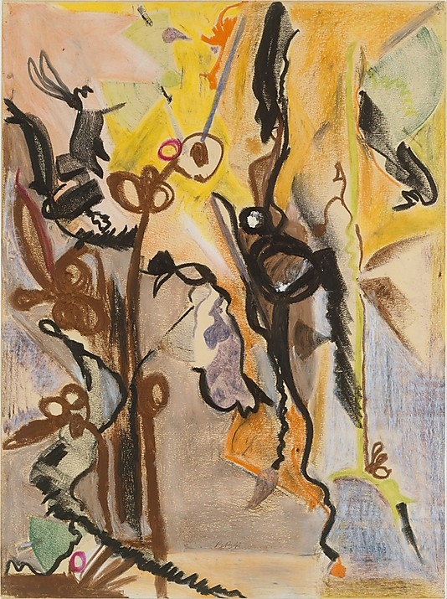

Slide 12
The Song of Orpheus (1944-1945) Barnett Newman (American, New York City 1905–1970 New York City) Medium: Oil pastel on paper Dimensions: H. 20, W. 14-7/8 inches (50.8 x 37.8 cm.)

Slide 13
The Song of Orpheus (1944-1945) Barnett Newman (American, New York City 1905–1970 New York City) Medium: Oil pastel on paper Dimensions: H. 20, W. 14-7/8 inches (50.8 x 37.8 cm.)
“uses the evolution of the seed and stem to convey his association of myths about the death and renewal of nature with his scientific investigation of the origins of life” (Bernstock)

Slide 14
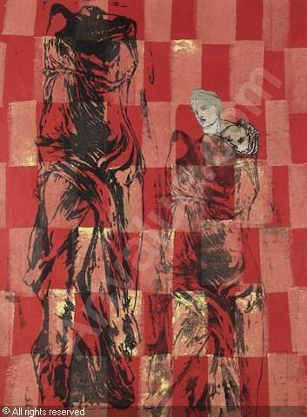
Classical Mythology and the Human Condition
Metaphoric protest against human suffering
Nancy Spero (1926-2009)
“For Artemis That Heals Woman’s Pan
Collage on Paper, 1979
Josh Baer Gallery, New York
Woman as both victim and scourge of man

Slide 15
Psychology
Preoccupation with the psyche
Focus on dream, desire and love
Basic savagery of man

Slide 16
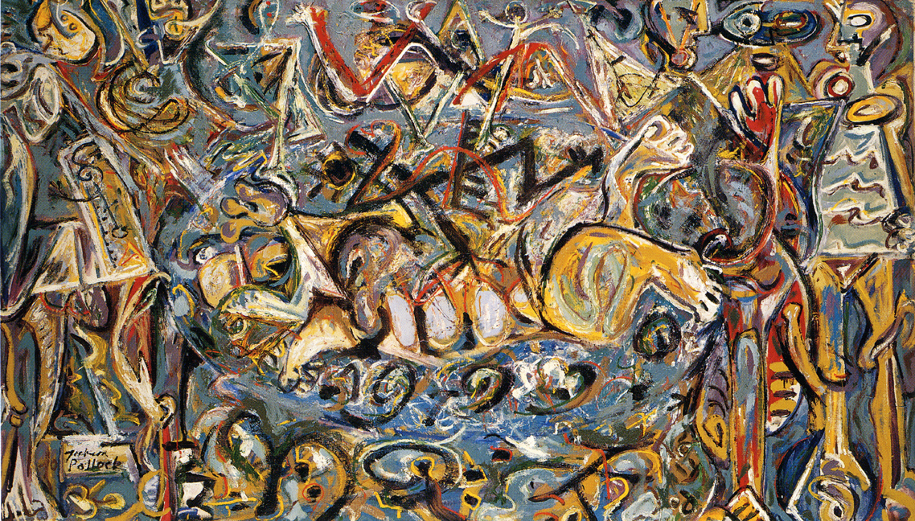
Jackson Pollock (1912-1956)
Pasiphae and the Bull

Slide 17
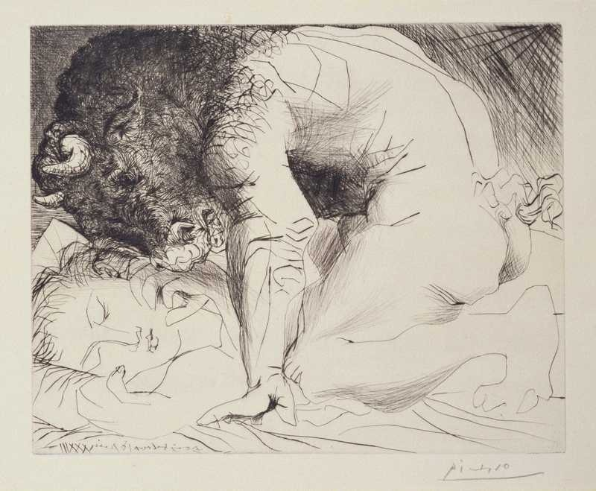
Pablo Picasso (1881-1973)
Minotaur Caressing a Sleeping Woman

Slide 18
Classical Culture: Literature and Art
Referencing mythology involves self-identification with native heritage
Close study of ancient religions
References to ancient literature
Frazer’s Golden Bough (1912) (http://www.bartleby.com/196/)
Friederich Nietzsche’s Birth of Tragedy (1872)
Mockery of ancient and Renaissance art as hidden homage

Slide 19
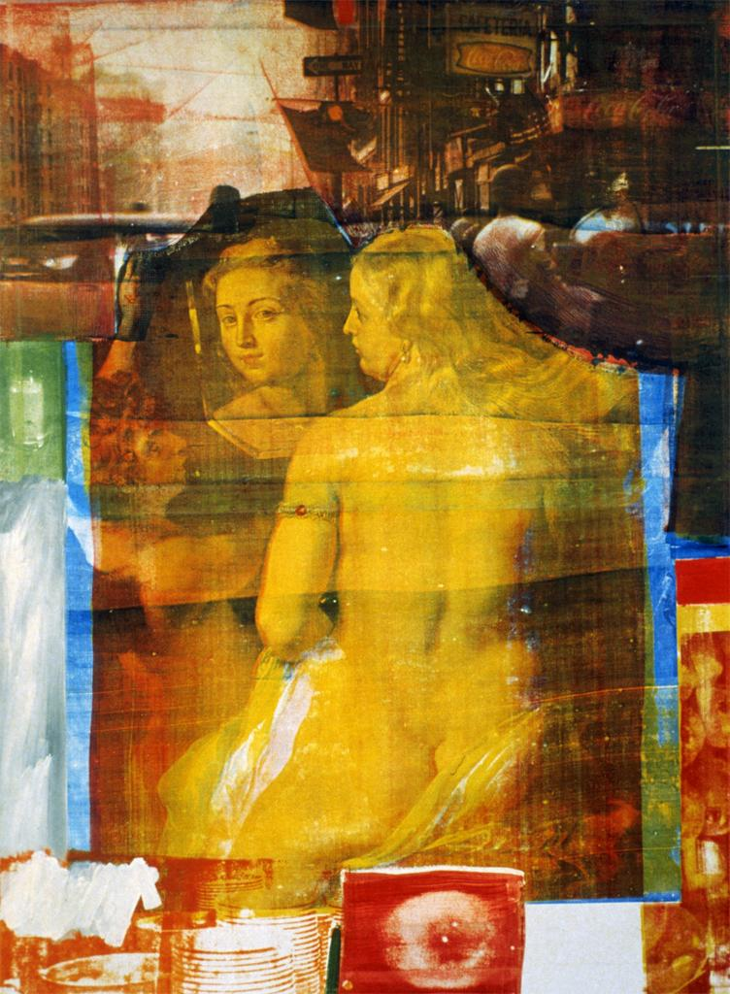
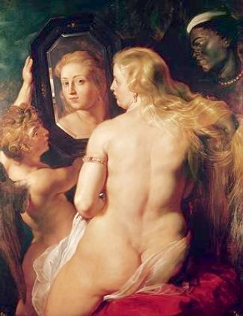
Robert Rauschenberg
Persimmon (1964)
Peter Paul Reubens (1577-1640)
Venus at her Toilet

