Slide 1
Classical Mythology in the 20th-Century
Judith Bernstock

Slide 2
Classical Mythology in the 20th-Century
Sources go beyond Ovid to include:
Greek tragedy
tragedies of Aeschylus, Sophocles and Euripides)
Greek epic (Homer)
Iliad and Odyssey
Modern studies of myth
Frederick Nietzsche’s Birth of Tragedy (1872)
Sigmund Freud’s Interpretation of Dreams (1911)
Sir James Frazer’s Golden Bough (1912)

Slide 3
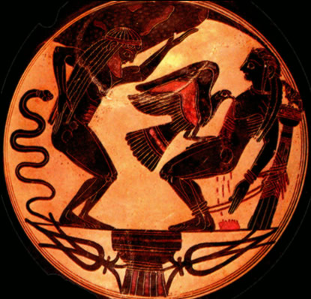
Prometheus
Hesiod’s Theogony and Aeschylus’ Prometheus Bound
Giver of fire (civilization) to humankind
Punished by Zeus and his eagle
Prometheus bound, Laconian black-figure amphoriskos C6th B.C., Vatican City Museums

Slide 4
Prometheus
Ovid: [I. 76] But one more perfect and more sanctified, a being capable of lofty thought, intelligent to rule, was wanting still man was created! Did the Unknown God designing then a better world make man of seed divine? or did Prometheus take the new soil of earth (that still contained some godly element of Heaven's Life) and use it to create the race of man; first mingling it with water of new streams; so that his new creation, upright man, was made in image of commanding Gods? On earth the brute creation bends its gaze, but man was given a lofty countenance and was commanded to behold the skies; and with an upright face may view the stars:—and so it was that shapeless clay put on the form of man till then unknown to earth.

Slide 5
Prometheus
Mythological dualism
Symbol of hopes, endurance and achievements of humankind
Human progress (Prometheus as fire-bringer)
Futile attempts of humankind to fulfill their potential
Human suffering (Prometheus and the Eagle)

Slide 6
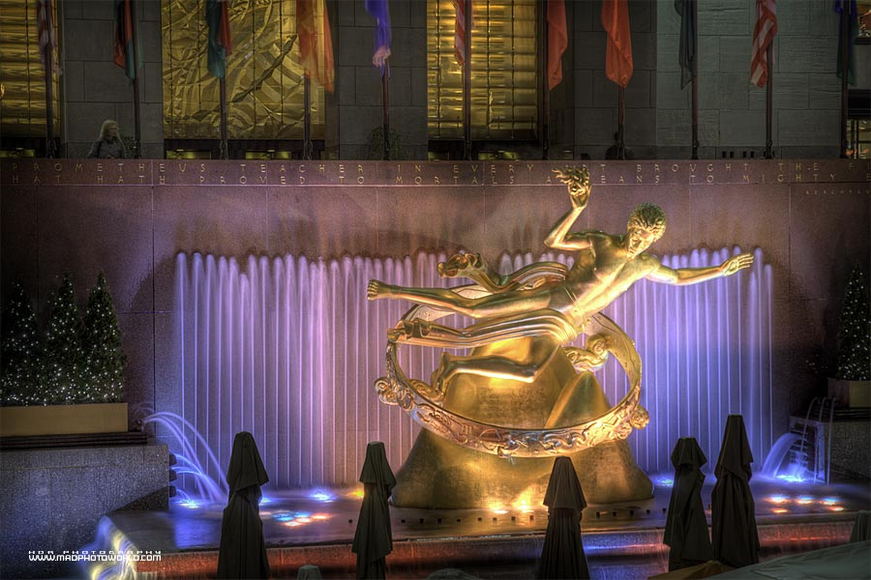
Paul Manship's Prometheus Fountain (1934) Rockefeller Center, New York City

Slide 7
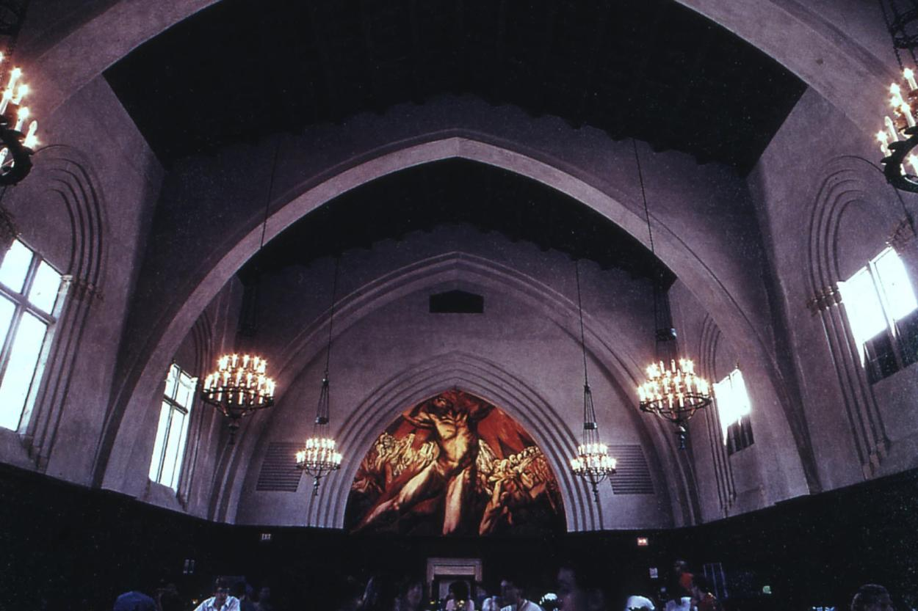
Frary Dining Hall (interior, view of mural by J. C. Orozco, Prometheus, 1930), Pomona College

Slide 8
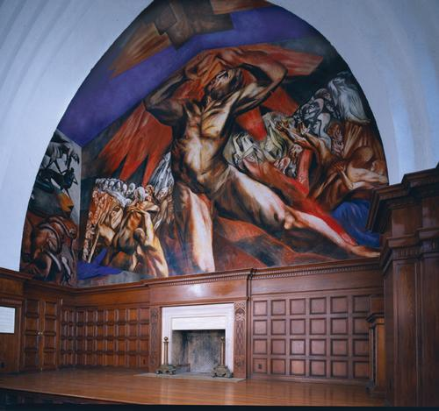
Prometheus as creative force of art, which brings order out of chaos

Slide 9
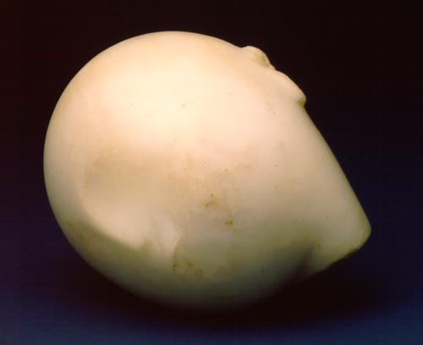
Constantin Brancusi: Prometheus
1911 Marble, 5 x 7" Philadelphia Museum of Art: The Louis and Walter Arensberg Collection
Ovoid shape suggests birthing of human aspiration, but the downward tilt of the head indicates his despair over his inability to attain the absolute. (Bernstock)

Slide 10
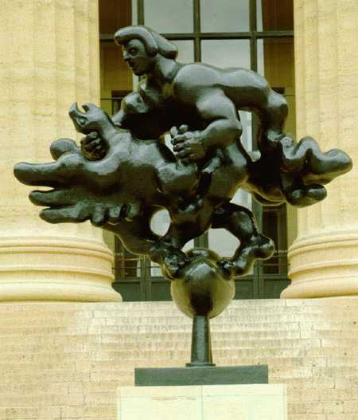
Transformation of the myth in order to emphasize rich humanisitic implications.
Eagle represents threats faced by Europe in 1930’s: Depression, rise of Hitler, anti-humanist ideas
Prometheus wears Phrygian cap of freedom: symbol of French revolution!
Humankind triumphant in struggle with destructive forces
Jacques Lipchitz: Prometheus Strangling the Vulture
1949 Bronze, 7'9" x 7'8" (including base) Philadelphia Museum of Art: Lisa Norris Elkins Fund Photo by Graydon Wood, 1994

Slide 11
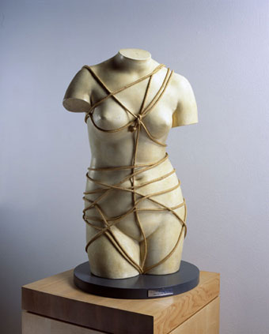
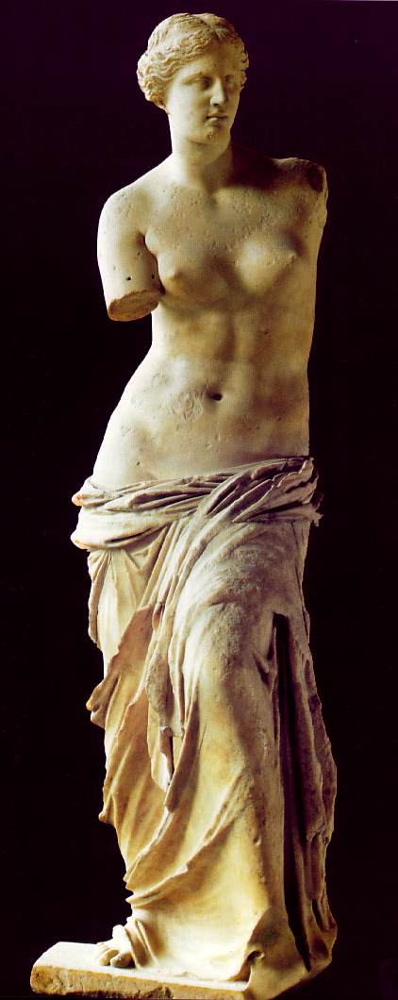
Man Ray
Venus Restored, 1936/1971
Man Ray , born in United States , active in U.S and France, 1890–1976
Venus Restored , 1936/1971
Assemblage: plaster cast and rope, 71 x 41 x 28 cm
Gift of Jose Mugrabi, , to American Friends of the Israel Museum

Slide 12
Oppressiveness of conformity to traditional ideas of beauty
Debunking established paragons of perfection
Goddess bound in ropes but as much enslaver as helpless victim
Man Ray
Venus Restored, 1936/1971
Man Ray , born in United States , active in U.S and France, 1890–1976
Venus Restored , 1936/1971
Assemblage: plaster cast and rope, 71 x 41 x 28 cm
Gift of Jose Mugrabi, , to American Friends of the Israel Museum

Slide 13
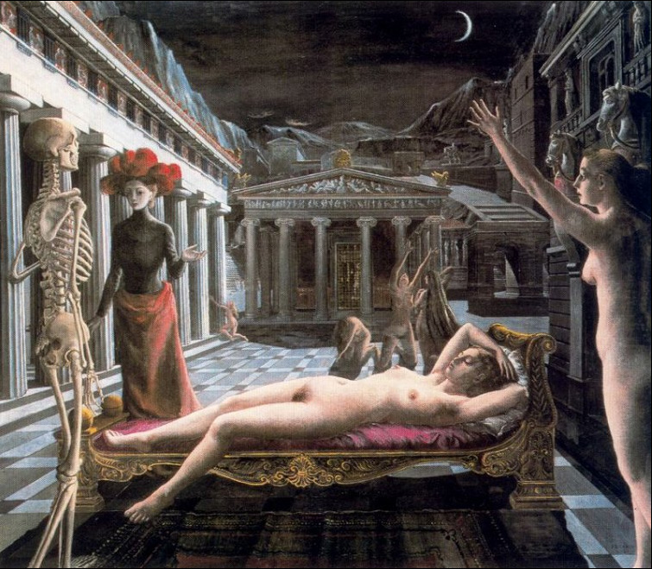
A response to the bombing of Brussels “to express anguish in contrast with the serenity of Venus”
(Bernstock)
Paul Delvaux. “Sleeping Venus” (1944) Tate Gallery, London

Slide 14
Apollo vs. Dionysus
Frederick Nietzsche’s Birth of Tragedy (1872)
Reason (Apollo) vs. Emotion (Dionysus)
Apollo as the paradigmatic artist vs. excessive intellectualism
Dionysus as source of freedom vs. destructive force

Slide 15
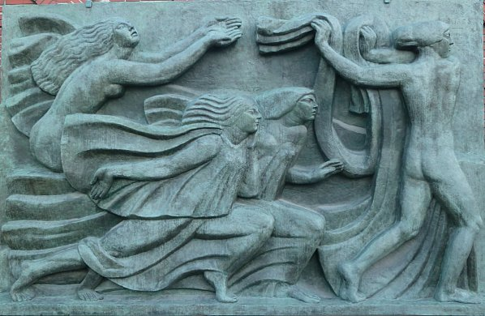
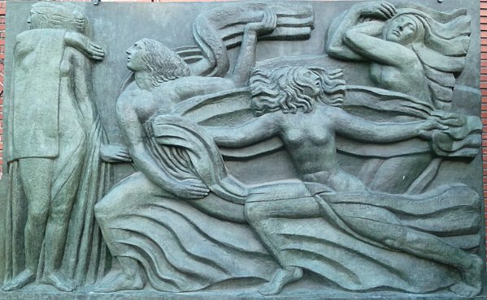
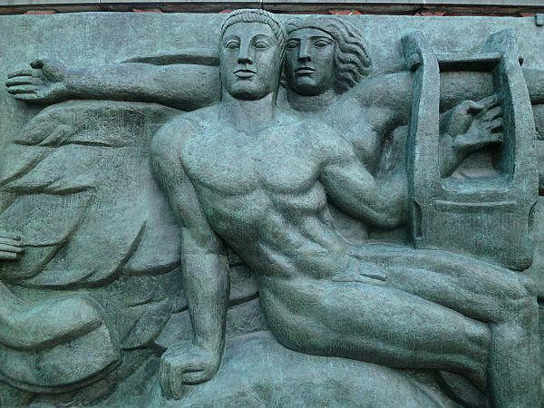
Emile-antoine Bourdelle
The Muses Running Toward Apollo (1910-1913)
Marble frieze
Theatre des Champs-Elysees, Paris

Slide 16
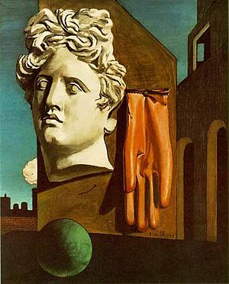
One of the first 20th-century examples of an artist’s ridicule of Apollo (Bernstock)
The Song of Love (“Le chant d'amour”; 1914) by the Italian metaphysical painter Giorgio de Chirico
Museum of Modern Art, NYC

Slide 17
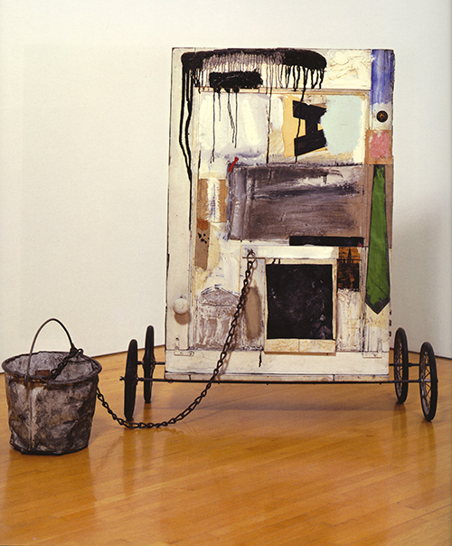
Apollo’s Chariot “Grounded”
Robert Rauschenberg (1925-2008)
“Gift for Apollo” (1959)
Panza Collection at the Museum of Contemporary Art in Los Angeles, CA This Rauschenberg COMBINE
includes oil paint, wood, fabric, newspaper, print reproductions, metal bucket, metal chain, dooknob and rubber wheels
43×29 inches, depth variable).

Slide 18
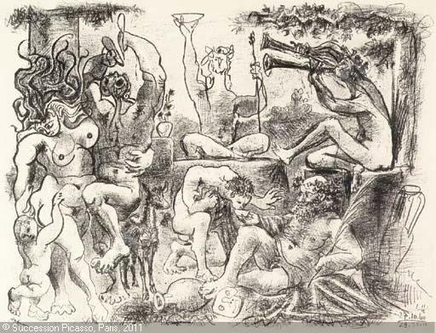
Bacchus (Dionysus)
Picasso. Homage to Bacchus (1960)

Slide 19
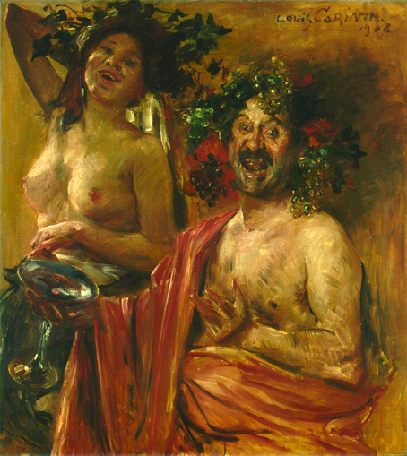
Als of
Pair of Bacchants (1908)
Lovis Corinth
German Painter, Printmaker and Lithographer
1858 – 1925
Manic portrayals of Bacchus in which the god resembles the artist

Slide 20
Orpheus
Orpheus as figure of peace and calm and a musician who tames nature
Orpheus as irrational and impetuous

Slide 21
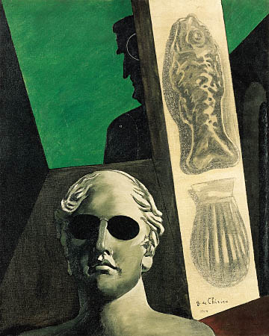
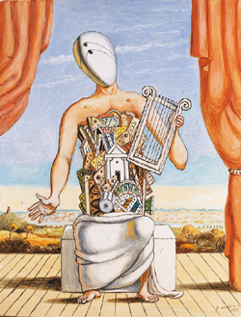
Giorgio de Chirico, Portrait prémonitoire de Guillaume Apollinaire
(Premonitory Portrait of Guillaume Apollinaire), 1914
Oil on canvas
Pompidou Center, Paris
http://www.centrepompidou.fr/education/ressources/ENS-surrealistart-EN/ENS-surrealistart-EN.htm#works
Giorgio de Chirico
Orfeo solitario
1973
81,3 x 62,2 cm
Museo Carlo Bilotti, Rome

Slide 22
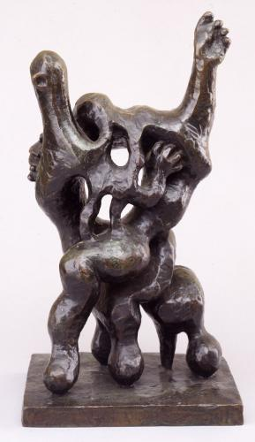
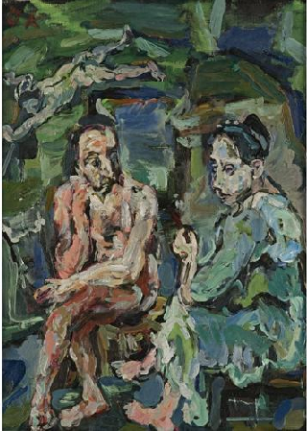
Oskar Kokoschka, Orpheus und Eurydike, 1917
“descending into the underworld to confront death and rebirth” (Bernstock)
The Joy of Orpheus I (1945)
Jacques Lipchitz
American, b. Lithuania, 1891-1973
Bronze
18 1/2 x 10 x 7 1/4 “

Slide 23
Oedipus
Solution of riddle of Sphinx
Murder of his father
Sophocles’ “Oedipus Trilogy”: Oedipus Rex, Oedipus at Colonus, Antigone
Freudian interpretations
(Oedipus complex, incest)

Slide 24
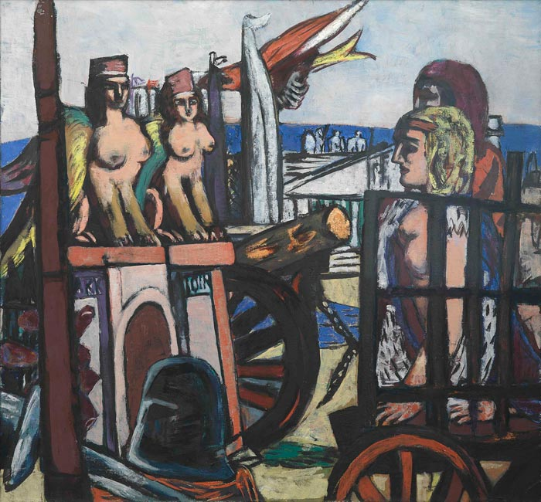
Max Beckmann
Removal of the Sphinxes, 1945
Kunsthalle, Hamburg
Explicit association of Sphinx with evil of modern society
Symbolizes liberation of Holland from Nazis

Slide 25
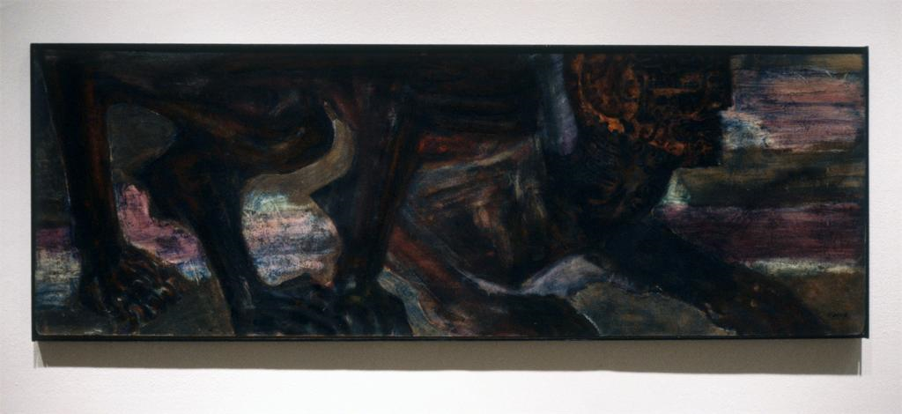
Leon Golub
The Prince Sphinx
Painting (lacquer and oil on masonite)
1955
Exhibited at Ronald Feldman Fine Arts, Spring 1996
25 x 72 inches
“The legacy of the Surrealist notion of Oedipus and the Sphinx as a composite creature may be found in Golub’s ferocious male sphinxes, which represent man’s self-division and his disintegrated self.” (Bernstock)

Slide 26
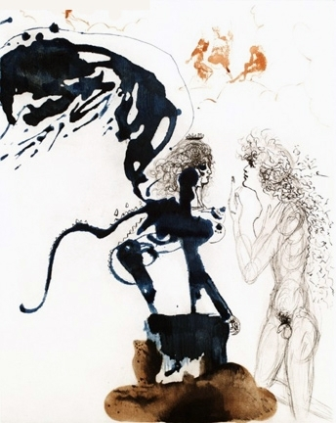
Oedipe et le Sphinx (Oedipus and the Sphinx)
Dali, Salvador
1960
Etching
76,2 x 57,1 cm
30.0 x 22.5 in
“the Surrealist interpretation of Oedipus’s conflict with the Sphinx as a sexual struggle between the male and the famale principles” (Bernstock)

Slide 27
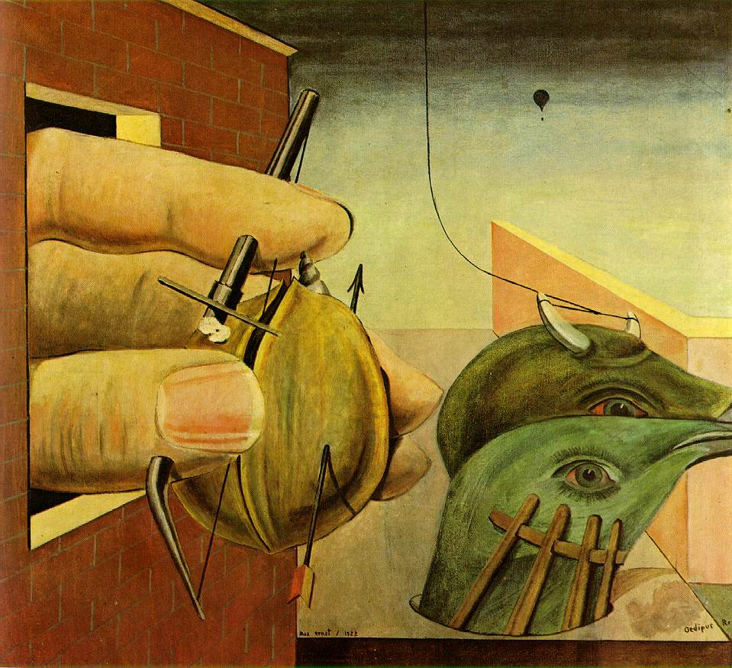
Ernst, Max
Oedipus Rex
1922
Oil on canvas
93 x 102 cm
Private collection, Paris
“Ernst’s image of castration in Oedipus Rex of 1922 reflects the artist’s Freudian interpretation of the myth and his own Oedipal pattern of behavior with his father” (Bernstock)
Freudian interpretations:
http://mama.indstate.edu/users/dada/Ernstmain.html
http://www.artnet.com/magazineus/features/kuspit/kuspit4-14-06.asp

Slide 28
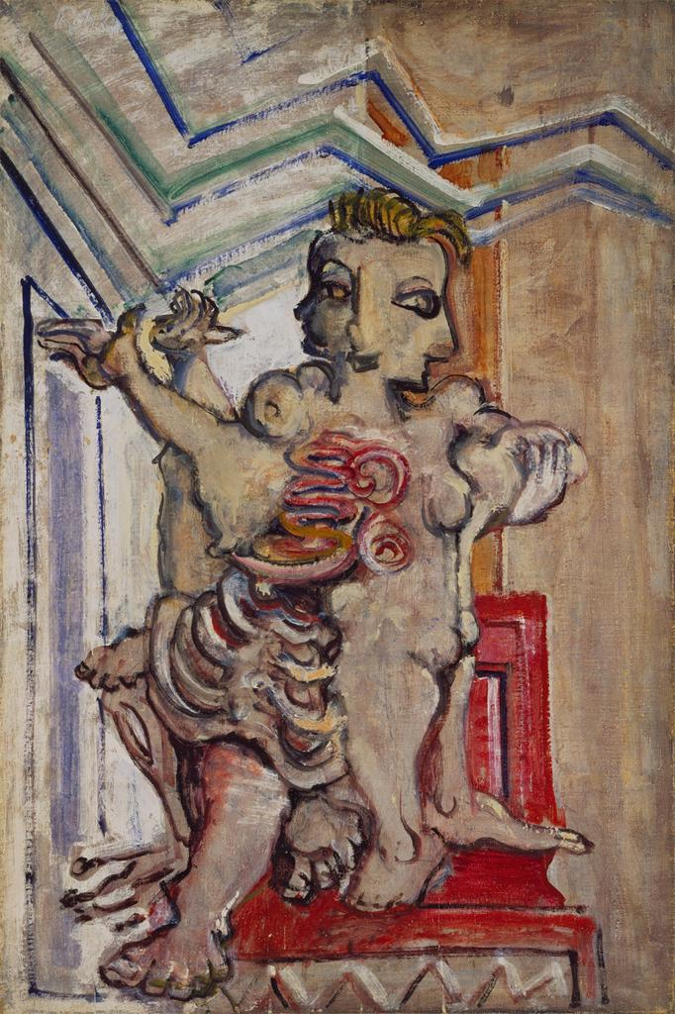
Mark Rothko, American, 1903-1970
Oedipus {Untitled} (1940)
oil on linen
36 x 24 in.
the three heads of Oedipus fused as one (for the three plays about Oedipus, Oedipus Rex, Oedipus at Colonnus and Antigone
also note the body fetish

Slide 29
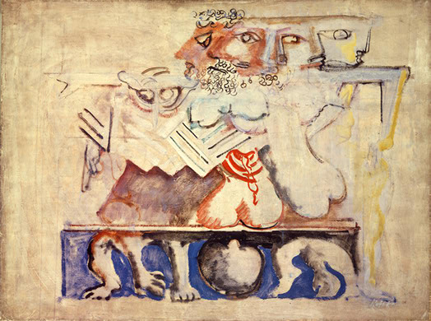
Mark Rothko, American, 1903-1970
Antigone (1939-1940)

Slide 30
Odysseus/Ulysses
“The humanistic appeal of Homer’s hero relates to his peregrinations, which constitute the mythological equivalent of the modern individual’s existential journey.”
(Bernstock)

Slide 31
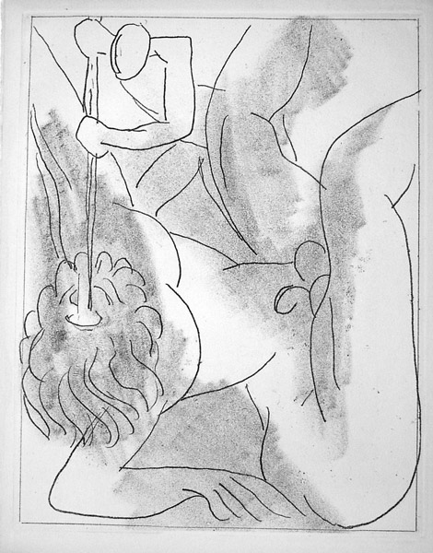
Henri Matisse. Odysseus blinding Polyphemus. (Freiburg 221). Original soft-ground etching, 1935. 1500 impressions the Limited Editions Book Club edition of James Joyce's Ulysses. Matisse did not read Joyce before executing the etchings, but instead reread Homer's Odyssey. The prints were very well printed and are frequently included in books on Matisse and exhibitions of Matisse's works (and, in fact, they were on display at the Musée Matisse during the summer of 1999). Illustrated in Matisse: L'Art du Livre (Nice: Musee Matisse, 1986), p. 33. Image size: 270x2134mm.
http://www.spaightwoodgalleries.com/Pages/Matisse2.html

Slide 32
“suggests Newman’s identification with the subject in his own long quest for personal and artistic identity. The ubiquitous deep blue in the painting is evocative of the sea on which Odysseus endlessly voyaged.” (Bernstock)
Barnett Newman
Ulysses 1952 Oil on canvas 132 1/2 x 50 1/8 inches (336.6 x 127.3 cm) Philadelphia Museum of Art The Menil Collection, Houston. Gift of Adelaide de Menil Carpenter and Dominque de Menil.

Slide 33
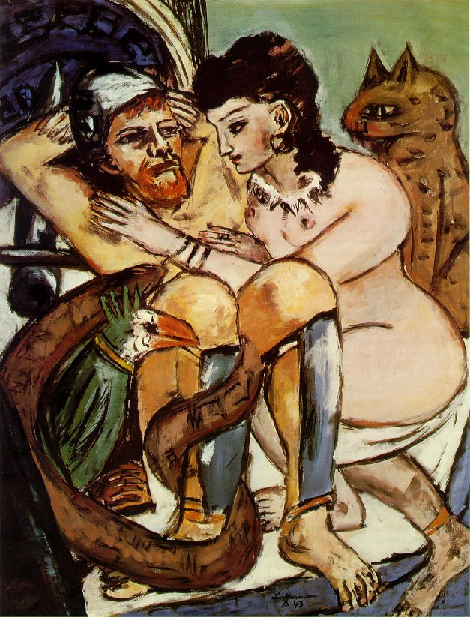
Beckmann, Max Odysseus and Calypso 1943 Oil on canvas 150 x 115.5 cm Göpel 646 Kunsthalle, Hamburg
“The humanistic meaning of the painting is clear in the veiled allusion to contemporary events: Beckmann portrays Odysseus and Calypso seeking refuge together from a martial environment.” (Bernstock)

Slide 34
The Cretan Saga and Surrealism
Theseus: man’s search for his own well-guarded center
Pasiphae and the Bull: destructive animal instincts
Minotaur: concept of metamorphosis
The Labyrinth: the passageway to the inner self, the individual’s search for awareness
Ariadne’s Thread: fabric of self-knowledge achieved by dram analysis
Sleeping Ariadne: destructive Eros

Slide 35
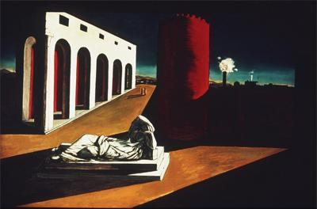
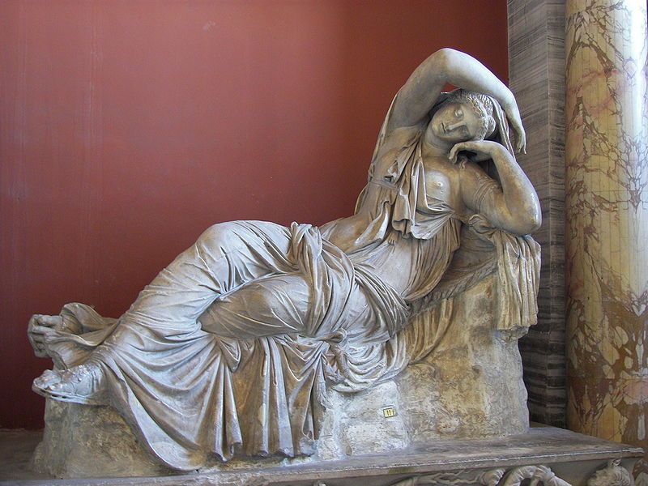
Sleeping Ariadne
Ancient Roman
Vatican Museums
De Chirico, Giorgio, 1888-
Joys and Enigmas of a Strange Hour
Date [n.d.]
Subject Arches
Italy--20th C. A.D
Surrealism

Slide 36
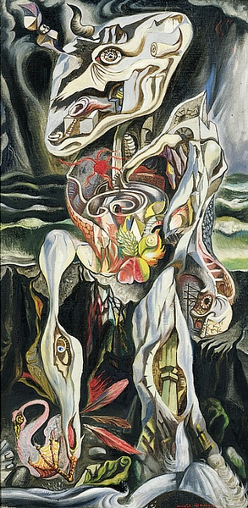
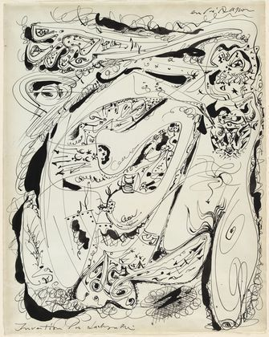
Theme of self-interrogation
Elemental forces of Eros and Thanatos: savage love and brutal death
Invention of the Labyrinth
André Masson (French, 1896-1987)
(1942). Ink on colored paper, 23 1/rk8 x 18 1/4" (58.7 x 46.4 cm). Gift of William S. Rubin. Metropolitan Museum of Art, New York
The Labyrinth
André Masson 1938

Slide 37
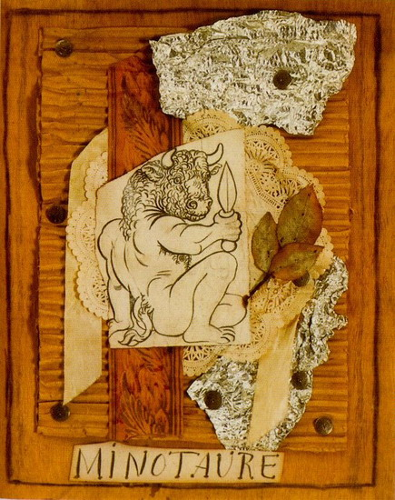
Pablo Picasso
Collage for cover of “Minotaure” (May 1933, Paris)
Museum of Modern Art, New York

Slide 38
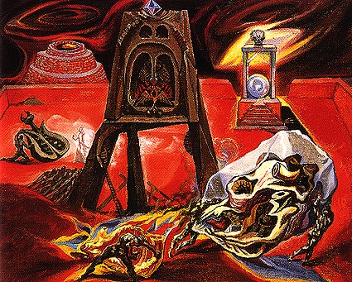
Le Chantier de Dédale (The Workshop of Dedalus) 1939
Andre Masson

Slide 39
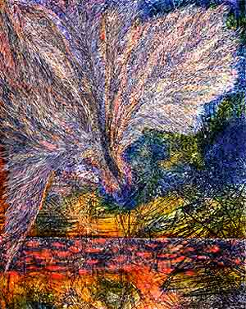
Icarus (1964) comments on a subject that Ernst visited numerous times: the Greek myth of Icarus and Daedalus. It was a theme dear to his heart--the unquestioning trust of a son for his father. The artist believed that the fall of Icarus was not about disobedience, but blind trust. One can understand, after witnessing the events of his youth, how trust might be in short supply. This work exemplifies Ernst’s artistic skills. The soft, feathered white strokes that fill the upper left hand region of the canvas give the impression of the falling wings of the mythological son as he plunges into the sea. The blue green background of the painting gives the feeling of the cold sea awaiting the falling flyer. The almost crystalline background of the imagery, created with a fine network of lines, recalls the scientific drawings of Leonardo. The whole is a complex vortex of color and line. http://www.artscenecal.com/ArticlesFile/Archive/Articles2004/Articles0104/JErnstA.html
Jimmy Ernst, "Icarus 64", 1964 Oil on canvas, 50" x 40"

