Slide 1
Apollo and Coronis

Slide 2
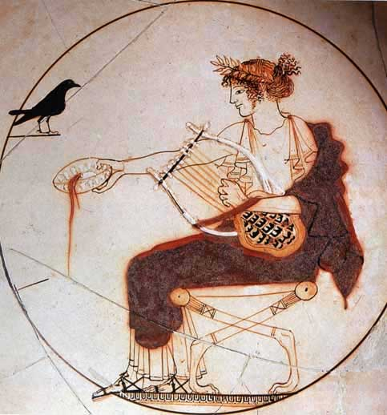
Seated Apollo pours the libation from a bowl, Left a raven , c. 480 BC., Delphi Museum 8140, Pistoxenos Painter?

Slide 3
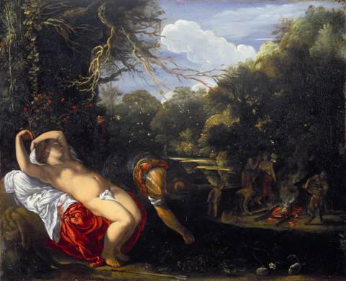
Author : ADAM ELSHEIMER
Date :1607-08
Technique :Oil on copper, 12,6 x 17,4 cm
Location :Walker Art Gallery, Liverpool

Slide 4
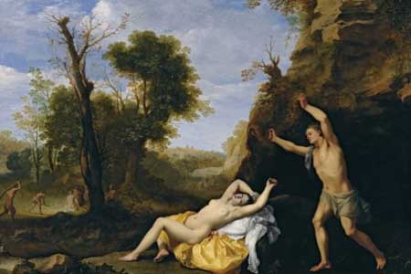
Cornelis van Poelenburch (1594/95-1667),
Apollo and Coronis

Slide 5
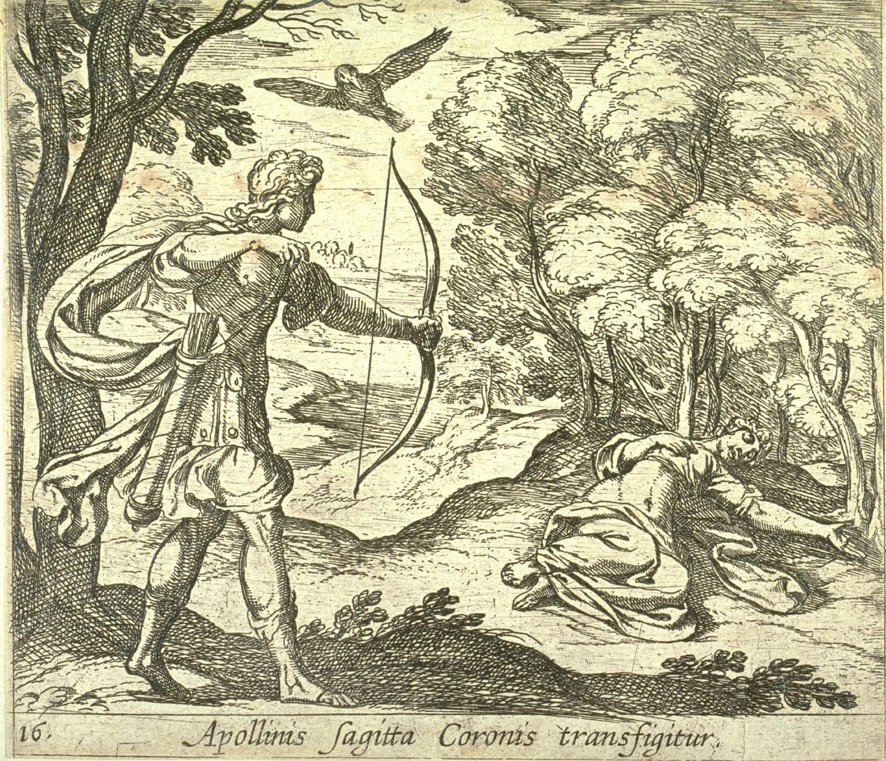
Tempesta, Antonio (Italian)
1555 – 1630
Fine Arts Museum of San Francisco

Slide 6
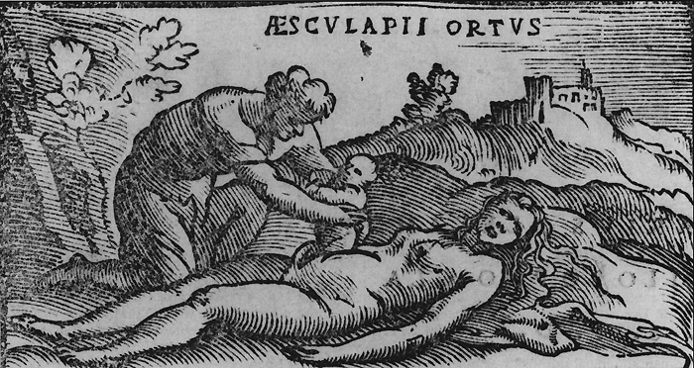
Woodcut from the 1549 edition of Alessandro Beneditti's De Re Medica.

Slide 7
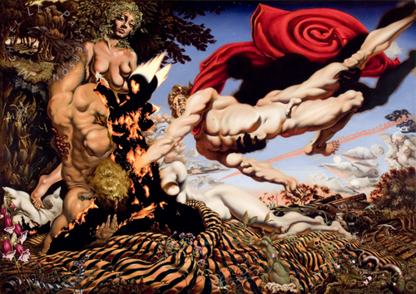
Michael Lee Patterson
Apollo Snatching the Unborn Asclepius from the Flaming Womb of Coronis
2003
oil painting on canvas
copyright 2005

