Slide 1
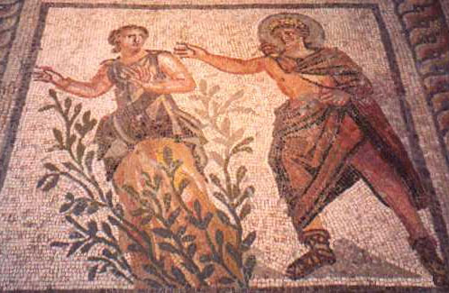
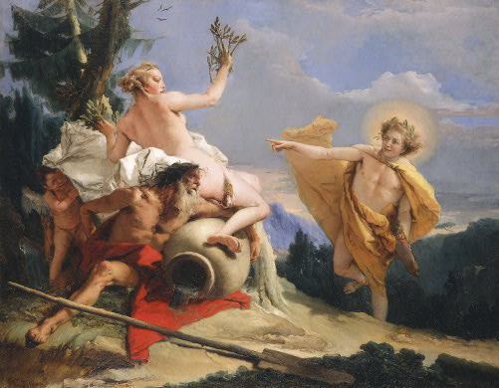
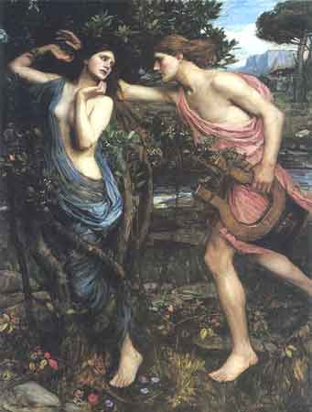
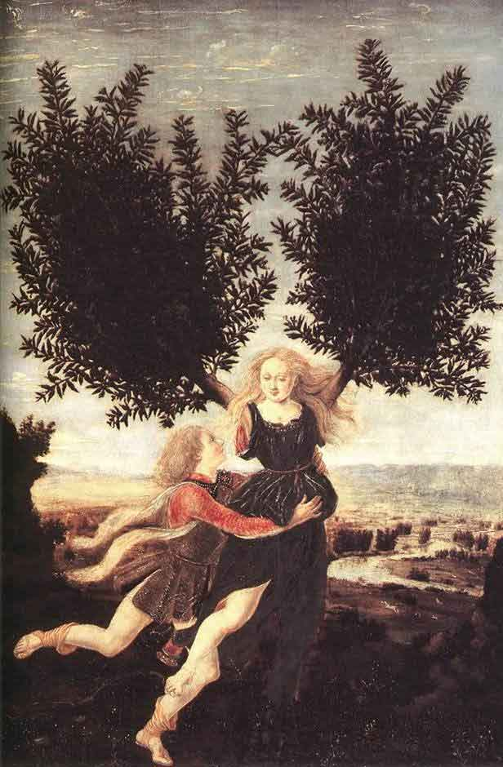
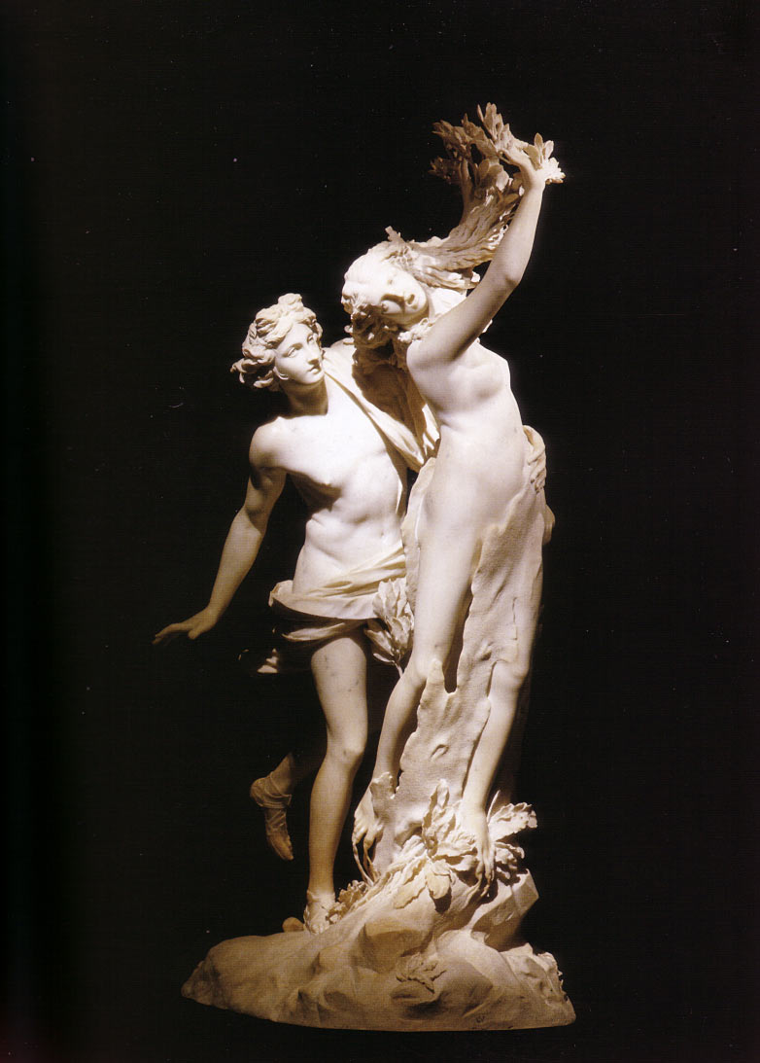
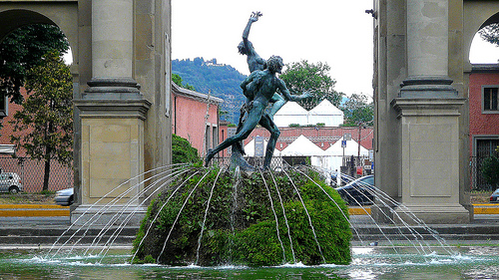
Ovid’s Metamorphoses
Apollo and Daphne

Slide 2
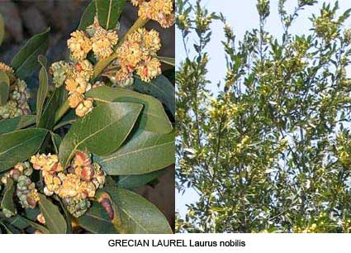

Slide 3
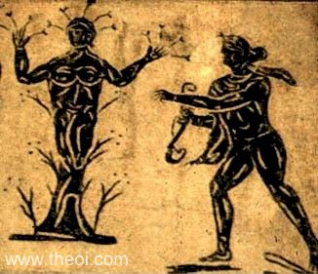
APOLLON & DAPHNE
Museum Collection: Ostia Antica, Rome, Italy Catalogue Number: TBA Type: Floor Mosaic Context: Ostia Date: -- Period: Imperial Roman

Slide 4
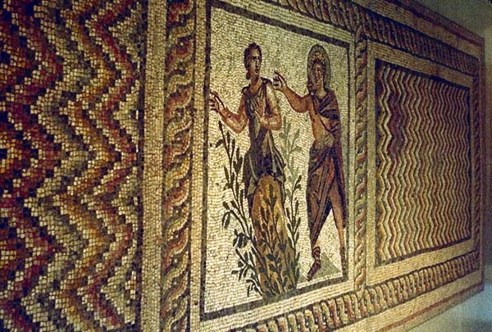
Apollo & Daphne, Greco-Roman mosaic from Antioch C2nd-3rd A.D., Antakya Museum, Turkey

Slide 5
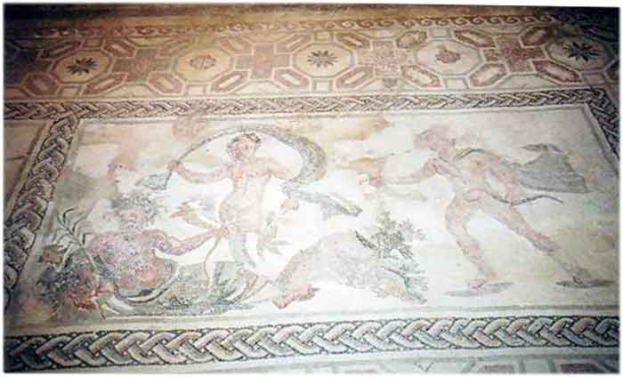
The River god Peneus, Daphne and Apollo
House of Dionysus,
Paphos., Cyprus
3rd c. AD

Slide 6
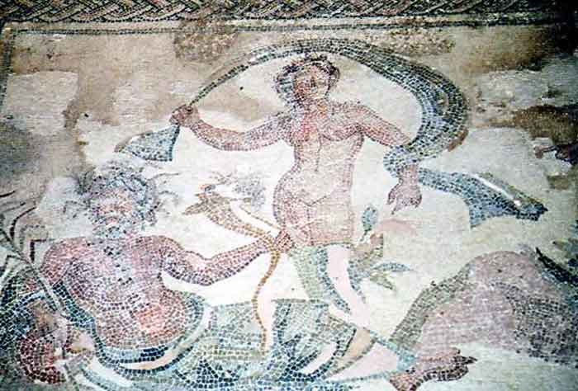

Slide 7
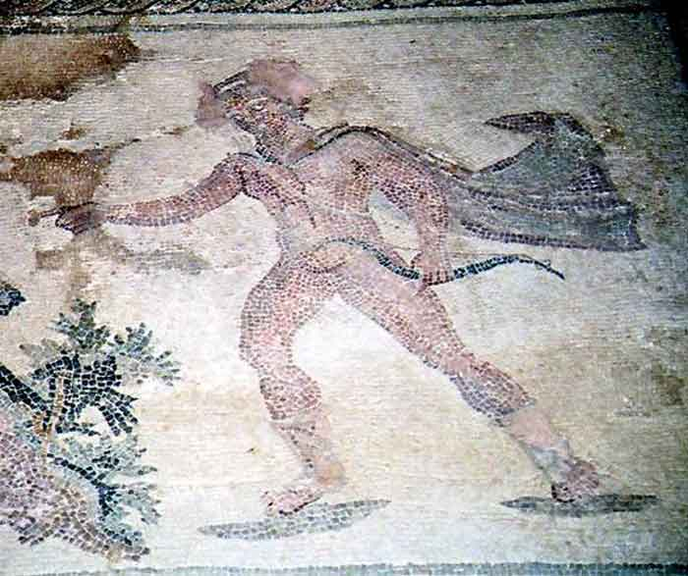

Slide 8
Apollo and Daphne
probably 1470-80, Antonio del Pollaiuolo
National Gallery, London

Slide 9
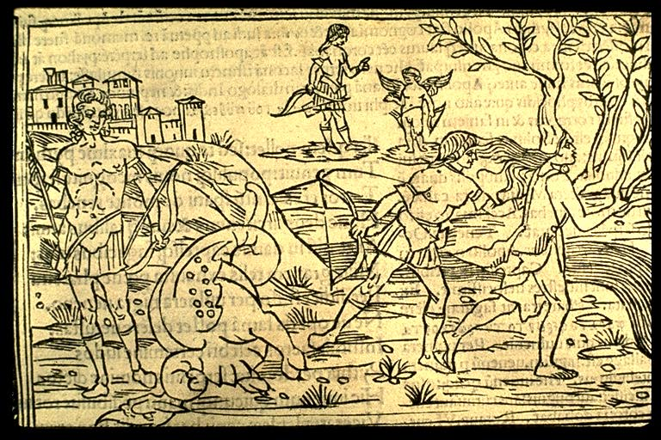
Anonymous: Raphael Regius (died 1520), Venice ca. 1513

Slide 10
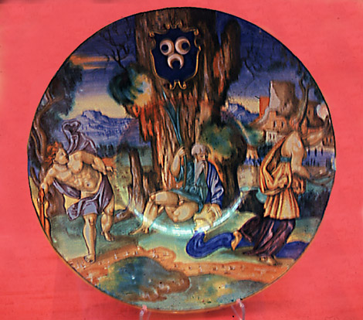
Daphne & Apollo Venetian Plate (16th century), Glasgow, Kelvingrove Museum.

Slide 11
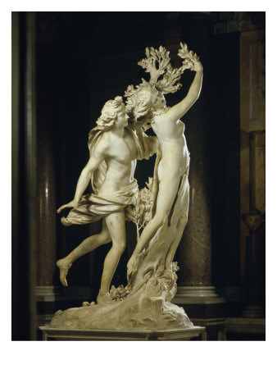
Apollo and Daphne
Gian Lorenzo Bernini, 1622-1625
Marble, height 243 cm
Rome, Galleria Borghese

Slide 12
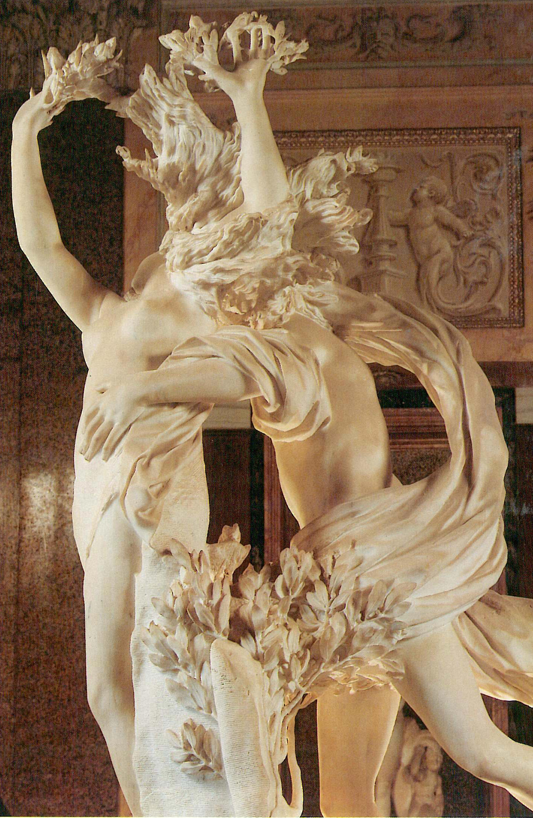
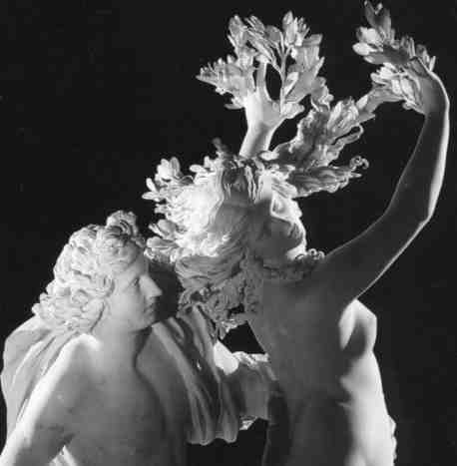
http://www.students.sbc.edu/vermilya08/Bernini/Apollo%20and%20Daphne.htm
http://www.mcah.columbia.edu/arthum2/publicportfolio.cgi?view=2801&columns=2

Slide 13
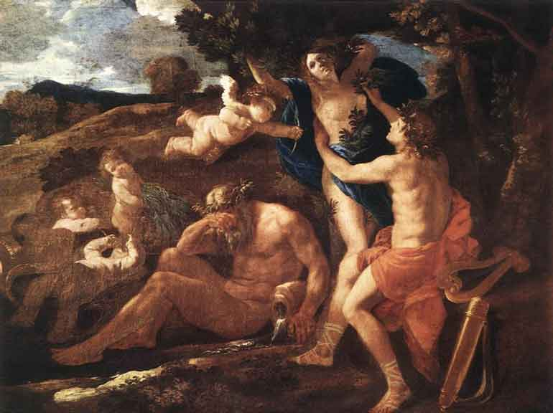
Title: Apollo and Daphne 1625
Painted by: Nicolas Poussin
Location: Alte Pinakothek, Munich, Bavaria, Germany
Year: 1625
Dimensions: 51.58 inch wide x 38.19 inch high
Orientation: Landscape

Slide 14
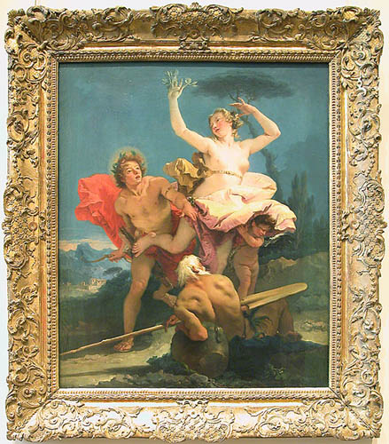
Giovanni Battista TIEPOLO (Venice, 1696 - Madrid, 1770) Apollo and Daphne c. 1743-44 © Musée du Louvre/A. Dequier - M. Bard

Slide 15
Giovanni Battista Tiepolo Apollo Pursuing Daphne, c. 1755/1760 Samuel H. Kress Collection 1952.5.78, National Gallery of Art, Washington, D.C.

Slide 16
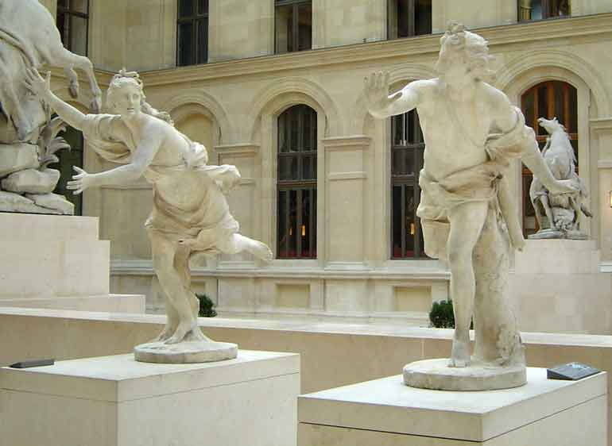
Daphne chased by Apollo, (1677-1746), marble, Louvre, Paris,
Guillaume Coustou the elder
1714
Accession number M.R. 1807 ; M.R. 1805 Location Richelieu

Slide 17
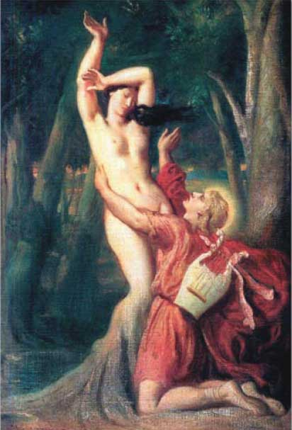
Apollo and Daphne (Apollon et Daphne)
Theodore Chasseriau (1819-1856)
(1846) Louvre, Paris

Slide 18
Apollo and Daphne, 1908
John William Waterhouse
Oil on canvas
Private collection

Slide 19
Tomasso Tomassi
Florence

Slide 20
