Slide 1
Europa

Slide 2
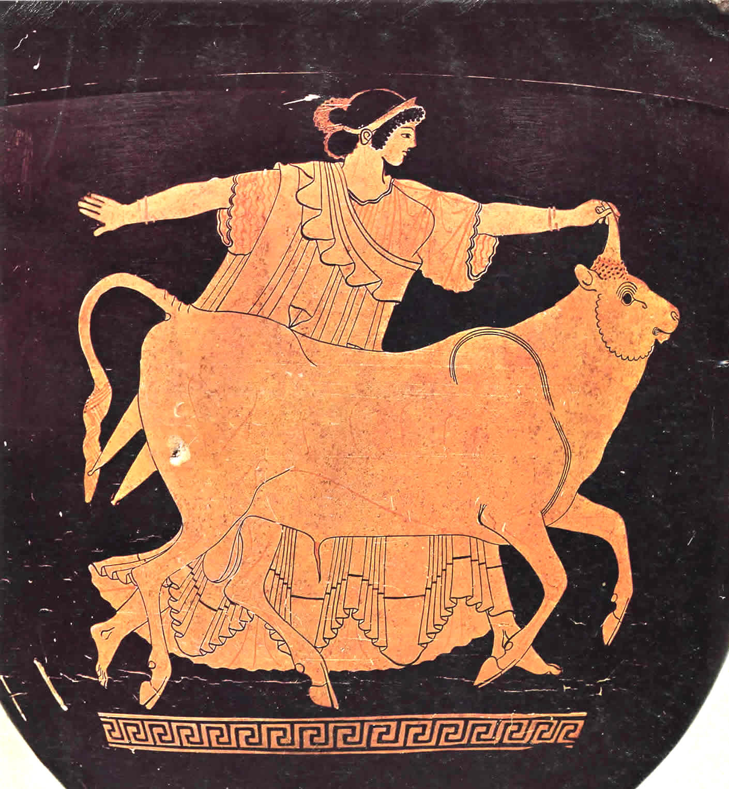
Europa and the Bull - Red-Figure Stamnos, Tarquinia Museum, circa 480 BCE

Slide 3
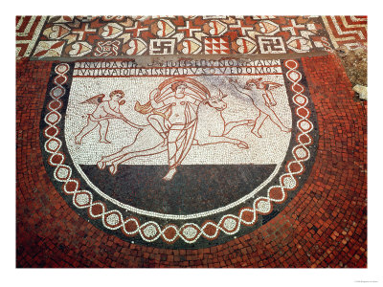

Slide 4
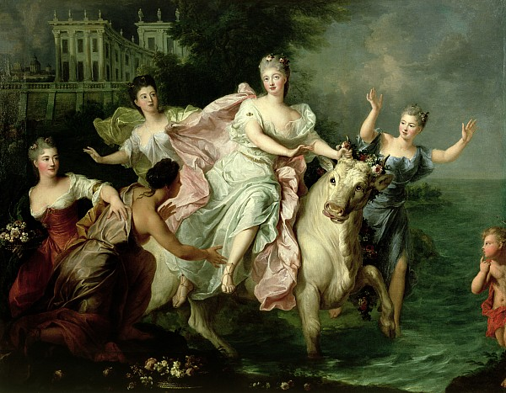

Slide 5
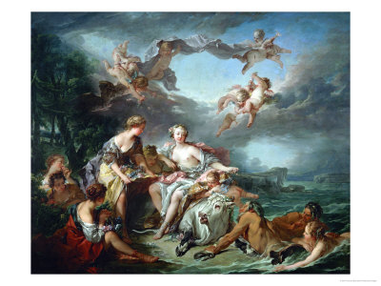

Slide 6
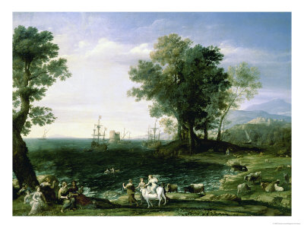

Slide 7
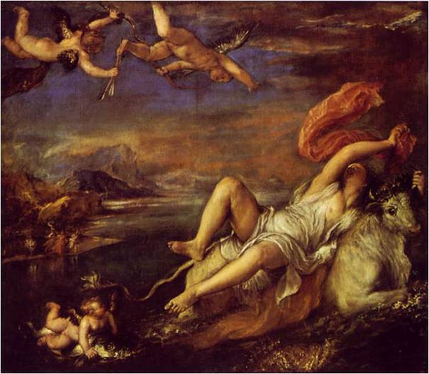

Slide 8
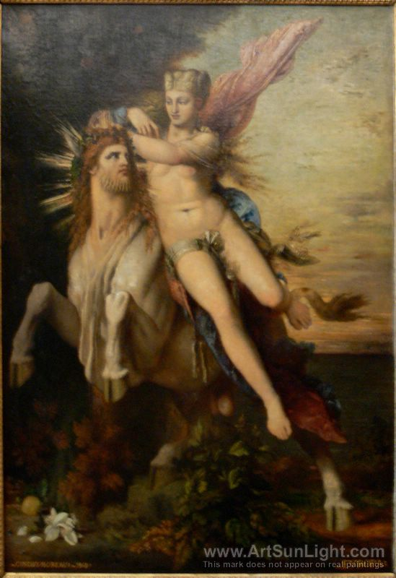

Slide 9
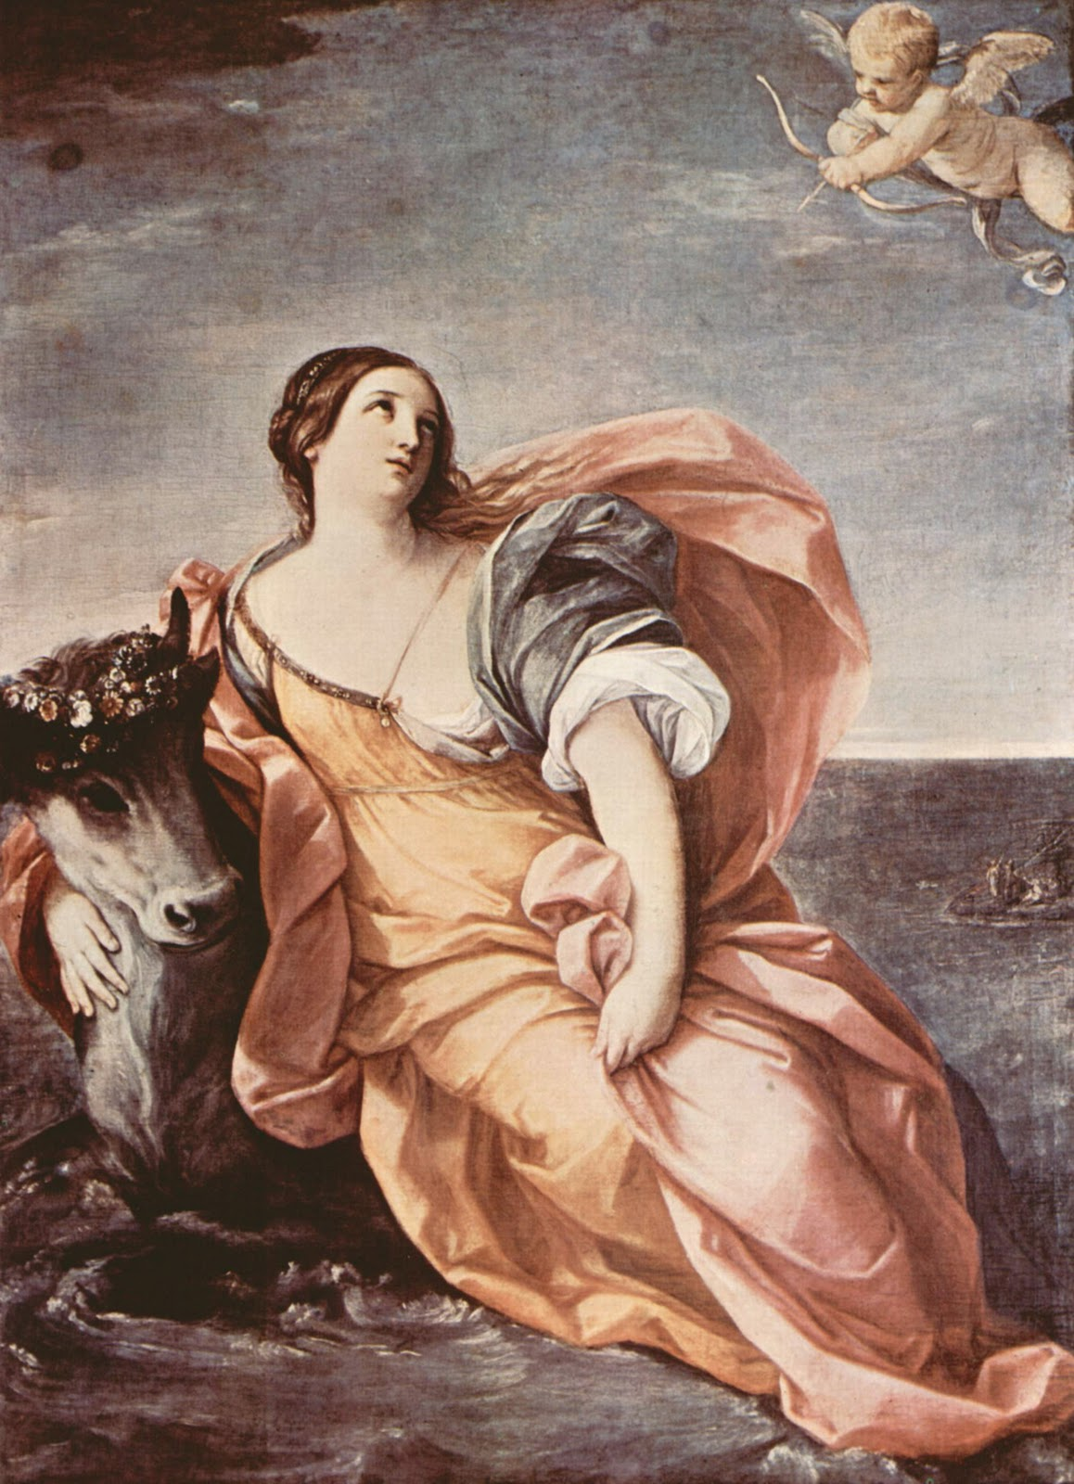

Slide 10
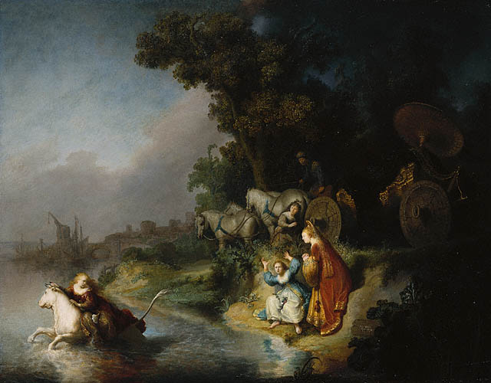
Rembrandt: THE ABDUCTION OF EUROPA (1632, Getty Museum, 61 x 78 cm)
http://traumwerk.stanford.edu/philolog/2005/12/rembrandt_and_ovid_the_abducti.html

Slide 11
http://www.fjkluth.com/grepar13.html
Moreau
Titian
Reni
Rembrandt
http://traumwerk.stanford.edu/philolog/2005/12/rembrandt_and_ovid_the_abducti.html

