Slide 1
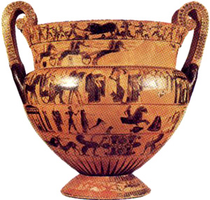
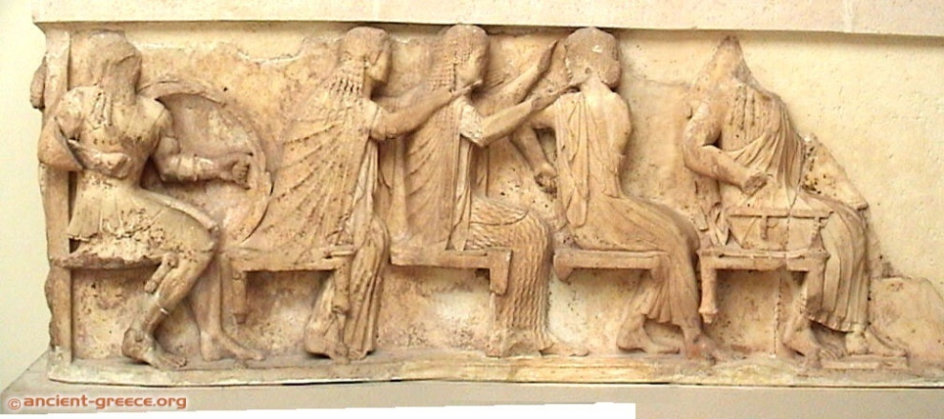
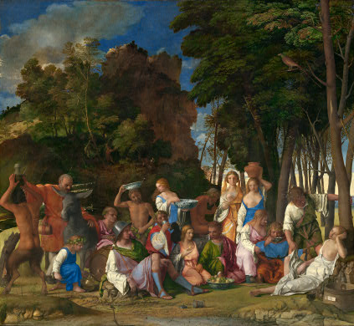
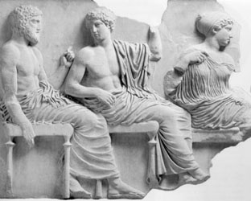
Pantheons and Assemblies of the Gods

Slide 2
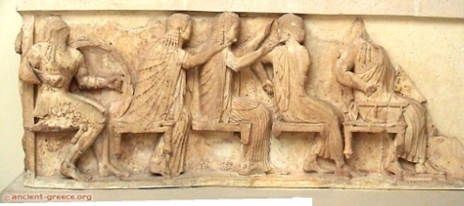
Timelines
François Vase
Athens
c.550 B.C.
Siphnian Treasury Frieze
Delphi
530-25 BC
Bellini
“Feast of the Gods”
1514
Parthenon Frieze
Athens
443-438 B.C.
http://department.monm.edu/classics/Courses/Chronology.htm
http://chaos1.hypermart.net/fullsize/artancfs.gif
http://chaos1.hypermart.net/fullsize/artrenfs.gif
http://www.metmuseum.org/toah/intro/atr/04sm.htm

Slide 3
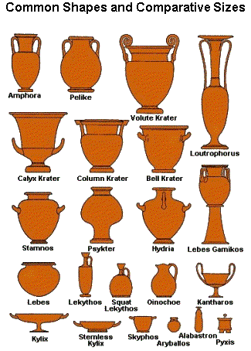
On Greek Pottery
François Vase
Athens
c.550 B.C.
http://www.alamo.edu/sac/vat/arthistory/arts1303/greek2.htm
http://www.ancientgreece.co.uk/dailylife/explore/pot_shapes.html
http://www.beazley.ox.ac.uk/pottery/default.htm
http://www.metmuseum.org/toah/hd/vase/hd_vase.htm

Slide 4
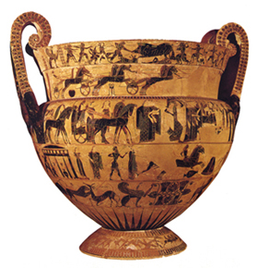
Myths on the François Vase: Side A
Kalydonian Boar Hunt
Patroklos’ Funeral Games
Wedding Procession of Pelias and Thetis: Read Apollodorus
Achilles chases Trojan Prince Troilos
Animal frieze.
Pygmies fight cranes (foot).

Slide 5
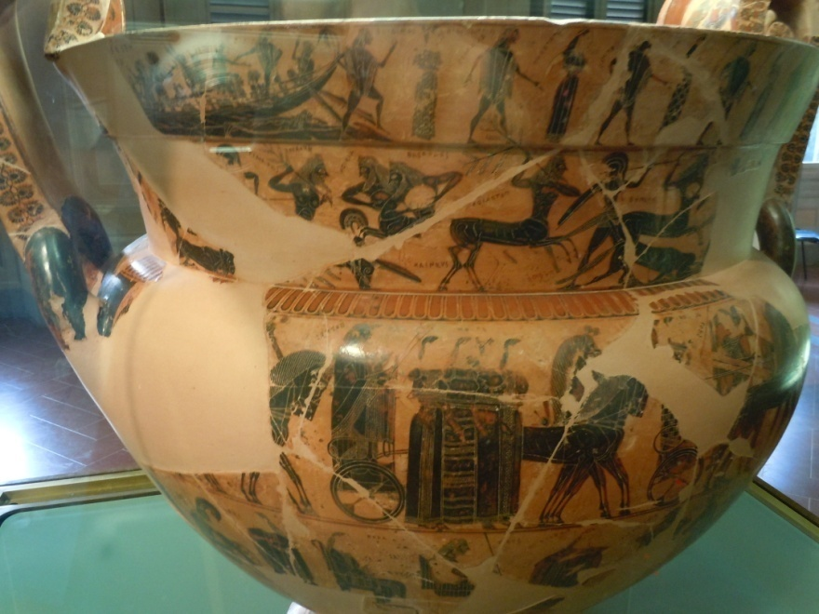
Myths on the François Vase: Side B
Theseus and Athenian Youths doing crane dance at Crete
Lapiths and Centaurs
Wedding Procession of Peleus and Thetis
Return of Hephaistos to Olympus . Read this myth here.
Animal frieze
Pygmies fight cranes (foot)

Slide 6
François Vase
François Vase
Athens
c.550 B.C.
http://www.mlahanas.de/Greeks/Arts/Francois.htm
http://www.beazley.ox.ac.uk/pottery/painters/keypieces/blackfigure/francois.htm
http://greekhistory.gr.funpic.de/pages/francois.htm
http://www.perseus.tufts.edu/hopper/artifact?name=Florence+4209&object=Vase&redirect=true
http://www.kapiticollege.school.nz/ClassWebs/ClassicsWeb/Classics301/Greek%20Vase%20Painting/BlackFigure/FrancoisVase.pdf

Slide 7
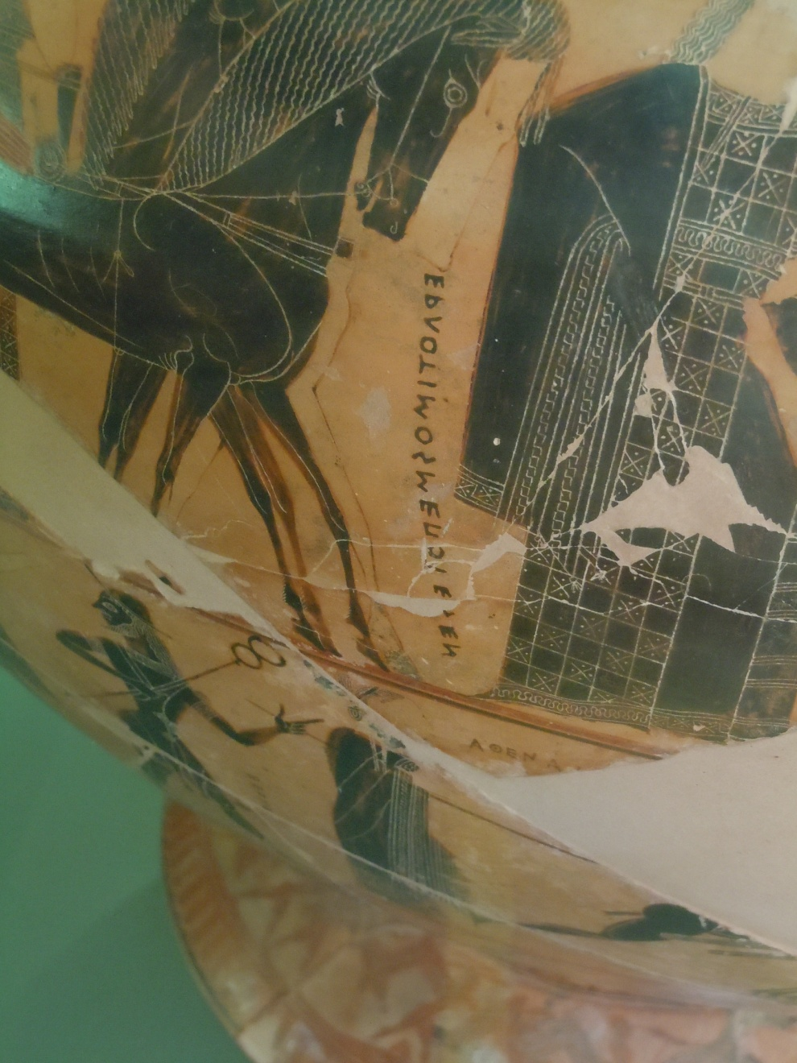
Ergotimos made me

Slide 8
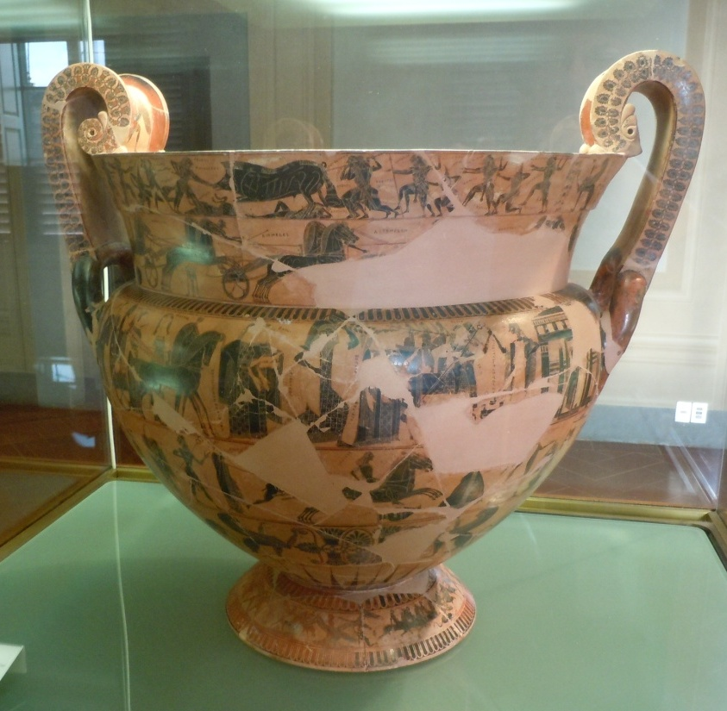

Slide 10
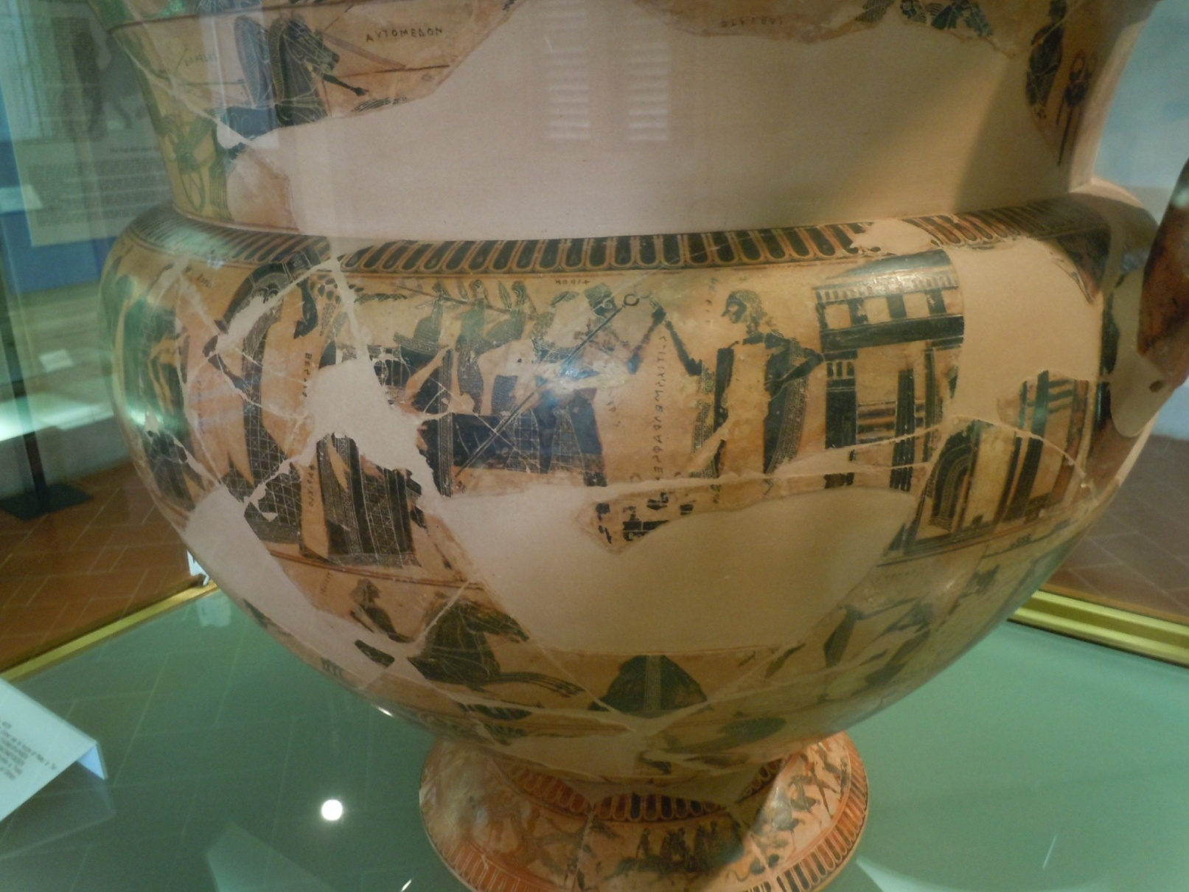
Peleus and Thetis

Slide 11
Moirai (Fates)

Slide 12
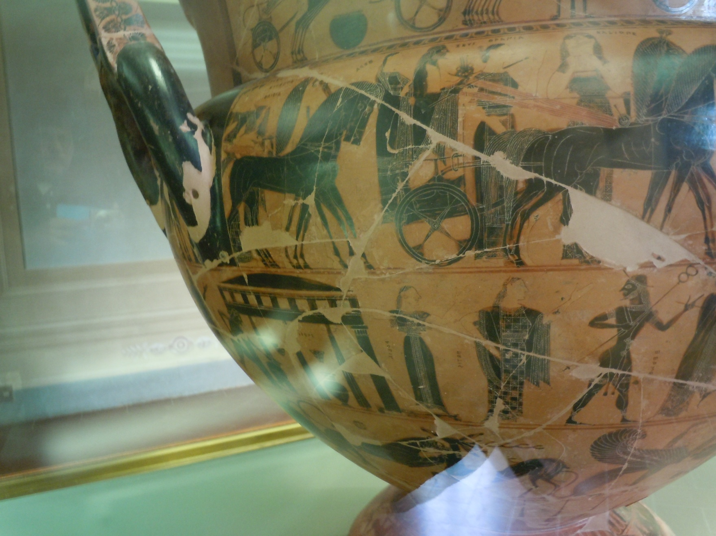
Zeus and Hera

Slide 13
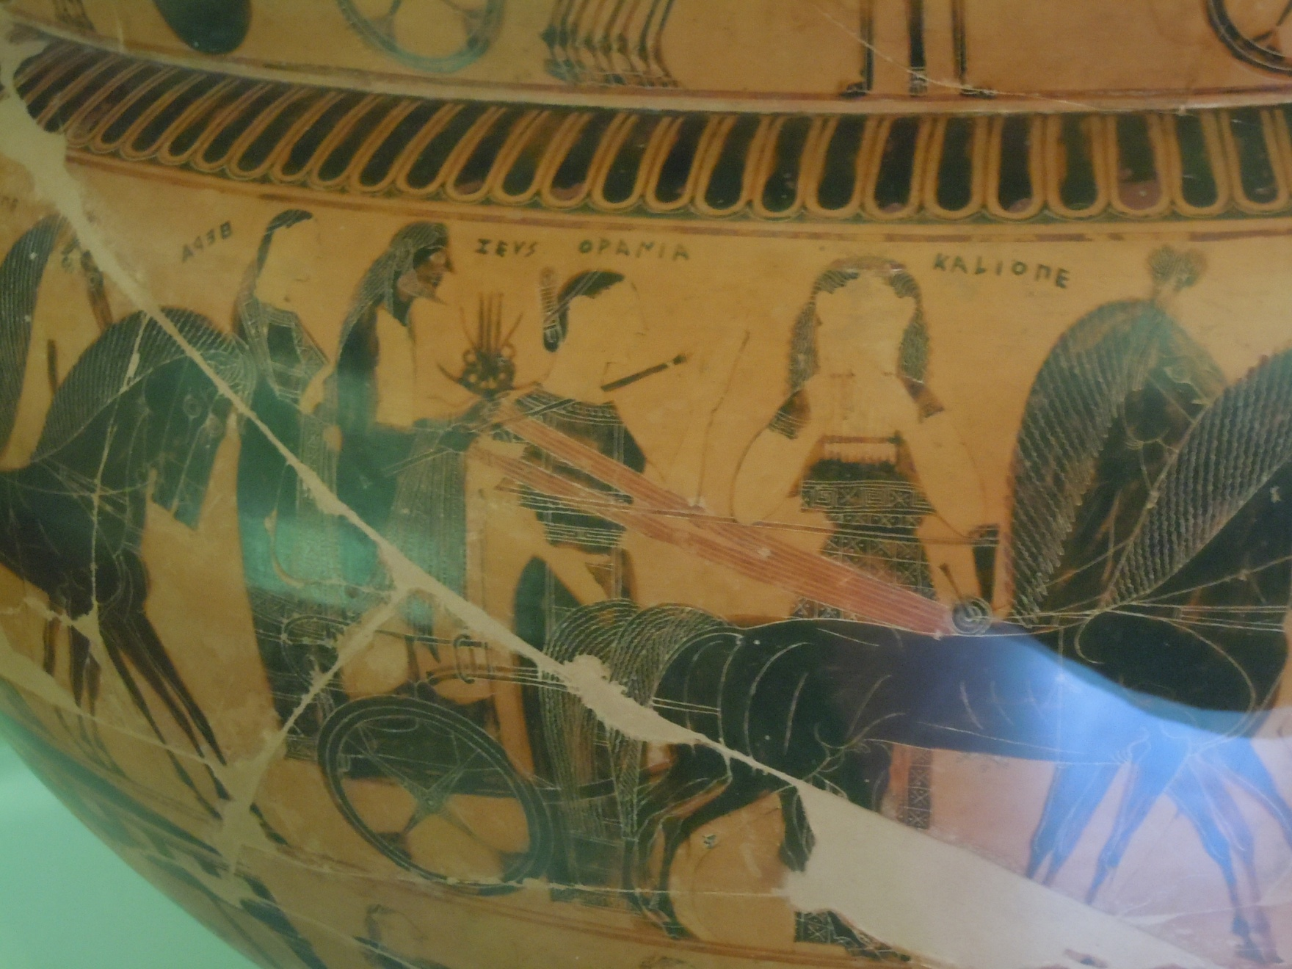
Ourania and Kalliope

Slide 14
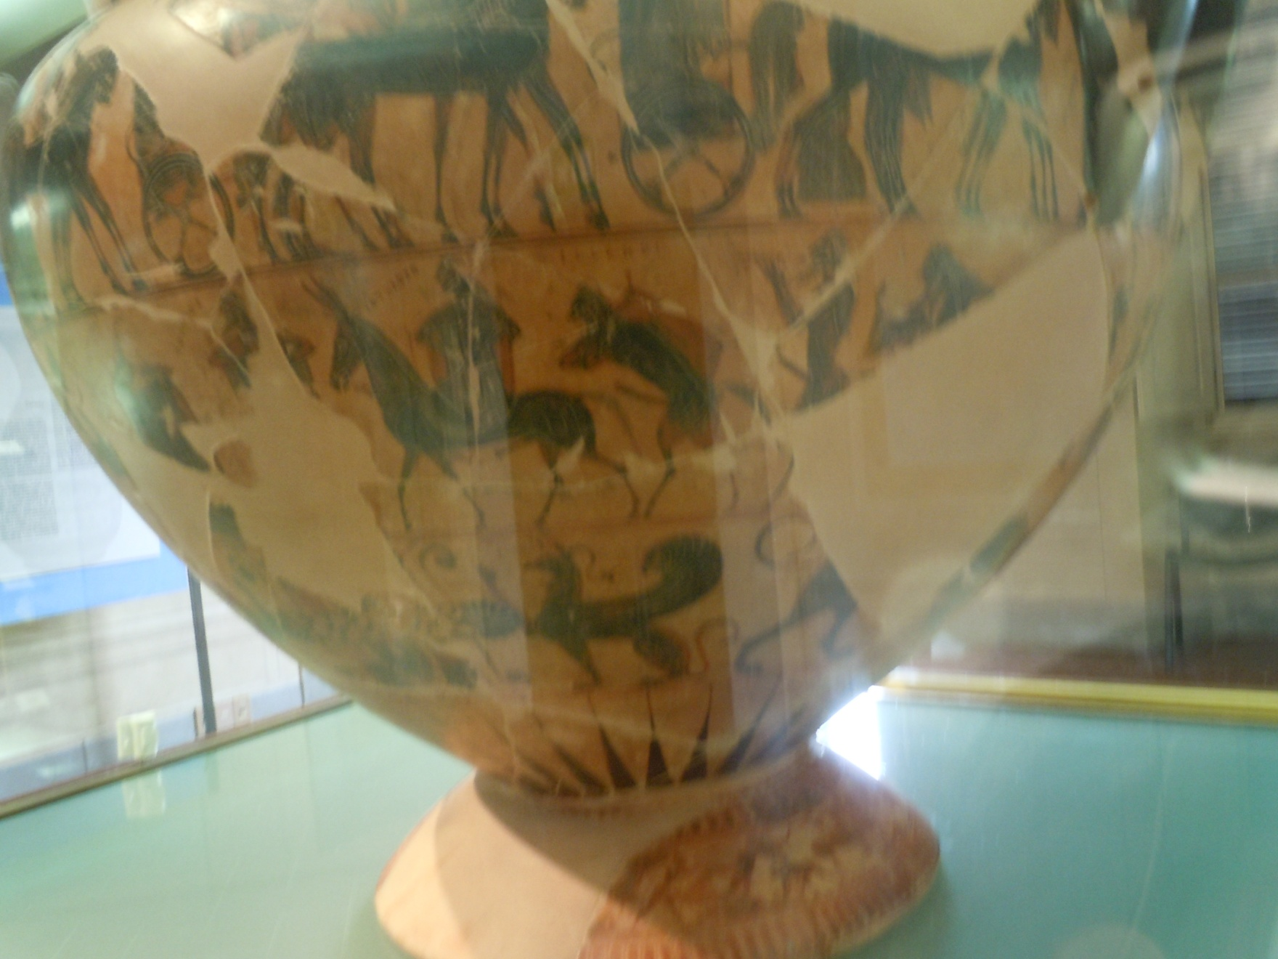
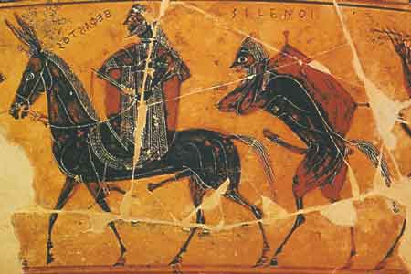
Return of Hephaistos

Slide 15
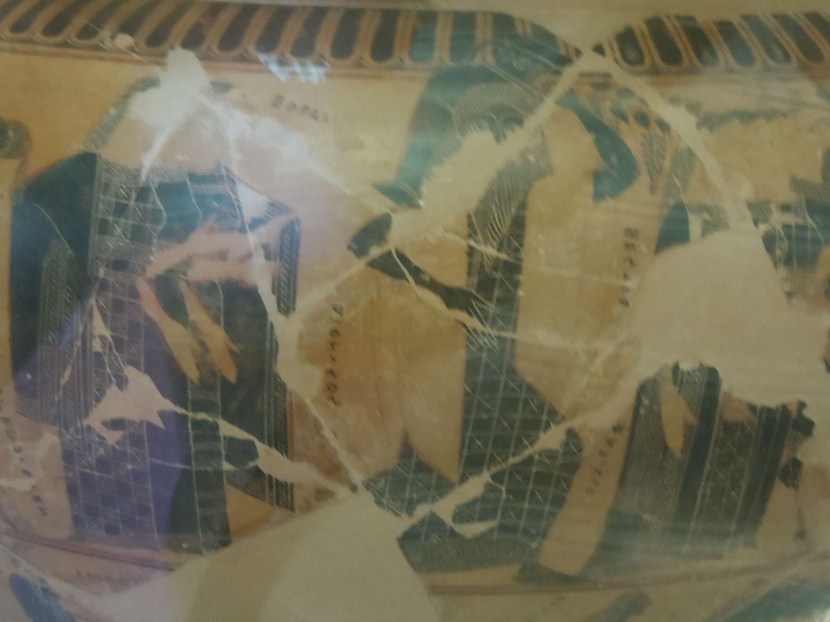
Dionysus

Slide 16
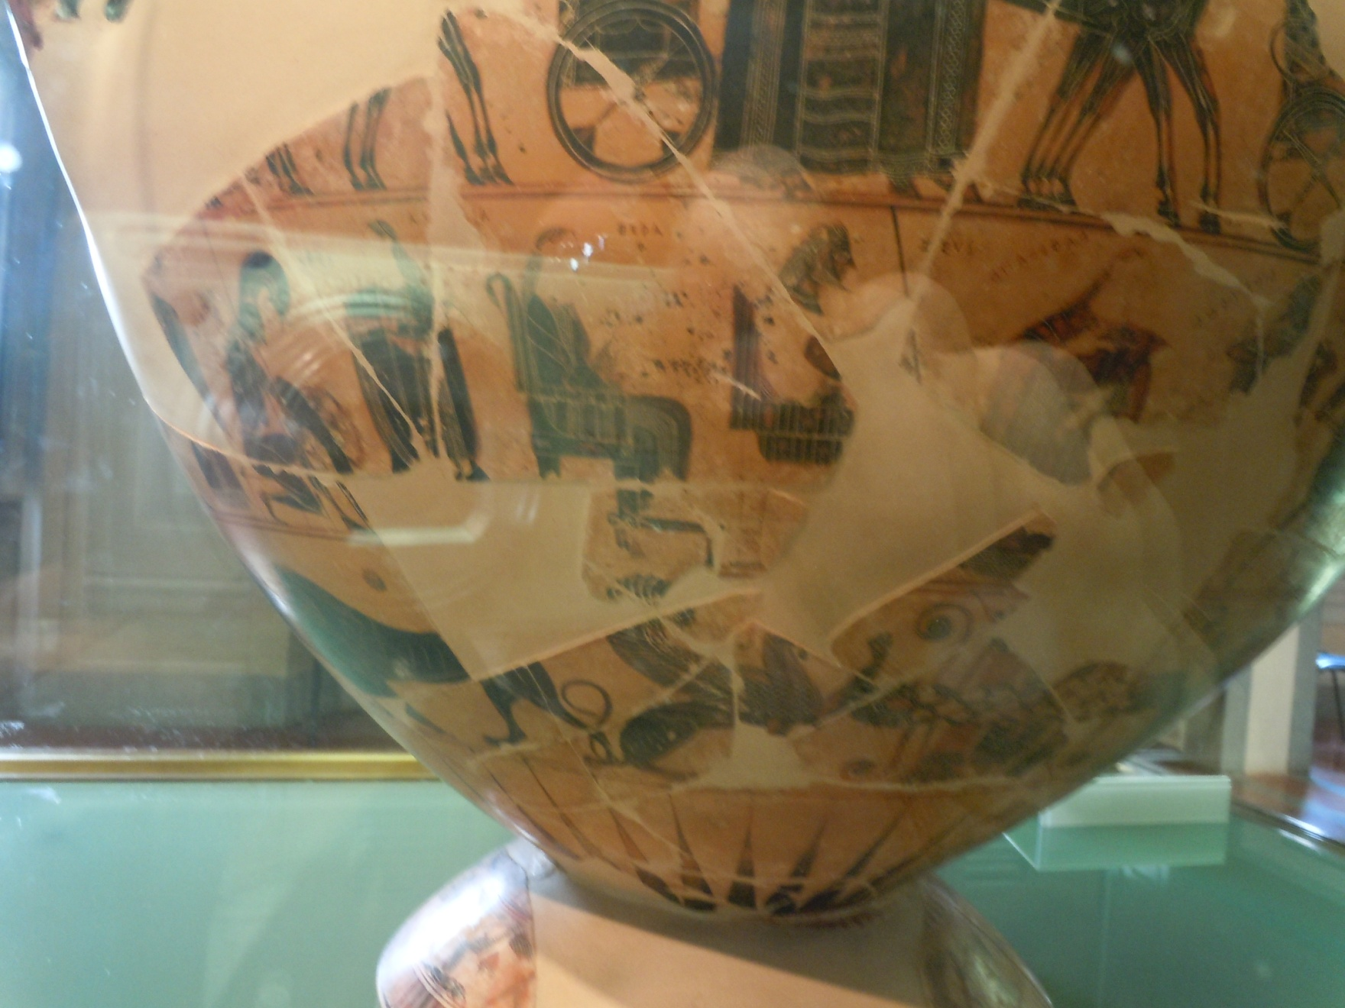
Zeus and Hera Enthroned

Slide 17
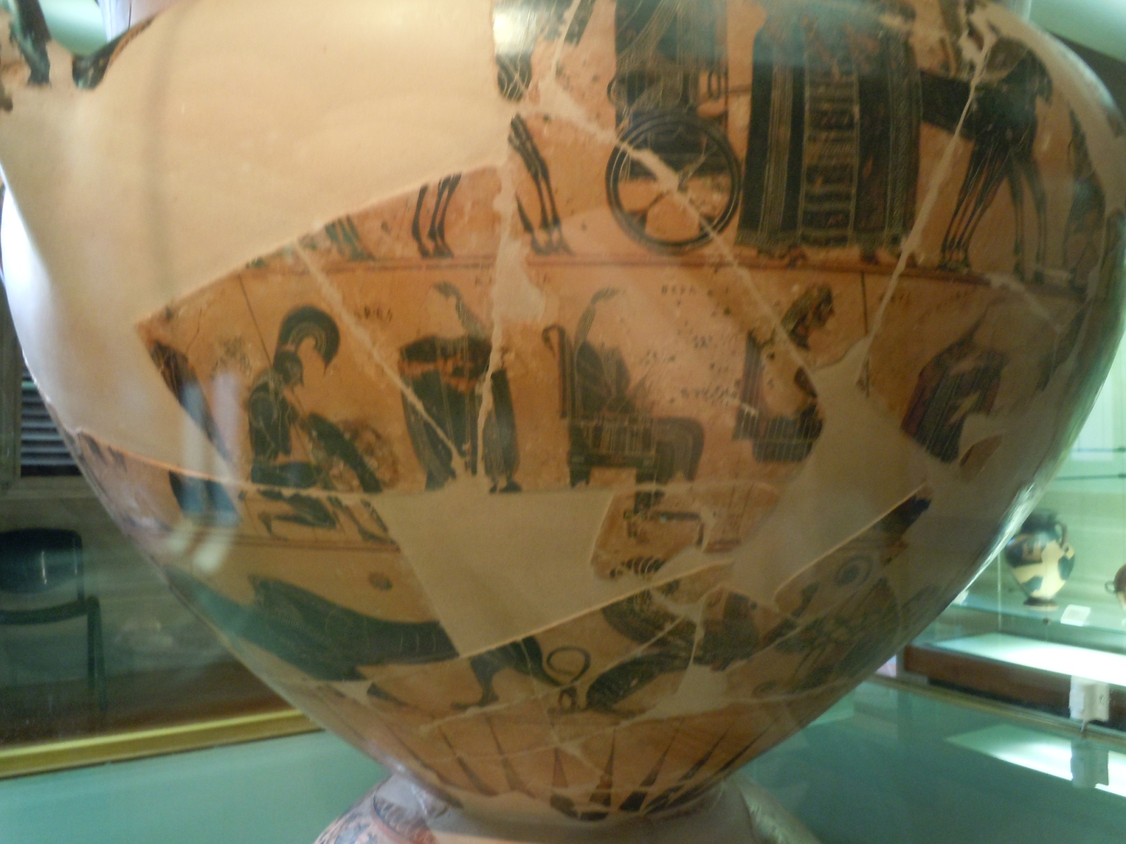
Ares

Slide 18
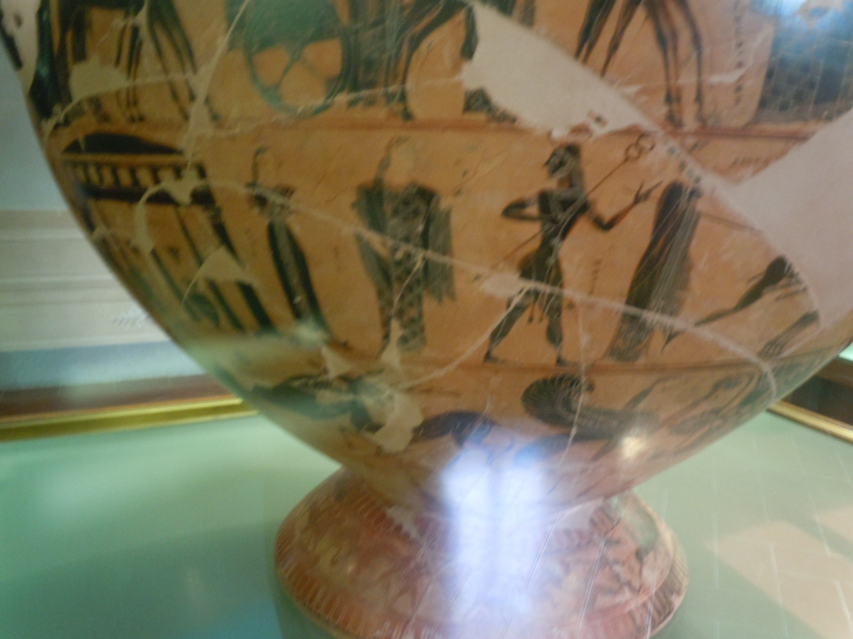
Hermes

Slide 19
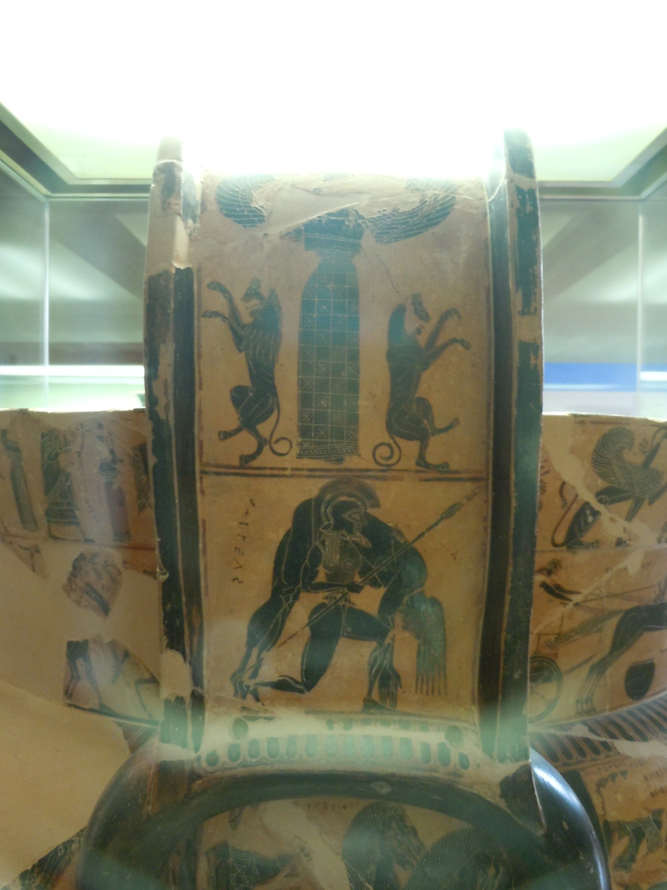
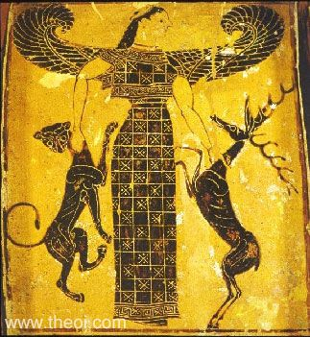
Artemis

