Slide 1
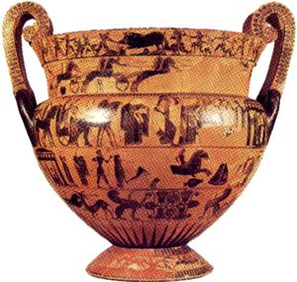
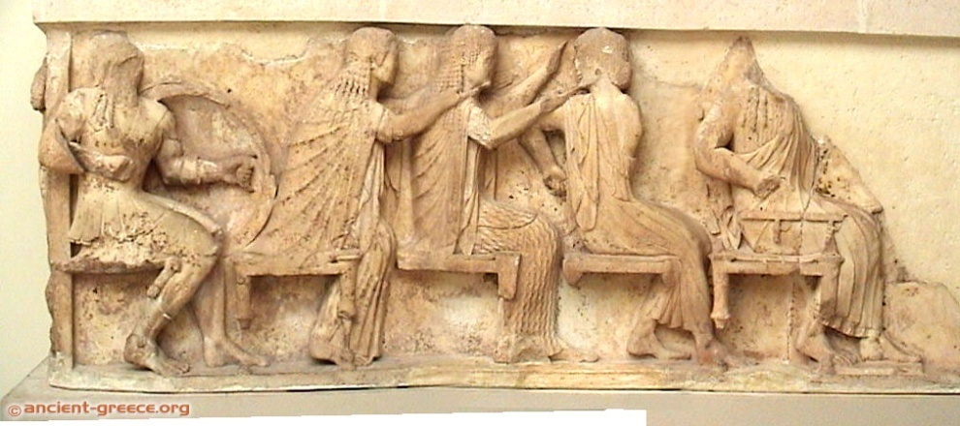
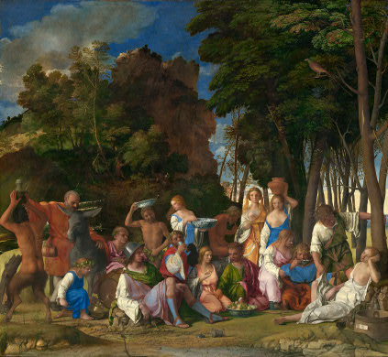
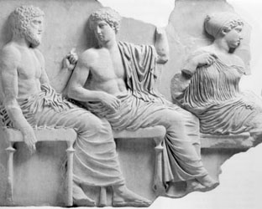
Pantheons and Assemblies of the Gods

Slide 2
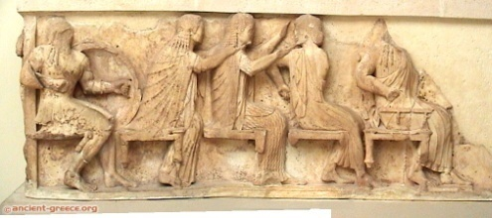
Timelines
François Vase
Athens
c.550 B.C.
Siphnian Treasury Frieze
Delphi
530-25 BC
Bellini
“Feast of the Gods”
1514
Parthenon Frieze
Athens
443-438 B.C.
http://department.monm.edu/classics/Courses/Chronology.htm
http://chaos1.hypermart.net/fullsize/artancfs.gif
http://chaos1.hypermart.net/fullsize/artrenfs.gif
http://www.metmuseum.org/toah/intro/atr/04sm.htm

Slide 3
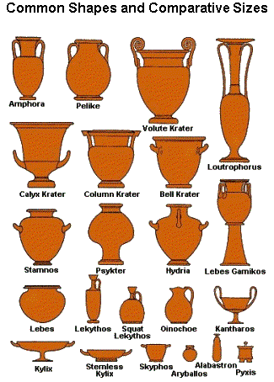
On Greek Pottery
François Vase
Athens
c.550 B.C.
http://www.alamo.edu/sac/vat/arthistory/arts1303/greek2.htm
http://www.ancientgreece.co.uk/dailylife/explore/pot_shapes.html
http://www.beazley.ox.ac.uk/pottery/default.htm
http://www.metmuseum.org/toah/hd/vase/hd_vase.htm

Slide 4
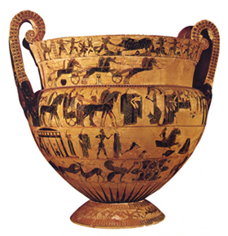
Myths on the François Vase: Side A
Kalydonian Boar Hunt
Patroklos’ Funeral Games
Wedding Procession of Pelias and Thetis: Read Apollodorus
Achilles chases Trojan Prince Troilos
Animal frieze.
Pygmies fight cranes (foot).

Slide 5
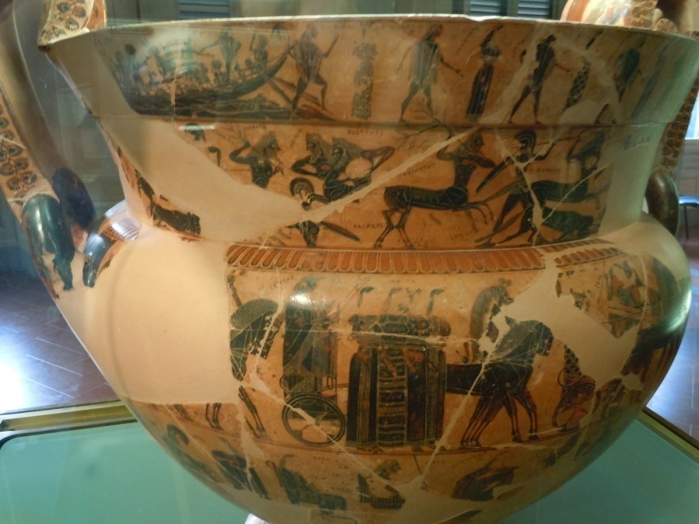
Myths on the François Vase: Side B
Theseus and Athenian Youths doing crane dance at Crete
Lapiths and Centaurs
Wedding Procession of Peleus and Thetis
Return of Hephaistos to Olympus . Read this myth here.
Animal frieze
Pygmies fight cranes (foot)

Slide 6
François Vase
François Vase
Athens
c.550 B.C.
http://www.mlahanas.de/Greeks/Arts/Francois.htm
http://www.beazley.ox.ac.uk/pottery/painters/keypieces/blackfigure/francois.htm
http://greekhistory.gr.funpic.de/pages/francois.htm
http://www.perseus.tufts.edu/hopper/artifact?name=Florence+4209&object=Vase&redirect=true
http://www.kapiticollege.school.nz/ClassWebs/ClassicsWeb/Classics301/Greek%20Vase%20Painting/BlackFigure/FrancoisVase.pdf

Slide 7
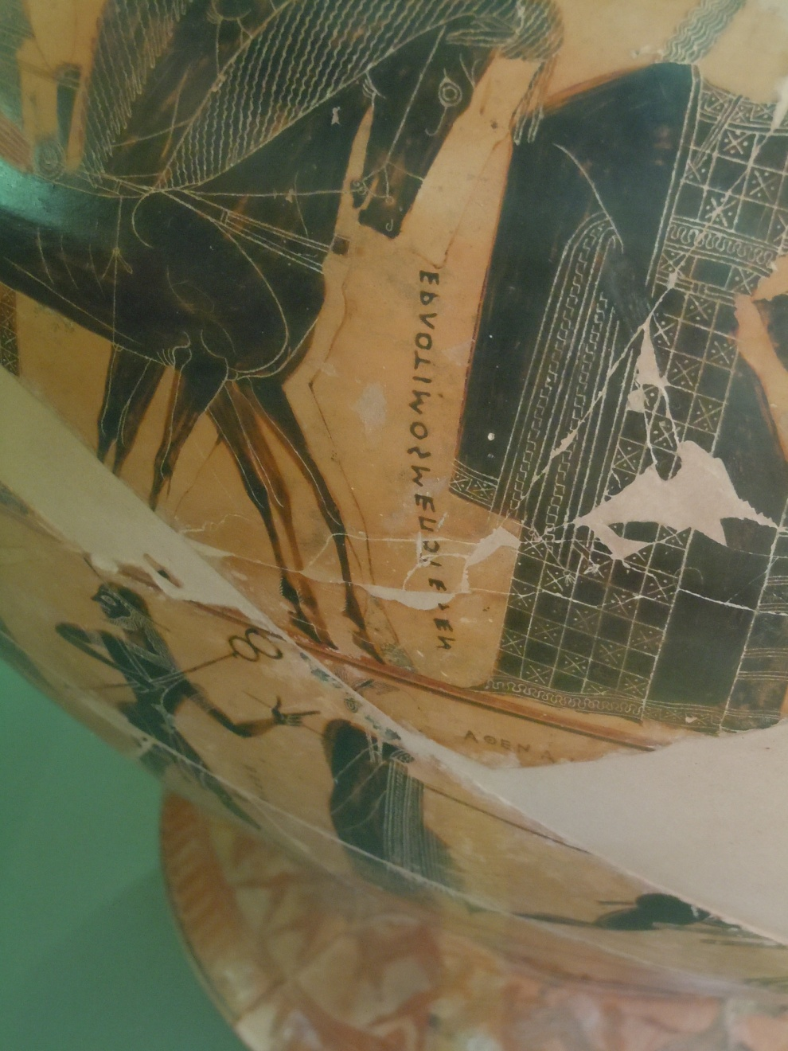
Ergotimos made me

Slide 8
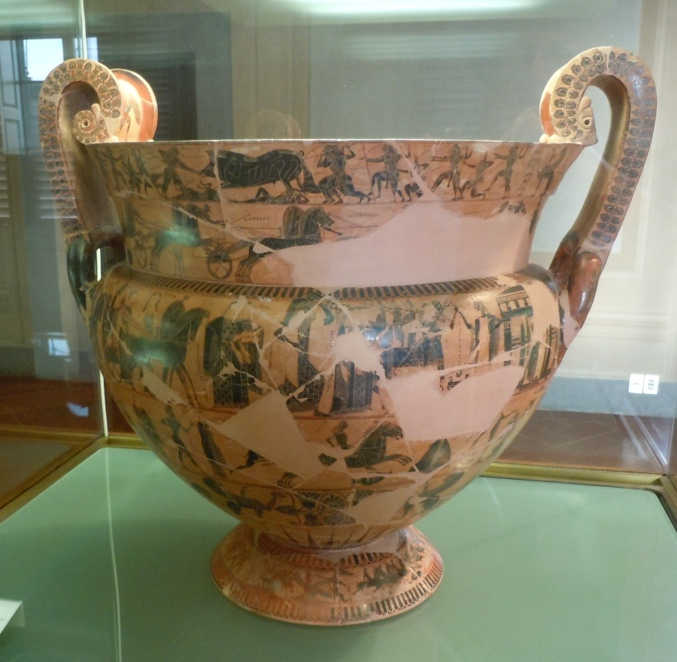

Slide 9
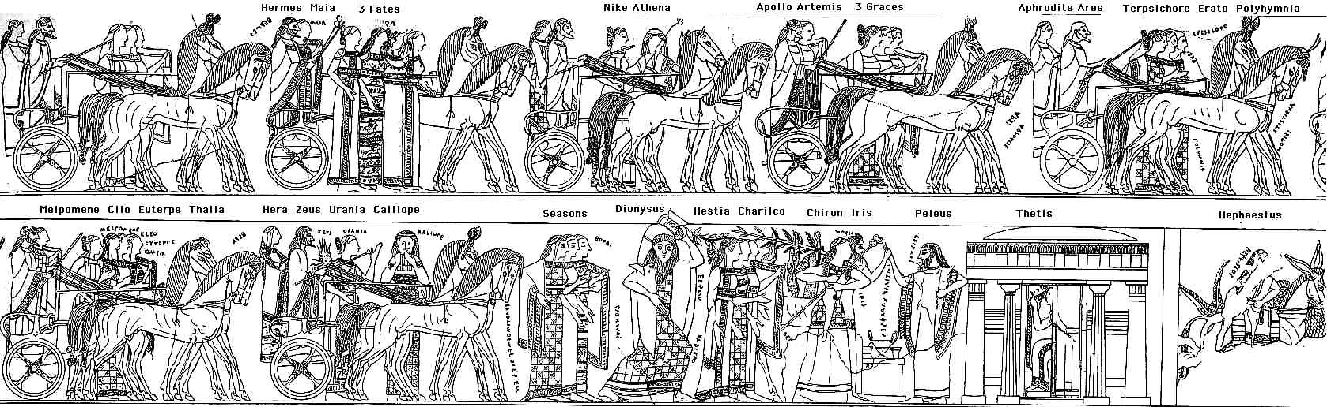

Slide 10
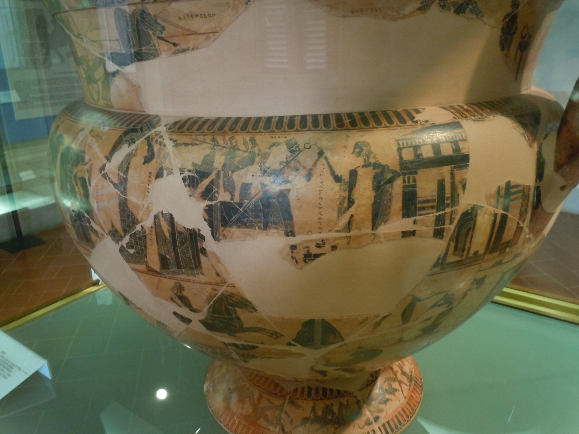
Peleus and Thetis

Slide 11

Moirai (Fates)

Slide 12
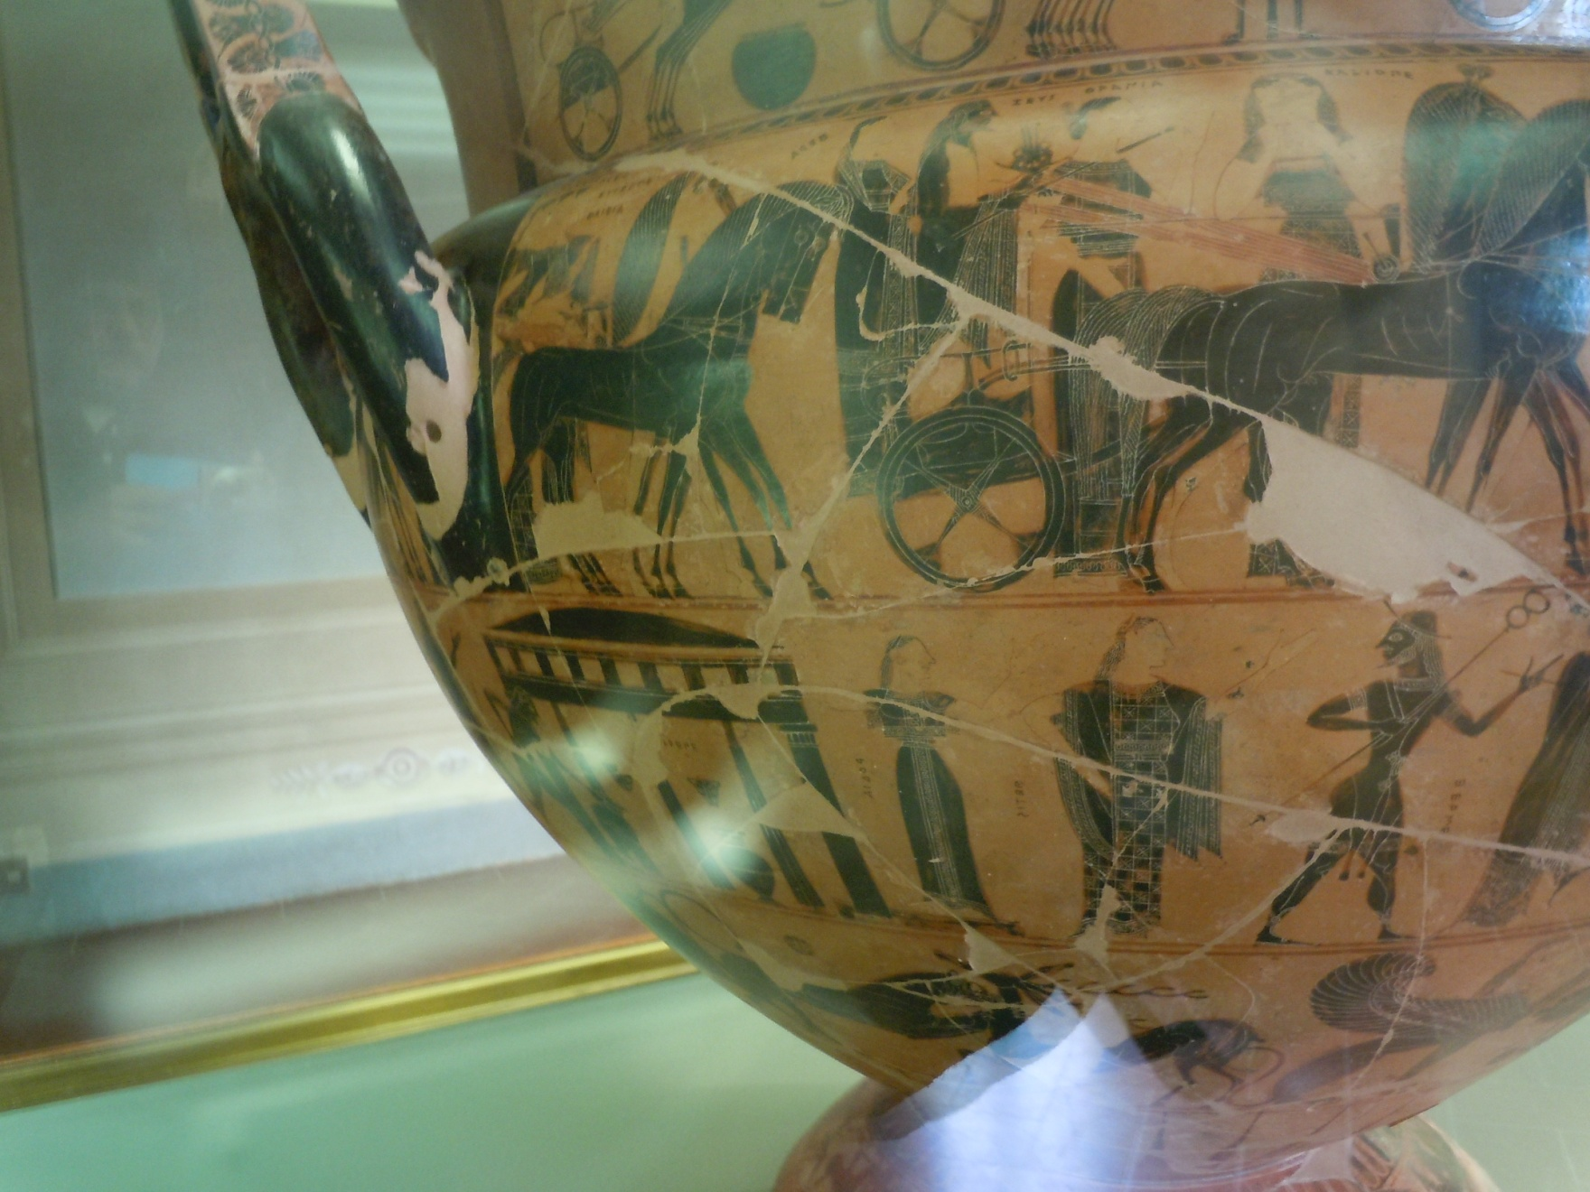
Zeus and Hera

Slide 13
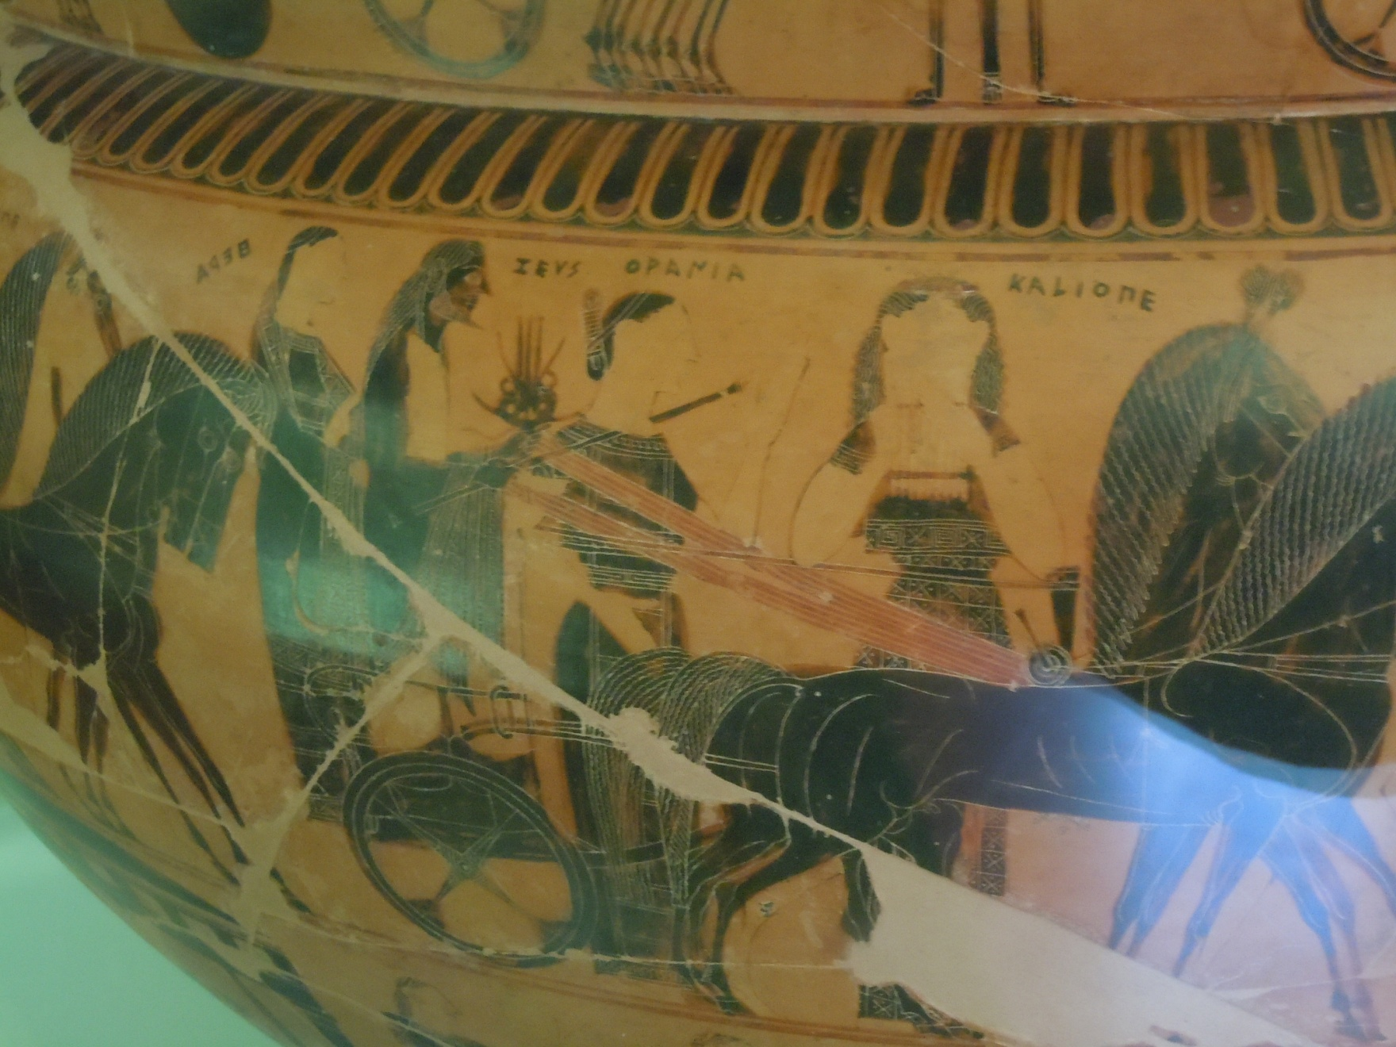
Ourania and Kalliope

Slide 14
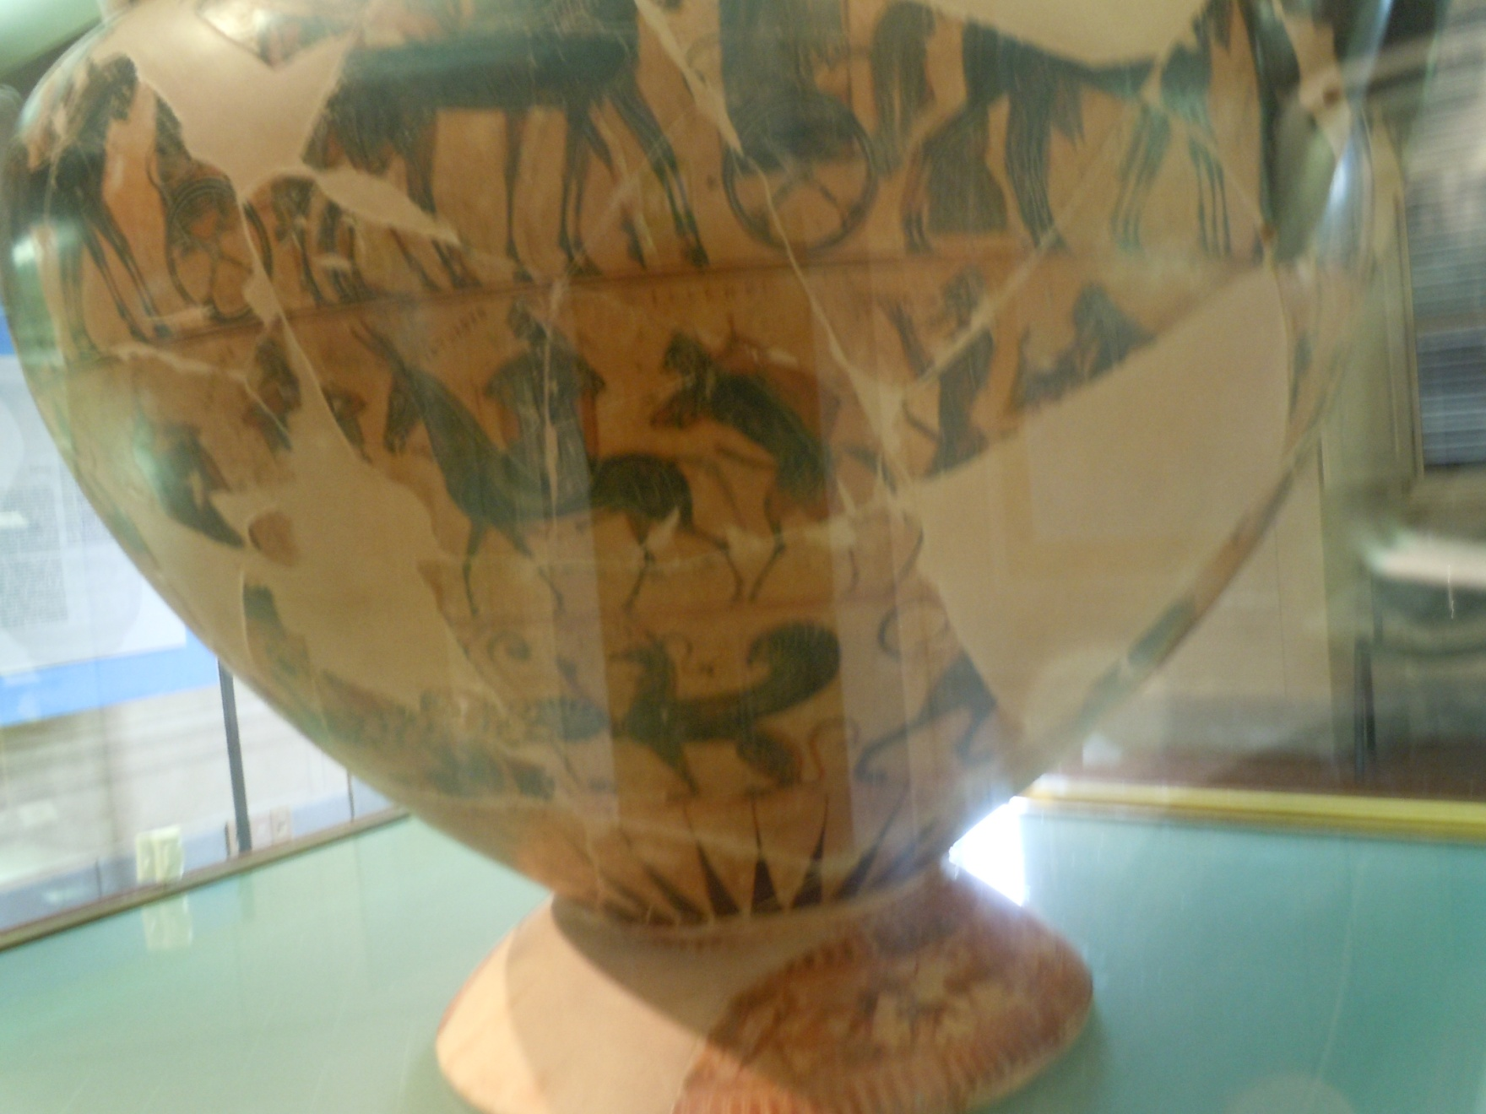
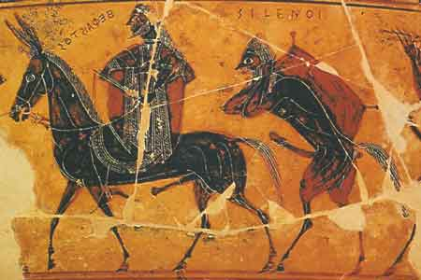
Return of Hephaistos

Slide 15
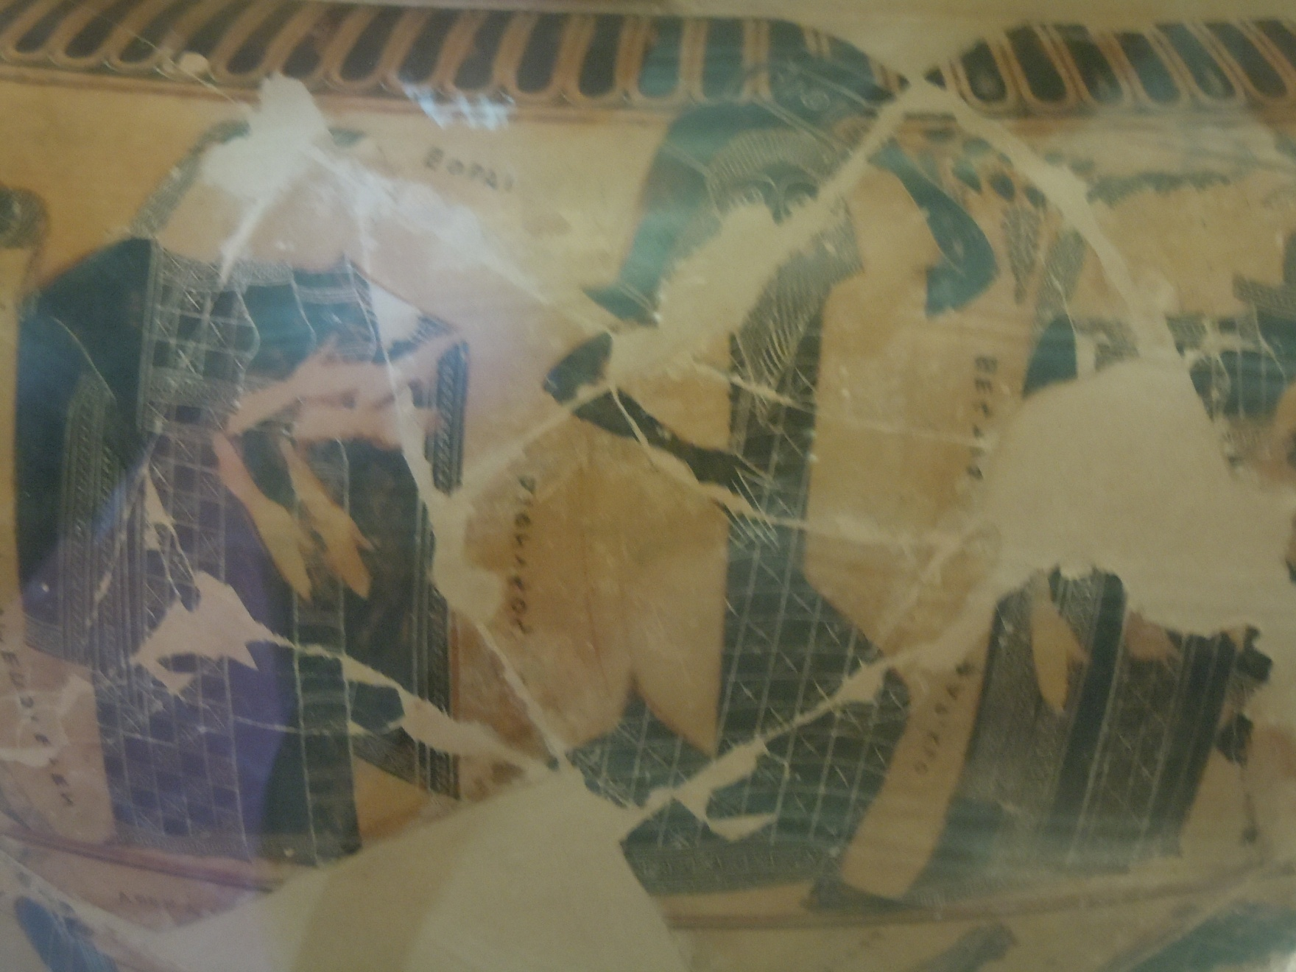
Dionysus

Slide 16
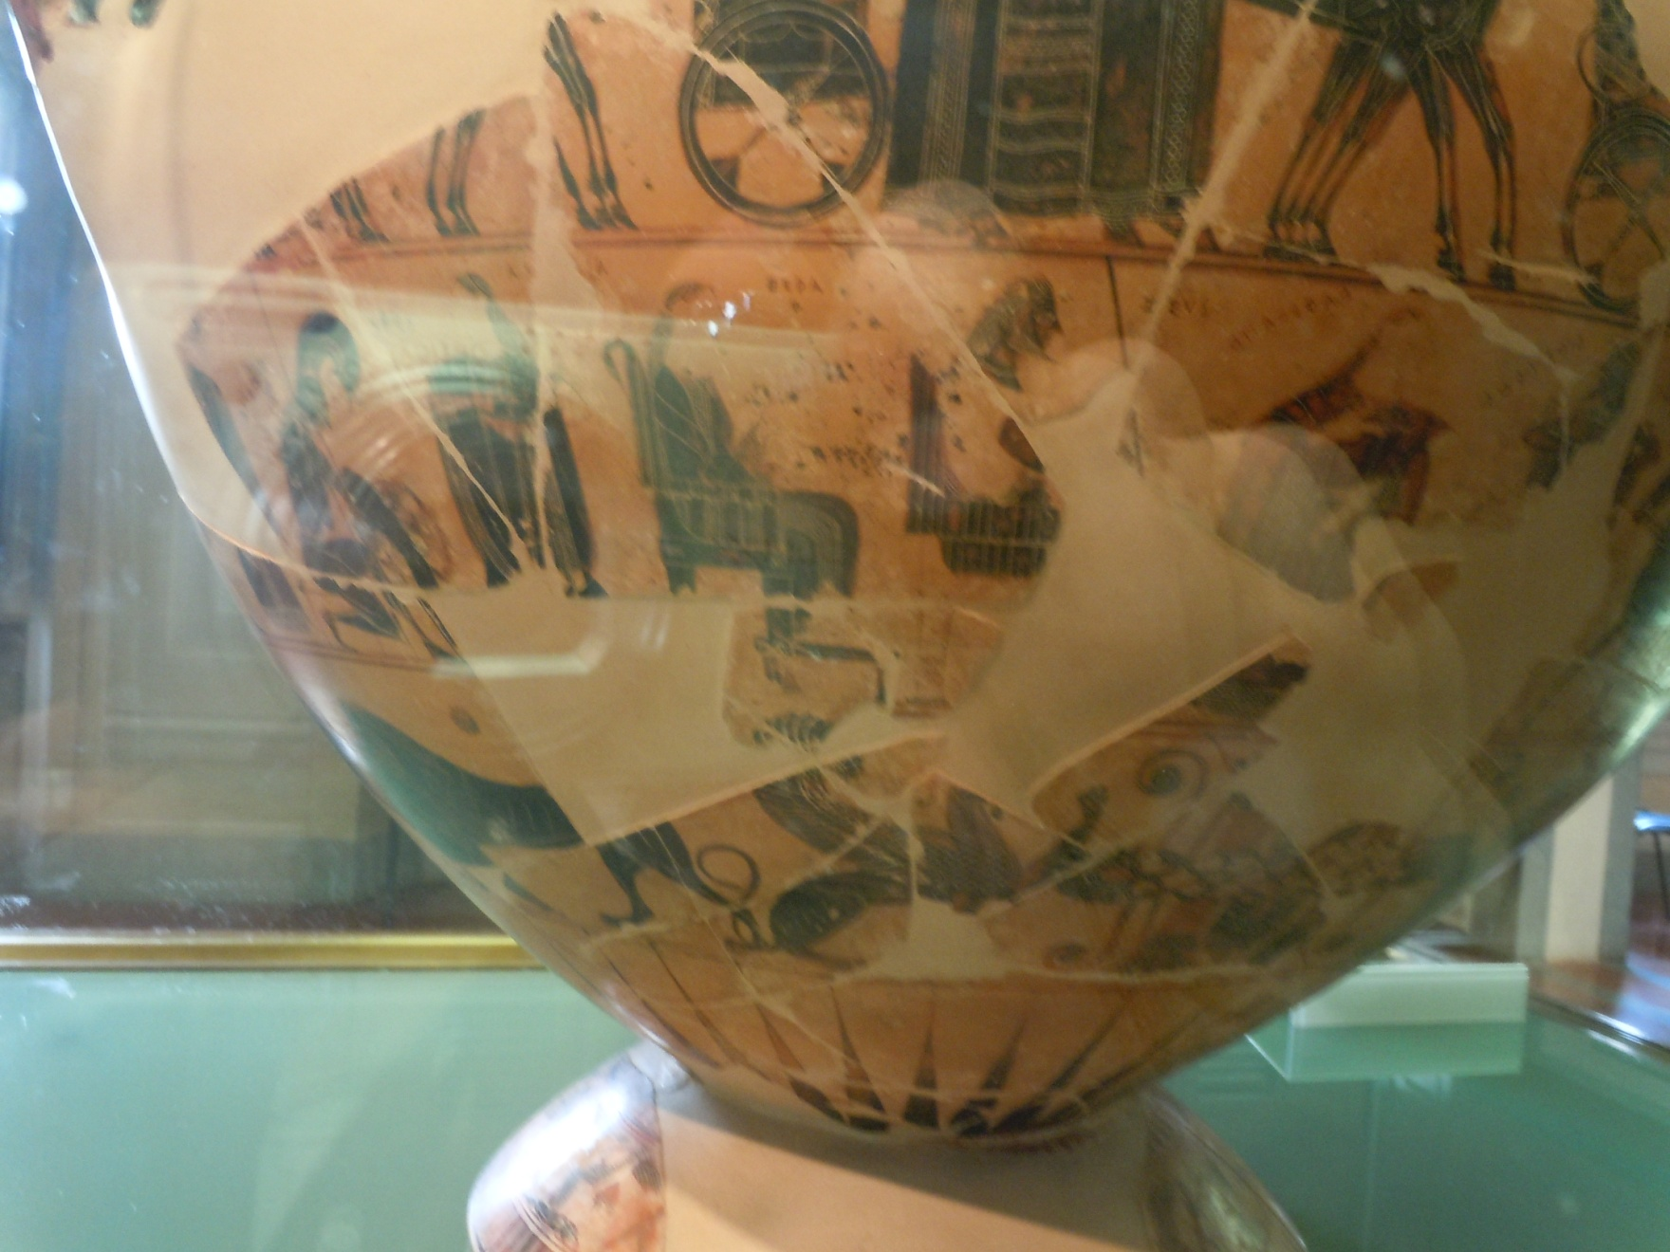
Zeus and Hera Enthroned

Slide 17
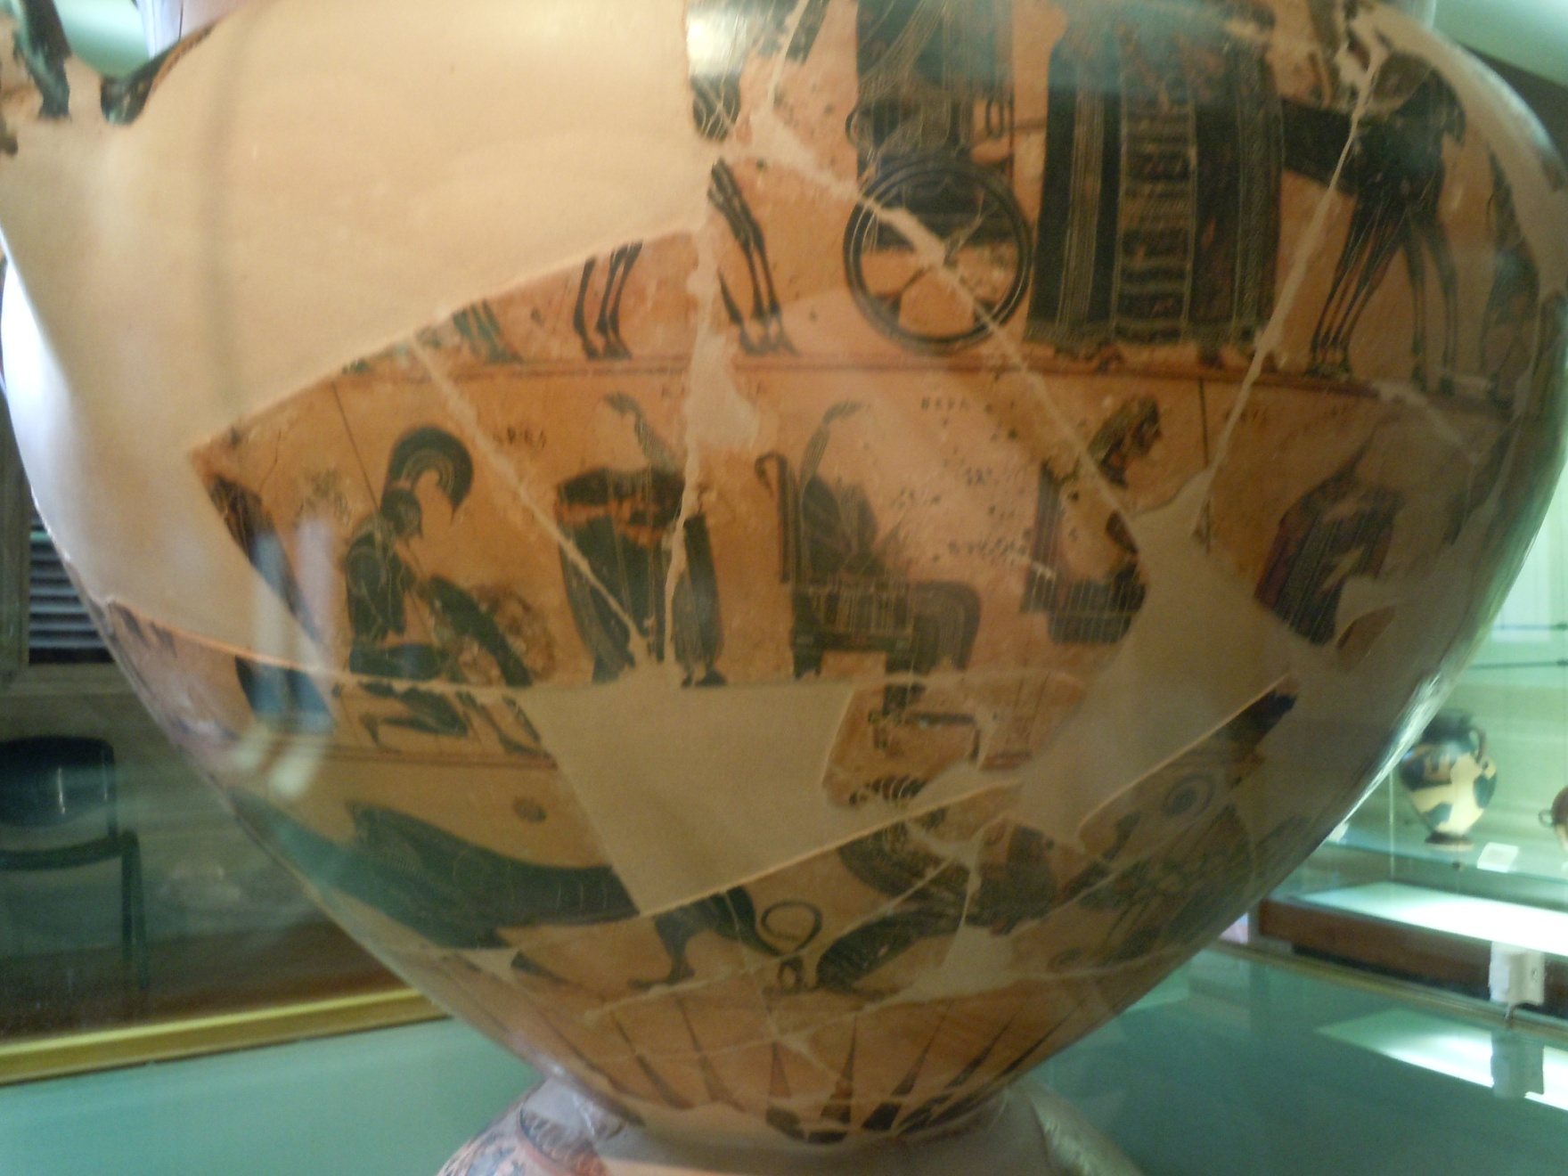
Ares

Slide 18
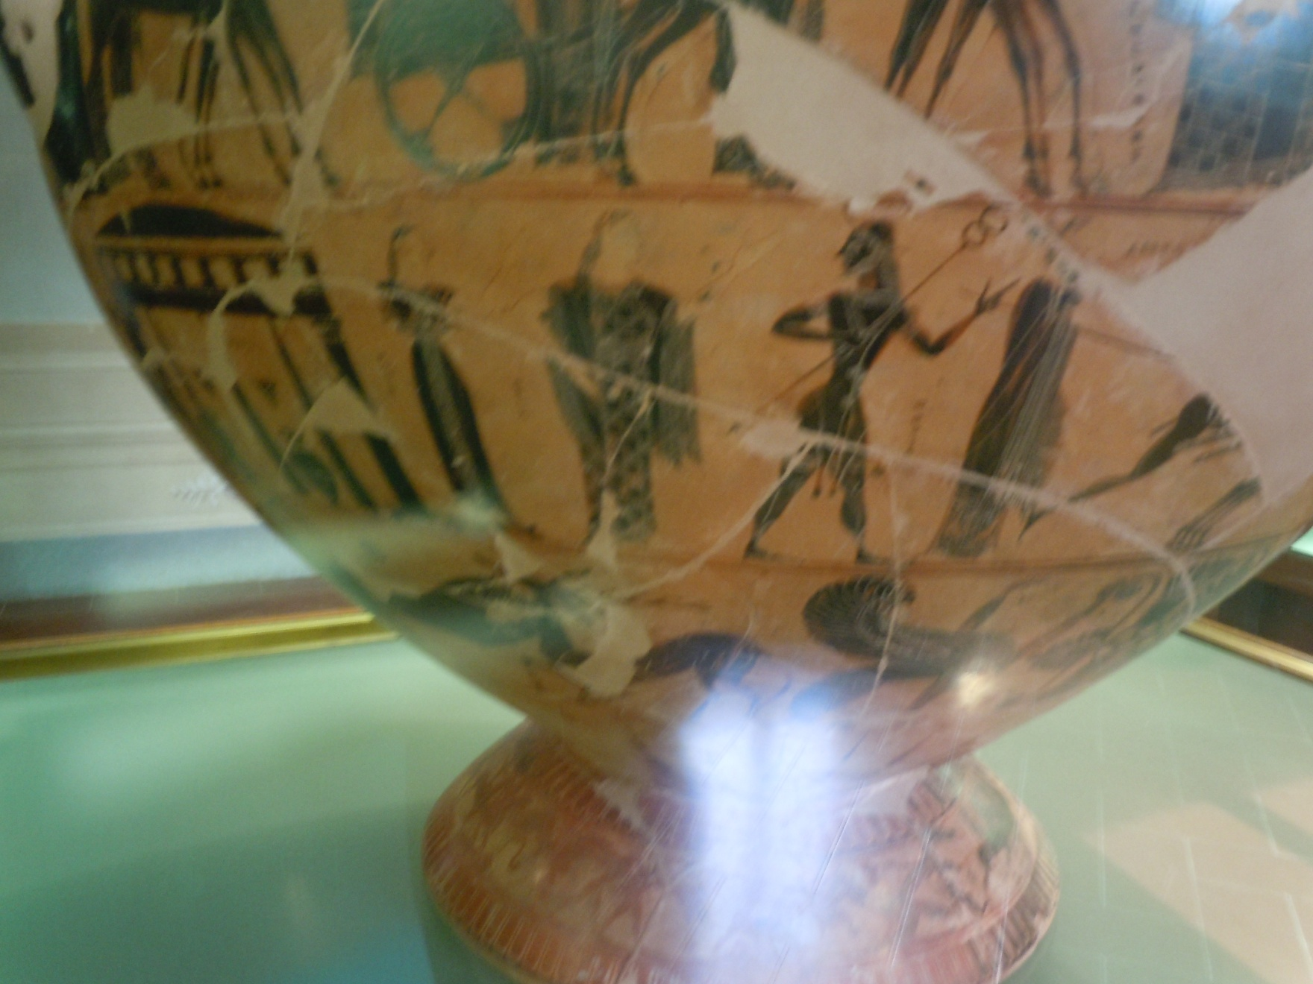
Hermes

Slide 19
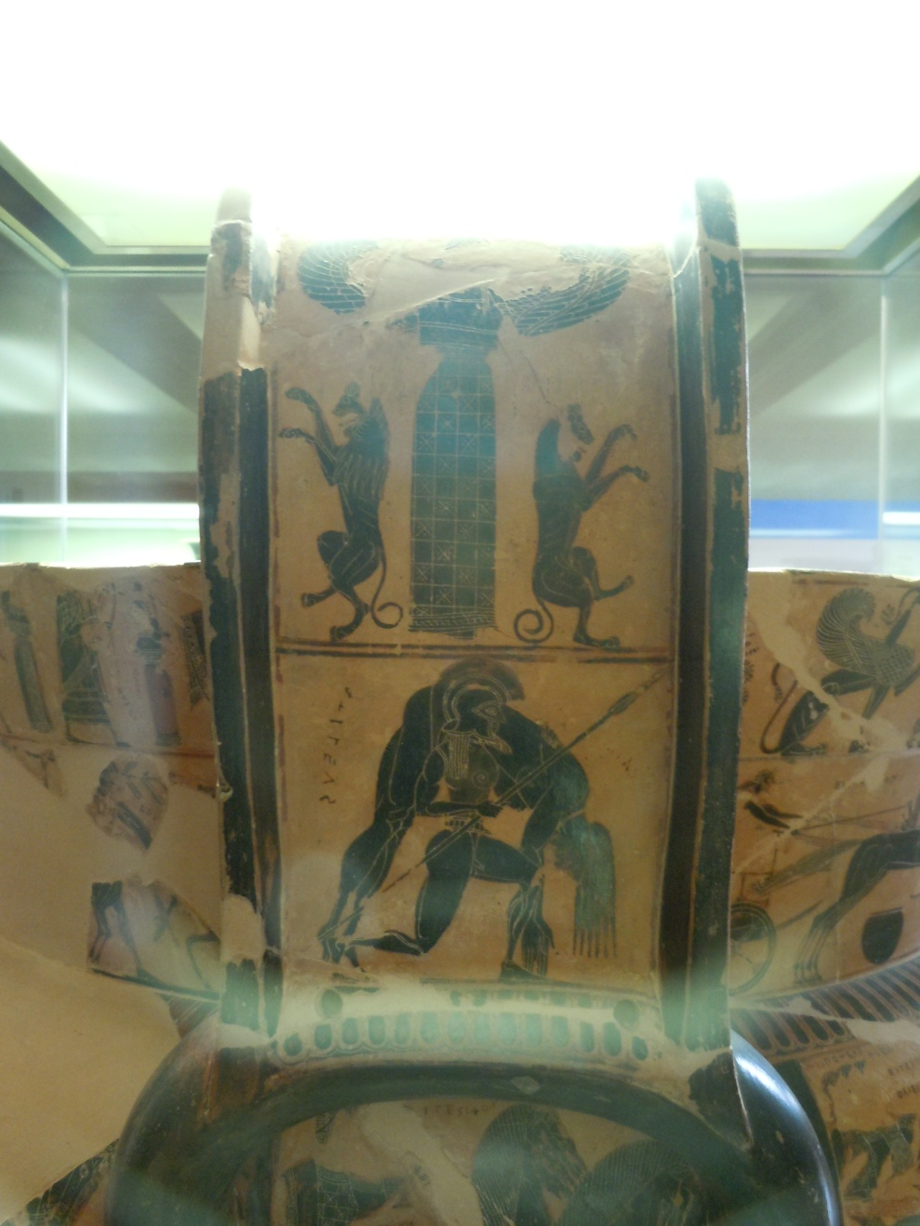
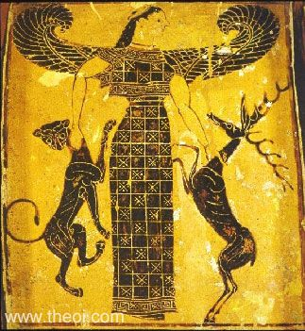
Artemis

Slide 20
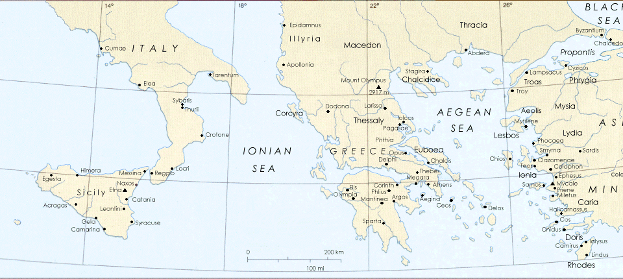
Geography
Delphi
Athens

Slide 21
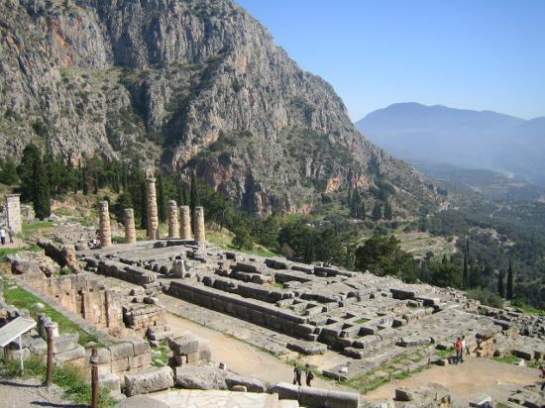
Delphi
http://www.olympia-greece.org/delphi.html
http://www.sacred-destinations.com/greece/delphi

Slide 22
Siphnian Treasury Frieze
Siiphnian Treasury Frieze
Delphi
530-25 BC
http://www.coastal.edu/ashes2art/delphi2/sanctuary/siphnian_treasury.html
http://www.ancient-greece.org/museum/muse-delphi-siphnos.html
http://www.ancient-greece.org/images/ancient-sites/delphi/treasury-siphnos-metope.jpg
http://www.mlahanas.de/Greeks/Temples/SiphnianTreasury.html
http://www.greek-thesaurus.gr/Museum_of_Delphi.html
http://www.perseus.tufts.edu/hopper/artifact;jsessionid=BC4896D195F440C75BEAE60A18A5DB11?name=Delphi%2C+Siphnian+Treasury+Frieze--East&object=Sculpture

Slide 23
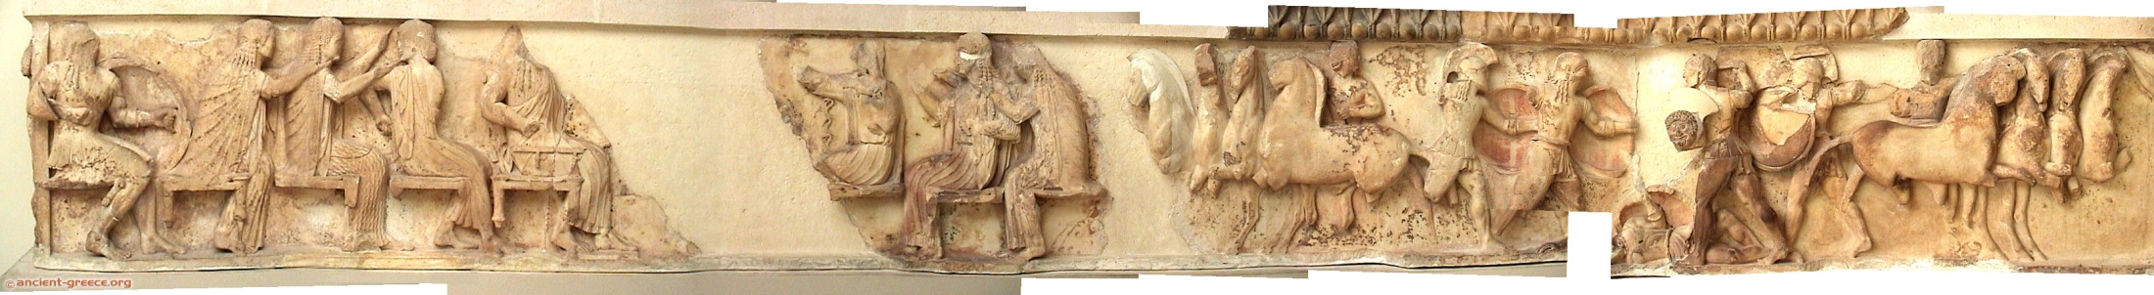


Slide 24
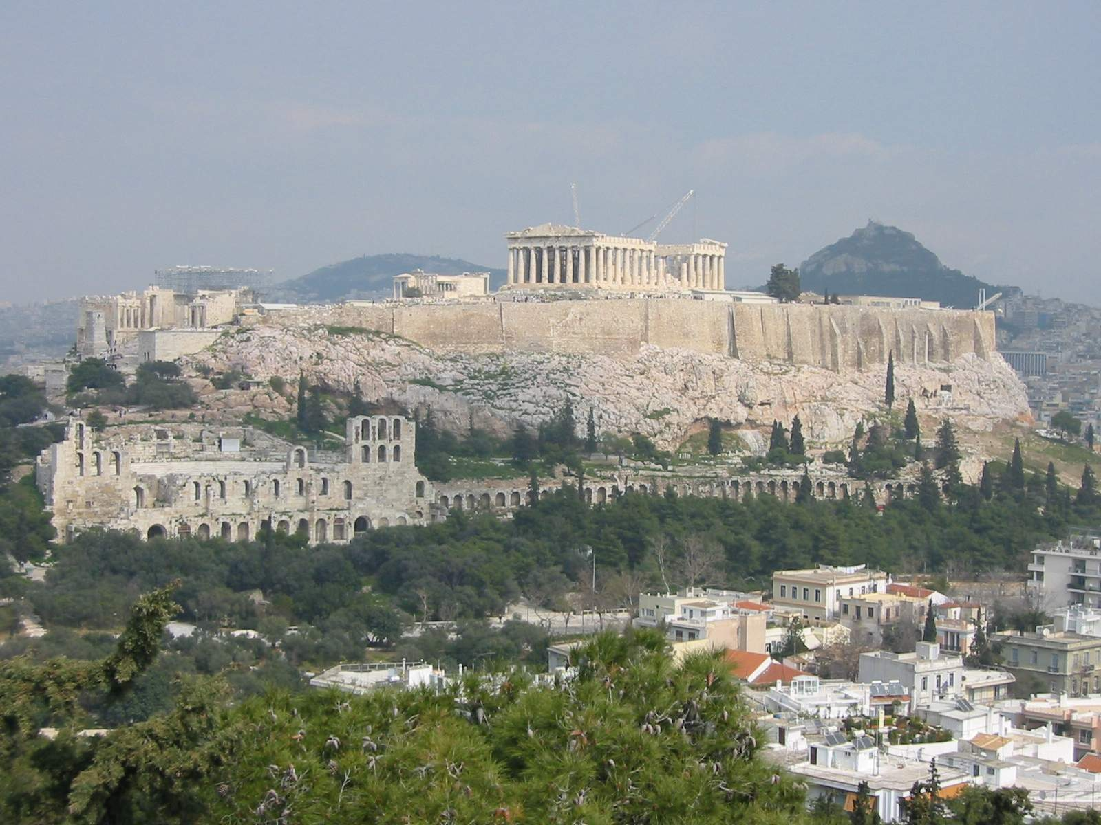
The Athenian Acropolis
http://witcombe.sbc.edu/sacredplaces/acropolis.html
http://www.stoa.org/athens/sites/acropolis.html

Slide 25
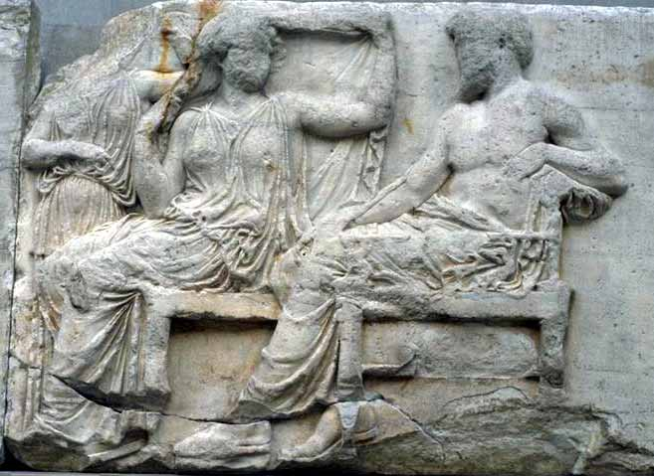
Parthenon Frieze
Parthenon Frieze
Athens
443-438 B.C.
Hera and Zeus

Slide 26
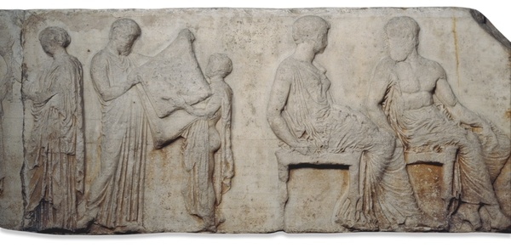
Parthenon Frieze
Parthenon Frieze
Athens
443-438 B.C.
Athena’s Peplos

Slide 27
Parthenon Frieze
Parthenon Frieze
Athens
443-438 B.C.
Athena and Hephaistos

Slide 28
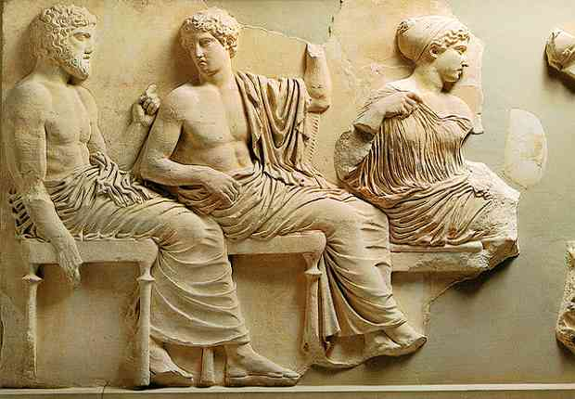
Parthenon Frieze
Parthenon Frieze
Athens
443-438 B.C.
Poseidon, Apollo, Artemis

Slide 29
Parthenon Frieze
Parthenon Frieze
Athens
443-438 B.C.
THE GODS In ASSEMBLY on the frieze
http://www.parthenonfrieze.gr/img/Polyptycho_Thewn_EN.pdf

Slide 30
Parthenon Frieze
Parthenon Frieze
Athens
443-438 B.C.
Parthenon:
http://www.ancient-greece.org/architecture/parthenon.html
http://www.perseus.tufts.edu/cgi-bin/architindex?entry=Athens,Parthenon
http://www.greatbuildings.com/buildings/The_Parthenon.html
Parthenon Frieze:
Greek Ministry of Culture: http://www.ekt.gr/parthenonfrieze/index.jsp?lang=en&w=1280
Ancient Greek Cities: http://www.sikyon.com/athens/Parthenon/frieze01_eg.html
Columbia University: http://www.mcah.columbia.edu/parthenon/flash/main.htm
http://www.hammerwood.mistral.co.uk/elgin.htm
  http://www.britishmuseum.org/explore/online_tours/museum_and_exhibition/audio_description_tour/central_scene_of_the_east_frie.aspx
  Here are some helpful reviews of books about the Parthenon and its frieze:
  http://ccat.sas.upenn.edu/bmcr/2005/2005-11-10.html
  http://ccat.sas.upenn.edu/bmcr/2000/2000-05-18.html
  http://ccat.sas.upenn.edu/bmcr/2002/2002-06-14.html
  http://ccat.sas.upenn.edu/bmcr/1997/97.04.29.html
  http://ccat.sas.upenn.edu/bmcr/2003/2003-07-33.html
Here is an important article to read:
  “Reconfiguring the Gods on the Parthenon Frieze.”
  Author(s): Jenifer Neils Source: The Art Bulletin, Vol. 81, No. 1 (Mar., 1999), pp. 6-20
  Published by: College Art Association
  Stable URL: http://www.jstor.org/stable/3051284

Slide 31
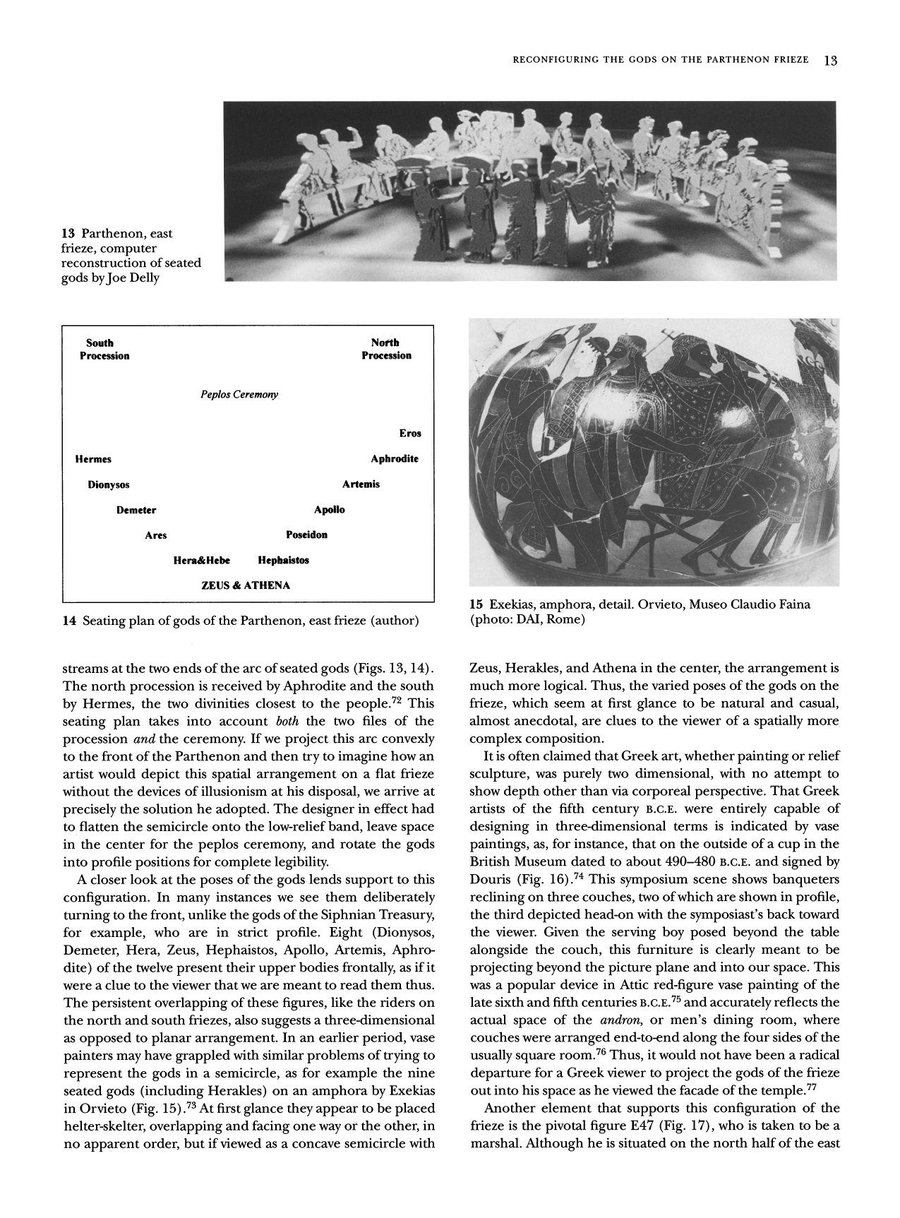
Reconfiguring the Gods on the Parthenon FriezeAuthor(s): Jenifer Neils
Source: The Art Bulletin, Vol. 81, No. 1 (Mar., 1999), pp. 6-20
Published by: College Art AssociationS
table URL: http://www.jstor.org/stable/3051284

Slide 32
Bellini’s “Feast of the Gods”
Bellini
“Feast of the Gods”
1514
Bellini's "Feast of the Gods http://www.webexhibits.org/feast/
http://www.webexhibits.org/feast/aCloser/view.html
Sienkewicz on Bellini's "Feast of the Gods”
National Gallery on Bellini’s “Feast of the Gods”

