Slide 1
Ajax
Shannon Sullivan and Christina Durante
“Even his shield makes war: and arms, for his arms, are raised.” –Ovid Book XII

Slide 2
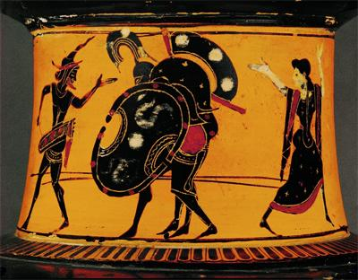
Antimenes Painter
Attic Black-figure vessel, c. 520-510 BCE
Muee du Louvre, Paris, France
Ajax carrying the body of Achilles

Slide 3
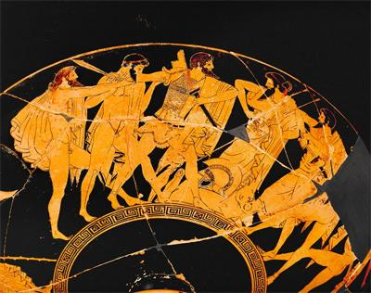
Douris Painter
Red-figure cup, c. 500-450 BCE
Kunsthistorisches Museum
Agamemnon attempts to separate and hold back Ajax and Ulysses as they are competing for the armor of Achilles.

Slide 4
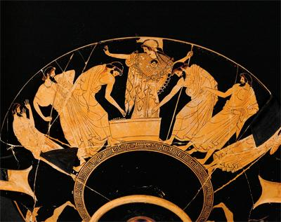
Douris Painter
Red-figure cup, c. 500-450 BCE
Kunsthistorisches Museum
Athena is portrayed in the middle as Ulysses (right) and Ajax (second left) cast lots for the arms of Achilles.

Slide 5
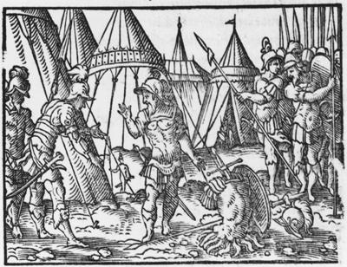
Virgil Solis German
Woodcut from the sixteenth century
Now found in Vienna
Argument between Ajax and Ulysses for Achilles armor

Slide 6
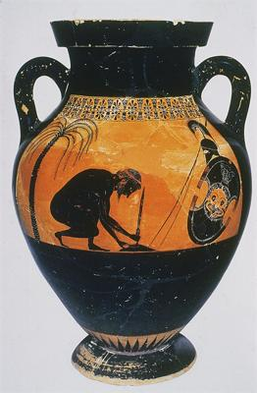
Exekias
Attica-Black Figure vase
540 B.C.E.
Can be found in Attike Greece
Ajax prepares to kill himself on Hector’s sword

Slide 7
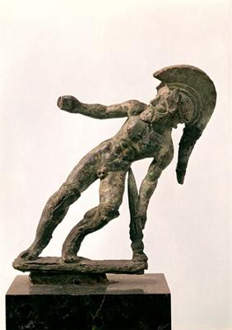
Etruscan bronze statue, c. 6th century BC
Museo archeologico di Firenze
Ajax “Unconquered” falls on his sword after losing to Ulysses in the debate to receive the armor of Achilles

Slide 8
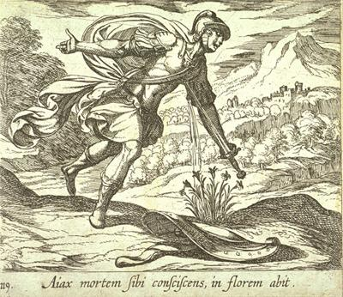
Antonio Tempesta (Italian, 1555-1630)
17th century etching
Fine Arts Museum of San Francisco
The Death of Ajax

Slide 9
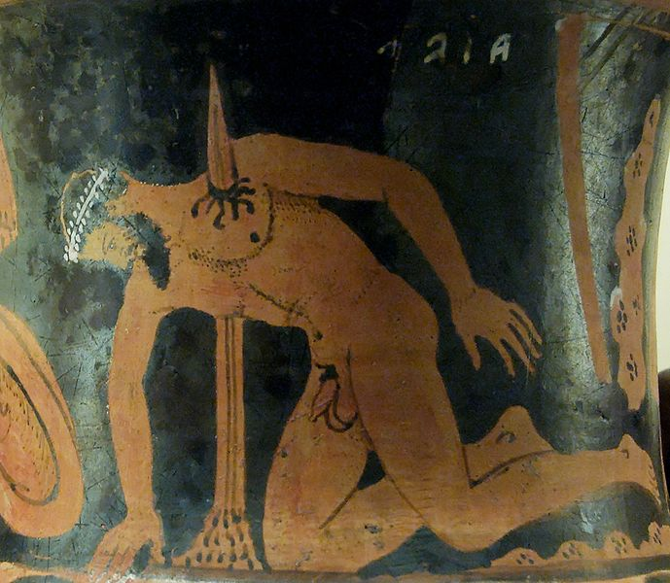
“The Suicide of Ajax the Great”
Etrurian red-figure calyx-krater, c. 400-350BCE
British Museum
“…the bloodstained ground bore a purple flower from the green turf…”

