Slide 1
Daedalus and Icarus
By Nick Raes
Sam Mackey

Slide 2
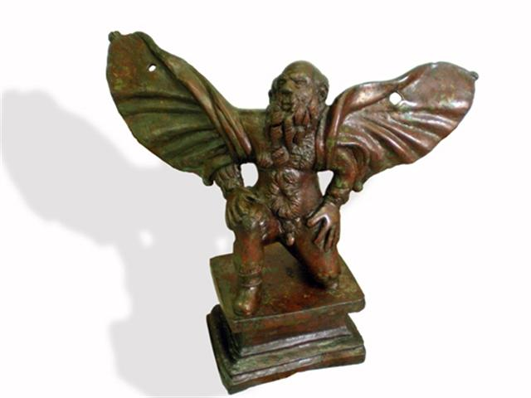
Bronze Sculpture of Daedalus
3rd Century C.E.
Found in Macedonia

Slide 3

Daedalus
Andrea Pisano 1295 – 1348
Relief
Campanile, Florence

Slide 4
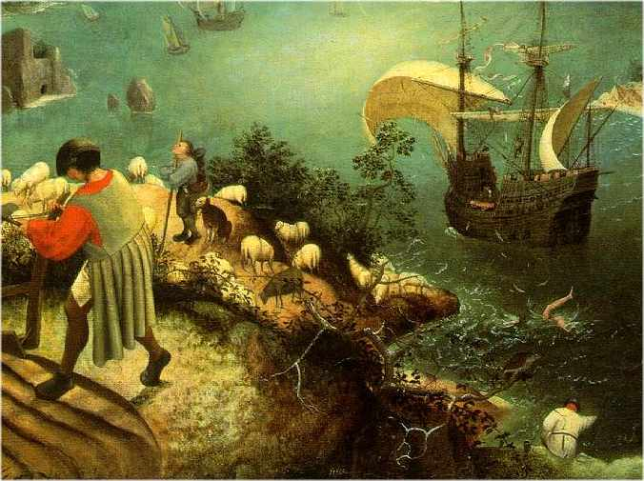
Landscape with the Fall of Icarus
Pieter Brughel the Elder (c.1525 – 1569)
Oil on Canvas
c. 1560
Royal Museum of Fine Arts Belgium

Slide 5
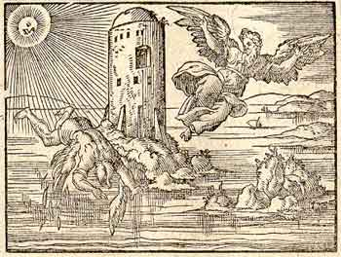
Daedalus and Icarus
Woodcut found Illustrated in Ovid: Metamorphoses
Illustrated by Virgil Solis c. 1569
University of Glasgow, UK

Slide 6
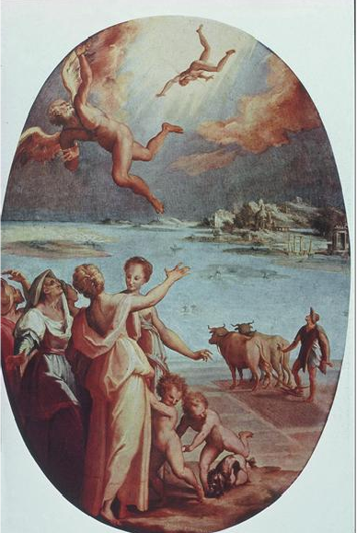
Palazzo Vecchio (Studiolo) Fall of Icarus
Tommaso Manzuoli 1536-71
c. 1570-71
Located at Palazzo Vecchio in Florence, Italy

Slide 7
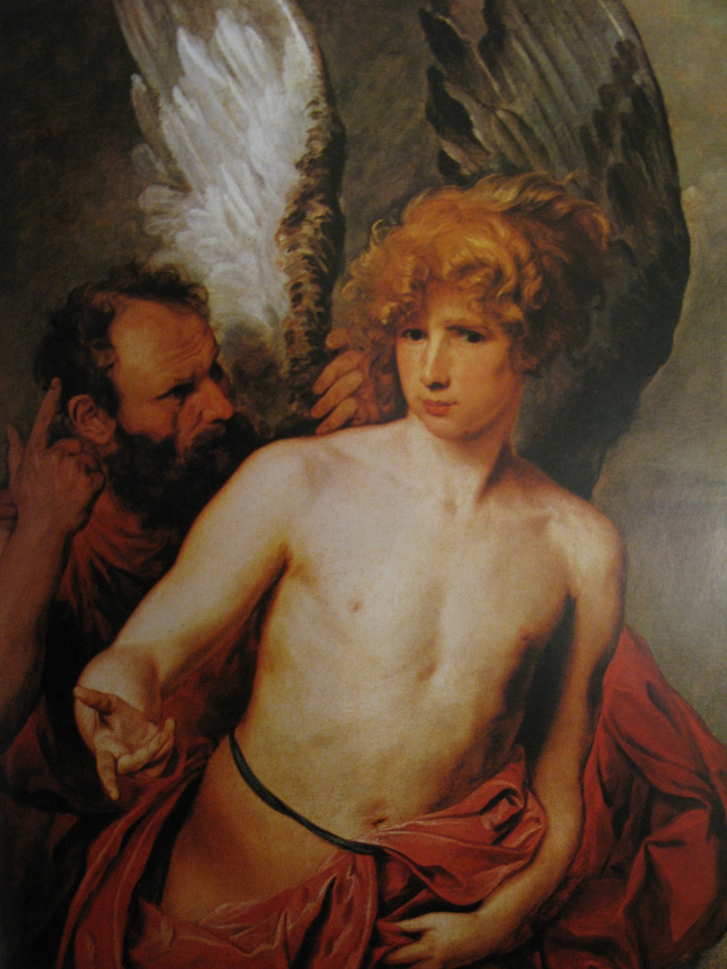
Daedalus and Icarus
c. 1620 by Anthony van Dyck
Oil on Canvas
Art Gallery of Ontario

Slide 8
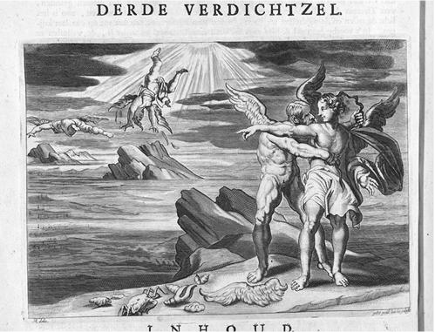
Daedalus, wanting to flee Crete, made wings of wax, for himself and for his son [Icarus], to escape the domination of Minos. Icarus falls into the sea, having paid no attention to his father's warnings, while Daedalus escapes to Sicily.
Engraving by Peter Paul Bouche after a drawing by Hendrik Abbé
Print; Book Illustration
Text: 1st Century BCE
Image Published: 1703
Warburg Instute Library London

Slide 9
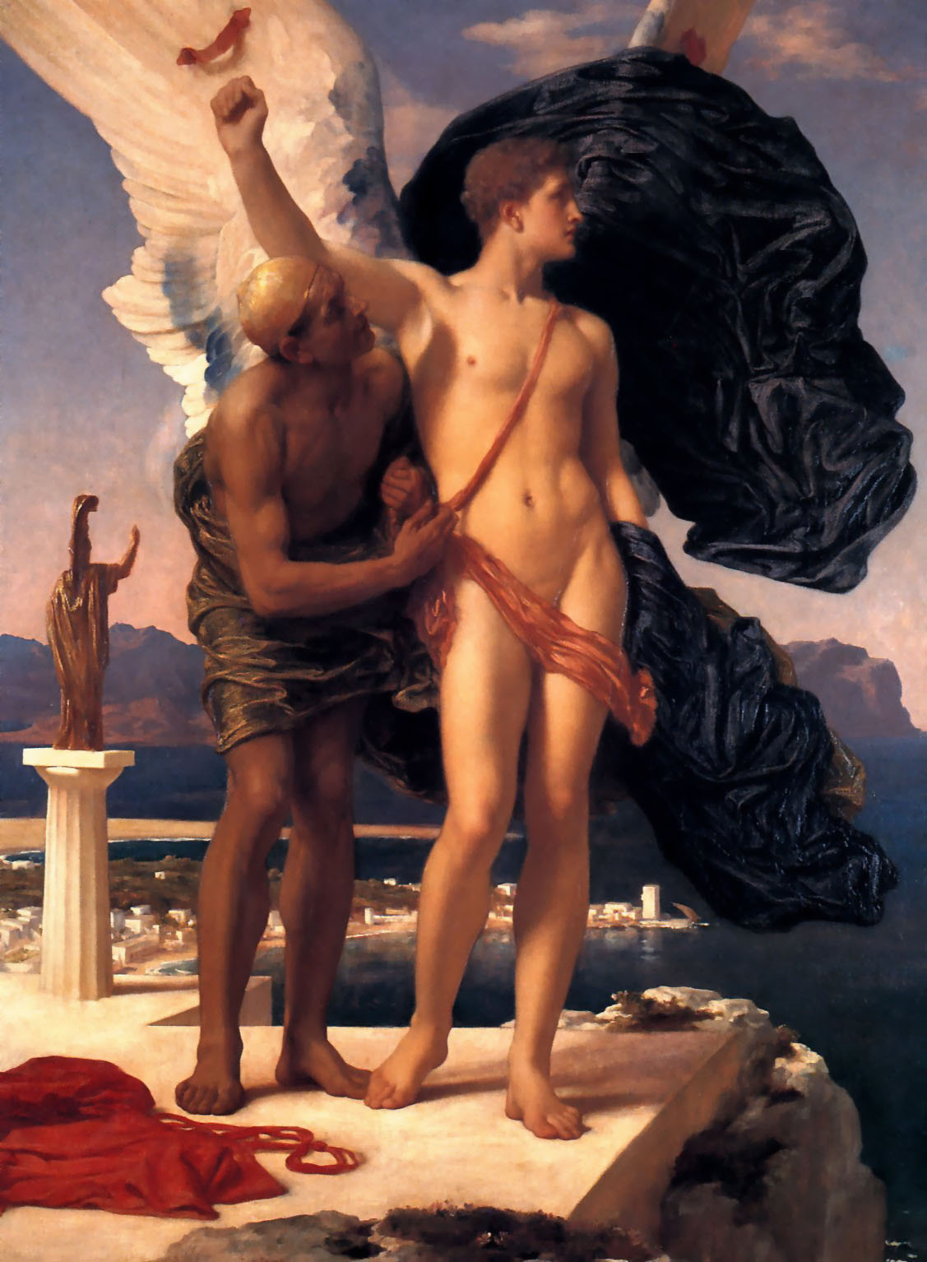
Icarus and Daedalus
c. 1869
Oil on Canvas
Frederic Leighton, 1st Baron Leighton (1830–1896)
Private Collection

