Slide 1
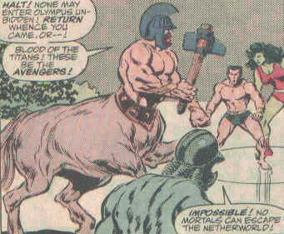
Lapiths and the Centaurs
Chris Baldwin, David Nieman,
& Zack Monti

Slide 2
http://library.artstor.org/library/welcome.html#3|search|6|All20Collections3A20Lapiths20and20Centaurs|Filtered20Search|||type3D3626kw3DLapiths20and20Centaurs26geoIds3D26clsIds3D26id3Dall26bDate3D26eDate3D26dExact3D3126prGeoId3D
Creator: Florence Painter
Culture: Greek
Title: Column Krater with Theseus in centauromachy (Combat between Centaurs and Lapiths)
Work Type: ceramics
Date: c. 480-450 BC
Material: red-figure
Style Period: Classical Period

Slide 3
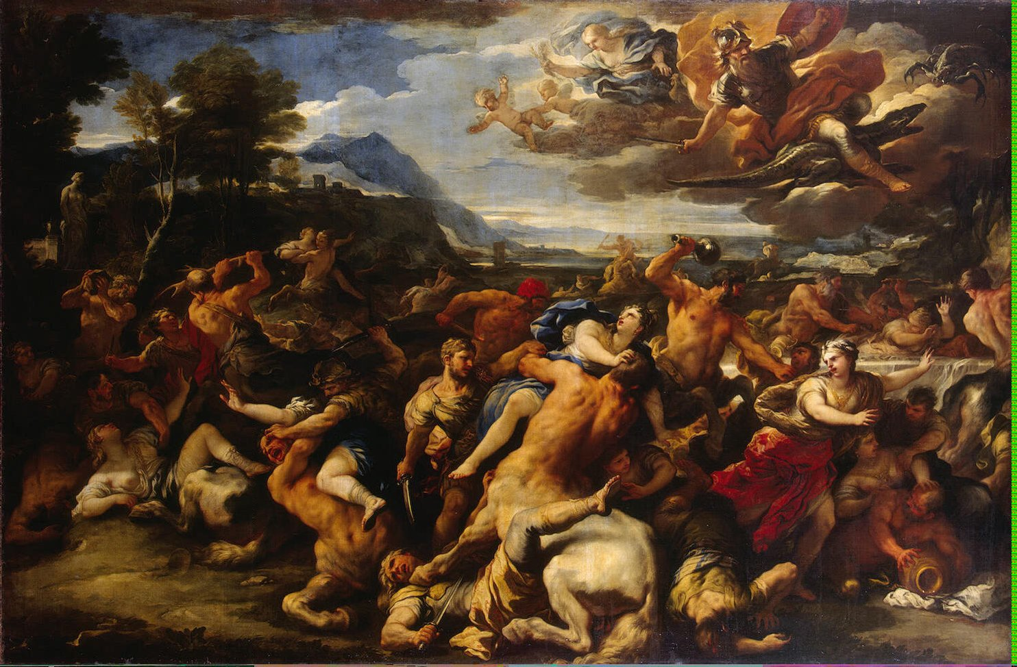
Sebastiano Ricci, Italian, 1659-1734
Title The Battle of the Lapiths and Centaurs
Work Type Painting
Date c. 1705
Material Oil on canvas

Slide 4
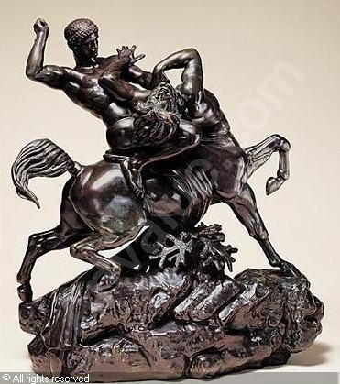
Creator Antoine-Louis Barye, European; French, 1796 - 1875, (sculptor)
Title Theseus Slaying a Centaur
Work Type Sculpturebronze
Date about 1850
Material bronze, wooden base

