Slide 1
Perseus and Medusa
Clark Hilliard
Alex Townsend

Slide 2
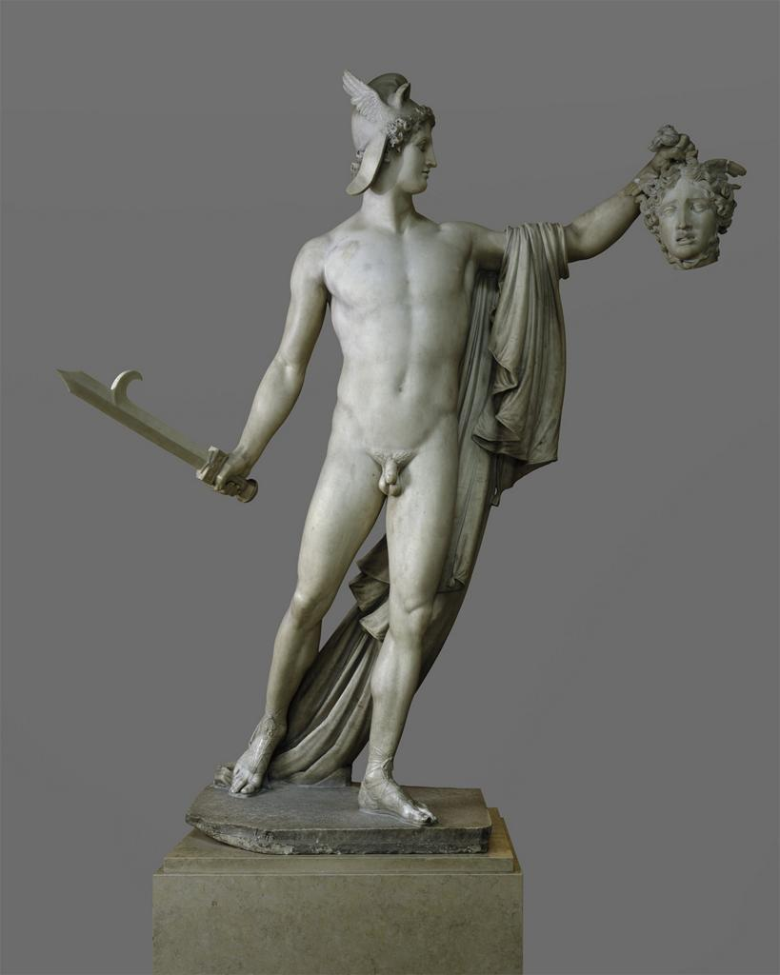

Slide 3
Perseus with the Head of Medusa
Antonio Canova
Rome, Italy
1804-1806
Marble
The Metropolitan Museum

Slide 4
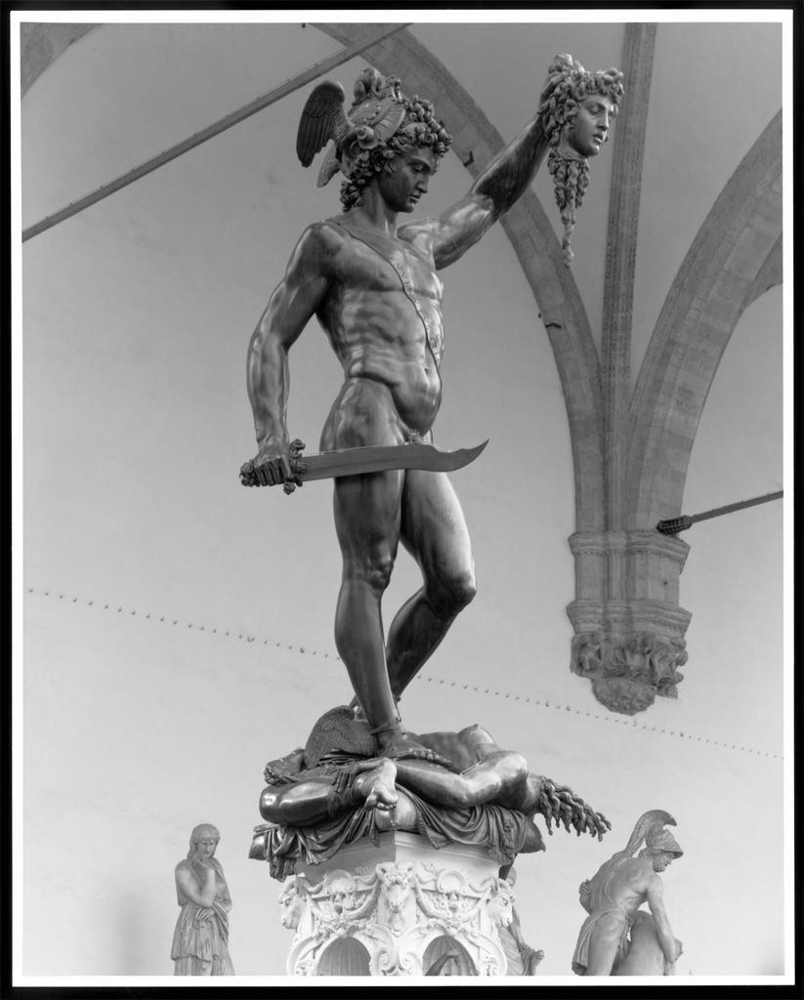

Slide 5
Perseus with the Head of Medusa
Benvenuto Cellini
Florence, Italy
1545-1553
Bronze
Loggia della Signoria

Slide 6
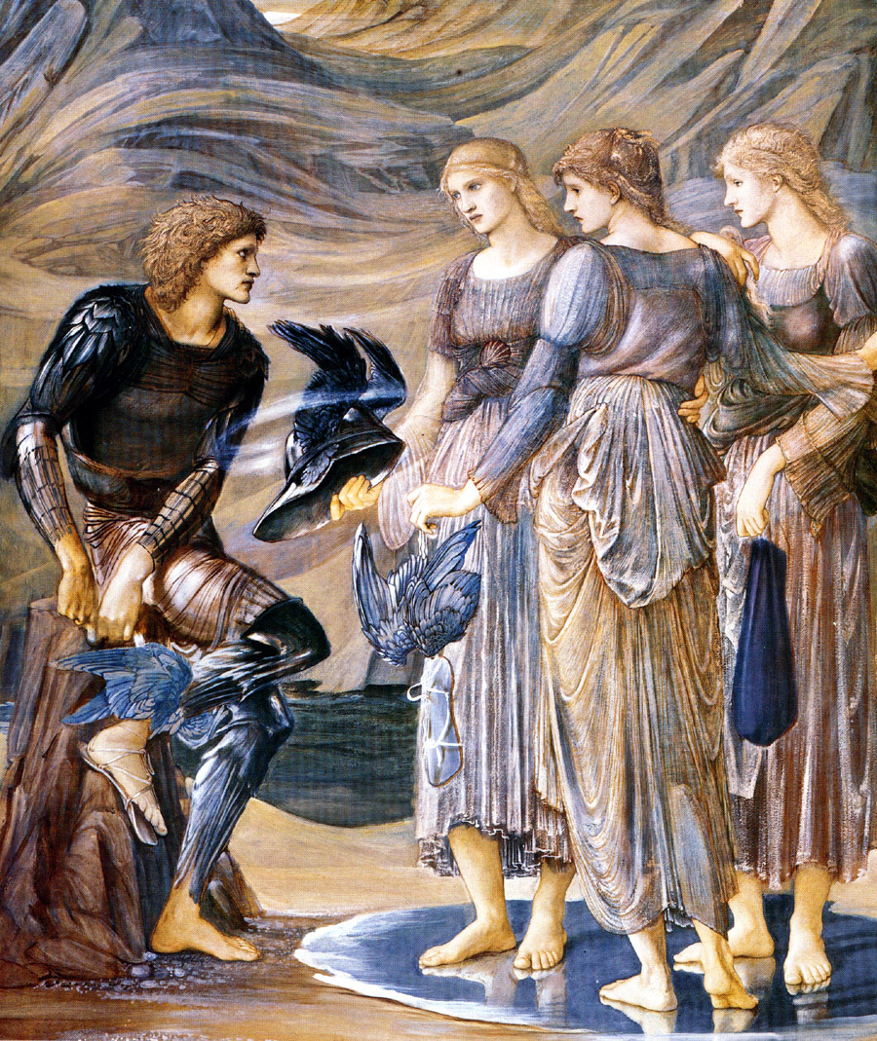

Slide 7
Edward Burne-Jones
1877
Tempera on canvas

Slide 8
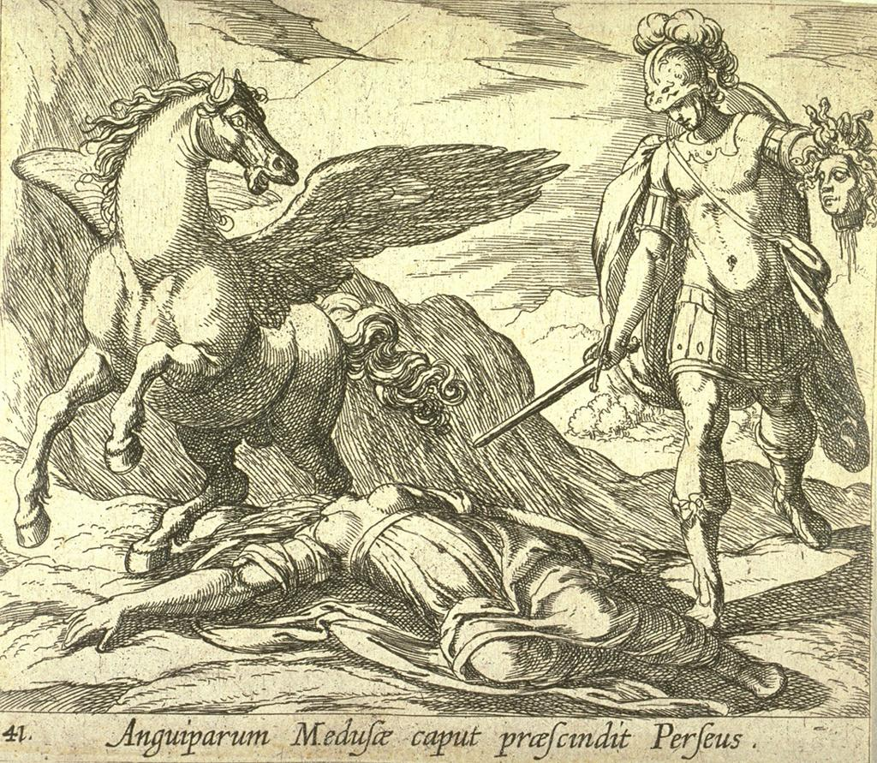

Slide 9
Anguiparum Medusae caput praescindit Perseus
Antonio Tempesta
Ovid’s Metamorphoses
17th century
Etching
Fine Arts Museum of San Francisco

Slide 10


Slide 11
Perseus Slays Medusa
Virgil Solis
Ovid’s
Woodcut
Vienna

Slide 12
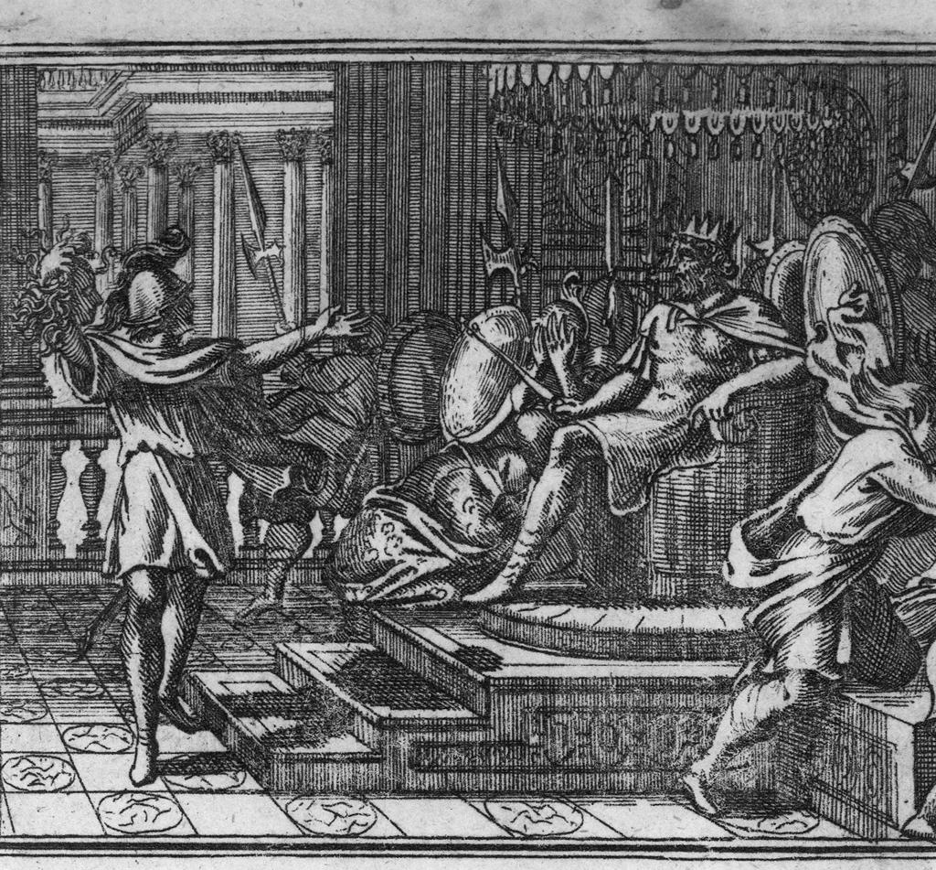

Slide 13
Polidectus wird zu einem Stein
Johann Ulrich Kraus
1694
Engraving
The Warburg Institute Library, London, United Kingdom

Slide 14
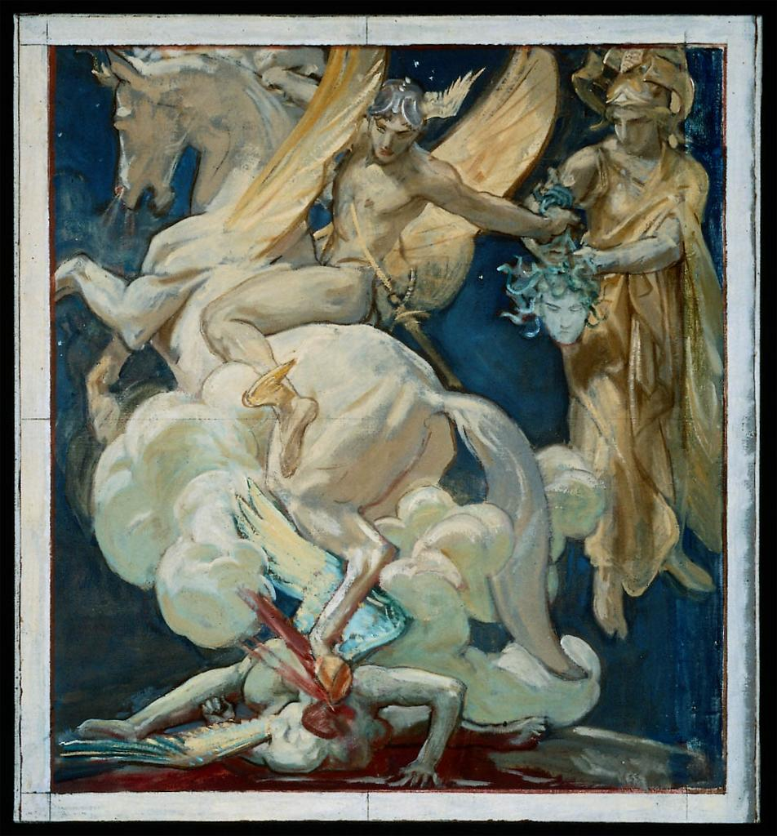

Slide 15
Perseus on Pegasus Slaying Medusa
John Singer Sargent
1922-1924
Oil and graphite on canvas
Museum of Fine Arts, Boston

