Slide 1
Proserpina
Rachael Laing
Tim Morris
Jahlel Watkins

Slide 2
Stages of the Myth
The Abduction (or Rape) of Proserpina
Ceres’ Search
The Return and Fate of Proserpina

Slide 3
Names To Know
Pluto (aka Hades, or Dis)
Proserpina (aka Persephone)
Ceres (aka Demeter)
Jupiter (aka Zeus)
Cyane
Arethusa
Ascalaphus

Slide 4
Metamorphoses
Cyane “Melting” Into Her Swamp
Ceres Into An Old Woman
Annoying Boy Into A Lizard
Ascalaphus Into A Screech Owl
Proserpina’s Friends Into The Sirens

Slide 5
Pluto and Proserpina
Bernini
1623
Galleria Borghese

Slide 6
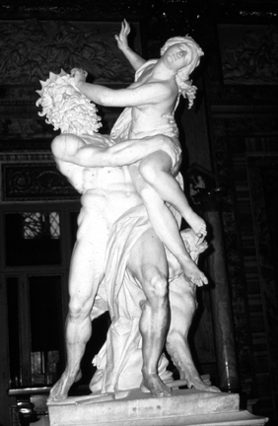

Slide 7
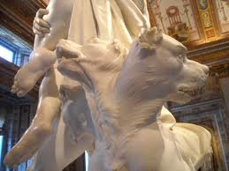

Slide 8
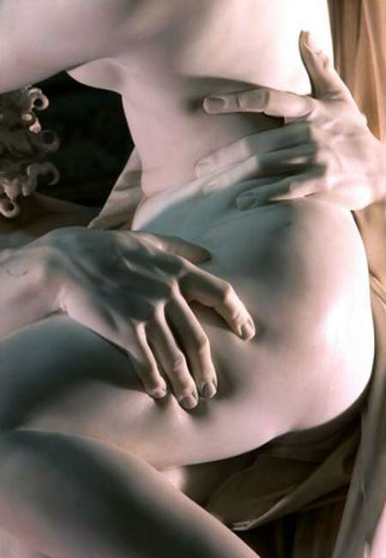

Slide 9
Persephone
Thomas Hart Benton
1938-1939
Nelson-Atkins Museum of Art

Slide 10
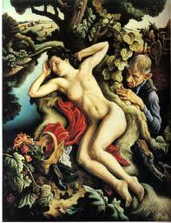

Slide 11
Greek Fresco
Vergina, Macedonia Tomb I
4th Century B.C.
Classic Greek

Slide 12
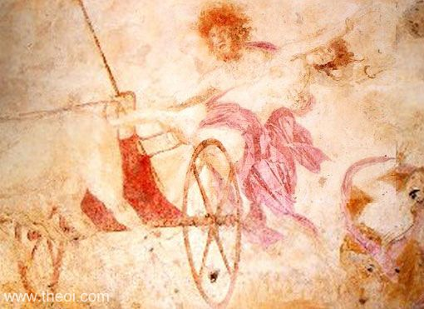

Slide 13
Rape of Persephone
James Childs
2002

Slide 14
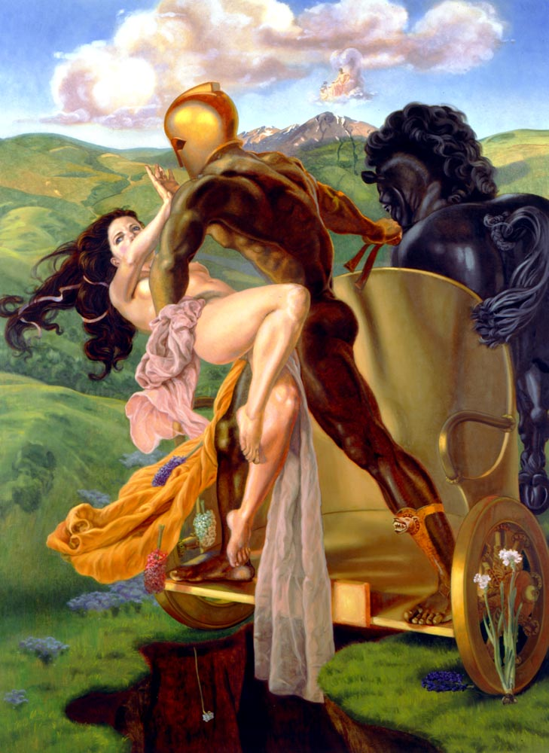

Slide 15
Rape of Persephone
Christoph Schwartz
1500s

Slide 16
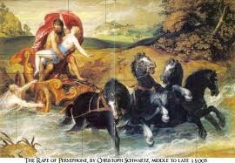

Slide 17
Rape of Persephone
Luca Giordano, 1686
London National Gallery

Slide 18
