Slide 1
Pyramus and Thisbe
Mercedes Streeter Nikki Hurt Henry LeCrone

Slide 2
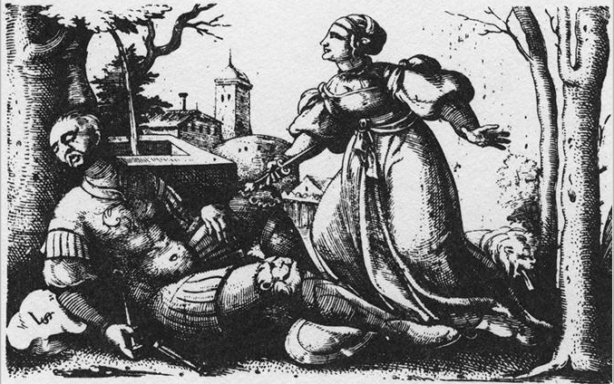
Virgil Solis
Pyramus and Thisbe
engraving
Berlin
6th Century
http://library.artstor.org/library/ExternalIV.jsp?objectId=8zJTcjI2ISNeJyU4ez5%2B
Notes:
Gregorio Pagani’s representation shows the moment after Thisbe discovers Pyramus is dead. The sword is still in Pyramus’s dead body and Thisbe is gently gripping the very tip of it; probably anticipating the move to take her own life. This part of Ovid’s myth is after the incident where she sees a lion and is frightened and leaves her veil behind. Pyramus spots her veil and believes the lion has eaten her so he kills himself. This painting depicts the part in Ovid’s myth before she kills herself. Things to point out: Cupid statue symbolism of their love for one another, Thisbe’s veil wrapped around Pyramus’s left arm, mulberry trees played a major part in the myth because the mulberry’s were white before the death of the two lovers and after turned a dark red because of their blood. The fruit was changed to red to honor their love, and hinting in the midst of the trees we catch a glimpse of buildings could also represent the home of where the two lived next to one another and were not allowed to wed because their parent’s rivalry. This art piece does not show the lion.

Slide 3
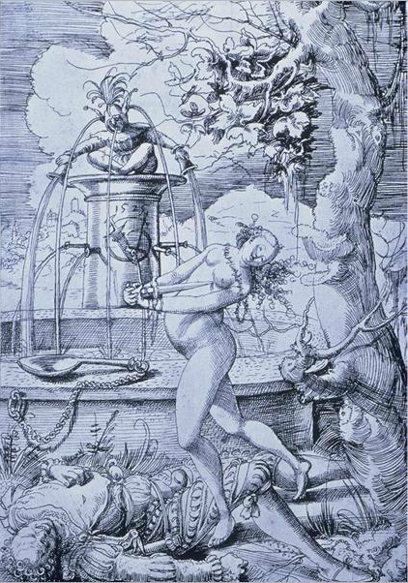
Pyramus & Thisbe
Urs Graf
1525
University of California, San Diego
http://library.artstor.org/library/ExternalIV.jsp?objectId=8CJGczI9NzldLS1WEDhzTnkrX3gqf1d8diQ%3D
Notes:
Graf depiction shows Thisbe about to stab herself with Pyramus’s sword. She has discovered his dead body and is about to kill herself.

Slide 4
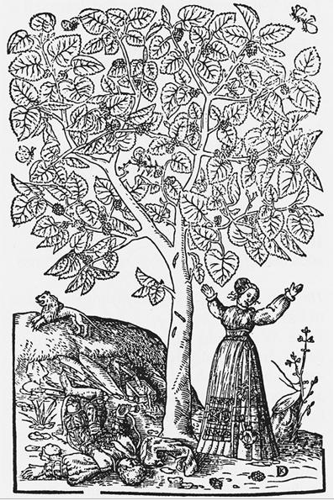
The Tragedy of Pyramus and Thisbe Beneath a Mulberry Tree
David Kandel
Bock, Kreuterbuch, Germany
1546
Woodcut
http://library.artstor.org/library/ExternalIV.jsp?objectId=8zJTcjI2ISNfJiE8ezh9
Notes:
This would have to be the most Ovidian, it includes most major points in the story that the others did not. Like how the first sculpture only showed Thisbe coming upon the dead Pyramus or the second painting only showing them coming up with the plan to meet. This painting shows the tree, the lion, and Thisbe coming upon the dead Pyramus. The lion portion of this myth happens after they create the plan. Thisbe goes to the tree is then chased off by the lion and her veil is torn off and covered in blood. Pyramus then finds the veil and assumes she had died (been eaten).

Slide 5
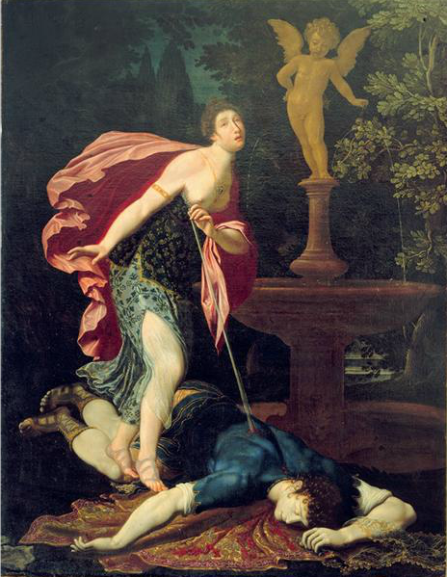
Gregorio Pagani
Pyramus and Thisbe
painting
c. 1600
oil on canvas
Galleria delgi Uffizi, Florence, Italy
http://library.artstor.org/library/ExternalIV.jsp?objectId=4iFCeTg4NCciJy8laCt2KngqVXkhf158fg%3D%3D
Notes:
Virgil Soil’s representation shows the moment where Thisbe is taking the sword and about to stab herself. This part of Ovid’s myth is after the incident where she sees a lion and is frightened and leaves her veil behind. Pyramus spots her veil and believes the lion has eaten her so he kills himself. This part in Ovid’s myth is right before her death. Things to point out: Lion in the background Major part of the story he is the reason for them both dying, the castle-like compounds in the background shows where they possibly lived giving tribute to the fact they lived extremely close to one another and their parents forbid them to wed because of their parents rivalry, and the trees all around the borders of the art piece signify the mulberry tree. The mulberry played a major part in the myth because the mulberry’s were white before the death of the two lovers and after turned a dark red because of their blood. The fruit was changed to red to honor their love. No veil is in this piece.

Slide 6
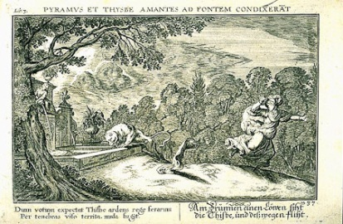
Johann Wilhelm
1600-1640
http://david-drake.com/ovid-translations/metamorphoses-pyramus-and-thisbe/
Notes:
The depiction by Johann Wilhelm Baur shows Thisbe running from the lion and fear and her cloak falling off her back.

Slide 7
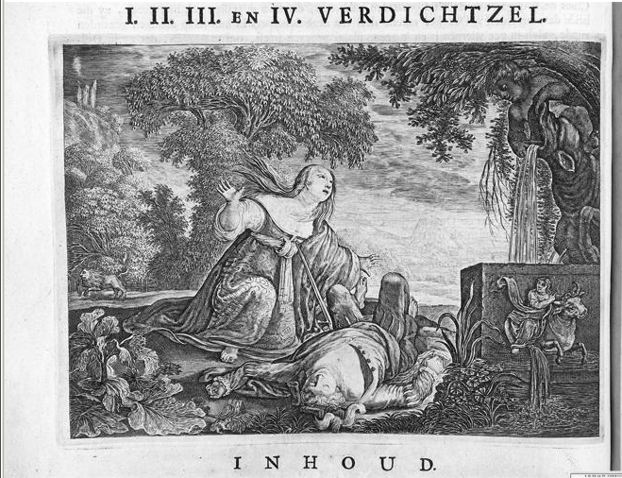
Thisbe discovers the body of her lover Pyramus
Work Type: print; book illustration
text 1st century BCE; engraving published 1703
Engraving
The Warburg Institute Library, London, United Kingdom
http://library.artstor.org/library/ExternalIV.jsp?objectId=8CdWZyUxLSE9IjZUej54RngvX3wicQ%3D%3D
Notes:
The unnamed artists representation also shows the moment after Thisbe discovers Pyramus is dead. The sword is just beginning to stab Thisbe’s chest. This part of Ovid’s myth is after the incident where she sees a lion and is frightened and leaves her veil behind. Pyramus spots her veil and believes the lion has eaten her so he kills himself. This painting depicts the part in Ovid’s myth at the moment she begins to kill herself. Things to point out: perhaps its Cupids fountain symbolizing their love for one another, mulberry trees are very much a part of this art piece and played a major part in the myth because the mulberry’s were white before the death of the two lovers and after turned a dark red because of their blood. The fruit was changed to red to honor their love, the lion on the left hand side because he is the reason why they both kill themselves. No veil is in the piece.

Slide 8
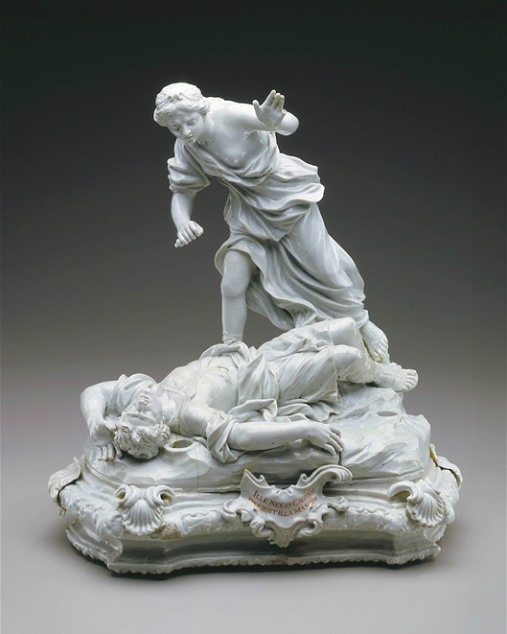
Pyramus and Thisbe
Doccia Porcelain Factory
Southern European; Italian
1745-50
White Doccia Porcelain
The Detroit Institute of Arts
Detroit, Michigan
http://library.artstor.org/library/welcome.html#3|search|5|2020Pyramus20and2C20Thisbe|Advanced20Search|||type3D3526kw3DPyramus7Call23and2CThisbe7Call26geoIds3D26clsIds3D26id3Dall26bDate3D26eDate3D26dExact3D30
Notes:
Follows Ovid correctly, the only difference being that there is no Mulberry Tree above them. Depict this portion of the myth relating to how Pyramus assumed that because he found a bloodied veil of Thisbe’s that she had been killed by the lion. And thus caused him to commit suicide. However; she was not died and she came upon him after he died under the Mulberry Tree and killed herself. This myth explains how the Mulberry berrys got their color (blood).

Slide 9
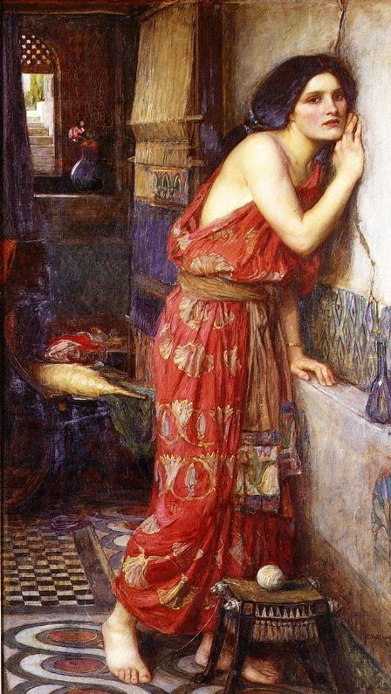
Thisbe
Private Collection
1909
Oil on Canvas
http://www.johnwaterhouse.com/view.cfm?recordid=57
Notes:
Seems to follow Ovid. Showing how they were separated by their parents because they hated each other. They grew up in Babylon next to each other and fell in love; their parents denied them marriage. This is when they hatched their plan to meet under the Mulberry Tree. They had the conversation through the crack in their separating wall.

Slide 10
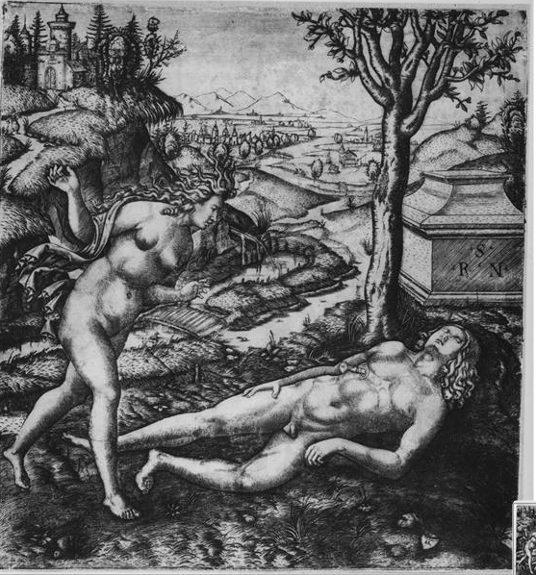
Marcantonio Ralmandi
Pyramus and Thisbe
Vienna
http://library.artstor.org/library/ExternalIV.jsp?objectId=8zJTcjI2ISNeKC89ez18
Notes:
Marcantonio Ralmandi depictions show the moment when Thisbe discovers the dead body of Pyramus. Her is wild and she appears to have a look of distress on her face.

