Slide 1
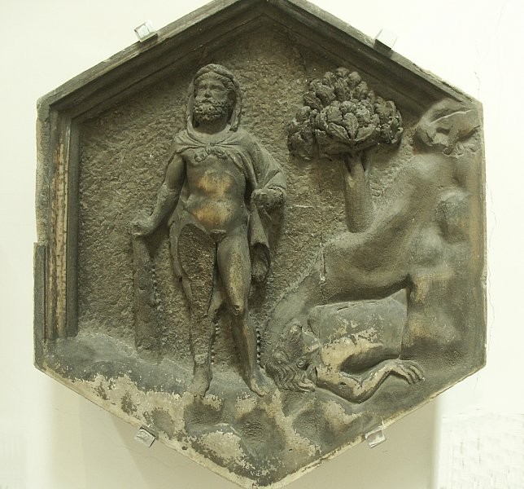
Hercules in Medieval and Renaissance Literature
Macrobius (Ambrosius Theodosius Macrobius) 4th cent.
  Dream of Scipio
  Saturnalia
Dante (Durante degli Alighieri, c.1265–1321)
  The Divine Comedy
Giovanni Boccaccio (1313 –1375)
  De Genealogia deorum gentilium (“On the Genealogy of the pagan gods”)
  De praeclaris mulieribus (On Famous Women)
Petrarch (Francesco Petrarca, 1304–1374)
  De Viris Illustribus (On Famous Men)
Coluccio Salutati (1331-1406)
  De laboribus Herculis (“On the Labors of Hercules”)
  Epistolario (“Letters”)

Slide 2
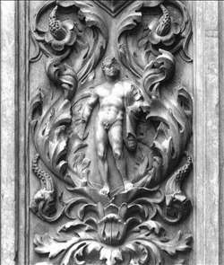
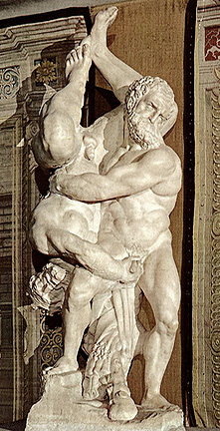
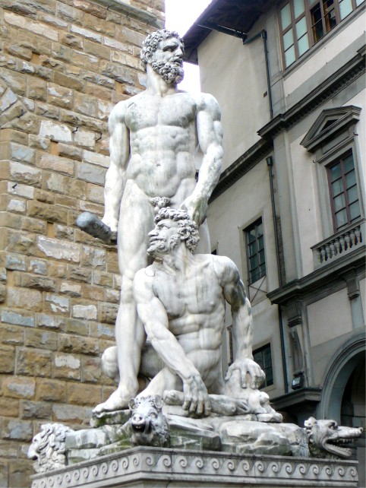
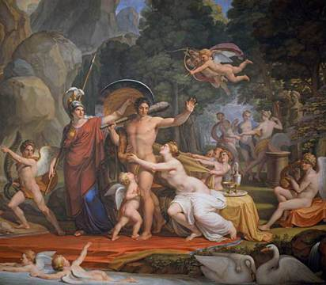
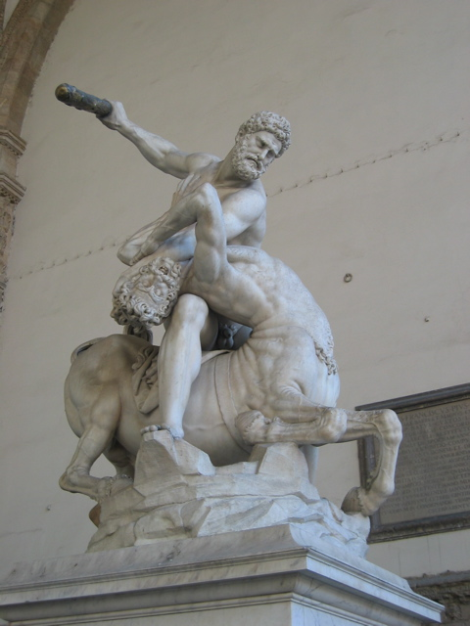
Hercules in Florence
De Rossi.
Palazzo Vecchio
Porta della Mandorla (Duomo)
Bandinelli.
Palazzo Vecchio
Benvenuti. Pitti Palace
Campanile of Duomo
Giambologna. Loggia dei Lanzi

Slide 3
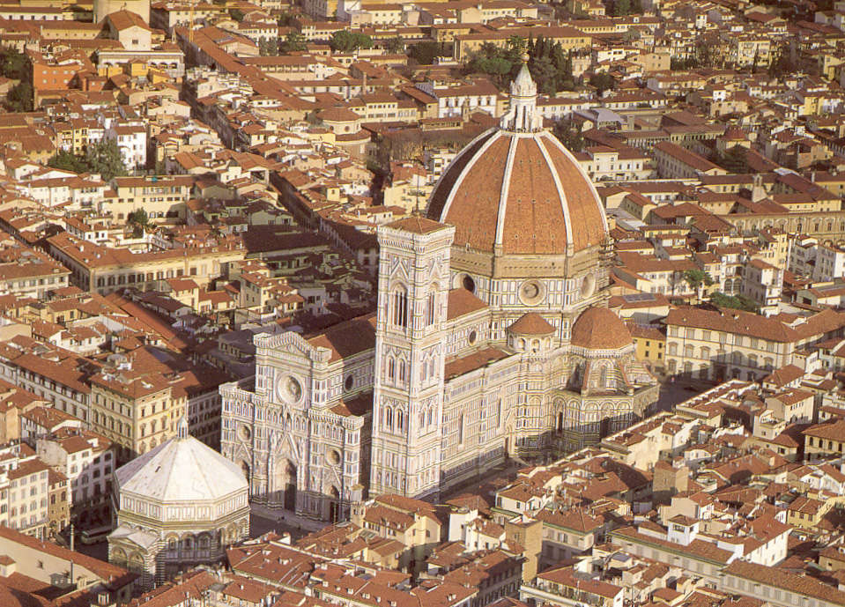
Baptistery, Duomo, Campanile

Slide 4
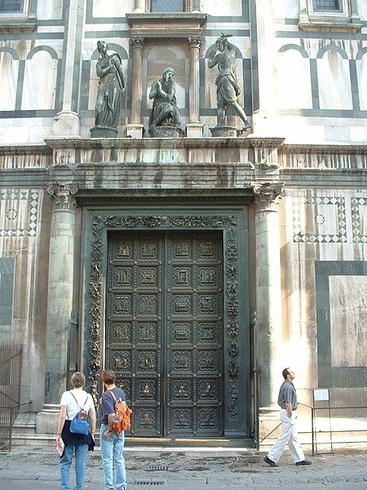
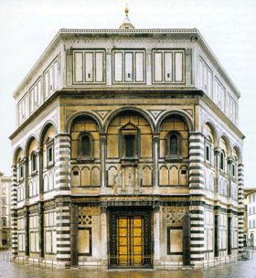
Andrea Pisano’s Baptistery Doors (1336)

Slide 5
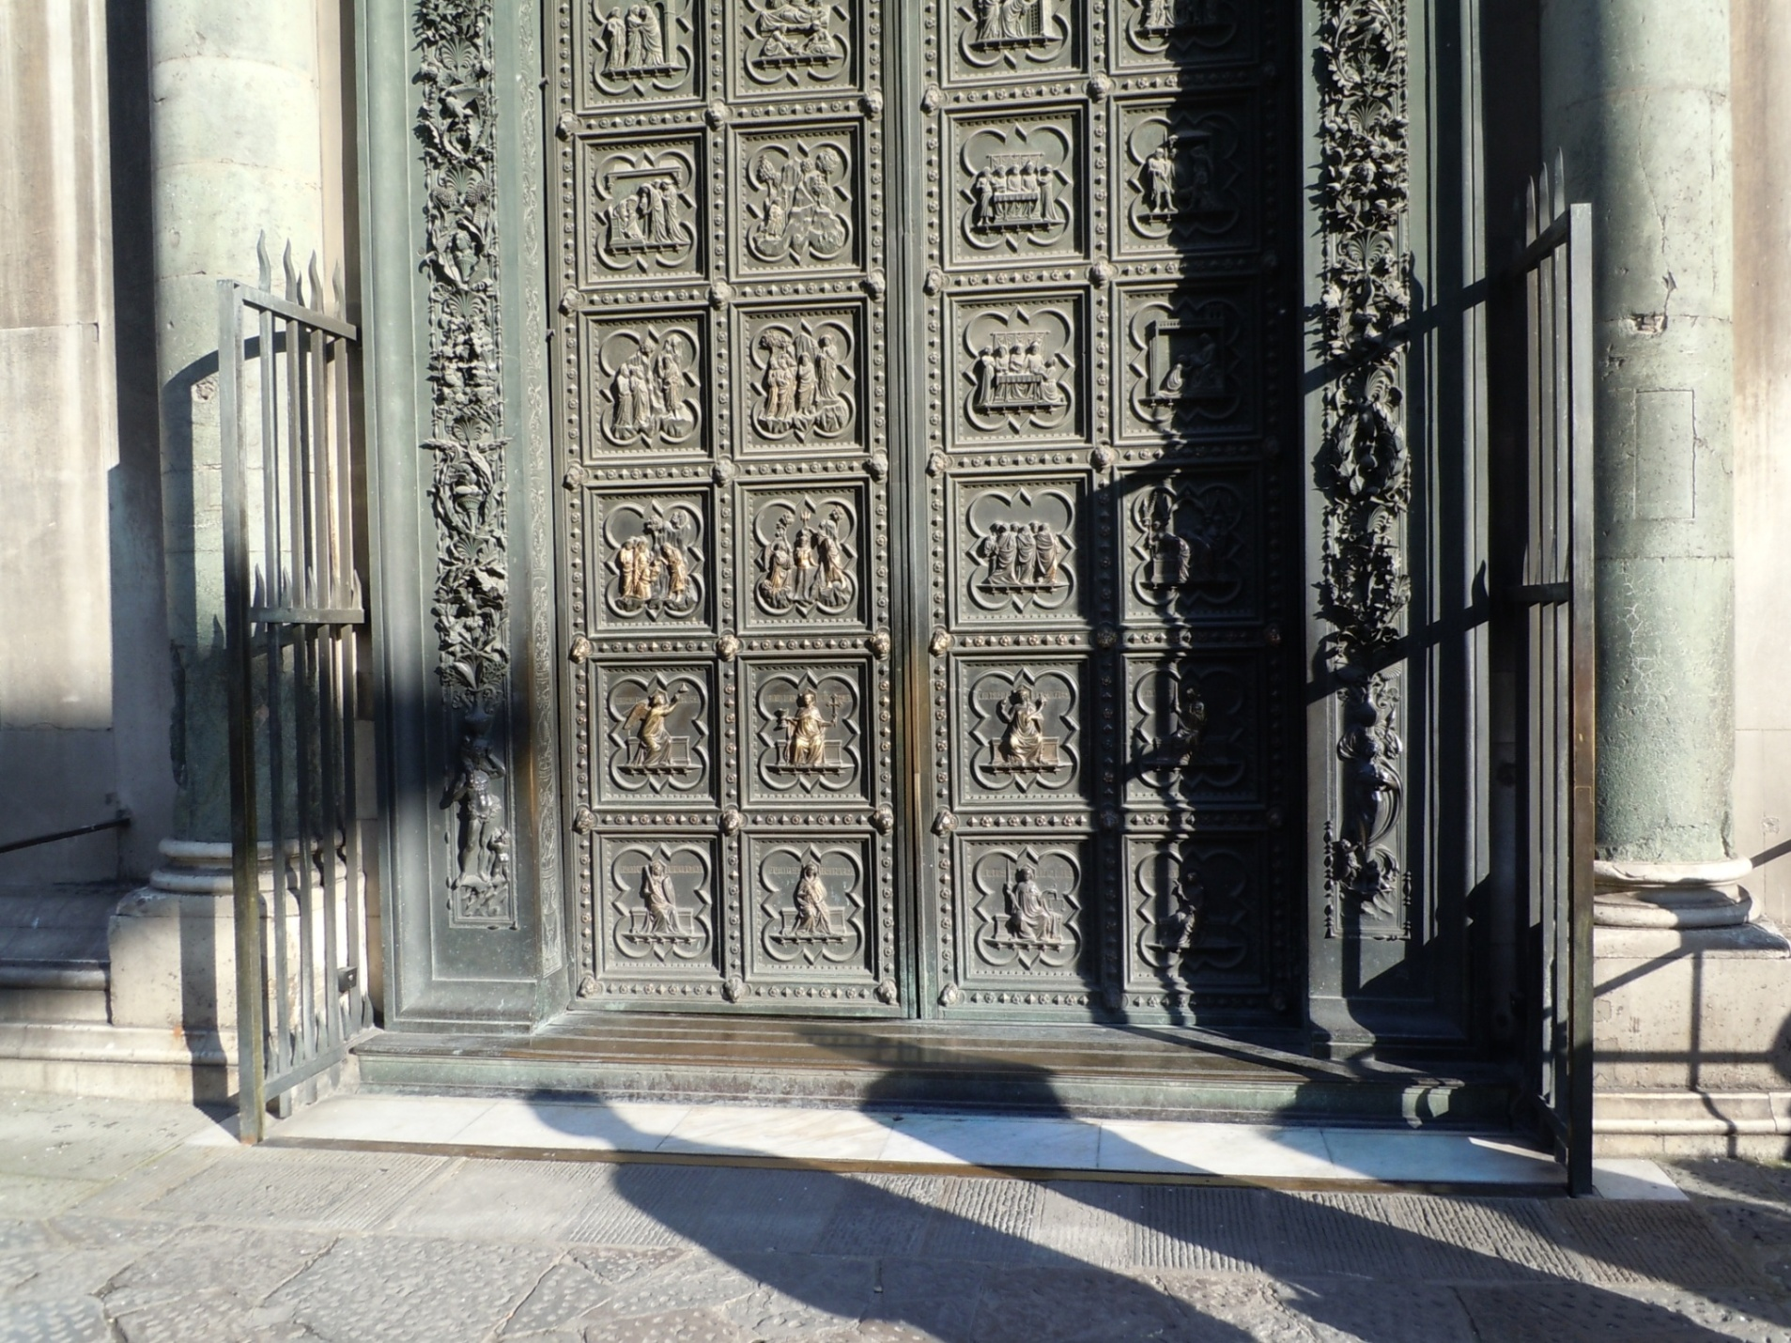
http://www.bluffton.edu/~sullivanm/italy/florence/pisanosouth/pisanosouthdoors.html
http://commons.wikimedia.org/wiki/Category:South_Doors_of_the_Florence_Baptistry

Slide 6
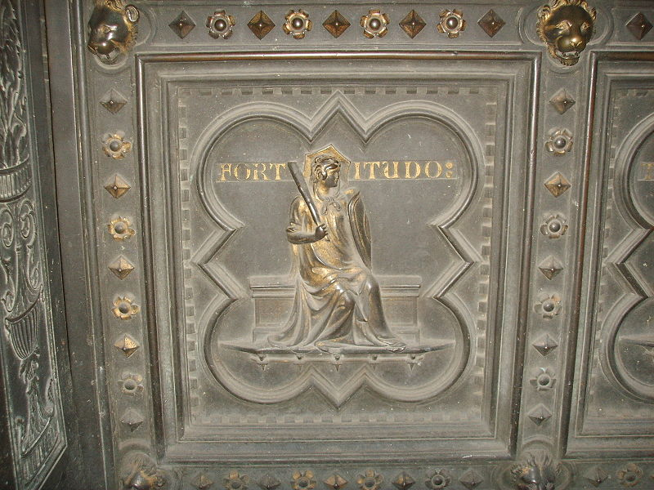

Slide 7
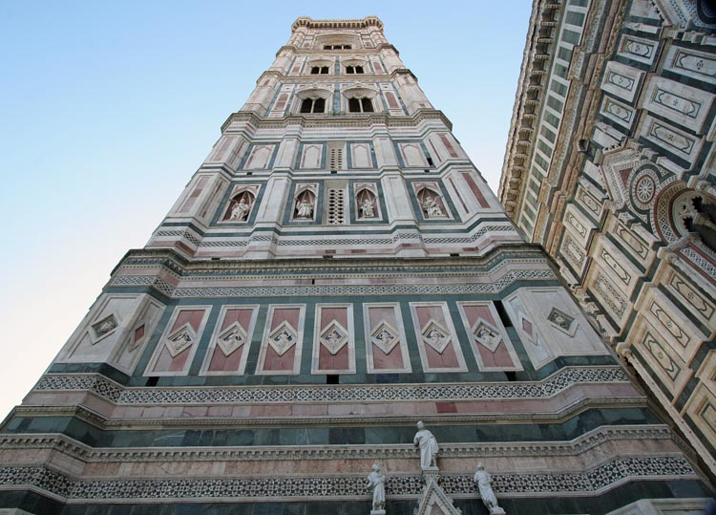
Giotto’s Campanile (1334 – 1359)
http://www.florence-guide.it/it/immagini/zoom-view/campanile-di-giotto

Slide 8
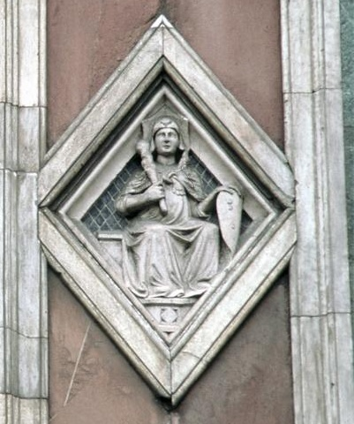
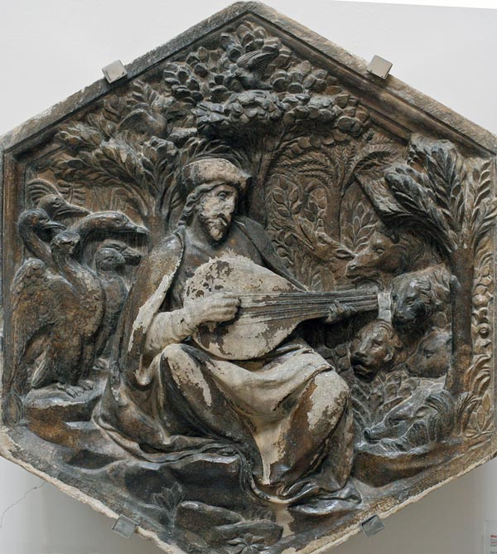
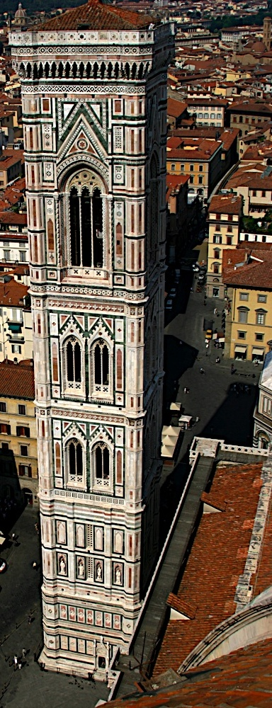
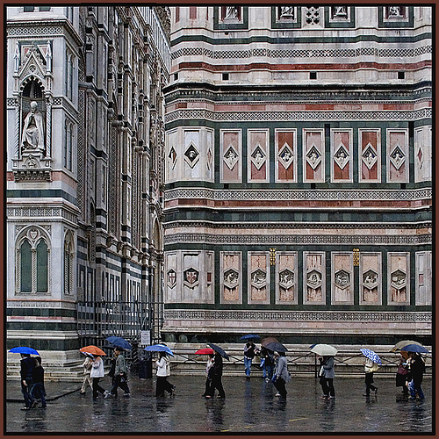
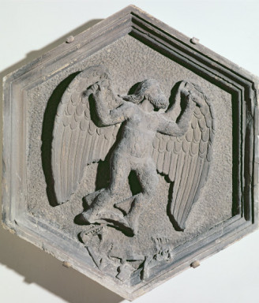
Giotto di Buoninsegna, Andrea Pisano and Fr. Talenti.

Slide 9
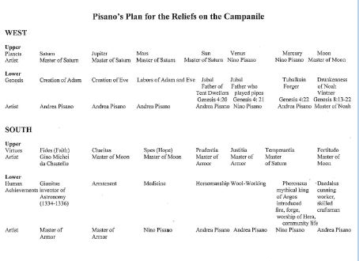

Slide 10
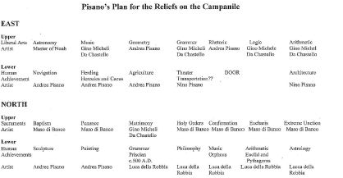

Slide 11
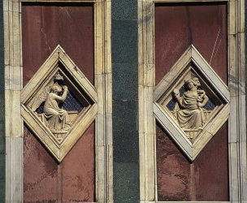
The Cardinal Virtues

Slide 12
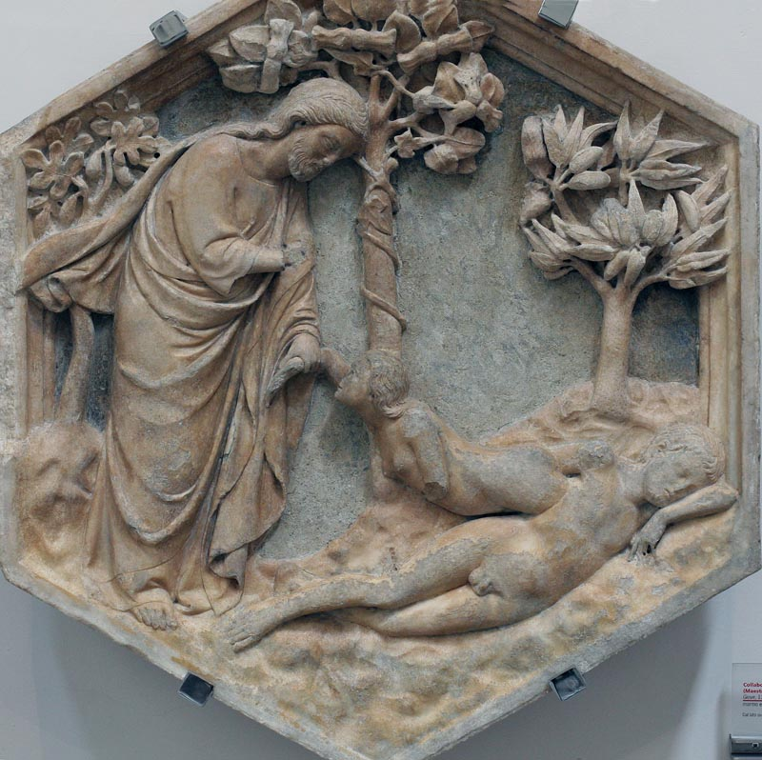

Slide 13
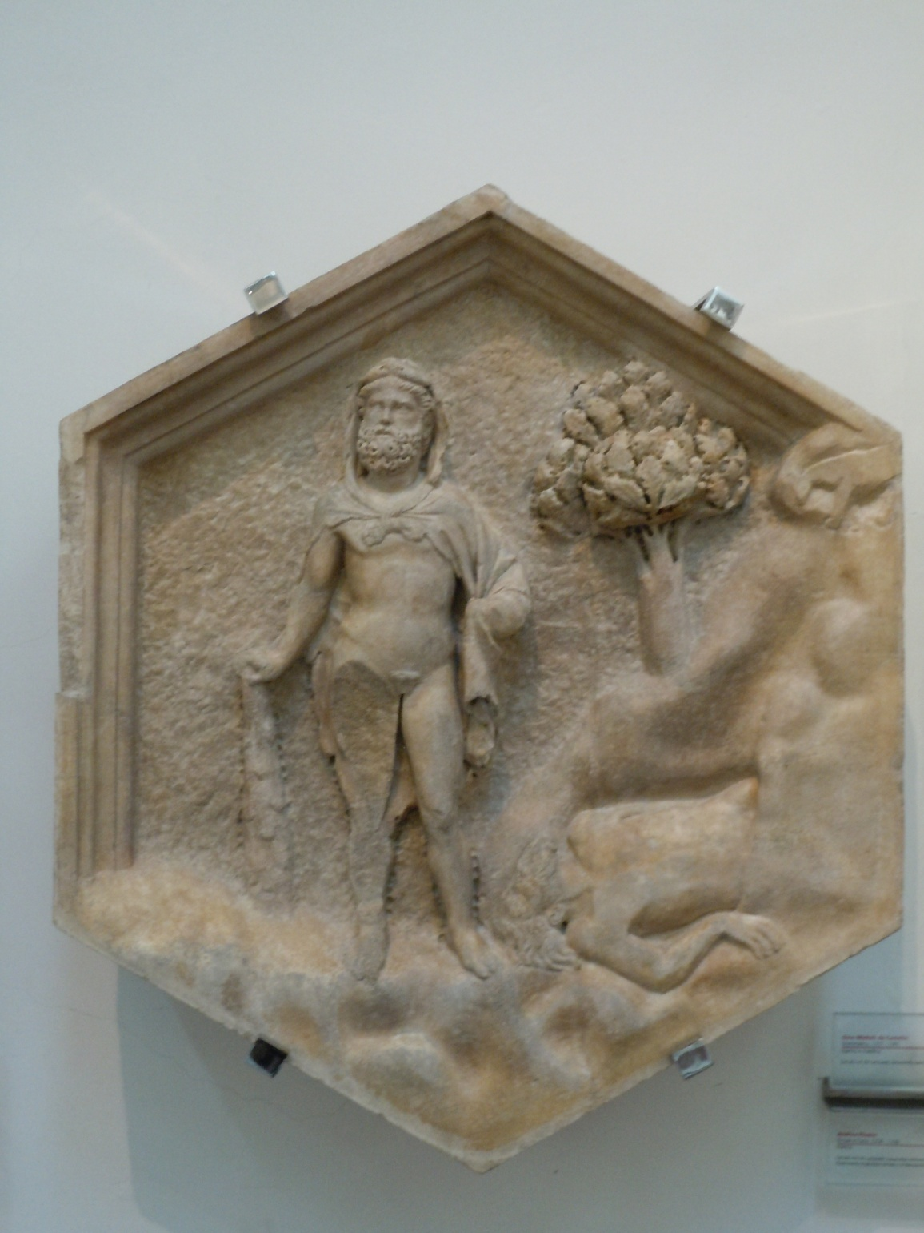

Slide 14
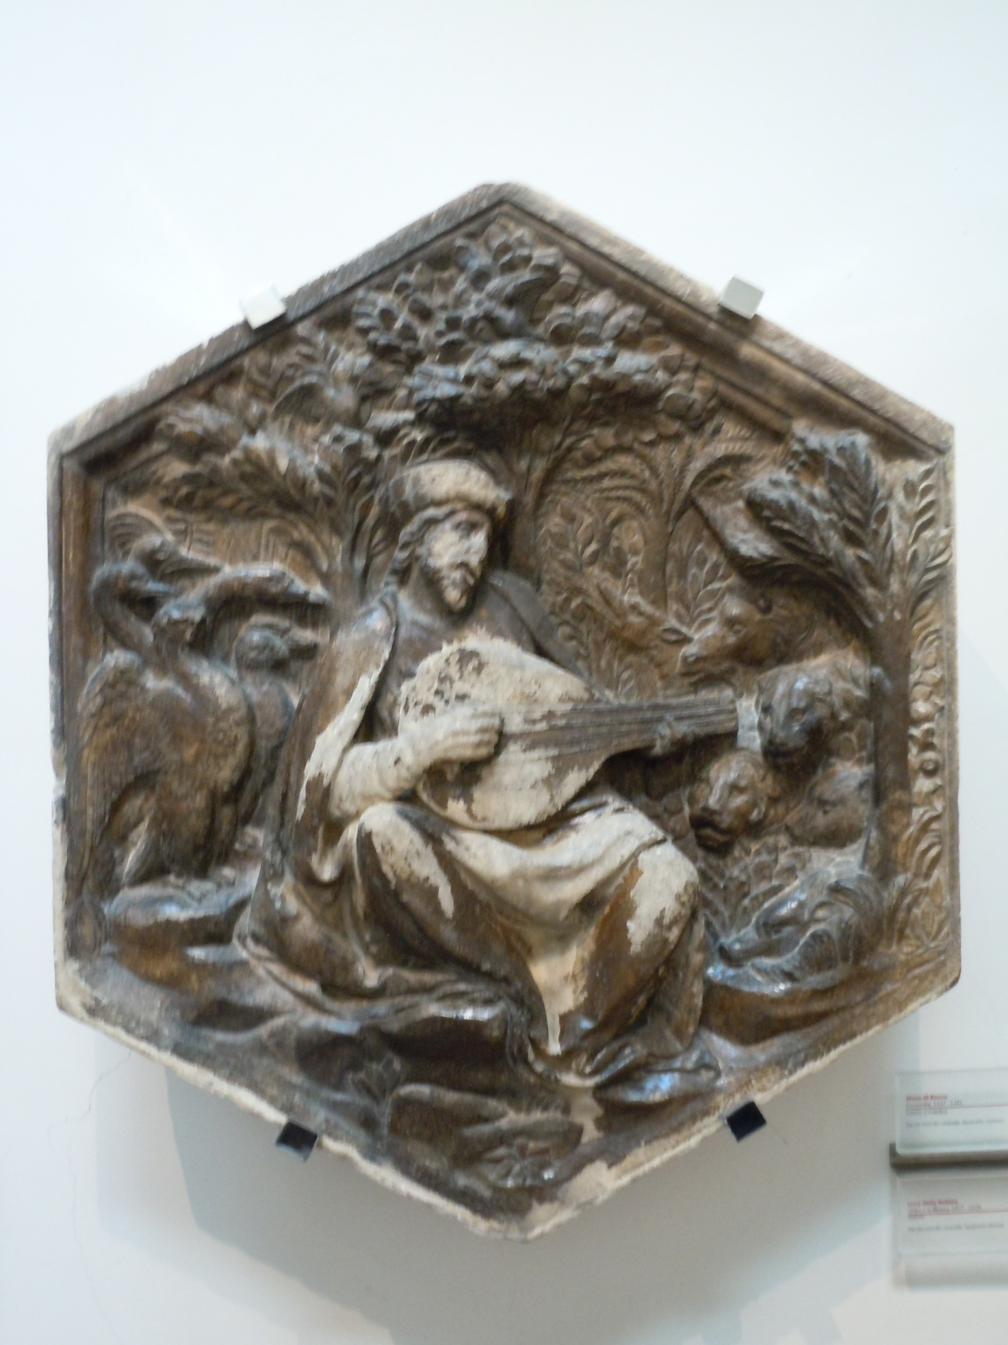

Slide 15
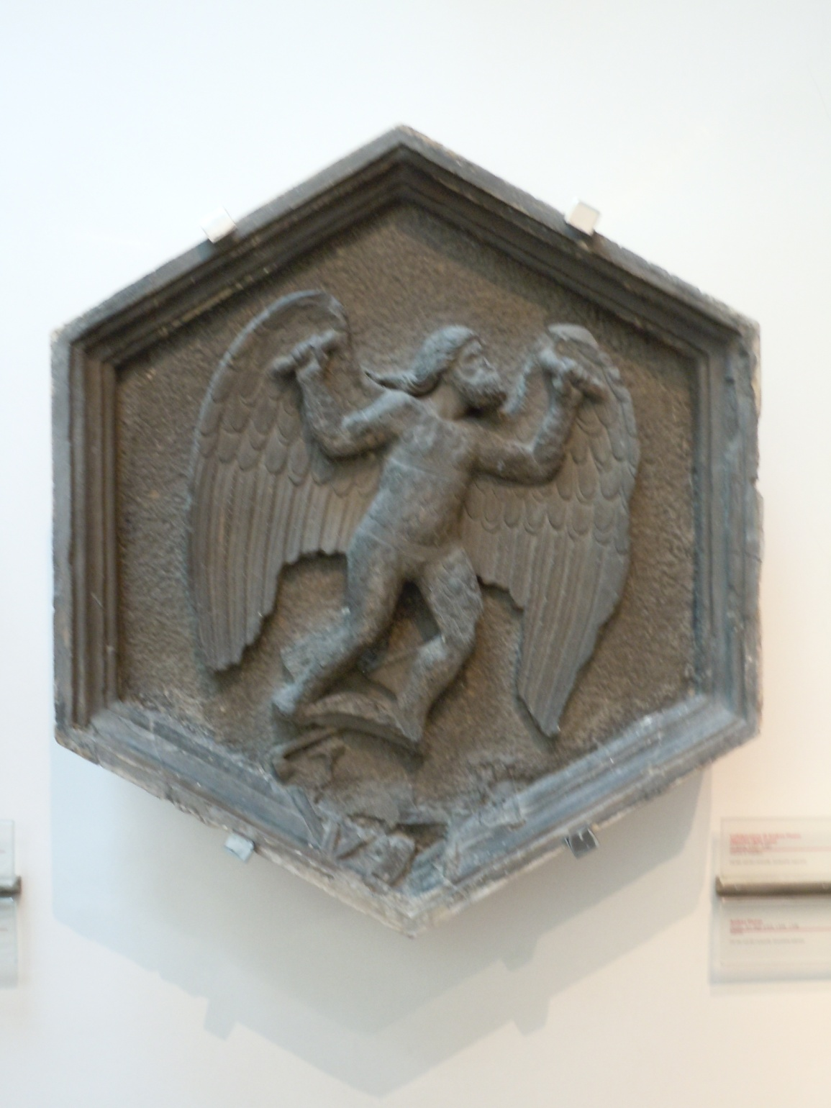

Slide 16
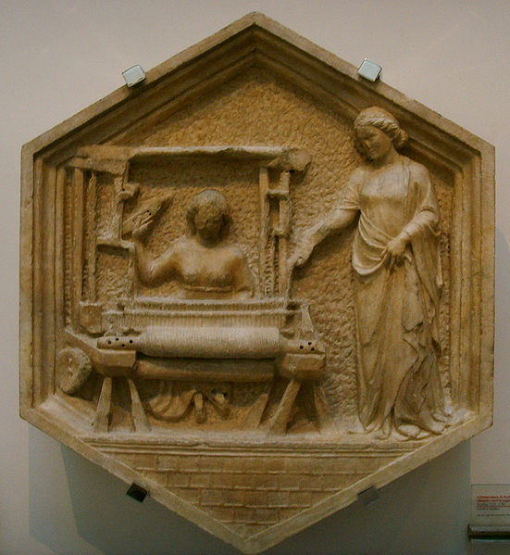

Slide 17
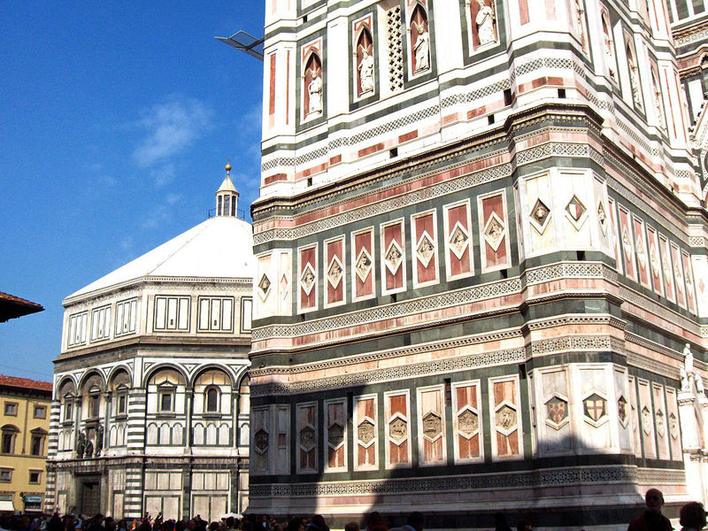
http://www.bluffton.edu/~sullivanm/italy/florence/duomomuseo/reliefscampanile.html
http://www.bluffton.edu/~sullivanm/pisano/reliefs.html

Slide 18
Other Websites on Campanile
http://www.bluffton.edu/~sullivanm/pisano/reliefs.html
http://www.christusrex.org/www2/art/santa_maria_del_fiore.htm
http://strose.lunaimaging.com:8180/luna/servlet/view/search?q=pisano
http://www.digital-images.net/Gallery/Scenic/Florence/Duomo/Campanile/campanile.html#EastSideSculptures
http://www.digital-images.net/Gallery/Scenic/Florence/Duomo/Campanile/campanile.html#EastSideSculptures

Slide 19
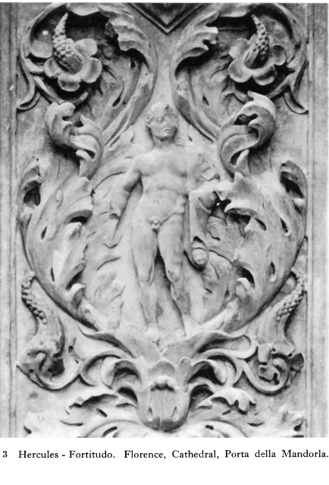
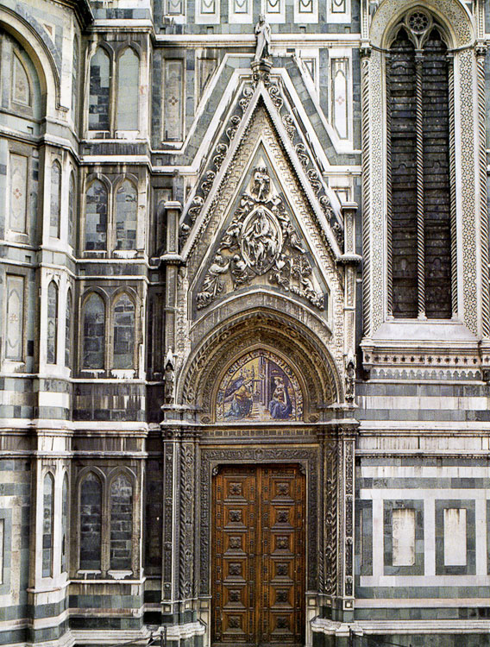
Hercules on the Porta della Mandorla of the Duomo
c.1391-1405, was carved by Giovanni d’Ambrogio, Piero di Giovanni Tedesco, Iacopo di Piero Guidi, and Niccolo Lamberti.

Slide 20
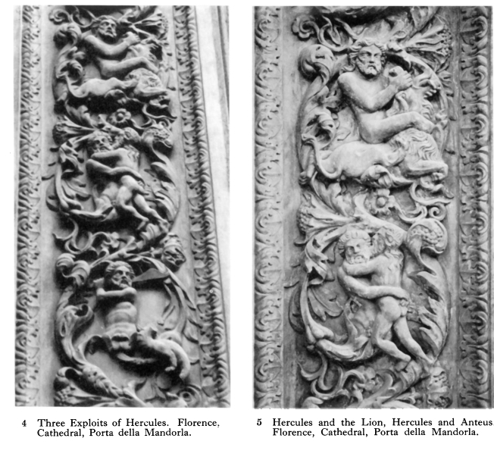

Slide 21
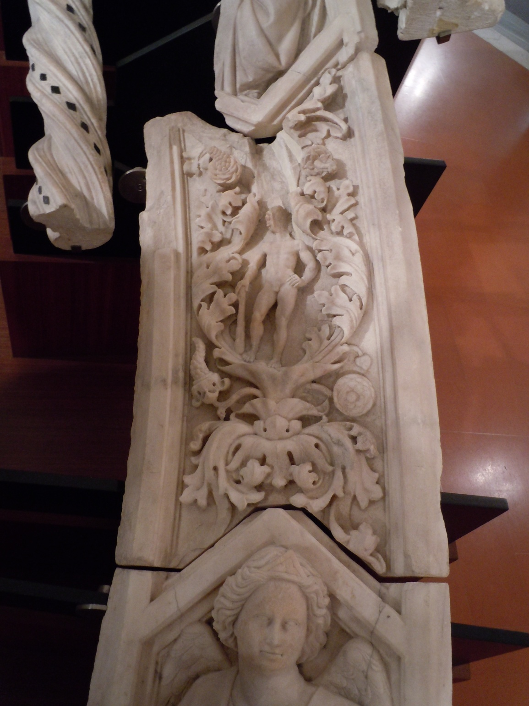

Slide 22
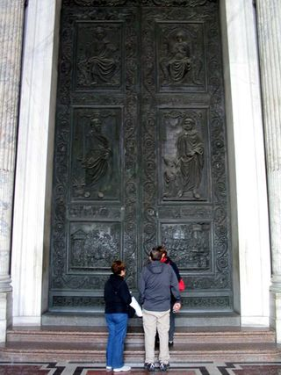
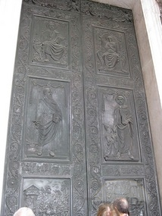
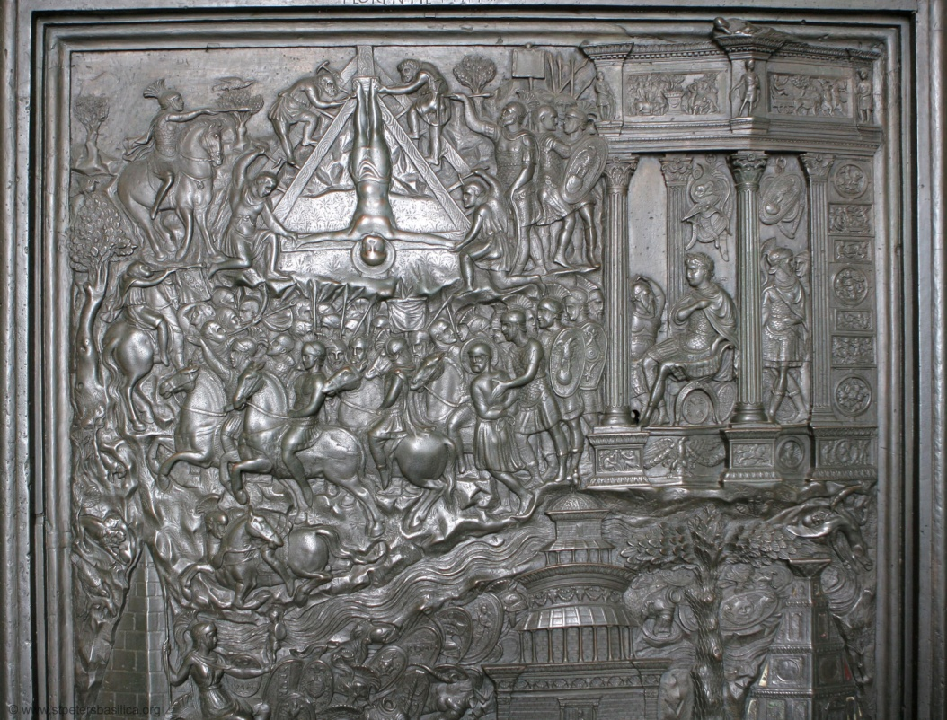
Filarete’s doors for old St. Peter’s (1445)

Slide 23
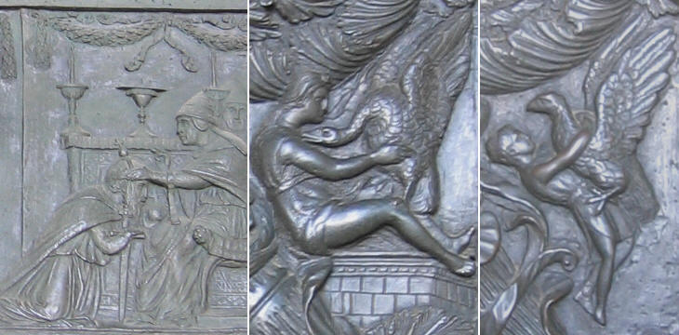
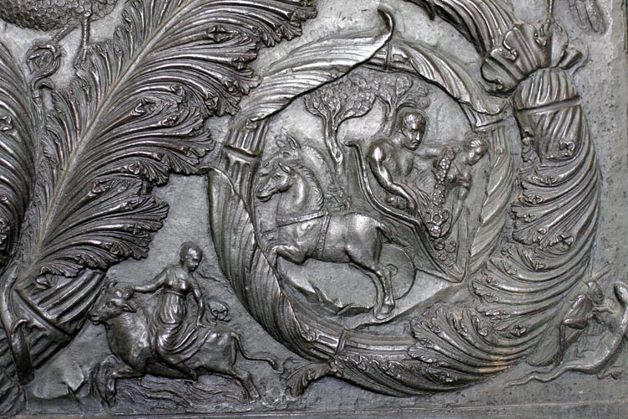

Slide 24
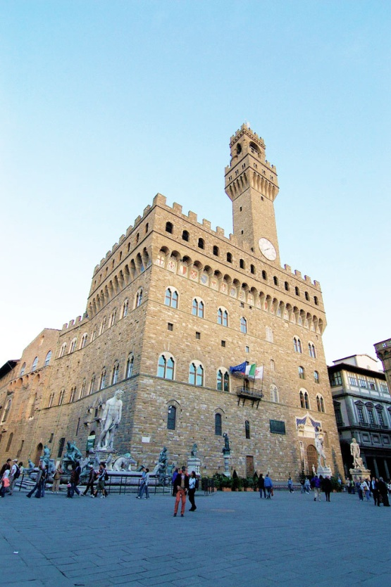
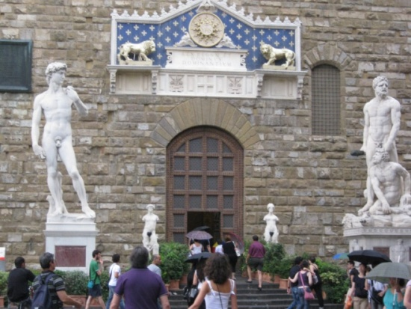
Piazza della Signoria
Bandinelli. Hercules. 1534

Slide 25
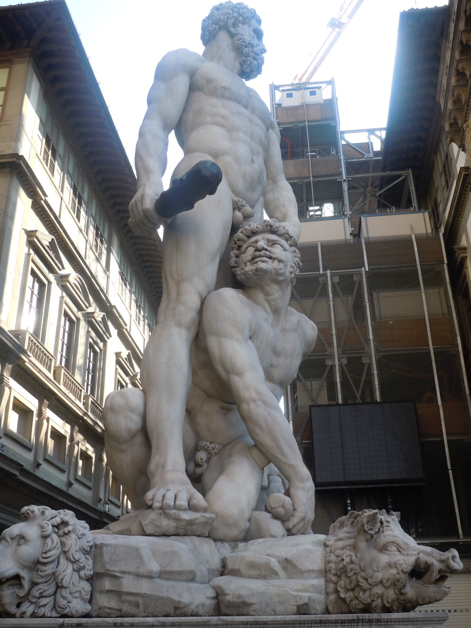

Slide 26
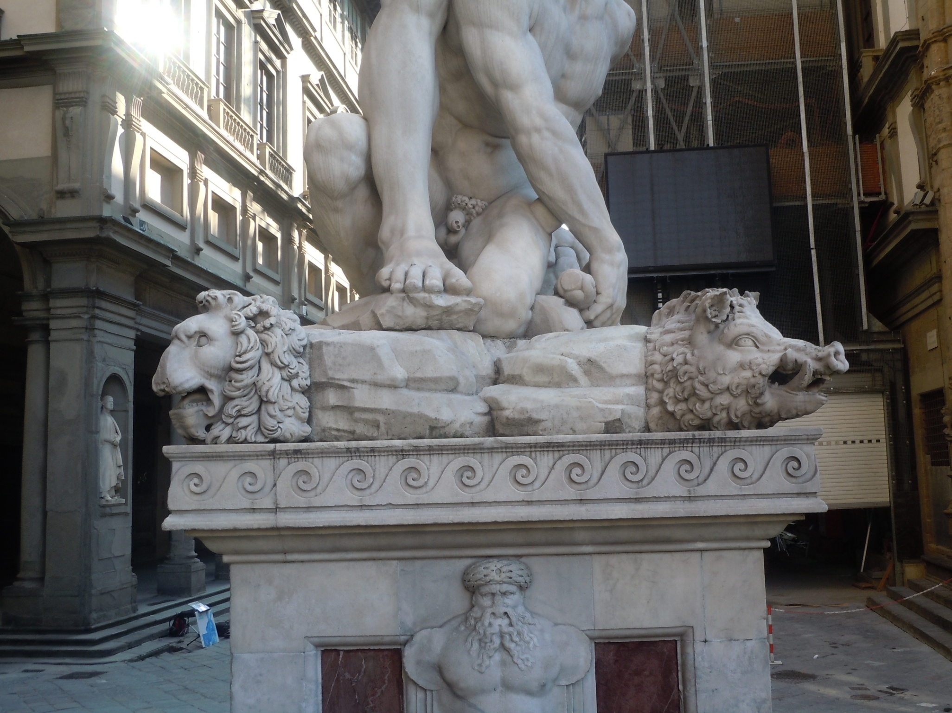

Slide 27
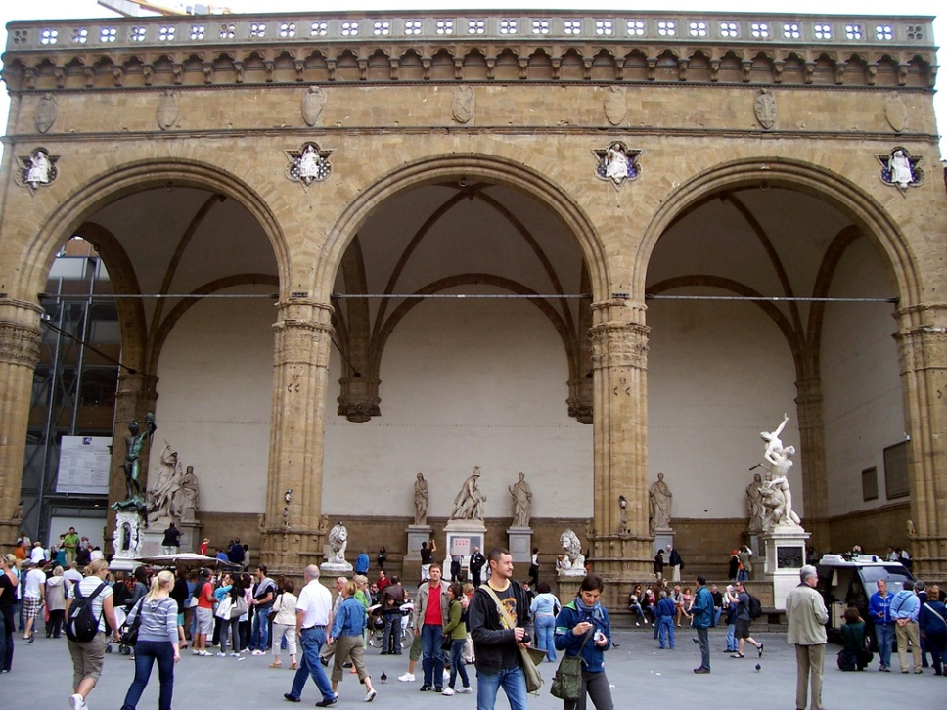
Loggia dei Lanai in Piazza della Signoria
Loggia dei Lanzi
Giambologna.
Hercules and Nessus 1594

Slide 28
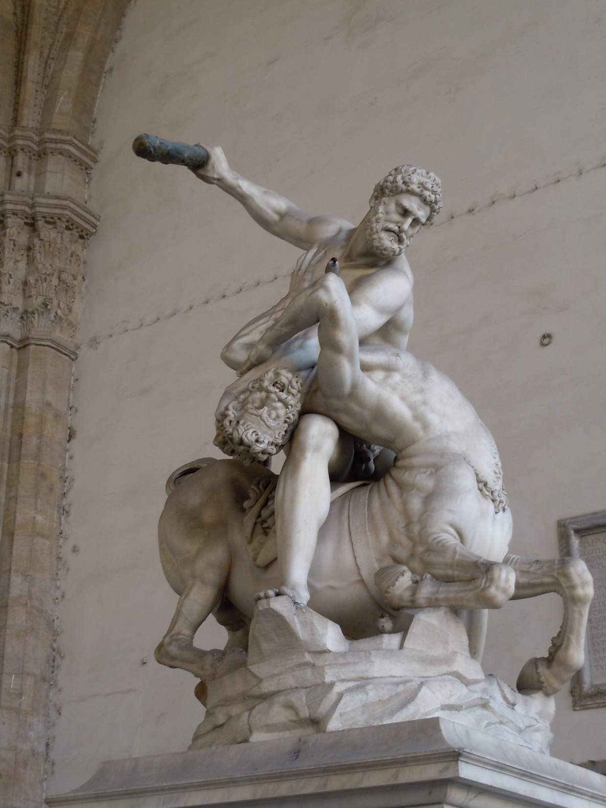

Slide 29
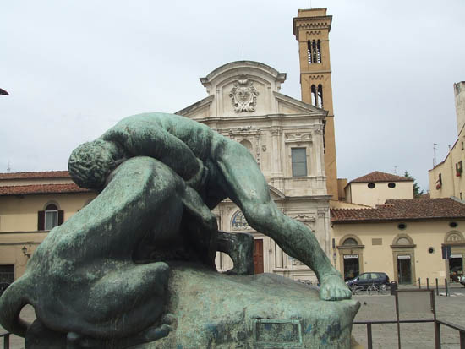
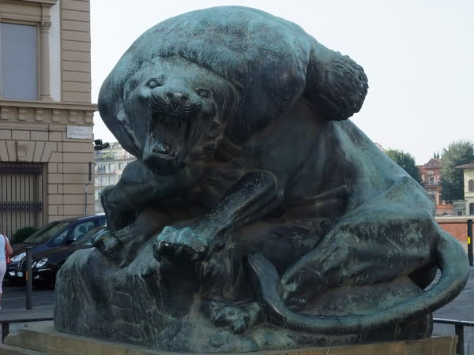
Piazza Ognissanti
Romanelli. Hercules and Nemean Lion
1907

