Slide 1
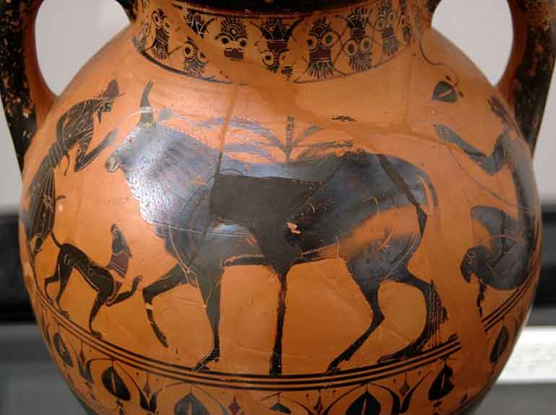
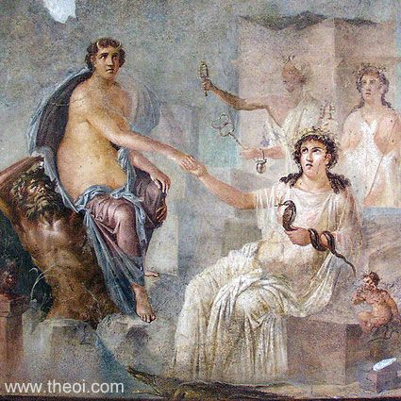
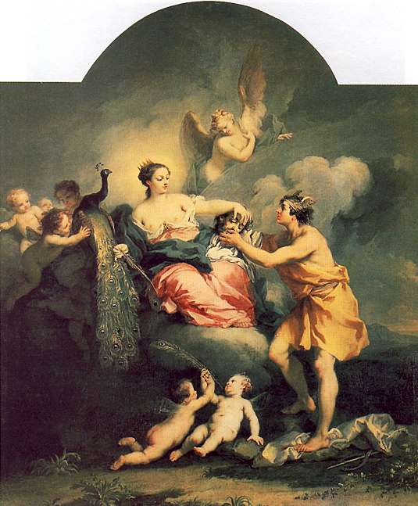
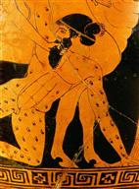
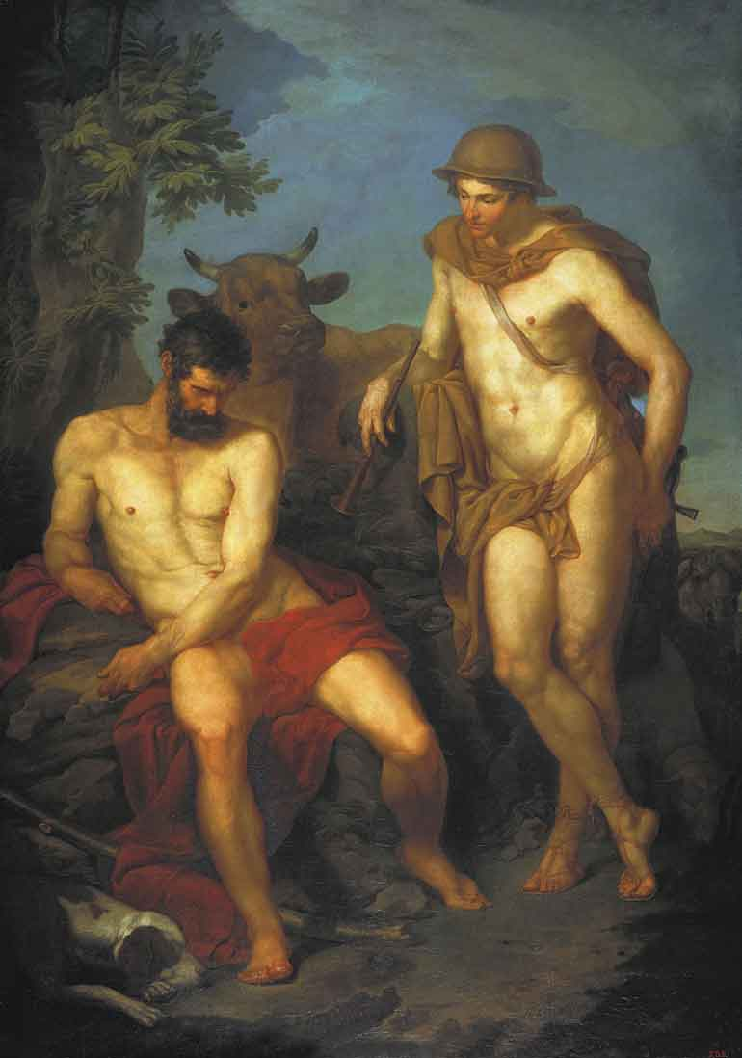
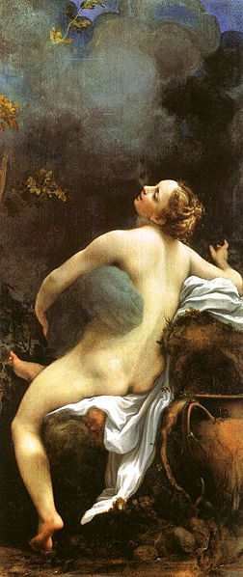
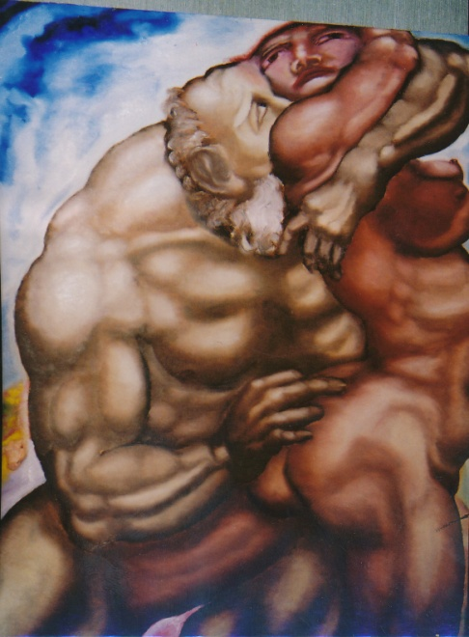
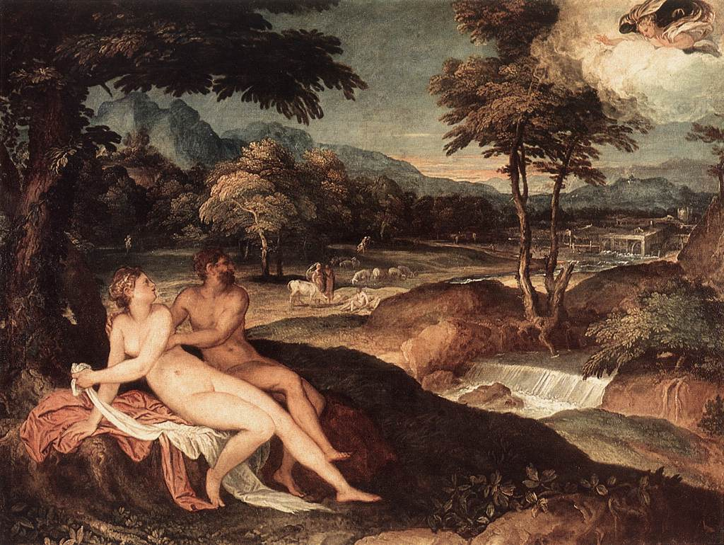
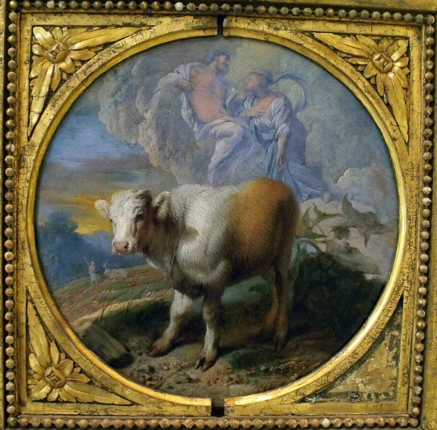
Io

Slide 2
Io and Argus
Some Useful Websites
http://www.theoi.com/Heroine/Io.html
http://www.artres.com/c/htm/PrintableThumb.aspx?Base=SEA&Box=&E=22SIJM5TB46HD&Pass=&TTitle=Search%20result&Page=1&DocPerPage=200
http://www.mlahanas.de/Greeks/Mythology/Argus.html
http://www.theoi.com/Gigante/GiganteArgosPanoptes.html

Slide 3
Staatliche Antikensammlungen, Munich, Germany. Accession number Inv. 585
Hermes, Io (as cow) and Argus. Side A from a Greek black-figure amphora, 540/30 BC.
Found in Italy.

Slide 4
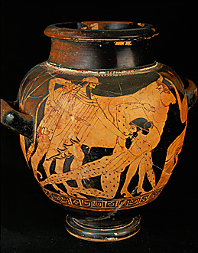
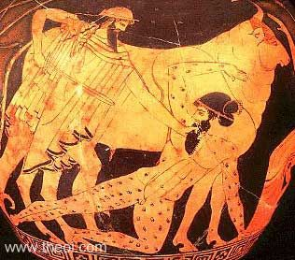
Museum Collection: Kunsthistorisches Museum, Vienna, Austria
Catalogue Number: Vienna 3729, Beazley Archive Number: 202608
Attic Red Figure Stamnos
Attributed to the Argos Painter

Slide 5
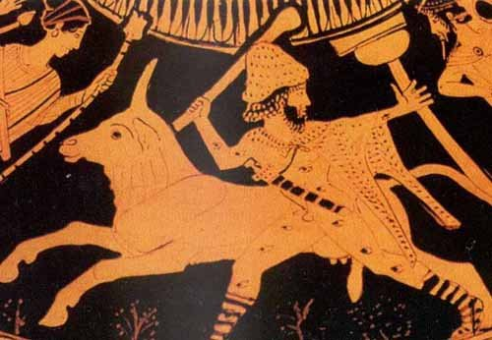
Argus Panoptes Guarding the Heifer (Io), Red Figure pitcher, c. 460 BC Museum of Fine Arts, Boston

Slide 6
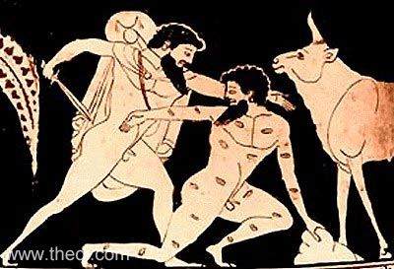
Museum Collection: Museum fur Kunst und Gewerbe, Hamburg, Germany
Catalogue No.: Hamburg 1966.34, Beazley Archive No.: 352495
Attic Red Figure Amphora, neck Date: ca 490 BC
Attributed to the Eucharides Painter

Slide 7
Museum Collection: Museo Archeologico Nazionale di Napoli, Naples, Italy
Fresco, Imperial Roman III Style
From Pompeii, Temple of Isis, Date: C1st BC

Slide 8
Sustris, Lambert( b. 1515/20, Amsterdam, d. after 1568, Padova).
St Petersburg, Hermitage Museum.

Slide 9
Jupiter and Io (1530)
Oil on linen canvas
Correggio (Antonio Allegri, Corrège)(Italian 1489-1534)
Kunsthistorisches Museum, Gemäldegalerie, Vienna

Slide 10
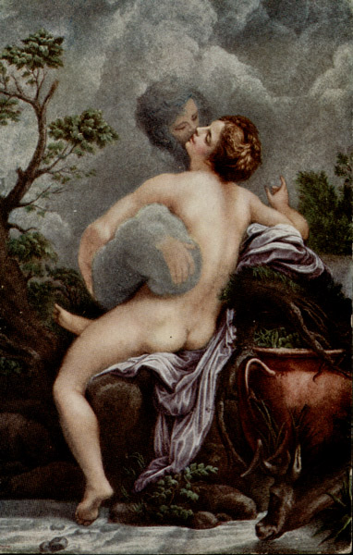
Postcard based on Corregigio’s painting
http://www.hugovandermolen.nl/briefkaarten/Correggio.php

Slide 11
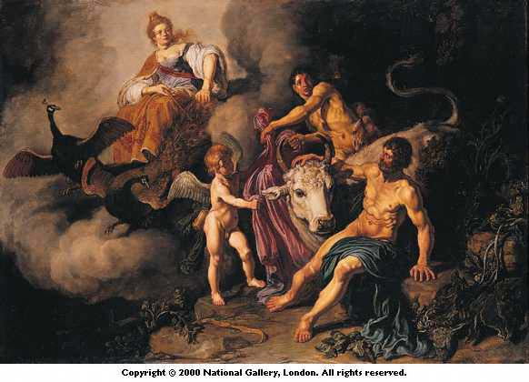
LASTMAN, Pieter
1583 – 1633
Painted: 1618
National Gallery, London

Slide 12
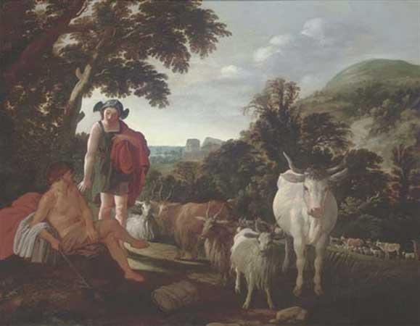
Moses van Uyttenbroeck. Argus and Mercury c. 1624
48.5 x 61.8 cm.
Currently on the art market

Slide 13
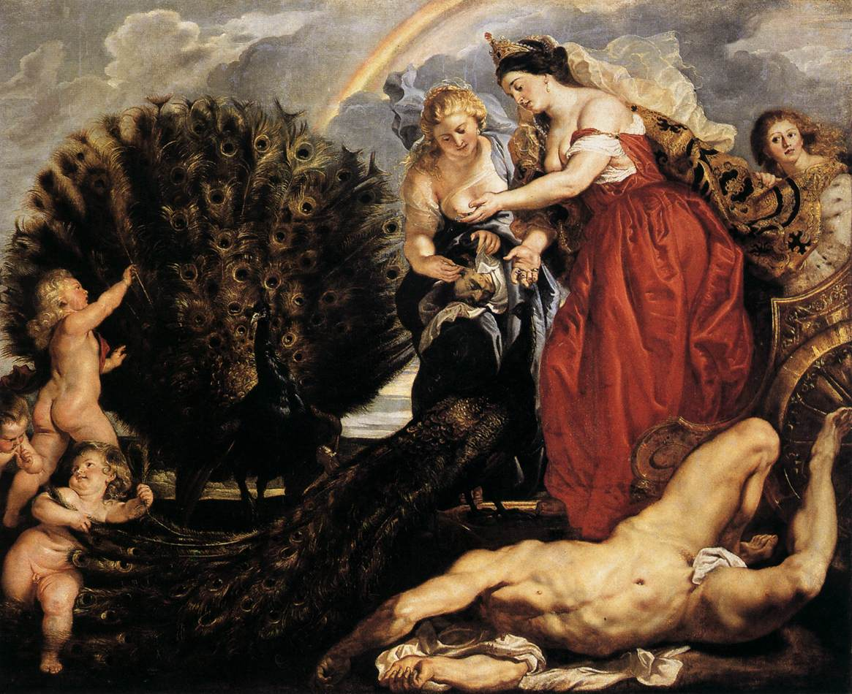
Juno and Argus. Peter Paul Rubens c. 1611. Wallraf-Richartz Museum, Cologne.

Slide 14
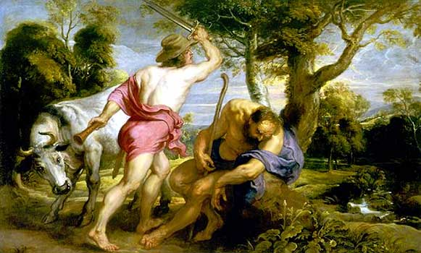
Mercury and Argus, c.1636
Peter Paul Rubens
179 cm x 297 cm
Prado Museum

Slide 15
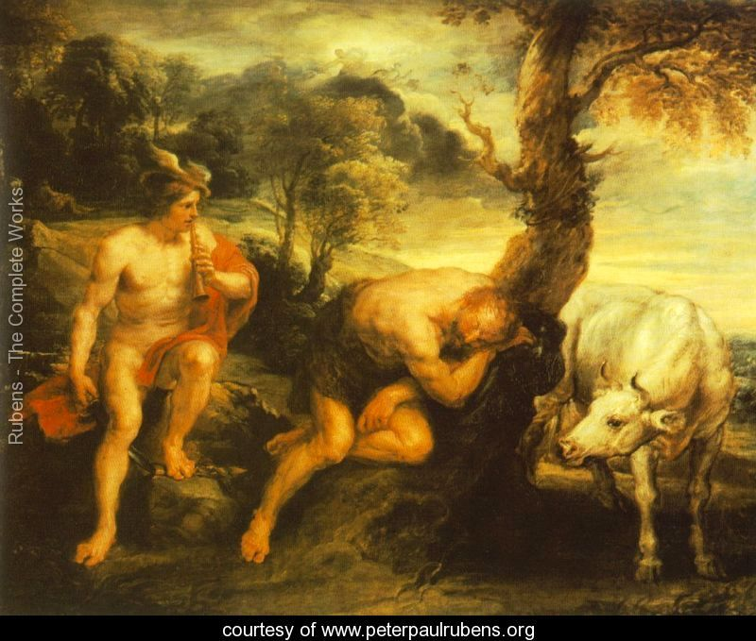
Mercury and Argus 1635-38
Peter Paul Rubens Gemäldegalerie, Dresden, Germany

Slide 16
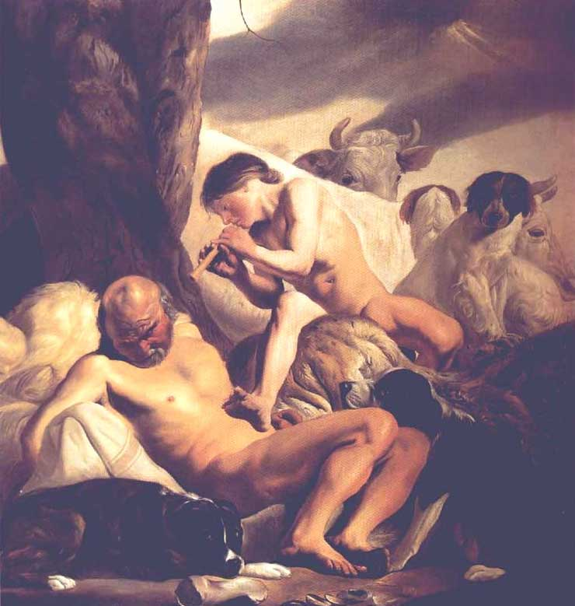
Mercury and Argus
Jacob van Campen
Argus, Hermes and Io
1630s
Oil on canvas,
204 cm x 193 cm
Mauritshuis The Hague

Slide 17
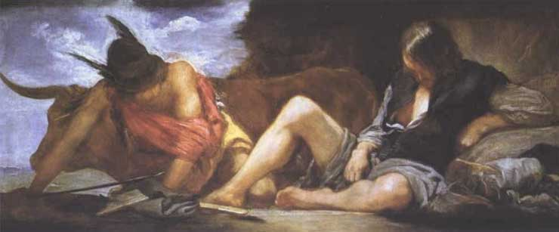
Mercury and Argos
Diego Velázquez, c. 1659
Hermes , Argus and Io
248 x 127 cm
c. 1659.
Oil on canvas. Museo del Prado, Madrid, Spain

Slide 18
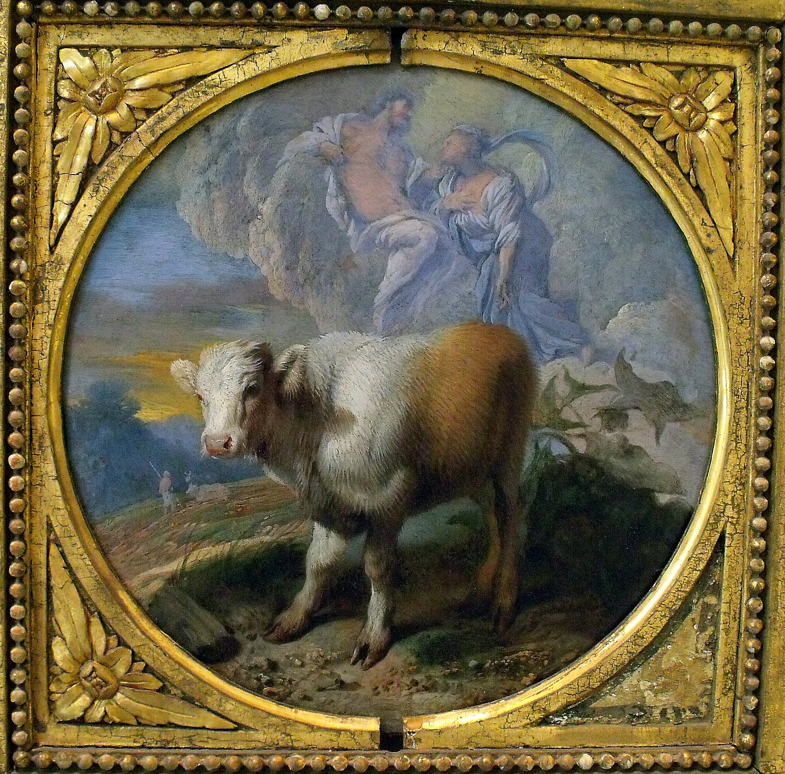
Casdiglione Giovanni Benedetto Casdiglione
1609-1663/65
Oil on canvas, Musée des Beaux-Arts, Caen

Slide 19
Juno Receives the Head of Argus. Jacopo Amigoni, c. 1730. Moor Park, Rickmansworth.

Slide 20
Hermes and Argus 1776
Pyotr Ivanovich Sokolov
1753 – 1 May 1791

Slide 21

Alexander Kanevsky
Born in Tula, Russia in 1959.

Slide 22
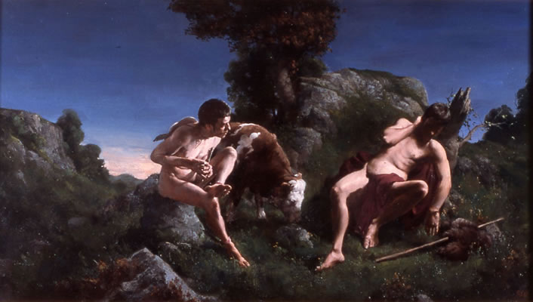
Paul Reid (born 1975)
HERMES and ARGUS
2002
Oil on canvas
76 x 127cm
Private collection

