Slide 1
Pan and Syrinx

Slide 2
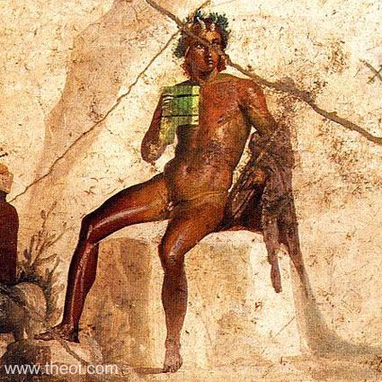
Museo Archeologico Nazionale di Napoli, Naples, Italy Fresco, Imperial Roman III Style Pompeii, House of Jason C1st AD Imperial Roman
http://www.theoi.com/Gallery/F22.1.html

Slide 3
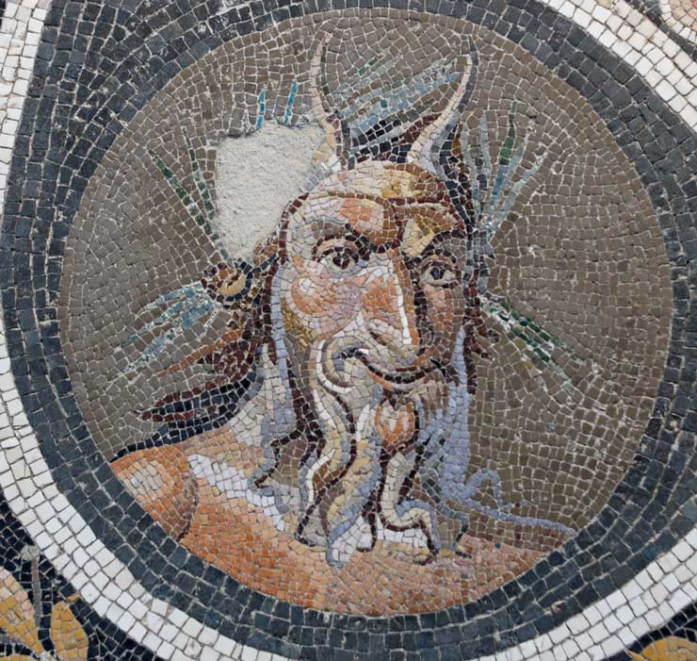
Palazzo Massimo alle Terme (Museo Nazionale Romano)
Rome, Italy Pavement mosaic with the head of Pan. Roman artwork, Antonine period, 138/192 AD

Slide 4
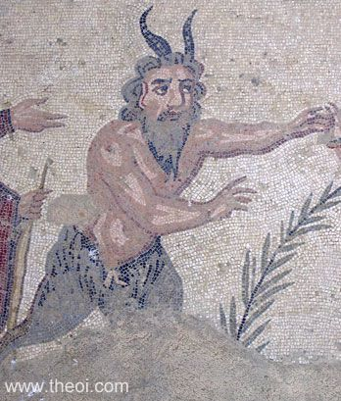
Villa Romana del Casale (in situ)
Piazza Amerina, Sicily, Italy Mosaic Villa Romana del Casale
ca 320 AD
Imperial Roman

Slide 5
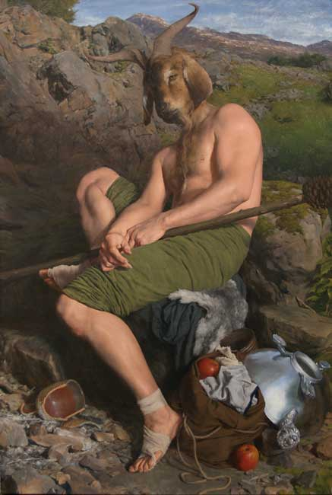
Paul Reid (born 1975)
Portrait of the God Pan Oil on canvas, 2010 105.5 x 70.5cm
http://www.108fineart.com/artists/paul_reid/paul_reid.htm

Slide 6
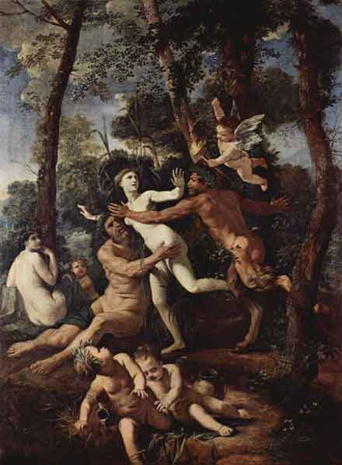
Pan and Syrinx Nicolas Poussin, 1637, 106,5 × 82 cm, Gemäldegalerie Dresden Germany

Slide 7
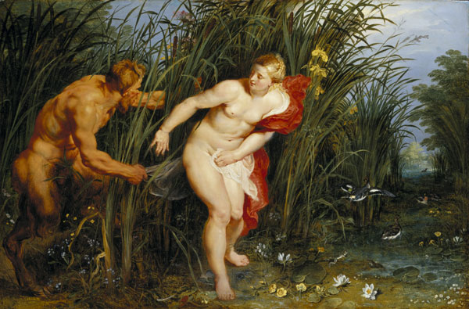
Pan and Syrinx 1617-1619
Peter Paul Rubens (1577–1640)
State Museum, Kassel, Germany

Slide 8
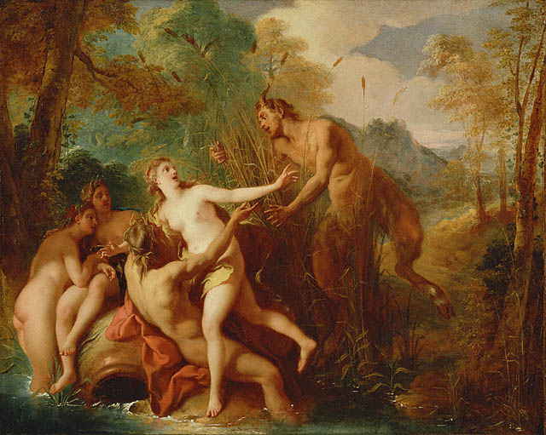
Jean François de Troy
[show]Jean-François de Troy (1679–1752)
Title | Pan and Syrinx
Date | 1722 - 1724
Jean François de Troy
[show]Jean-François de Troy (1679–1752)
J. Paul Getty Museum, Los Angeles, CA

Slide 9
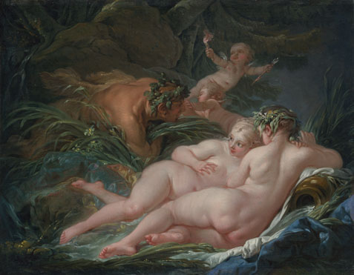
Pan and Syrinx
1759, François Boucher
National Gallery, London

Slide 10
Pan poursuivant Syrinx (1804) de Gilles-Lambert Godecharle (1750-1835). Musées royaux des beaux-Arts de Belgique, Bruxelles (Belgique)

Slide 11
Syrinx, Arthur Hacker (1858-1919)
Manchester Art Gallery

