Slide 1
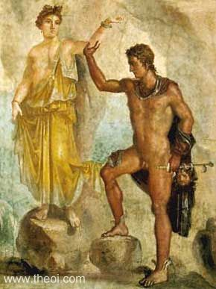
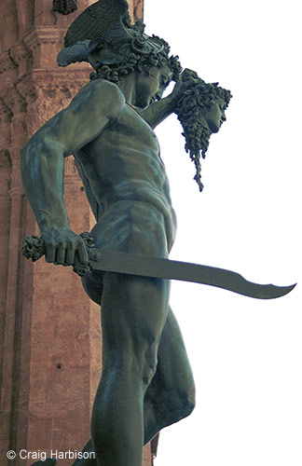
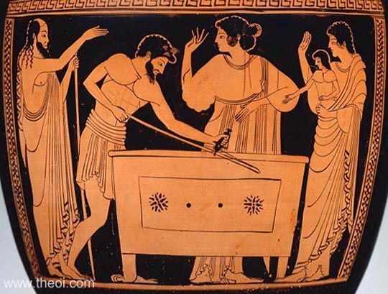
Perseus
Danae
Andromeda

Slide 2
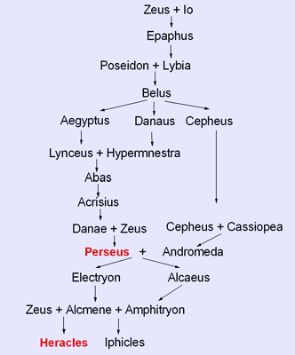

Slide 3
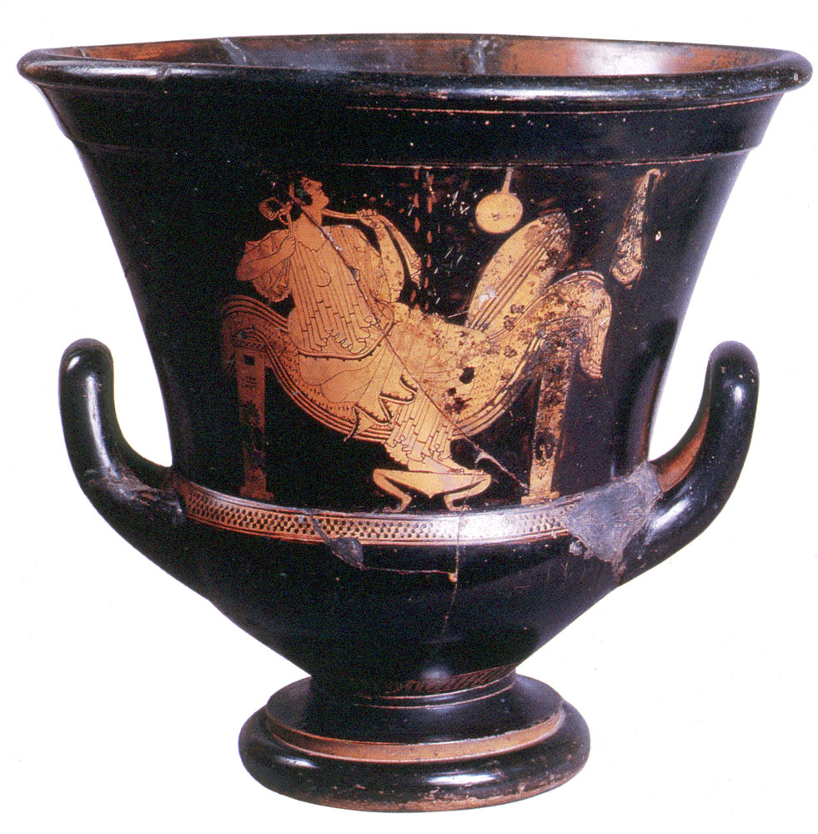
Attic Red-figure kalyx krater by the Triptolemos Painter, c. 490-480 BCE. St. Petersburg.

Slide 4
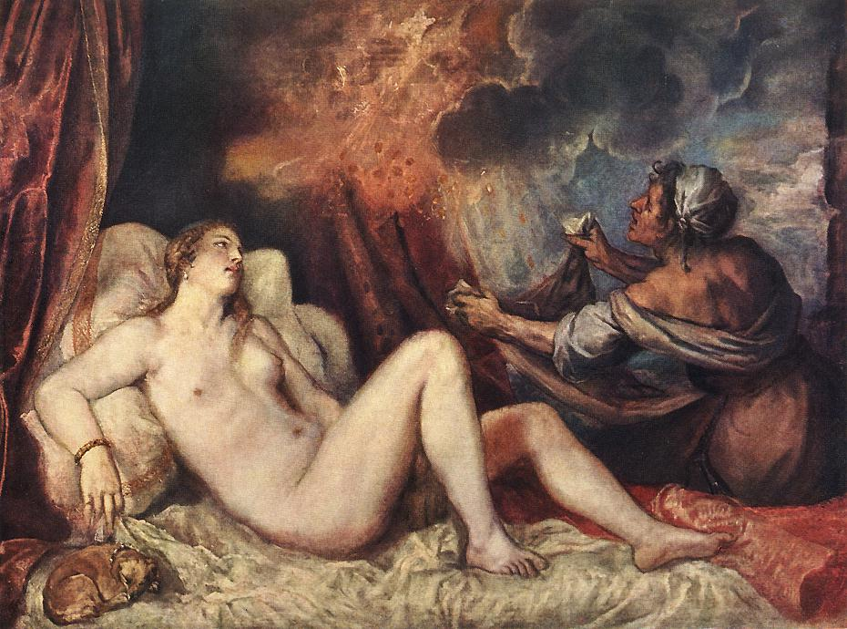
Titian, c. 1560. Kunsthistorische Museum, Vienna.

Slide 5
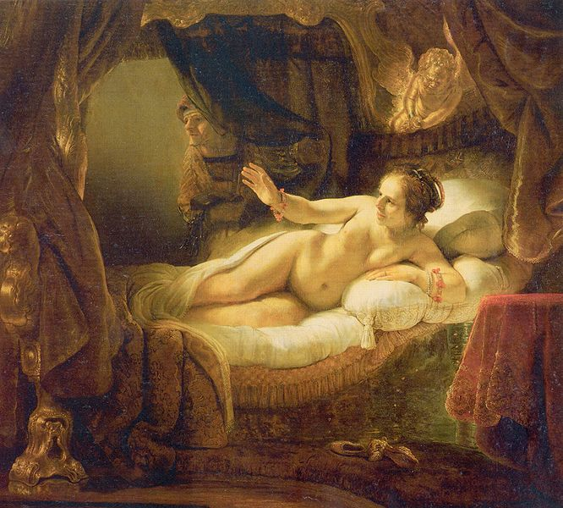
Rembrandt, 1636-1647. Hermitate Museum, St. Petersburg

Slide 6
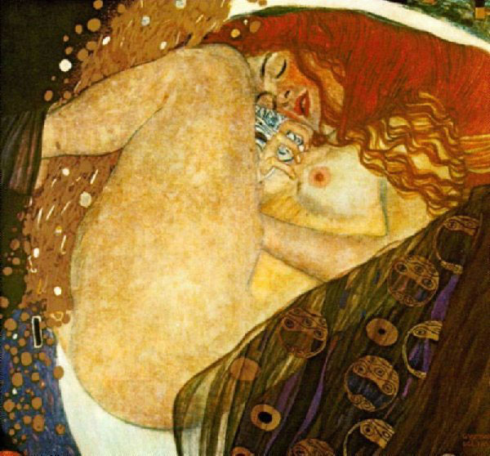
Gustav Klimt, 1907-1908. Private collection, Graz.

Slide 7
Museum Collection: Museum of Fine Arts, Boston, USA
Catalogue No.: Boston 13.200
Beazley Archive No.: 202466
Ware: Attic Red Figure
Shape: Hydria Painter: Attributed to the Gallatin Painter
Date: ca 490 BC
Period: Late Archaic

Slide 8
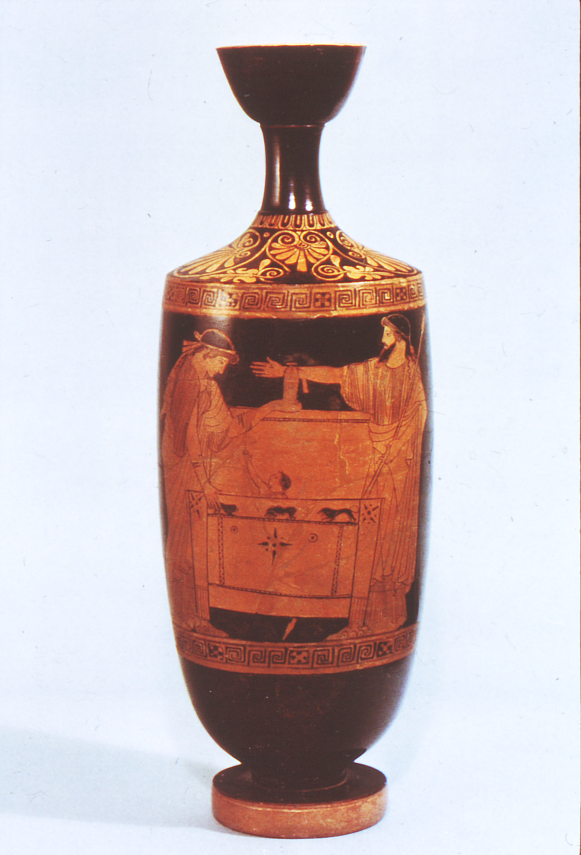
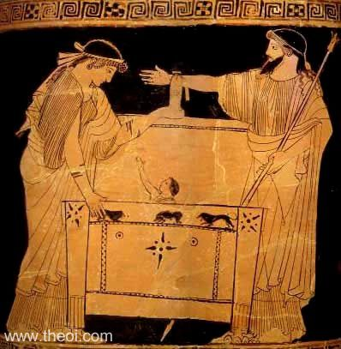
Museum Collection: Toledo Museum of Art,
Catalogue No.: Toledo 1969.369
Beazley Archive No.: 694
Ware: Attic Red Figure
Shape: Lekythos
Painter: Attributed to the Providence Painter
Date: ca 480 - 470 BC
Period: Early Classical

Slide 9
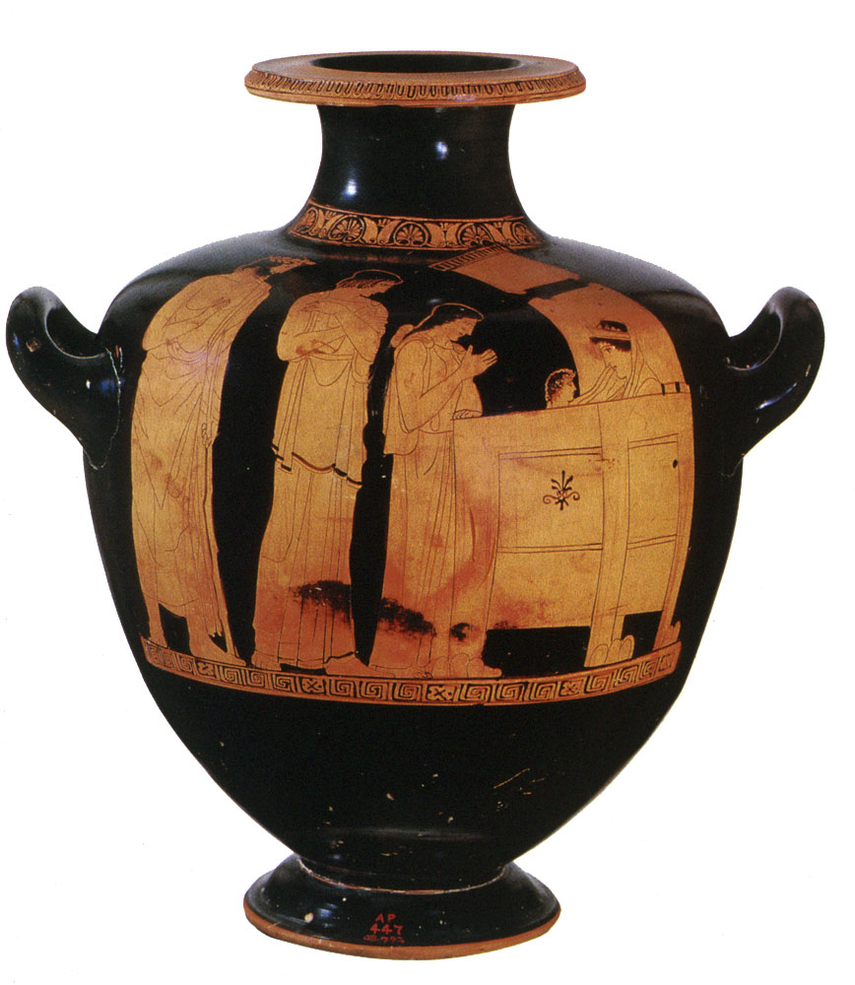
Danae Painter, c. 450 - 440 BCE. Attic hydria. Museum of Fine Arts, Boston.

Slide 10
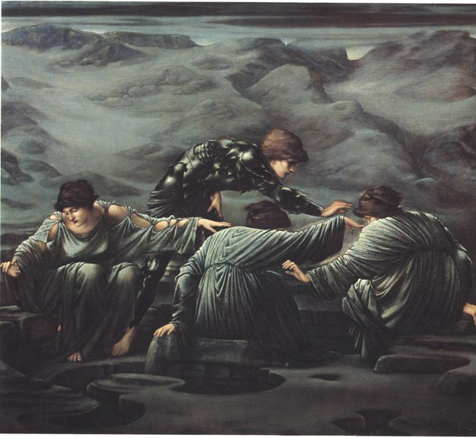
Perseus and the Graiae by Sir Edward Coley Burne-Jones, Bt ARA (1833-1898). Oil on canvas. 1892. [Number 2 in the Perseus Cycle]. Staatsgallerie Stuttgart.

Slide 11
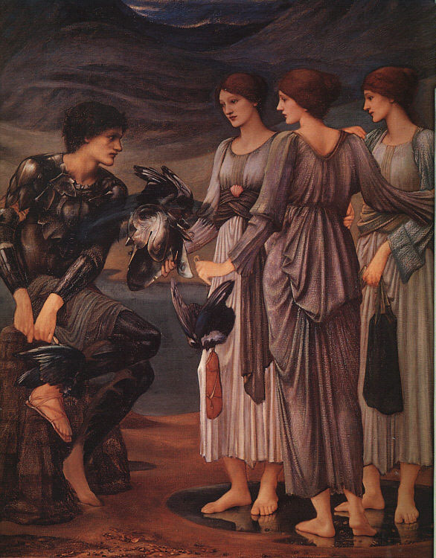
Perseus and the Graiae
Sir Edward Burne-Jones, 1885. Private collection.

Slide 12
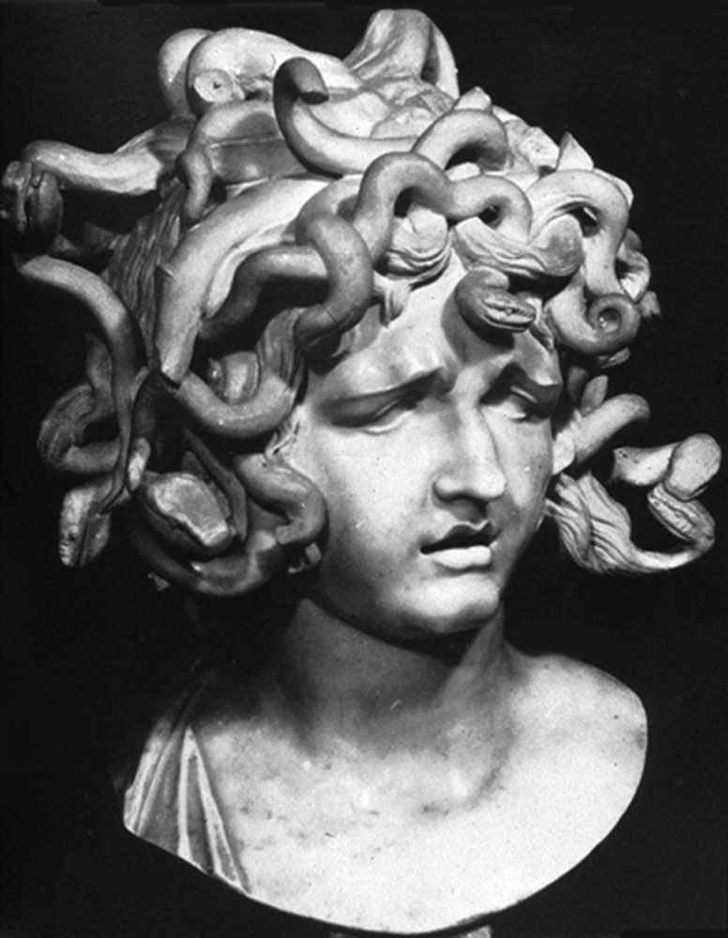
Giancarlo Bernini. Palazzo dei Conservatori, Rome.

Slide 13
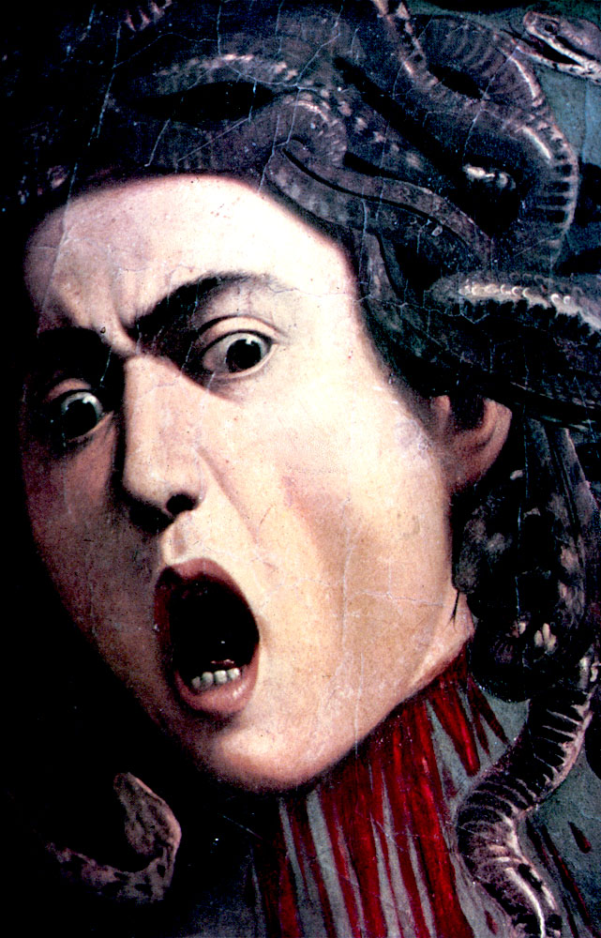
Caravaggio, 1598. Galleria degli Uffizi, Florence.

Slide 14
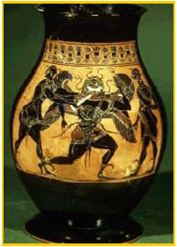
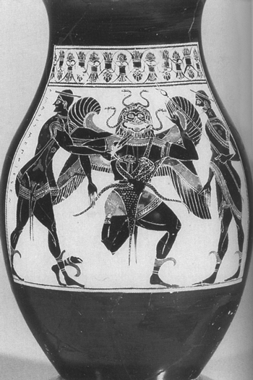
Attic black figure vase, ca. 550 BC.

Slide 15
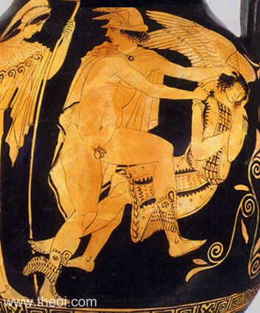
Museum Collection: Metropolitan Museum, New York, USA
Catalogue Number: New York 45.11.1
Beazley Archive Number: 213438
Ware: Attic Red Figure
Shape: Pelike
Painter: Attributed to Polygnotos
Date: ca 450 BC
Period: Classical

Slide 16
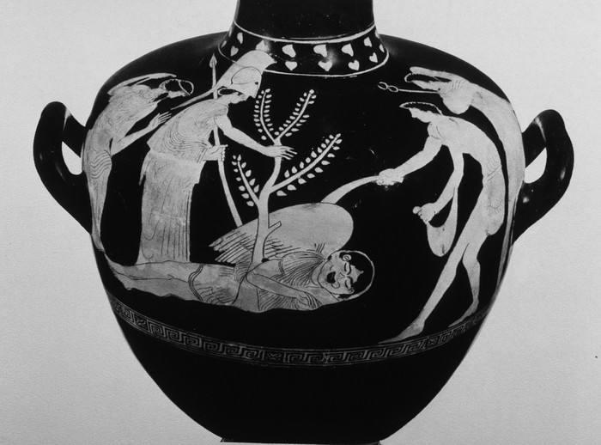
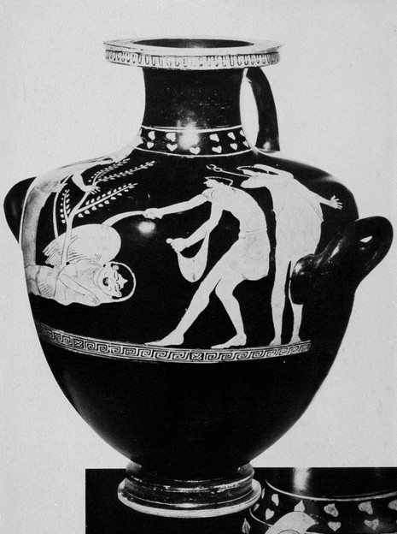
Nausicaa Painter (c. 450-440 BCE) Richmond, Virginia Museum 62.1.1

Slide 17
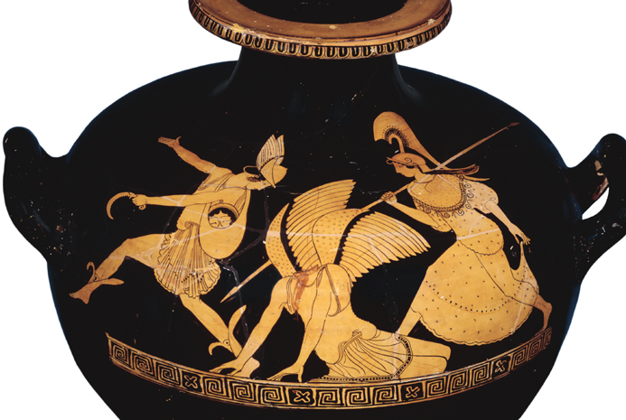
Red-figure amphora, showing the slaying of Medusa by Perseus

Slide 18
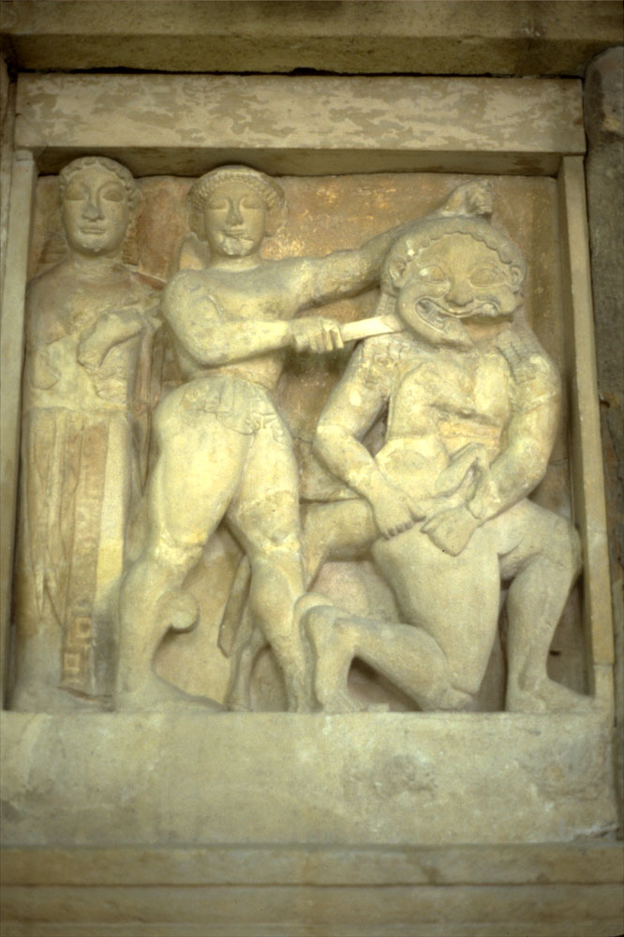
c. 560 - 550 BCE. Metope, Temple C at Selinus (Selinunte). Museo Archeologico, Palermo.

Slide 19
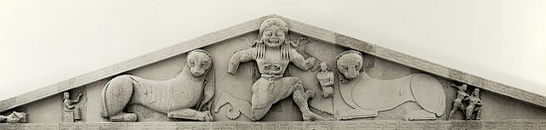
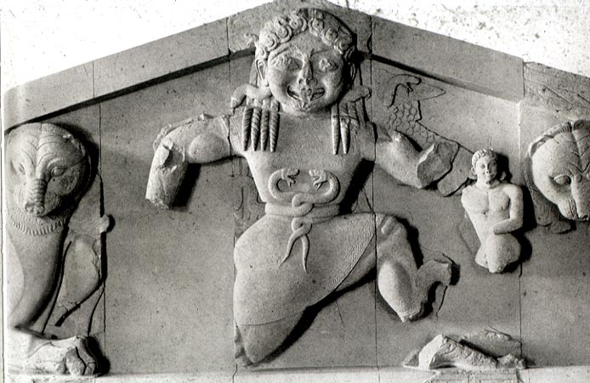
http://www.mlahanas.de/Greeks/Arts/ArtemisCorfuTemple.htm
Birth of Pegasus and Crysaor c. 580 BC. Temple Pediment, Corfu Selinus

Slide 20
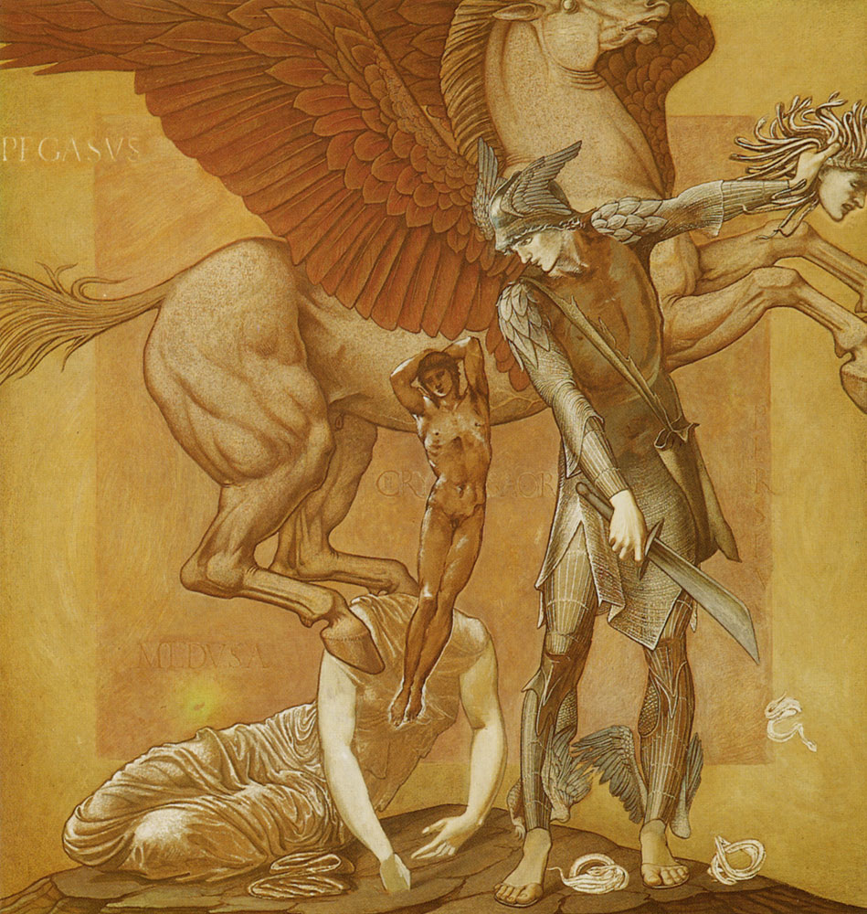
The Birth of Pegasus and Chrysaor from the blood of Medusa. Sir Edward Burne-Jones, 1876-1885. Southampton City Art Gallery.

Slide 21
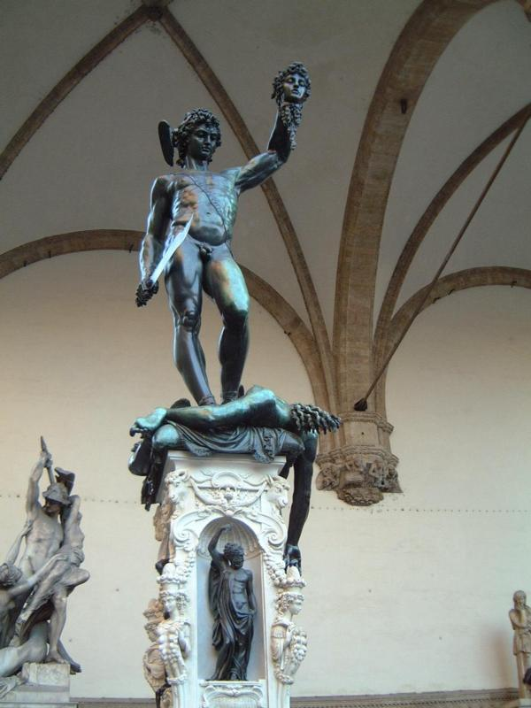
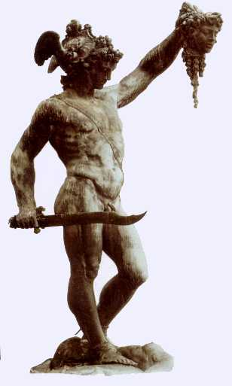
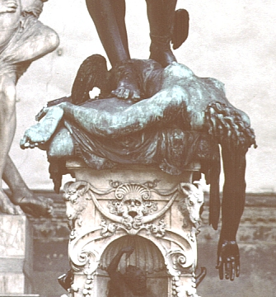
Perseus Beheading Medusa
Benvenuto Cellini
1645-1554
Loggia dei Lanzi, Florence
Bronze
18 feet high

Slide 22
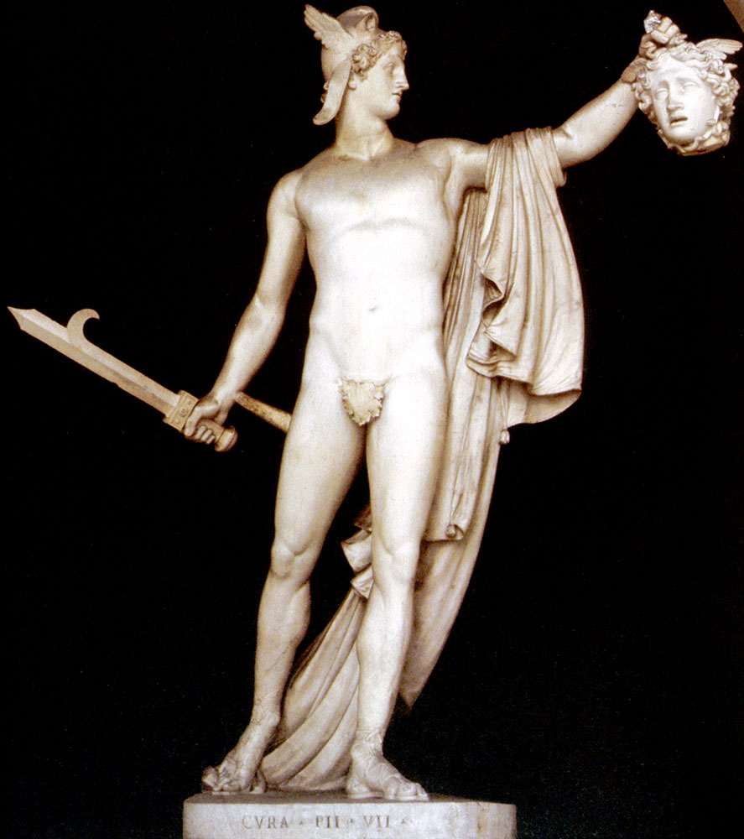
Antonio Canova, 1804-1808. Metropolitan Museum of Art, New York.

Slide 23
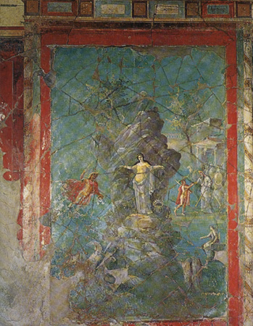
Perseus Liberating Andromeda, Pompeii.

Slide 24
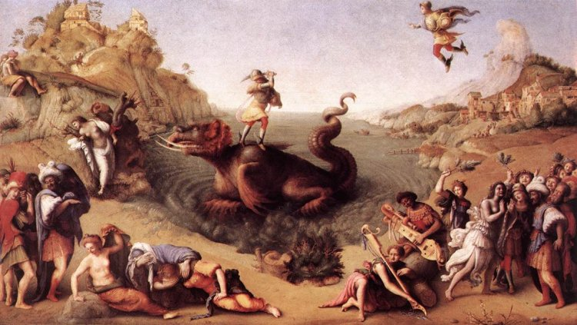
Andromeda
PIERO DI COSIMO. Perseus Frees Andromeda c. 1515 (Galleria degli Uffizi, Florence)

Slide 25
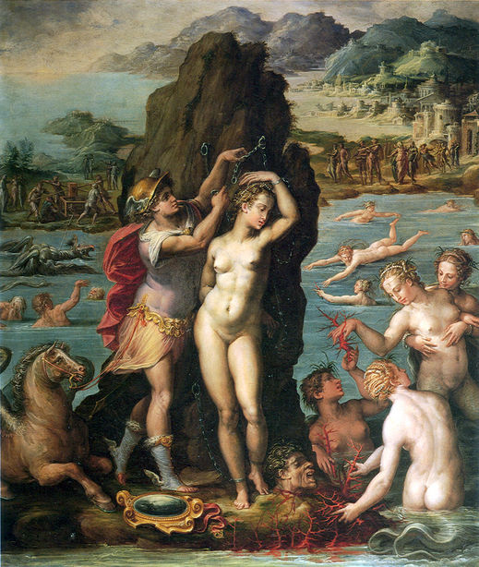
Andromeda
Perseus and Andromeda
Giorgio Vasari
1570-1572
Oil on slate, 45 ½ x 34’’
Florence, Palazzo Vecchio, Studiolo

Slide 26
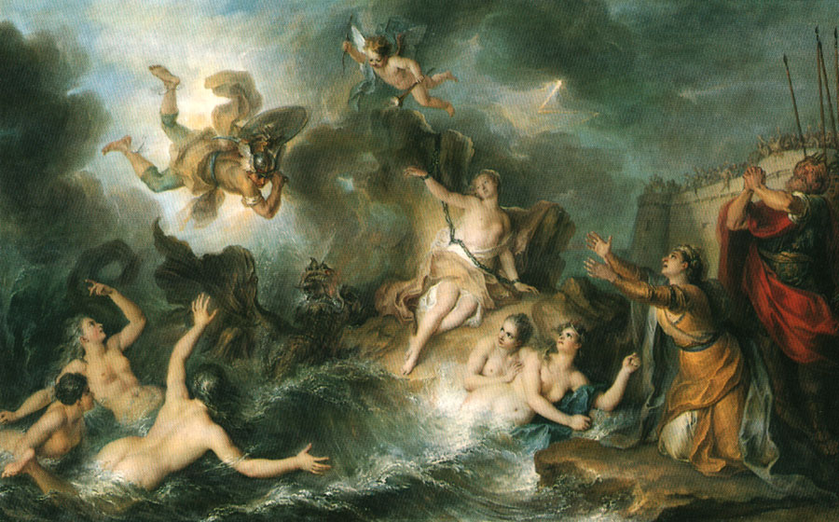
Charles-Antoine Coypel, c. 1726-1727. Musée du Louvre, Paris.

Slide 27
Museum Collection: Museo Archeologico Nazionale di Napoli, Naples, Italy
Catalogue Number: TBA
Type: Fresco, Imperial Roman
Period: Imperial Roman

Slide 28
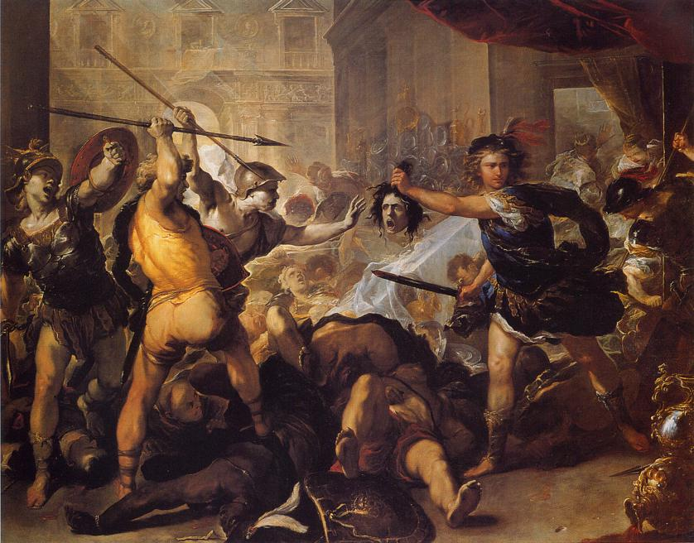
Lu
Luca Giordano
Early 1680s

Slide 29
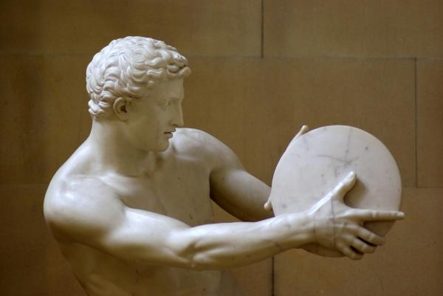
Death of Acrisius

