Slide 1
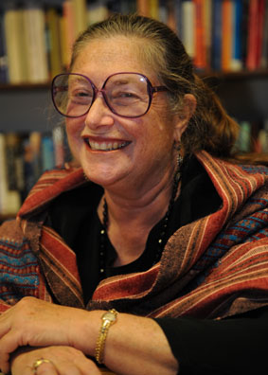
“One person’s myth is another person’s religion.” Wendy Doniger O'Flaherty

Slide 2
“One person’s myth is another person’s religion.” Wendy Doniger O'Flaherty
To what extent is one’ person’s god another person’s myth?

