Slide 1
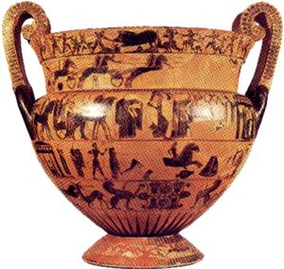
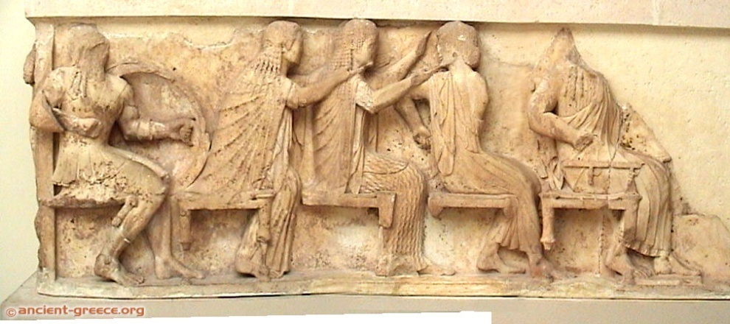
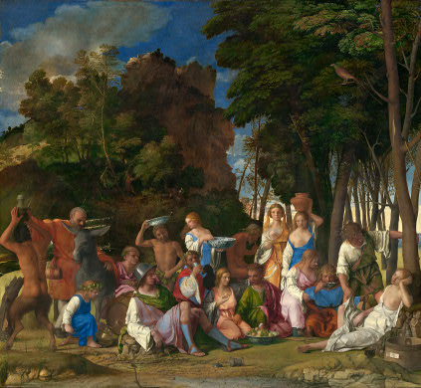
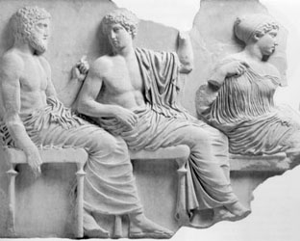
Greek Gods in Time and Place

Slide 2
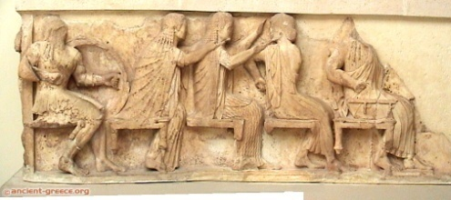
Timelines
François Vase
Athens
c.550 B.C.
Siphnian Treasury Frieze
Delphi
530-25 BC
Bellini
“Feast of the Gods”
1514
Parthenon Frieze
Athens
443-438 B.C.
http://department.monm.edu/classics/Courses/Chronology.htm
http://chaos1.hypermart.net/fullsize/artancfs.gif
http://chaos1.hypermart.net/fullsize/artrenfs.gif
http://www.metmuseum.org/toah/intro/atr/04sm.htm

Slide 3
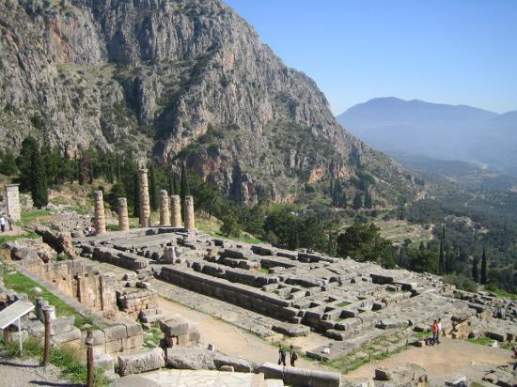
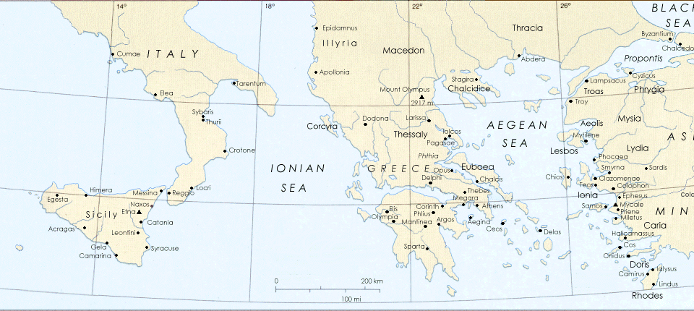
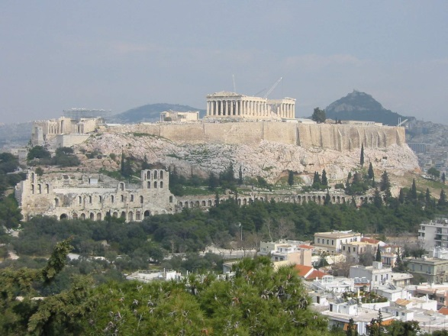
Geography
Delphi
Athens

Slide 4
Delphi
http://www.olympia-greece.org/delphi.html
http://www.sacred-destinations.com/greece/delphi

Slide 5
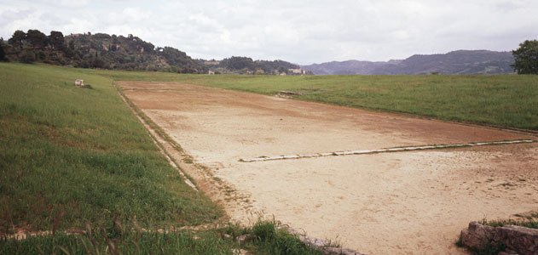
Olympia
http://www.greek-thesaurus.gr/Ancient-Olympia-the-sanctuary.html
http://www.pantheon.org/articles/o/olympia.html
http://www.olympia-greece.org/history.html
http://buffaloah.com/a/virtual/greece/olympia/sanc/index.html

Slide 6

The Athenian Acropolis
http://witcombe.sbc.edu/sacredplaces/acropolis.html
http://www.stoa.org/athens/sites/acropolis.html

