Slide 1
Cupid (Eros)

Slide 2
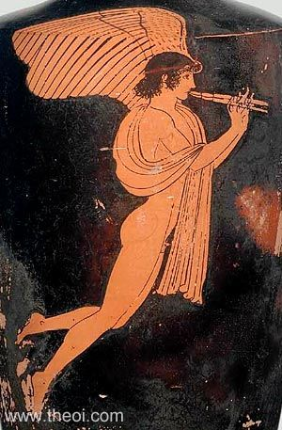
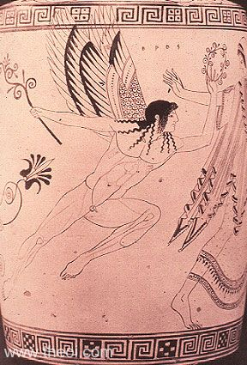
Eros Playing Flute
Athenian Red Figure Vase Painting
C5th B.C.
Eros and the race of Atalanta
Athenian red-figure lekythos C5th B.C.
Cleveland Museum of Art

Slide 3
Son of Aphrodite
Hesiod, Theogony 176 ff (trans. Evelyn-White) (Greek epic C8th or 7th B.C.) :
"Eros (Love), and comely Himeros (Desire) followed her [Aphrodite] at her birth at the first and as she went into the assembly of the gods."
[Hesiod may be suggesting that Eros and Himeros were born of Aphrodite at her birth. Indeed, according to Sappho, Ouranos (Uranus) was the father of Eros by Aphrodite, which suggests she was imagined born pregnant with the god. Nonnus says this explicitly.]
Stesichorus, Fragment 575 (trans. Campbell, Vol. Greek Lyric III) (C5th B.C.) :
"[Eros] You cruel child of guileful Aphrodite, whom she bore to Ares."
Scholiast on Apollonius of Rhodes (trans. Campbell, Vol. Greek Lyric III Ibycus Frag 324) (Greek scholia) :
"Apollonios (Apollonius) [Greek poet C3rd B.C.] makes Eros child of Aphrodite . . . Simonides [Greek poet C6th-5th B.C.] child of Aphrodite and Ares."
Sappho, Fragment 198 (from Scholiast on Theocritus) (trans. Campbell, Vol. Greek Lyric I ) (Greek Lyric C6th B.C.) :
"Sappho made Eros the child of Aphrodite and Ouranos (Uranus, Heaven)."
Pausanias, Description of Greece 9. 27. 1 (trans. Jones) (Greek travelogue C2nd A.D.) :
"Most men consider Eros to be the youngest of the gods and the son of Aphrodite."
Ovid, Fasti 4. 1 ff (trans.Boyle) (Roman poetry C1st B.C. to C1st A.D.) :
"[Aphrodite] gentle mother of twin Cupides (Loves) [Erotes], favour me."
Seneca, Phaedra 274 ff (trans. Miller) (Roman tragedy C1st A.D.) :
"Thou goddess [Aphrodite], born of the cruel sea, who art called mother of both Cupides [i.e. Eros and Anteros], that wanton, smiling boy of thine."

Slide 4
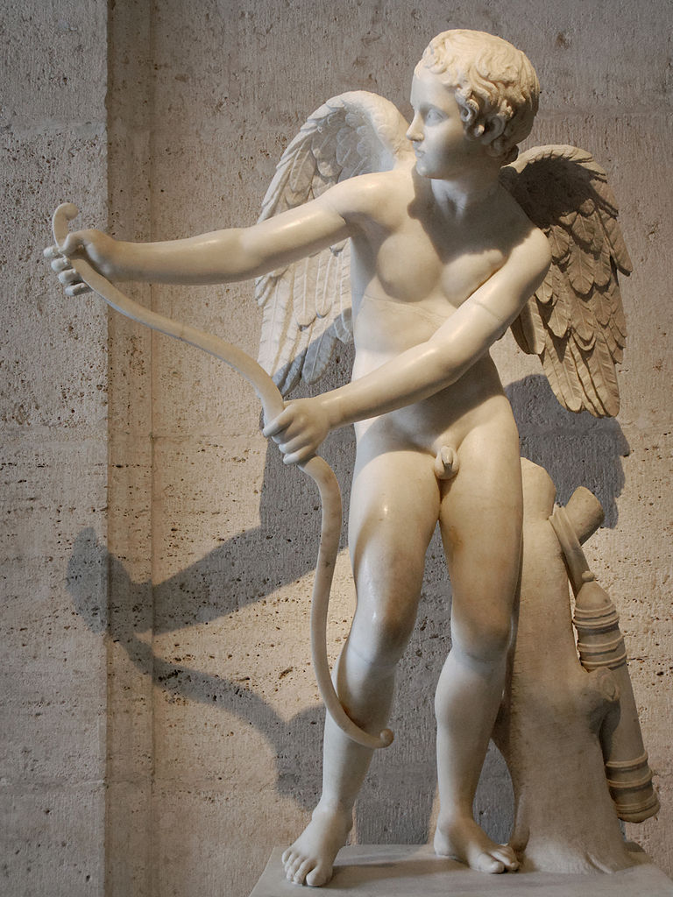
Cupid
Cupid with Bow
Roman, 2nd cent. A.D.
Capitoline Museum, Rome

Slide 5
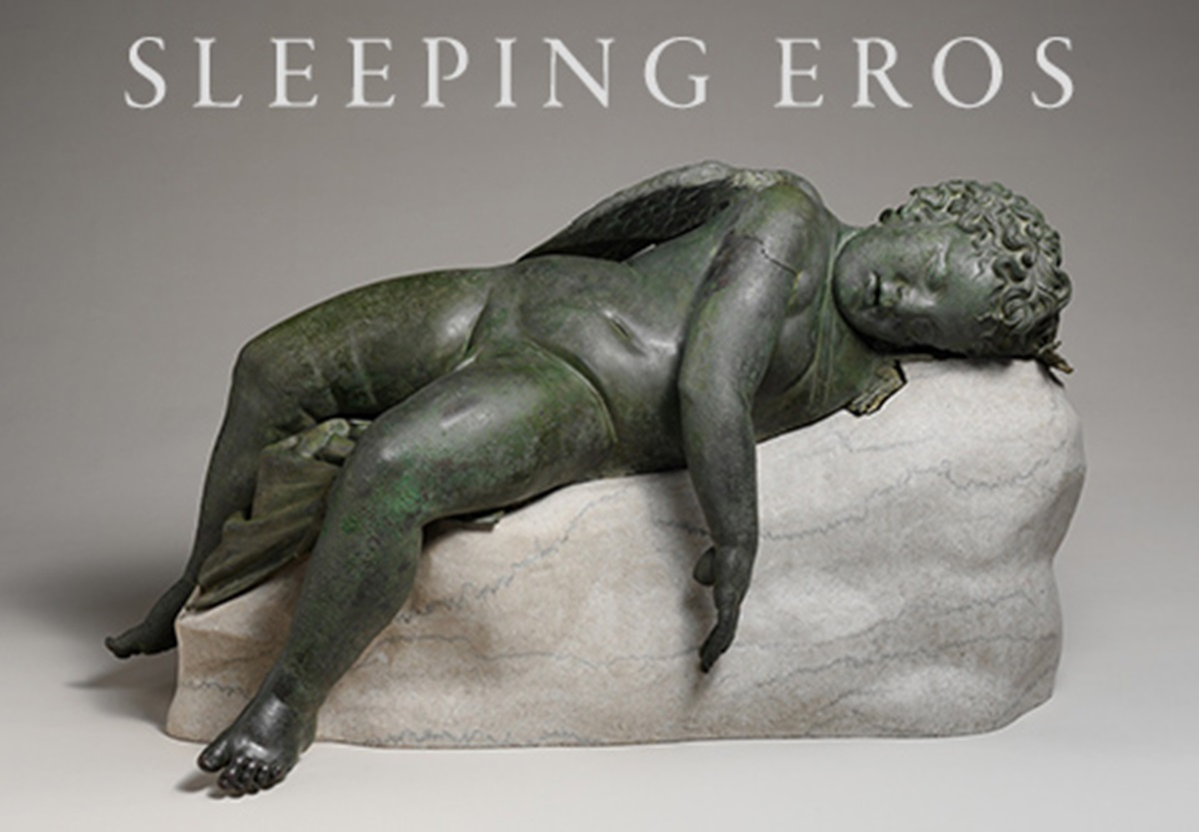
Date: 3rd–2nd century B.C.
Bronze. NY Metropolitan Museum of Art

Slide 6
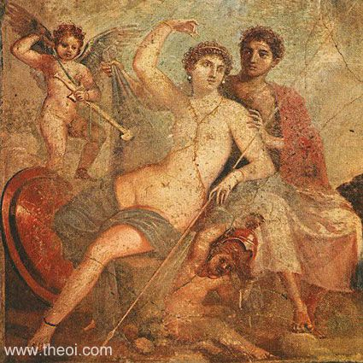
Aphrodite, Ares, Eros and Phobos, Greco-Roman fresco from Pompeii C1st A.D., Naples National Archaeological Museum

Slide 7
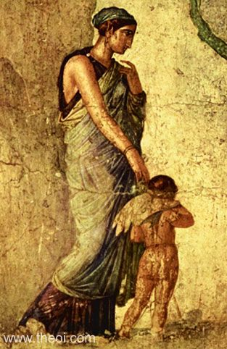
Aphrodite and Eros
Greco-Roman fresco from Pompeii
C1st A.D.
Naples National Archaeological Museum

Slide 8
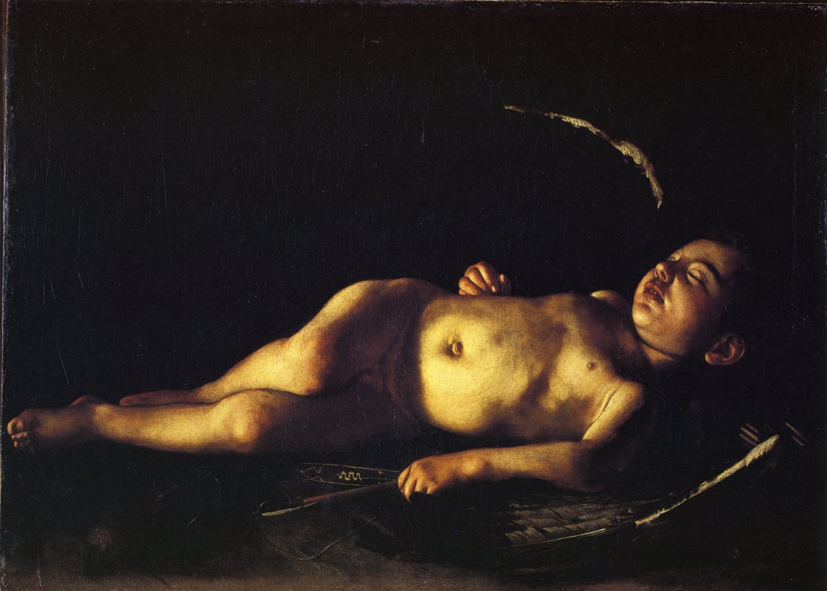
Sleeping Cupid 1608 - by Caravaggio
Palazzo Pitti, Galleria Palatina, Florence

Slide 9
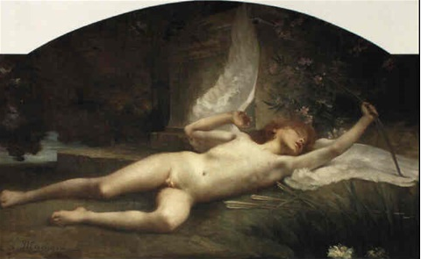
Jules Louis Machard
(1839–1900)
A sleeping cupid
Oil on Canvas

Slide 10
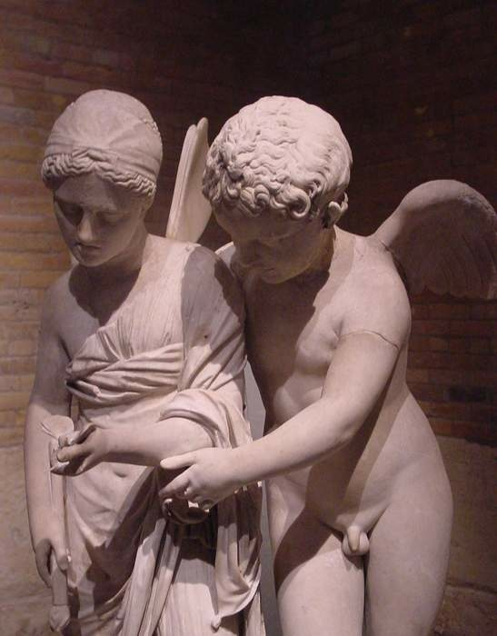
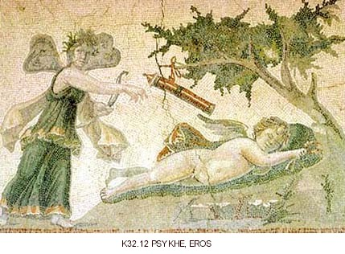
Cupid and Psyche
Apuleius The Golden Ass
Images of Cupid and Psyche
ZEUGMA MOSAICS (1st to 2nd century C.E.) in Gaziantep Museum, Gaziantep, Turkey. Psykhe and Eros, Antioch, House of the Drinking Contest
Eros and Psyche c.2nd - 1st century B.C.E. Marble

Slide 11
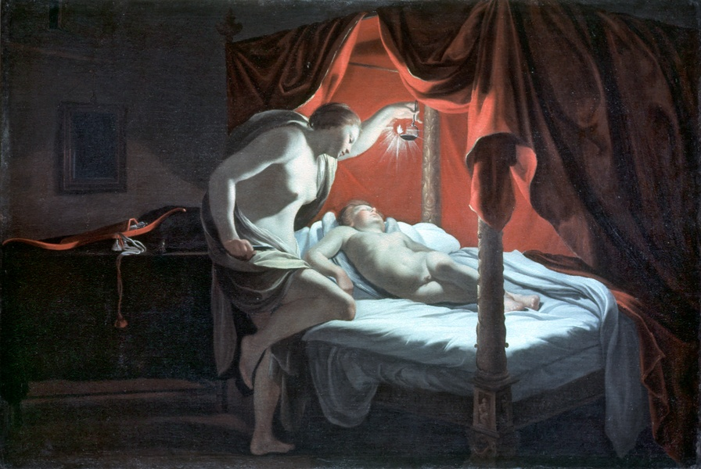
Psyche gazing at Cupid], by Simon Vouet, 1590-1649

Slide 12
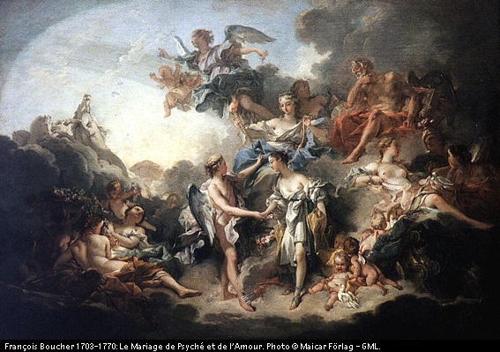

Slide 13
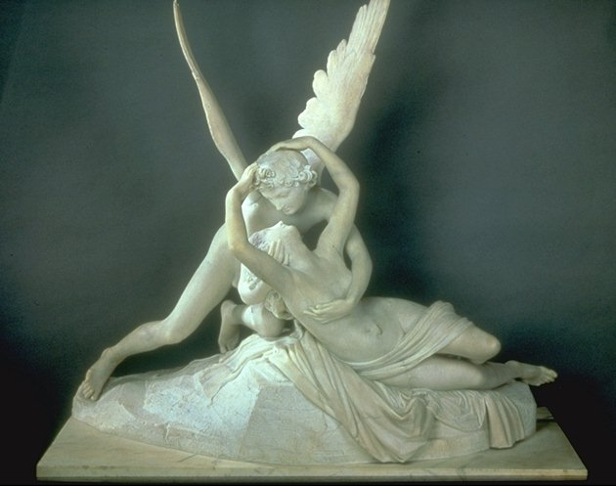
Cupid and Psyche sculpture, by Antonio Canova; group in marble H 0.55 m; W 0.68 m; D 1.01 m. (1787)

Slide 14
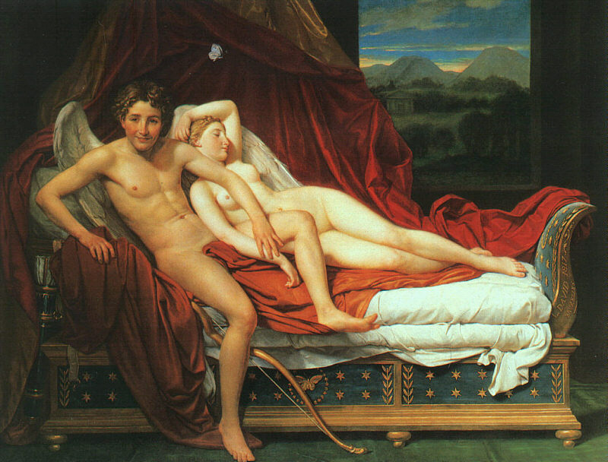
Cupid and Psyche, by Jacques-Louis David, 1748-1825 (1817). Cleveland Museum of Art

Slide 15
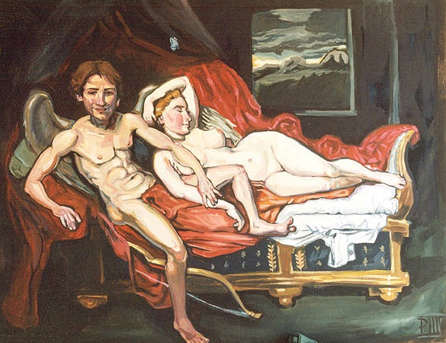
Cupid and Psyche, by Palmer Saylor (after Cupid and Psyche by David) (2001)

Slide 16




Cupid in the New Yorker

Slide 17

Bush as Cupid

Slide 18

MCupid Wooing Voters

Slide 19


Slide 20


