Slide 1
Aphrodite
Jenifer Crain, Kara-Jade Gordon, Simone Johnson

Slide 2
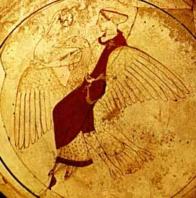
Goddess of Love
Athenian red-figure kylix
Here she is depicted riding a goose
http://www.theoi.com/Gallery/K10.3.html
Aphrodite
Olympian goddess of love, beauty, pleasure and procreation. Her attributes include a dove, apple, scallop shell, and mirror.
Famous Myths
Her birth from sea foam, her affair with her brother Ares and the judgement of Paris.

Slide 3
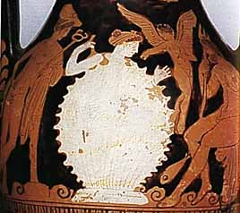
Birth of Aphrodite
There are many stories of how the goddess was birthed, the most popular however is from Hesiod’s Theogony as we learned about before:
Athenian red-figure pelike
http://web.uvic.ca/~athena/department_files/classical_myth/images/haifa/h105.jpg
Hesiod, Theogony 176 ff (trans. Evelyn-White) (Greek epic C8th or 7th B.C.) :
"Ouranos (the Sky) came, bringing on night and longing for love, and he lay about Gaia (the Earth) spreading himself full upon her. Then the son [Kronos] from his ambush stretched forth his left hand and in his right took the great long sickle with jagged teeth, and swiftly lopped off his own father's members and cast them away to fall behind him . . . and so soon as he had cut off the members with flint and cast them from the land into the surging sea, they were swept away over the main a long time: and a white foam spread around them from the immortal flesh, and in it there grew a maiden.
http://www.theoi.com/Olympios/AphroditeMyths.html#Birth

Slide 4
Aprhodite as Myth
Aphrodite as Allegory
Aphrodite is said to be personification of the generative powers of nature and the mother of all living beings. This comes from the contest of Typhon with the gods, she metamorphosed herself into a fish which was considered to be the animal that possess the greatest generative powers.
http://www.theoi.com/Olympios/Aphrodite.html
Aphrodite as Narratology
The birth of Aphrodite is explained because of the mutilation of Cronos’s genitals and when they were thrown into the sea she was born from sea foam. This in itself is an innuendo but the story makes sense in a fairytale kind of way.

Slide 5
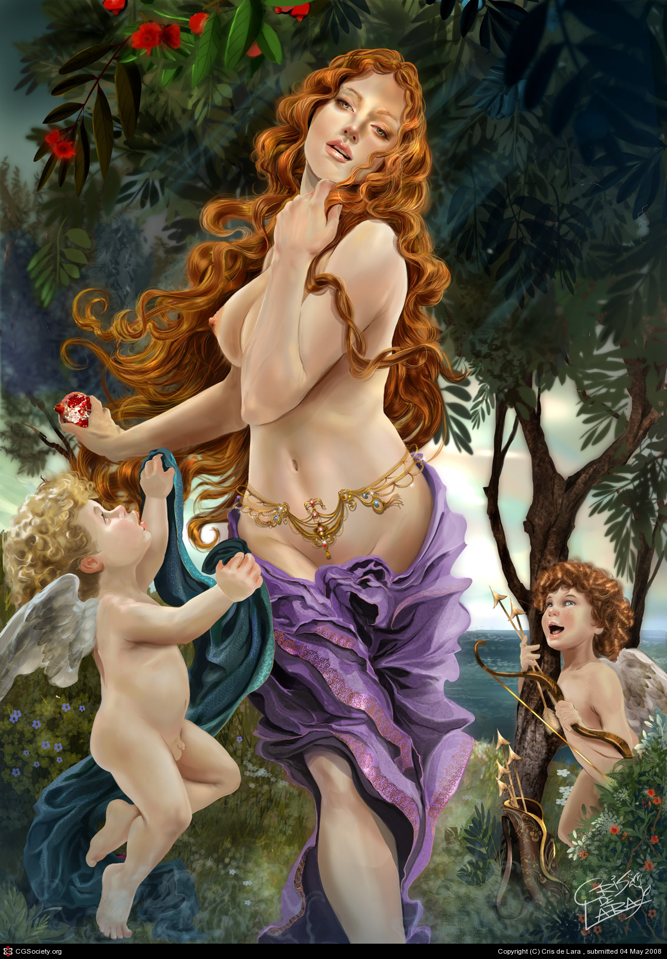
Aphrodite and Cupid
“As goddess of beauty Aphrodite’s job was to make other gods and goddess to fall in love. Zeus knew that she would get a lot of men going after her so Zeus made her marry Hephaestus the god of fire. Hephaestus was known to be the ugliest god. Despite the marriage Aphrodite would still get secret admires.Aphrodite had a son named Eros (cupid) together they teamed up to make Zeus fall in love with a human named Europa. Europa was a beautiful maiden. Aphrodite and Cupid shot Zeus with an arrow that made him fall in love with Europa. He changed into a bull and carried her away from her home to the island of Crete. The sons of Europa and Zeus became famous.”
https://sites.google.com/a/pvlearners.net/aphrodite-greek-mythology-project/home/information-about-aphrodite

Slide 6
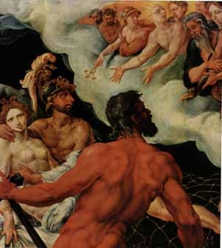
Aphrodite and Ares
“Aphrodite was the goddess of love and beauty. Aphrodite was known to the Romans as Venus. With her exquisite features and pleasant smile she attracted many suitors, gods and mortals alike. However, she was married to the graceless and lame Hephaestus, the god of fire. Her true love was Ares, the god of war. Their child was the beautiful goddess Harmonia. One day while Aphrodite and Ares were together they were caught in an invisible but strong net forged by Hephaestus, and exposed to the ridicule and laughter of the other gods at Mt. Olympus.”
http://www.windows2universe.org/mythology/gods_n_goddesses/Venus/Aphrodite_Ares.html
http://web.uvic.ca/~athena/department_files/classical_myth/images/haifa/h49.jpg

Slide 7
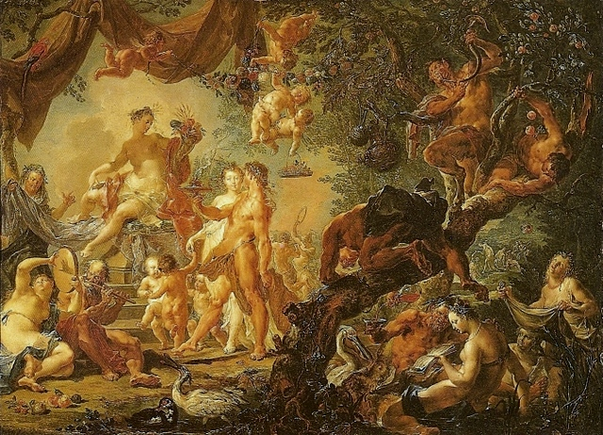
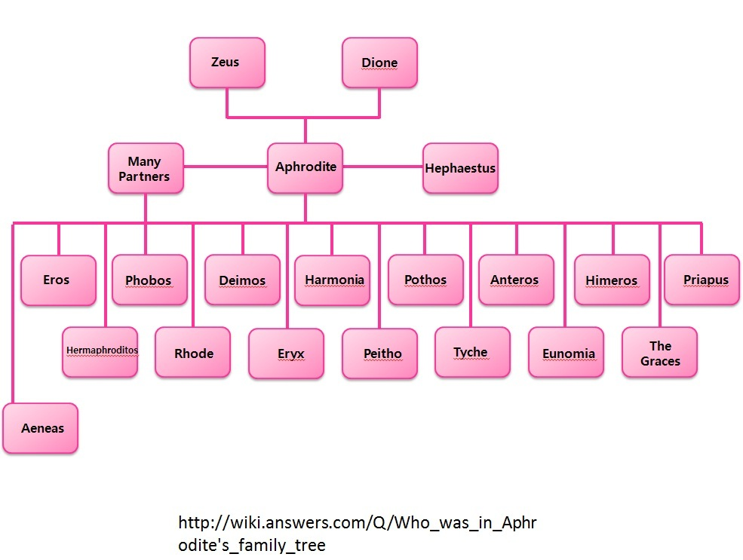
Offspring
Url
Aphrodite has immortal and mortal children.

Slide 8
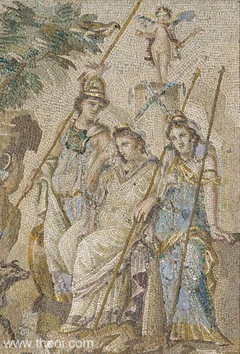
Judgement of Paris
http://www.theoi.com/Gallery/Z4.1.html
“THE JUDGEMENT OF PARIS was a contest between the three most beautiful goddesses of Olympos--Aphrodite, Hera and Athena--for the prize of a golden apple addressed "To the Fairest." The story began with the wedding of Peleus and Thetis which all the gods had been invited to attend except for Eris, goddess of discord. The three goddesses appearing before the shepherd prince, each offering him gifts for favour. He chose Aphrodite, swayed by her promise to bestow upon him Helene, the most beautiful woman, for wife. The subsequent abduction of Helene led directly to the Trojan War and the fall of the city.”

Slide 9
Discussion Question
What is love?
Is it better to have it happen naturally or force a connection?
The gods liked to play matchmaker a lot what are the advantages and disadvantages of some of these arrangements?

