Slide 1
Artemis
Meghan Cheever
Morgan Gulley
Brandi Yoder
Notes:
Artemis is the goddess of the hunt and animals, as well as of childbirth. She is also known as Diana (Roman). Her attributes in iconography include the bow and the fawn. She often appears with her brother, Apollo

Slide 2
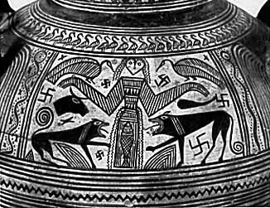
Artemis as Potnia Theron
Boeotian Vase
C. 680 BC
Mythmedia Project at Haifa University
Notes:
Mistress of Animals—Hunting companions are wolves
Artemis and Athena were associated with the symbol of feminism and hope that is called the knielauf position which goes across the sky…Artemis is the goddess of the moon

Slide 3
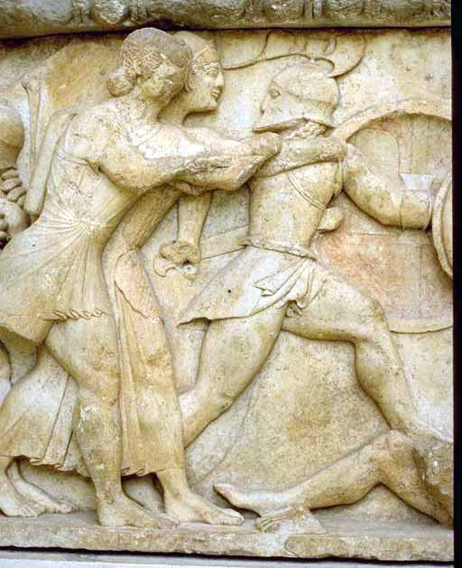
Apollo and Artemis Attacking Giants
Treasury of the Siphnians in Delphi: Gigantomachy
C. 525 BC
ArtServ at the Australian National University
Notes:
When the Titans and Olympians are fighting for control and supremacy of the cosmos, Artemis and Apollo are shown fighting next to each other to help their father Zeus take over.

Slide 4
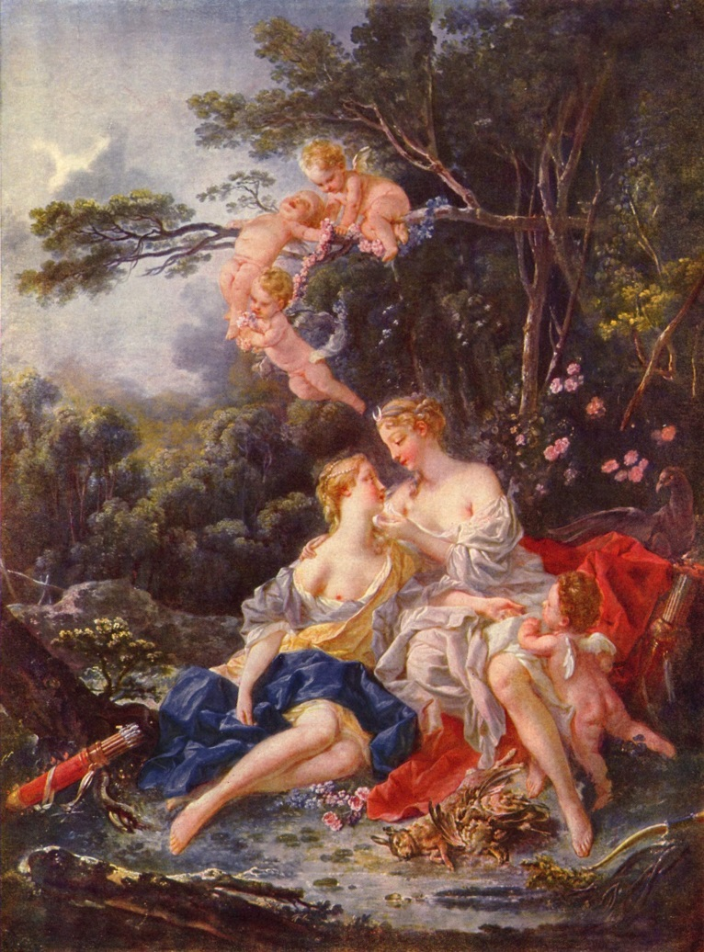
Jupiter and Callisto
Francois Boucher
Pushkin Museum, Mascow
1703-1770
Notes:
Callisto and Artemis were hunting buddies and Callisto swore her virginity and swearing off men with Artemis. Zeus changed his form to resemble Artemis, seduced Callisto, and impregnated her.
She gave birth to Arcas but later was transformed into a bear by Hera.
Arcas almost killed his mother, but Zeus stopped him and place Callisto into the heavens.
Both Callisto and Arcas were turned into the Ursa Minor and Ursa Major Constillations.

Slide 5
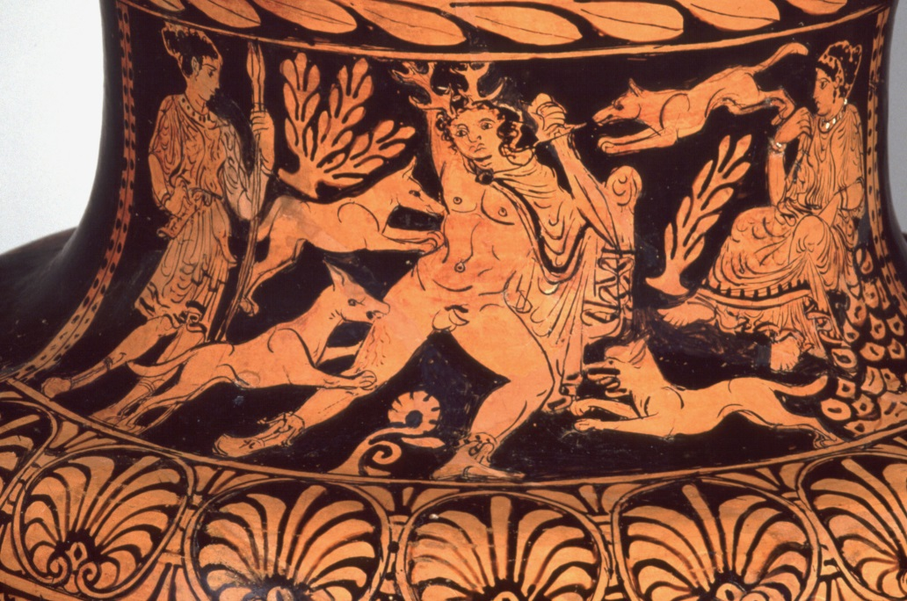
Death of Aktaion
On neck of vase
Harvard University Art Museum
C. 367 BC
Notes:
Artemis was bathing in the woods… he stopped and stared at her (another version said he raped her)… she got revenge… his speech was taken away, if he tried to speak he would be changed into a stag… after he heard his hunting party called him he tried to call out, got turned into a deer and his dogs attacked him. Asked gods at Mt. Olympus for help… he did not get it and was torn to pieces.

Slide 6
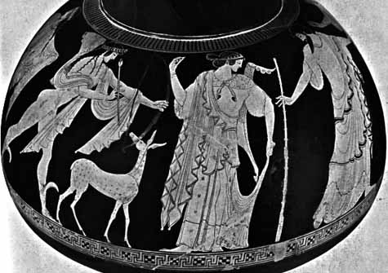
Apollo and Artemis
Pan Painter
C. 490 BC
Mythmedia Project at Haifa University
Notes:
Born to Leto first, immediately after her birth she helped her mother give birth to her brother, Apollo, and became the protect of childbirth and labor

Slide 7
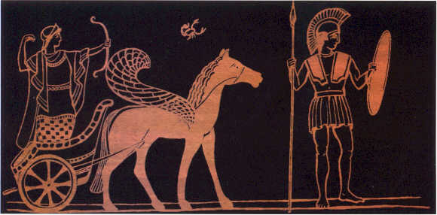
Artemis, Scorpion, and Orion
Post Modern Picture
http://www.skorpio-antares.com/en/pages/mythology.html
Notes:
He was the only one she ever loved… Gaea became a scorpion and killed him
He has a constellation now.

Slide 8
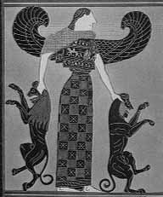
Deep Meaningful Question
How does Artemis represent the feministic movement?
Is it stereotypical that she is a hunter and a virgin? Do you have to be a virgin to be strong?
Kleitia: Francois Vase
570-560 BC
Mythmedia Project at Haifa University

