Slide 1
Athena
By: Laura Sanchez, Hannah Snyder, & Kayla Beadles

Slide 2
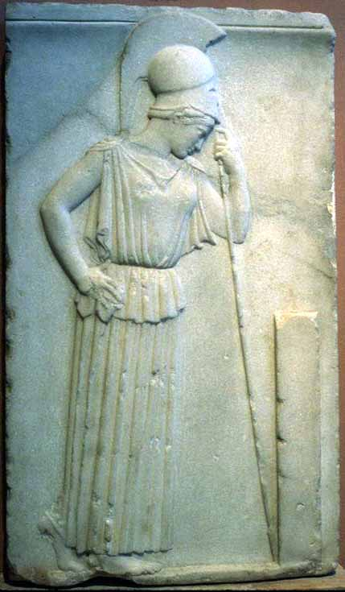
Background/Myth
Roman name: Minerva
  Other names: Palla, Owl-eyed
Goddess of wisdom, craft and war
Recognizable attributes
  Goatskin, Owl, Olive, Helmet, Gorgon’s head
  Always armed with shield and spear
  Wears a long robe with a snakeskin cape
Important myths:
  Contest with Poseidon, Heracles, Perseus, Judgement of Paris
Father is Zeus and sometimes Metis
Mourning Athene

Slide 3
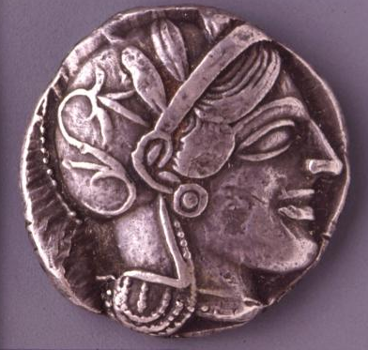
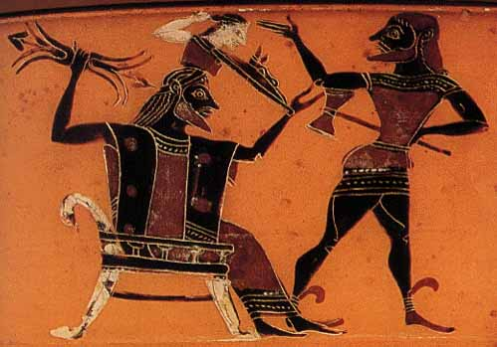
Birth of Athena The Symbol of Athena
Birth of Athene:
Phrynos Painter, ca 560-550 BC
Patriarchy and Matriarchy Theory of Myth seen as Zeus and Athena are both equally powerful.
Helmeted head of Athena, profile to the right; her helmet is adorned with an olive wreath.
Photograph by Maria Daniels, courtesy of the Dewing Greek Numismatic Foundation, September 1990

Slide 4
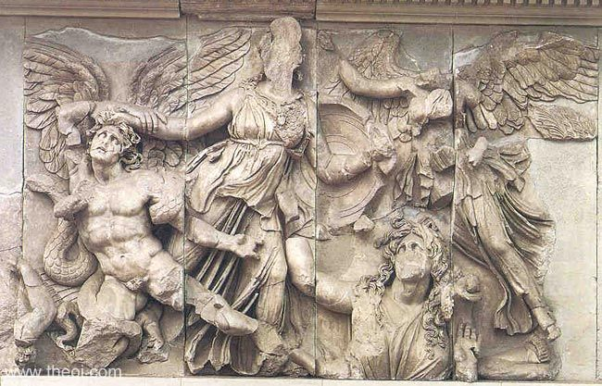
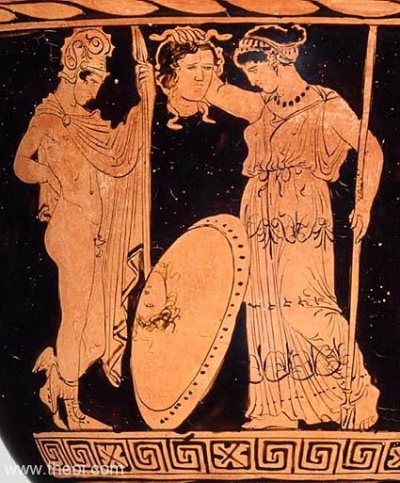
War of the Giants (Gigantomachia)
Perseus, Athena, and the Head of Medusa
Marble relief from an altar dedicated to Zeus. 2nd C. B.C. Pergamonmuseum, Berlin.
Athena is fighting off a giant (Alcyoneus)who is winged with serpent legs. She is helped by Herakles and Nike (goddess of victory).
Gaea is trying to defend her son.
400-386 B.C. Now located in the Museum of Fine arts in Boston. Late Classical period.
Perseus gives Athena Medusa’s head after he defeats her because Medusa compares her beauty to Athena’s.
  Athena had originally transformed Medusa’s hair into serpents for having slept with Poseidon in Athena’s home.

Slide 5
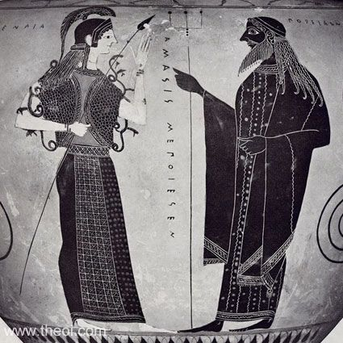
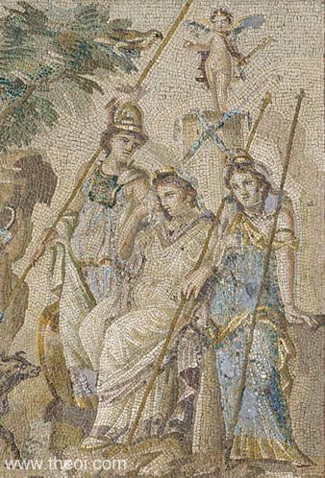
Contest with Poseidon Judgement of Paris
Athena stands facing Poseidon. She is wearing her snake trimmed aegis-cloak and holds a spear. Poseidon holds a trident.
Myth as an aetiology is seen as the city of Athens is named after Athena because of this contest.
Pictured: Athena (left) with aegis-cloak and spear, Aphrodite (middle): holding a sceptre, and Hera (right) dressed in blue and gold.

Slide 6
Discussion Questions
Athena is a virgin goddess with no children, why is it that she is depicted this way?
Would Metis be considered the mother of Athena, or is she motherless?
How important of a figure was Athena in the lives of the ancient Greeks?

Slide 7
Work Cited
Mourning Athene: http://web.uvic.ca/~athena/department_files/classical_myth/gods/athene_i.html
Birth: http://web.uvic.ca/~athena/department_files/classical_myth/images/haifa/h186.jpg
Coin: http://www.perseus.tufts.edu/hopper/image?img=Perseus:image:1990.26.0201&redirect=true
War of the Giants: http://www.theoi.com/Gallery/R43.2.html
Perseus, Athena, and The Head of Medusa: http://www.theoi.com/Gallery/P23.2.htm
Contest with Poseidon: http://www.theoi.com/Gallery/K2.11.html
Judgement of Paris: http://www.theoi.com/Gallery/Z4.1.html

