Slide 1
Demeter
Cheyenne, Aimee, Emily

Slide 2
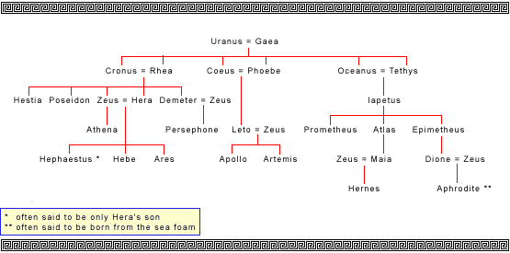

Slide 3
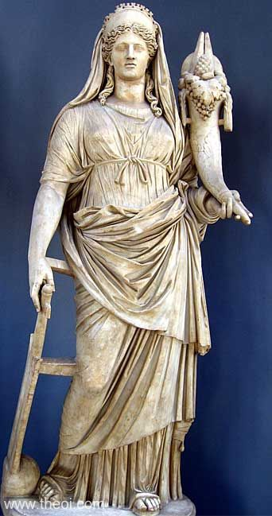
Demeter
Goddess of harvest & agriculture
Often wore crowns and bore sheafs of wheat or
had a cornucopia and torch

Slide 4
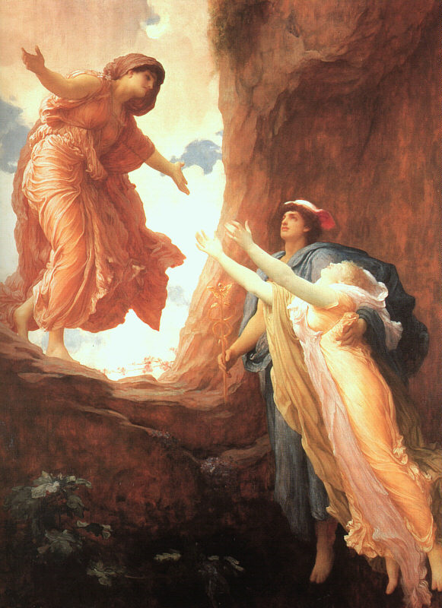
title | The Return of Persephone
artist | Frederic Leighton
period | Victorian
date | circa 1890-1
collection | City Art Gallery, Leeds
http://www.loggia.com/art/19th/leighton16.html

Slide 5
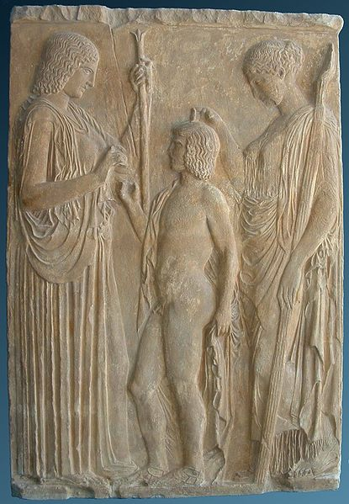
Triptolemus receiving wheat sheaves from Demeter and blessings from Persephone,
5th-century BC relief,
National Archaeological Museum of Athens
https://en.wikipedia.org/wiki/Eleusinian_Mysteries

Slide 6
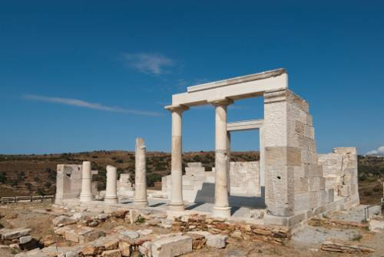
Demeter Temple

Slide 7
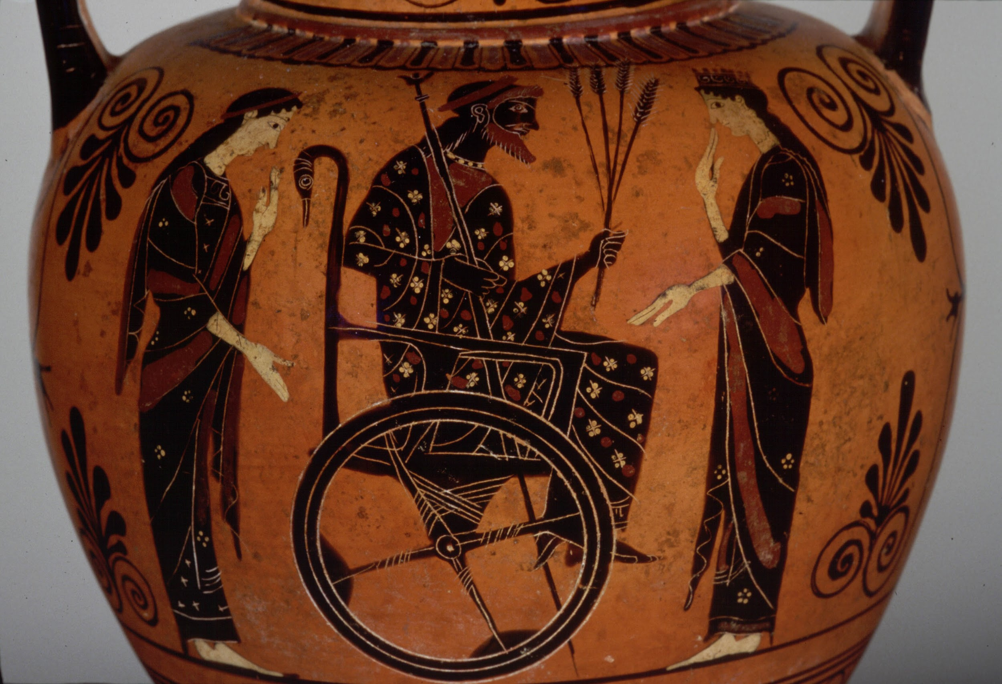
description | Triptolemos, in chair holding wheat with Persephone behind him and Demeter in front of him
ware | Attic Black Figure
collection | Museum of Art, Rhode Island School of Design
period | Archaic
date | Circa 550-530 B.C.
http://www.perseus.tufts.edu/hopper/image?img=Perseus:image:1990.03.0309&redirect=true

Slide 8
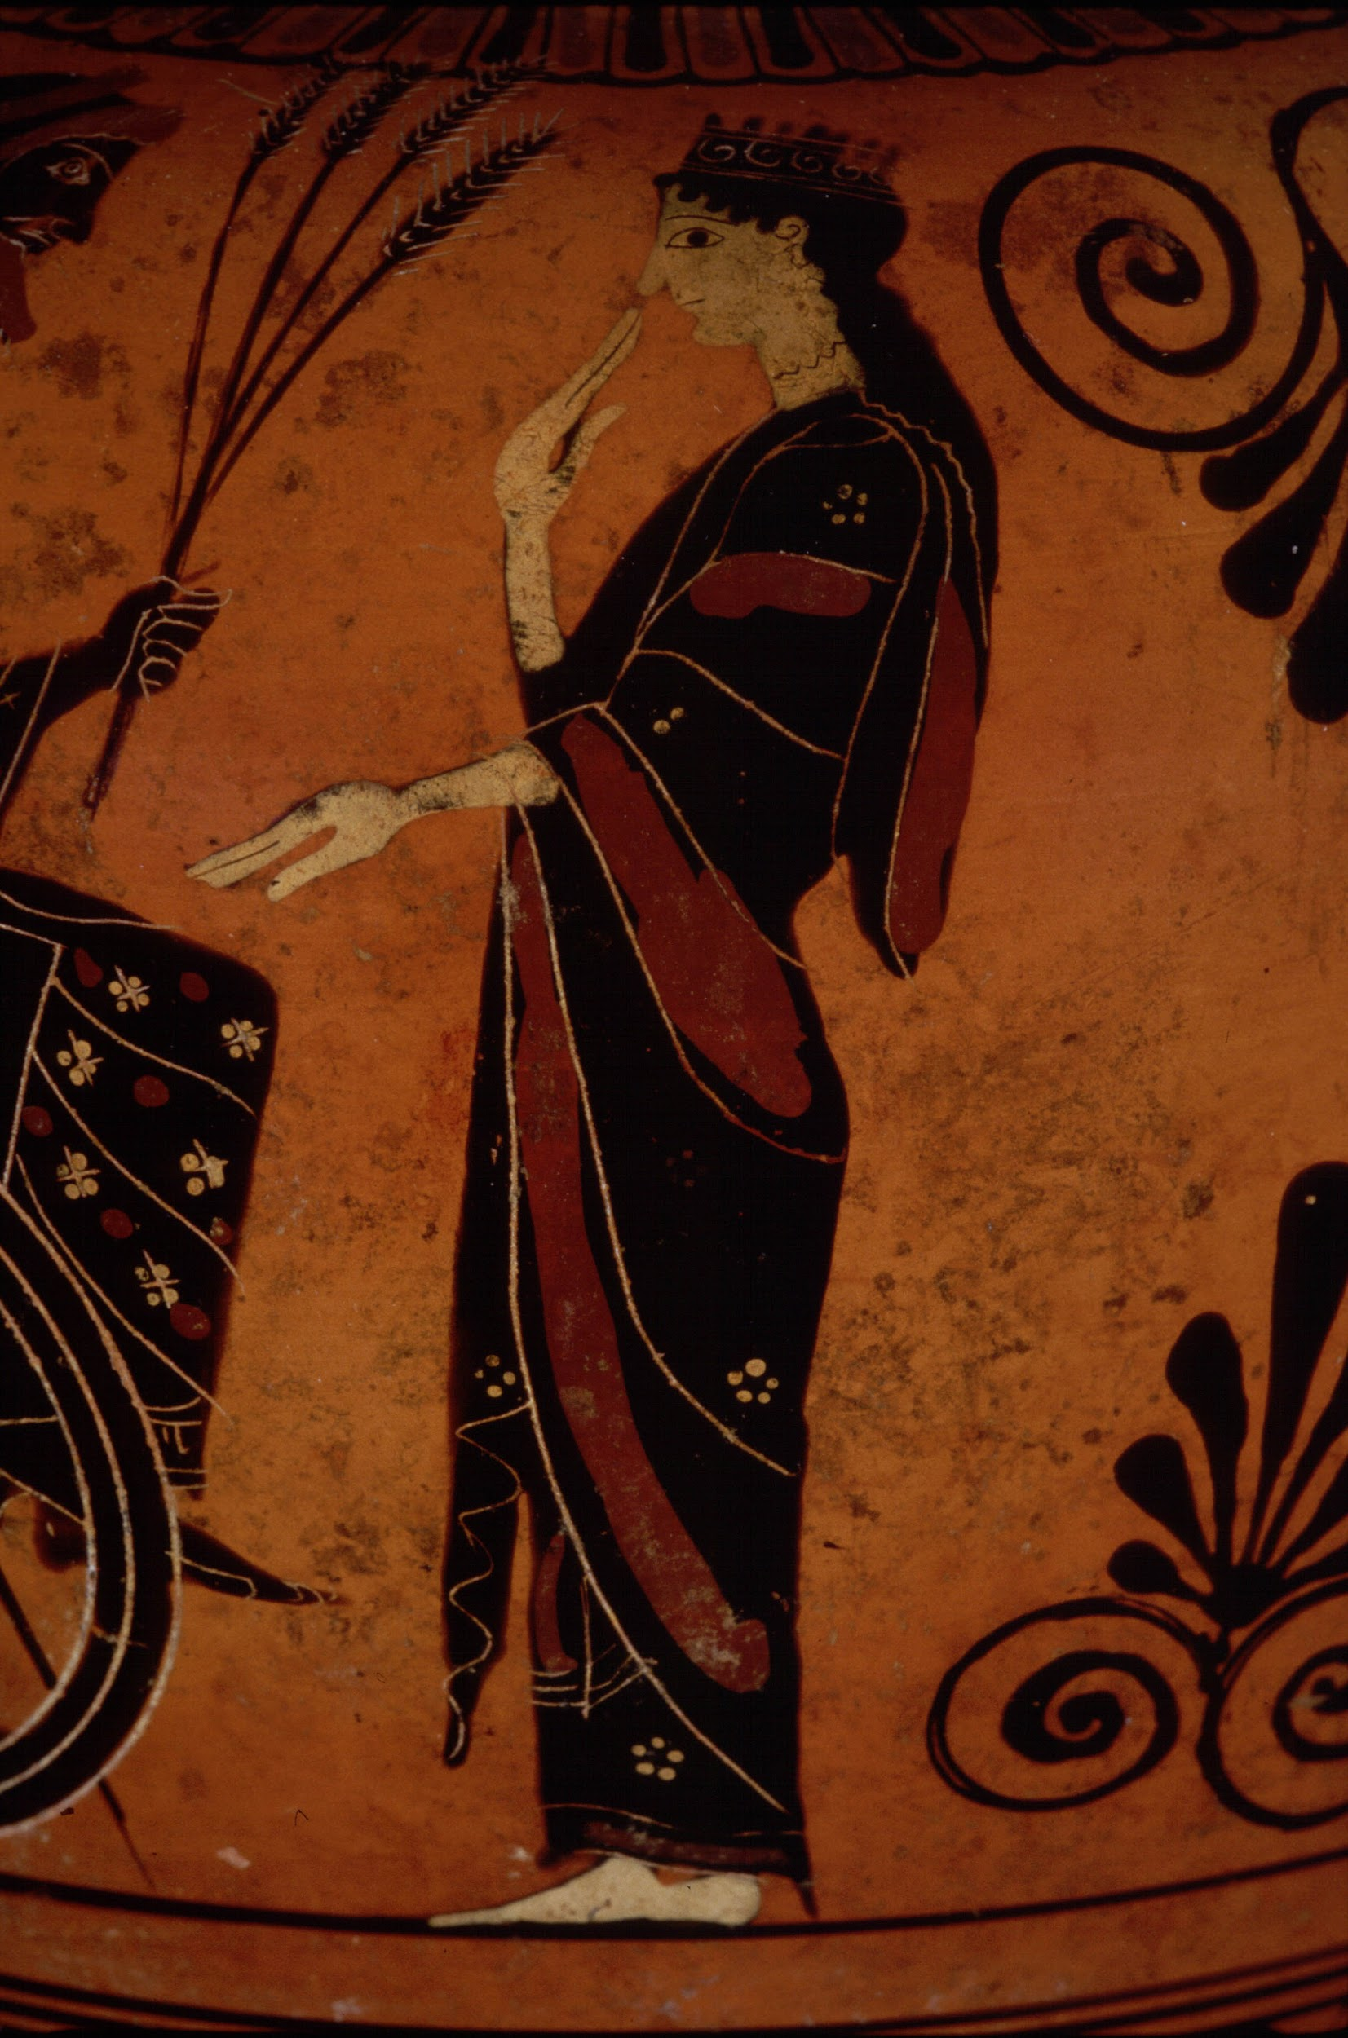
http://www.perseus.tufts.edu/hopper/image?img=Perseus:image:1990.03.0309&redirect=true
http://www.perseus.tufts.edu/hopper/image?img=Perseus:image:1990.03.0311&redirect=true

Slide 9
Myth associated with the vase:
Persephone is abducted by Hades
Demeter disguises herself as Doso, old lady
Court of Celeus- asked to nurse two sons Demophon and Triptolemus
Triptolemus-very ill
Gives Triptolemus her breast milk, which heals him and turns him into adult
Taught Triptolemus art of agriculture
http://www.greekmythology.com/Myths/Mortals/Triptolemus/triptolemus.html

Slide 10
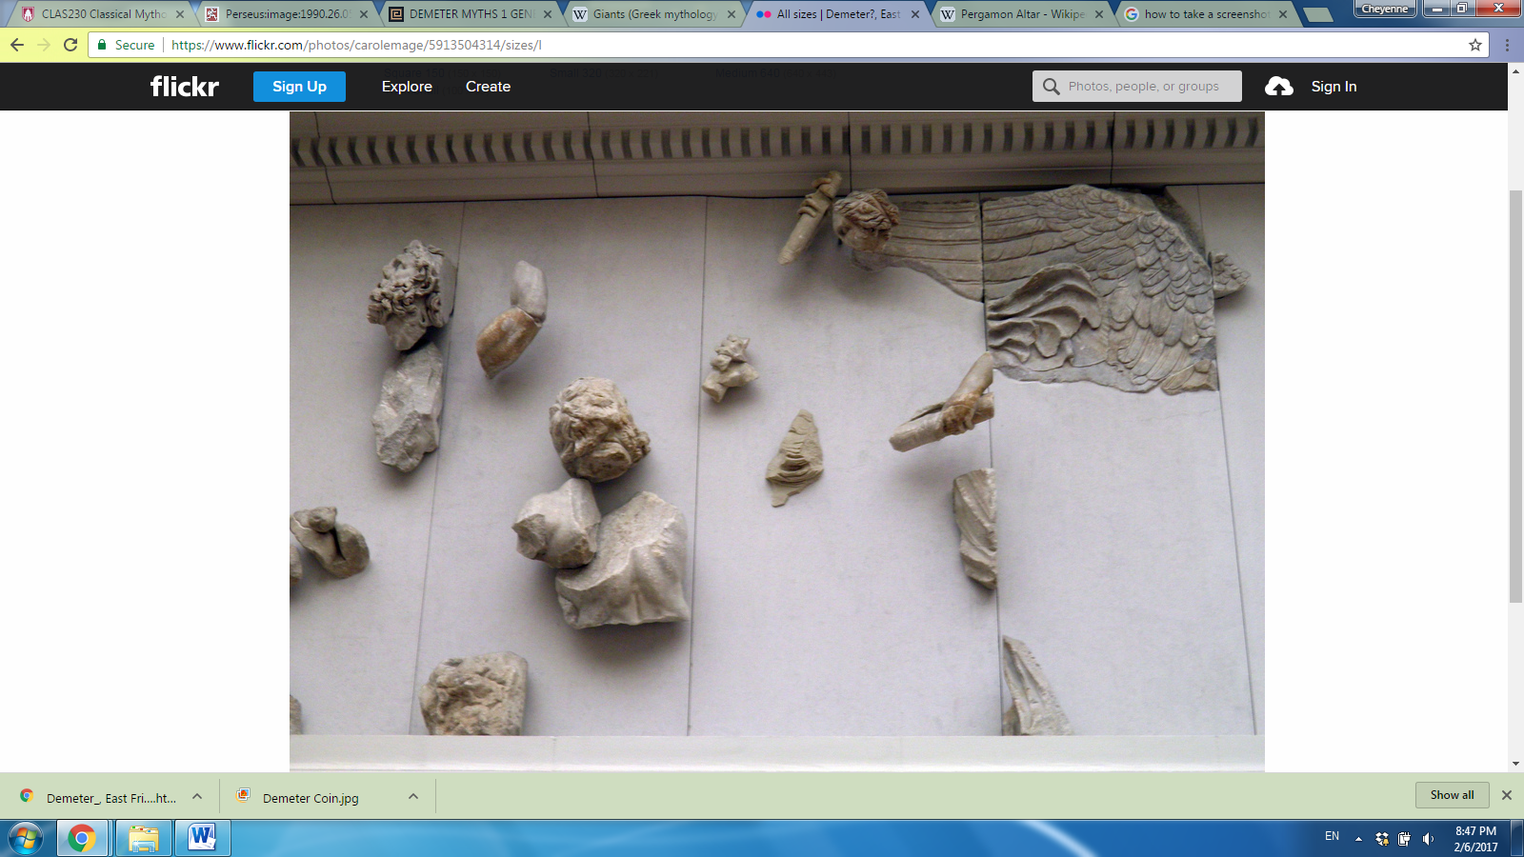
title | Pergamon Altar depicting the Gigantomachy
description | Demeter (barely visible) wields a pair of torches against Erysichthon
original location | Ancient Greek city of Pergamon in Asia Minor
current location | Pergamon Museum in Berlin, Germany
date | First half of the second century B.C.
https://www.flickr.com/photos/carolemage/5913504314/sizes/l

Slide 11
https://www.flickr.com/photos/carolemage/5913504314/sizes/l

Slide 12
Myth associated with the Pergamon Altar:
Depicts the Gigantomachy- battle between the Olympians and the Titans (Zeus vs. Cronos)
Demeter fought alongside Zeus
Usually said to have wielded two torches
In other variations, wields either a sword or a spear in one hand and a flaming torch in the other
https://en.wikipedia.org/wiki/Giants_(Greek_mythology)
http://www.theoi.com/Olympios/DemeterMyths.html#Gigantes

Slide 13
Comparison of Various Images
Based around her daughter Persephone and/or their relationship
Earth-toned colors (browns, reds, yellows)- equating with her being goddess of agriculture, fertility of Earth
Very “Mother Earth”-esque

Slide 14
Observations about Demeter
Myths revolve around her and her daughter and their relationship, like images
Motherly figure
Seems to be very correlated with Gaia in her jurisdictions (the Earth, et cetera)
In pottery pieces she seems to almost always be in a chariot

Slide 15
Theories of Myth
Allegory- Demeter and Hades argument for Persephone is a symbol for change in the seasons
Myth as Ritual- Demeter Eleusinian Mysteries

Slide 16
Did Demeter become a “Mother Earth” figure because she was such a committed mother to Persephone, or was she such a committed mother to Persephone because she had the “Mother Earth” persona?

