Slide 1
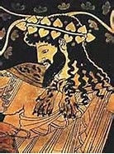
Dionysus
Rhemi Rexrode, Cindy Herrera, and Haley White

Slide 2
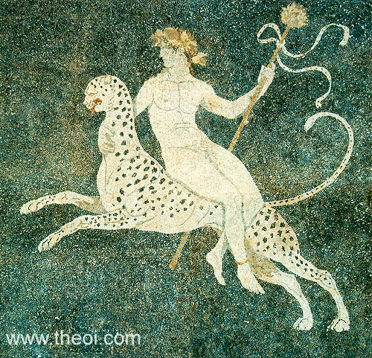
Overview
The son of Zeus and Semele (human)
The god of fertility and wine
Created wine and spread the art of viticulture
Attributes: thyrsos, drinking cup,
and crown of ivy

Slide 3
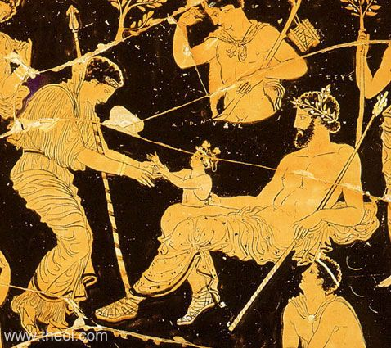
Birth of Dionysus
Hera, Zeus and birth of Dionysus, Apulian red-figure volute krater C4th B.C., National Archaeological Museum of Taranto

Slide 4
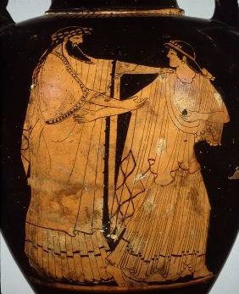
Dionysus pursuing Ariadne
Photograph by Maria Daniels, courtesy of the University Museums, University of Mississippi, May 1991

Slide 5
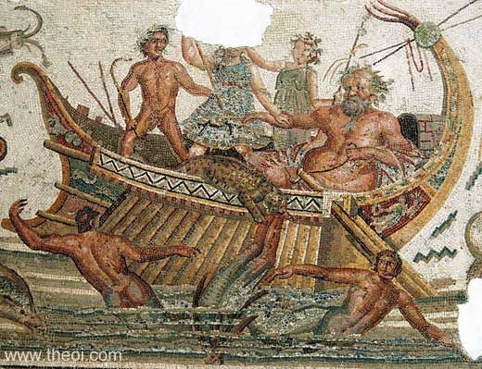
Dionysus, Silenus and the Tyrrhenian pirates
Greco-Roman mosaic from Utica, Bardo National Museum

Slide 6
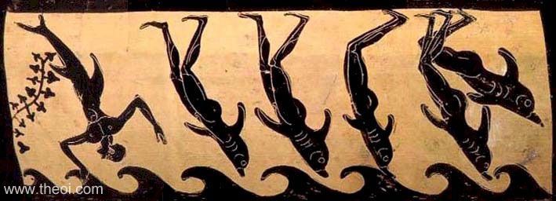
Metamorphosis of the Tyrrhenian pirates, Etruscan black-figure hydria C6th B.C., Toledo Museum of Art

Slide 7
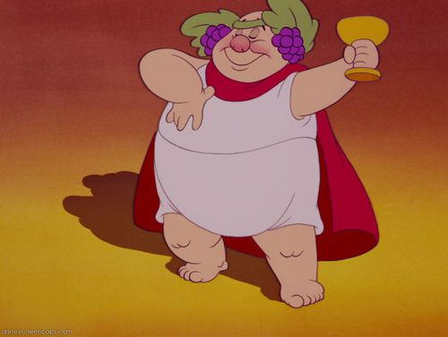
Disney’s fantasia

Slide 8
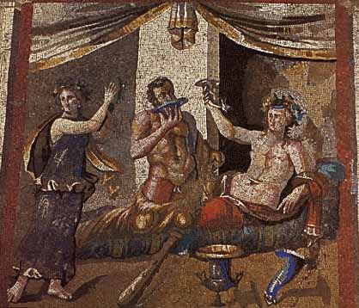
Drinking competition between Dionysus and Herakles

Slide 9
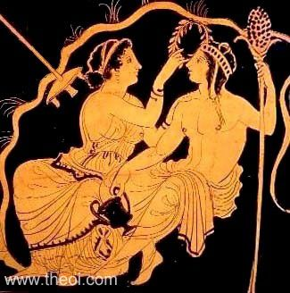
Dionysus and Ariadne
Lucanian red-figure volute krater C4th B.C., Toledo Museum of Art

Slide 10
Discussion
Dionysus shows both wrath and love, how does that tie into the fact that he is the god of wine?

