Slide 1
The Olympian Gods: Hera
By: Rachel Masch, Marjorie Carlson, and Sobhi Kazmouz

Slide 2
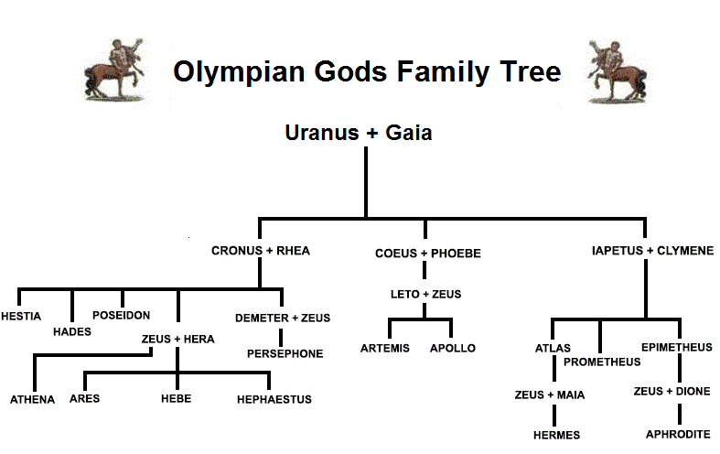
Who is Hera?
Queen of the Olympian gods
The goddess of marriage, fertility, childbirth, heirs, kings and empires
She was the daughter of Cronus
The sister/ wife of Zeus.
Scared animals: cow, peacock, and cuckoo

Slide 3
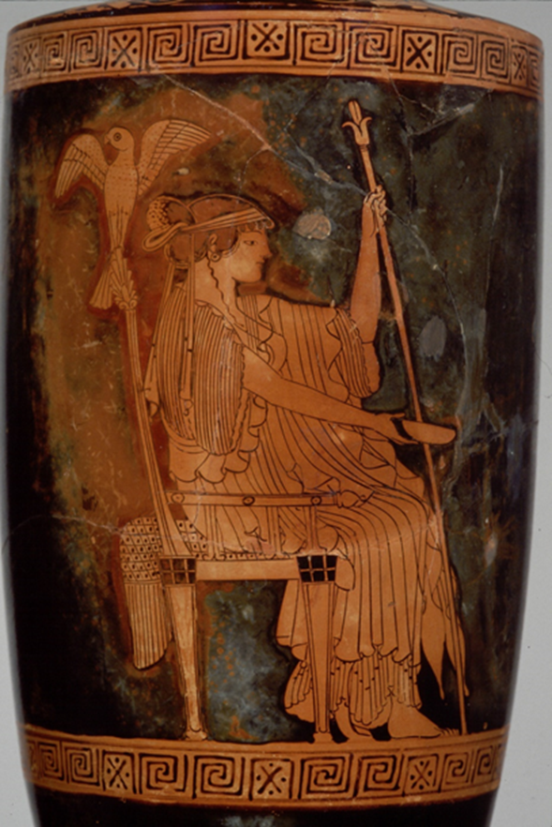

Description of Hera
Usually depicted as:
a beautiful woman
wearing a crown
holding a royal, lotus-tipped scepter
accompanied by a peacock or a cow.

Slide 4
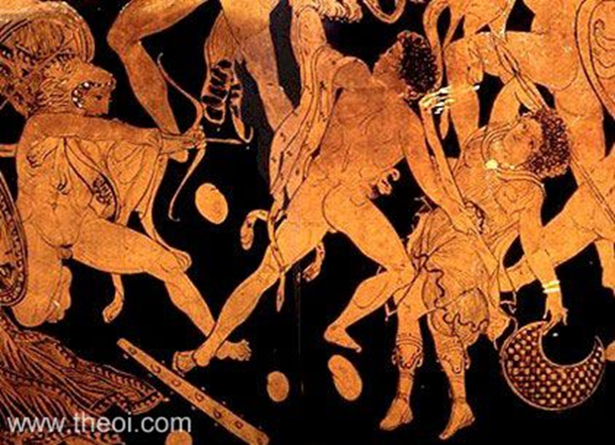

Hera in the War Against the Giants
During the war on the giants, Hera distinguished herself by slaying the giant Phoitos.
However, she was rescued in the war by Zeus and Hercules when the giant Porphrion attempted to rape her.

Slide 6
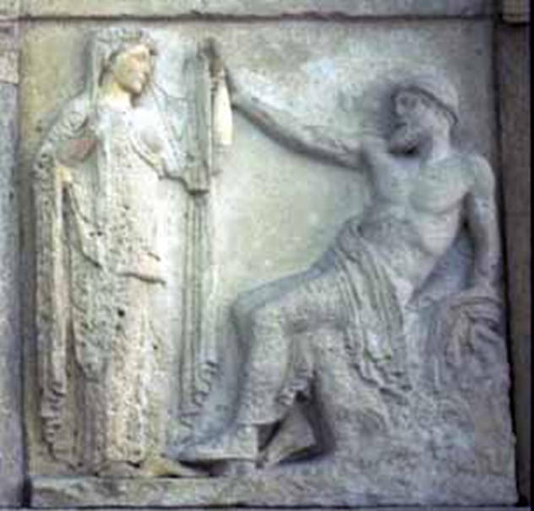

The marriage of Zeus and Hera
Hera grew up to be the most beautiful of the goddesses and Zeus made her his bride.
Hesiod, Theogony 921 ff (trans. Evelyn-White) (Greek epic C8th or C7th B.C.) :
"Lastly, he made Hera his blooming wife : and she was joined in love with the king of gods and men, and brought forth Hebe and Ares and Hephaestos“

Slide 7
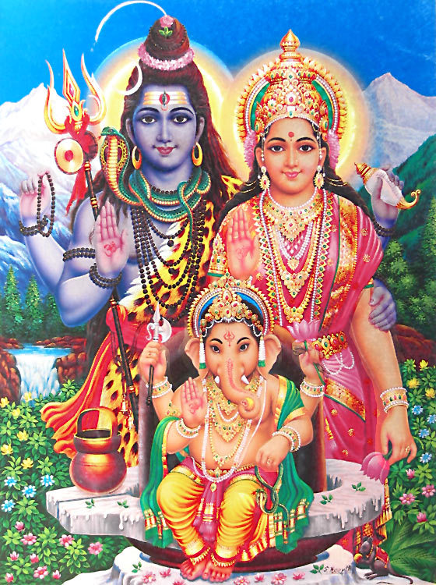
The Marriage of Parvarti and Shiva
The two were married in a sacred ritual performed by the gods and spent their honeymoon on the mountaintop that was the center of the universe.
Parvati’s consistent affection soon softened Shiva’s heart toward her
http://www.dollsofindia.com/product/hindu-posters/shiva-parvati-and-ganesha-reprint-on-paper-QM13.html

Slide 8
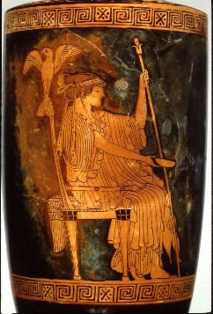

Comparison of Hera to Parvati
Parvati, Hindu Goddess
Hera, Greek Goddess
The goddess Parvati is the animating force that brings skill, power, prowess, and genius, and feminine energy of the universe.
Hera was the Olympian queen of the gods, and the goddess of marriage, women, the sky and the stars of heaven
http://yoganonymous.com/gods-goddesses-shakti-the-great-divine-mother

Slide 9
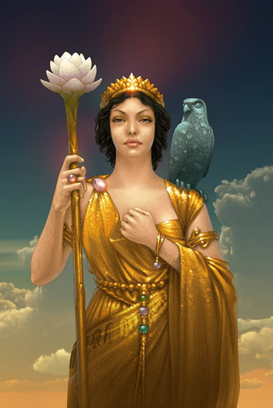
Hera
Percy Jackson
Celöbra dauth
October 27, 2011
http://riordan.wikia.com/wiki/File:Hera-the-heroes-of-olympus-15523197-1024-768.jpg
http://riordan.wikia.com/wiki/Hera
This is Hera as portrayed in Percy Jackson.
She is the queen of the gods thus she is portrayed with a in all gold with a crown and staff do to her high position.

Slide 10
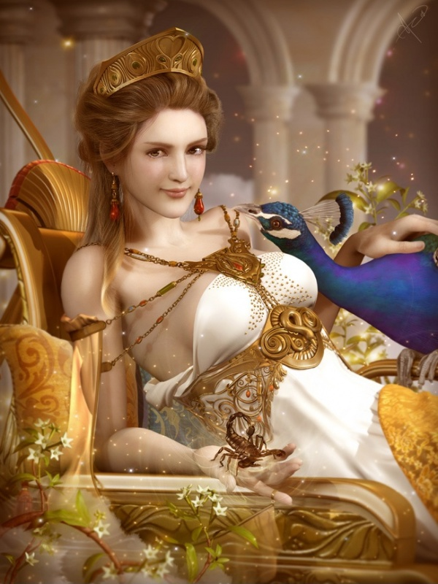
Hera
Hera Goddess and Bird
Soa-Lee
c. 2011
http://soa-lee.deviantart.com/art/Hera-goddess-and-a-bird-be-me-208329792

Slide 11
Modern versions of Hera
Modern depictions of Hera commonalities:
Black or brown hair
She wears gold jewelry or clothing
Has a crown
Has a staff or a throne
Has one of her sacred animals

Slide 12
Application of Theories to Hera's Myth
Myths as Allegory:
  Ancient theory
  Argues that gods are symbols of particular human qualities
  In Hera's myth, Hera is displayed as the personification of jealousy and also represents the jilted wife in society
Comparative Mythology
  Modern Theory
  F. Max Miller, the founder of social scientific study of religion
  Comparative Approach: compares ancient Indian (Vedic) people to myth of other culture’s, such as Greece and Rome

Slide 13
Discussion Question
How does the depiction of Hera represent modern female stereotypes?

