Slide 1
HERMES
(MERCURY)
Selene Hounsve, Nick Mainz, and Angelica Sartelle

Slide 2
BASIC INFORMATION
Parents: Zeus (Son of Cronos and Rhea) and Maia (Daughter of Atlas and Pleione)
God of: Herds, Trade, Thievery, Athletics, and Messengers.
Wife: Penelope (Daughter of Dryopos, no information on her mother)
Son: Pan (Had goat's feet and two horns at time of birth)
Fun Fact: Second youngest of the Olympians, the youngest being Dionysus.

Slide 3
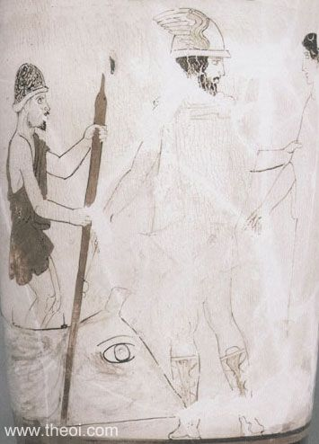
Guide for the dead
Persephone gets abducted and Hermes is sent by Zeus
to fetch the goddess back from Hades.
After retrieving Persephone, Hermes is appointed as
the Guide of Dead Souls.
Charon, Hermes psychopomp, and shade from C5th B.C. National Archaeological Museum, Athens

Slide 4
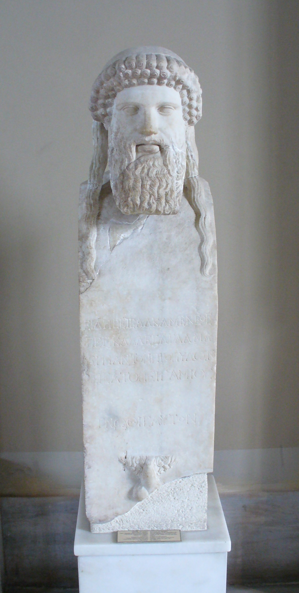
God of Roads, Travellers, and Hospitality
The roads were marked with stone statues called
Hermai or fertility totems which also acted as a shrine.
Zeus made Hermes as the patron-god and
protector of all travelers and hospitality, where Zeus
presided the laws of hospitality.
Hermes is man’s companion and guides
them to their destination.
Hermai of Hermes from 5th century BC

Slide 5
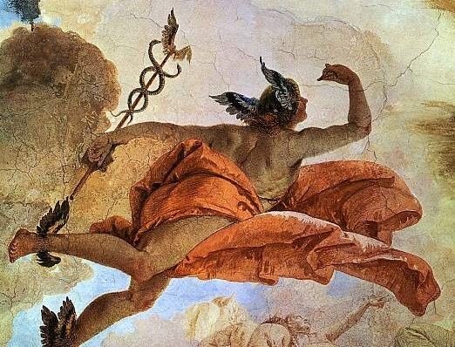
Hermes, the messenger of God
“There were sentries . . . but about these the courier Argeiphontes drifted sleep, on all [with his wand]” Homer, Iliad 24
The two serpents in Caduceus represents the Pillars of Severity and Mercy while the central staff represents the Pillar of Mildness.
"Hermes . . . With winged feet 'tis thine through air to course." Orphic Hymn 28
His tortoise hat makes him invisible to others.

Slide 6
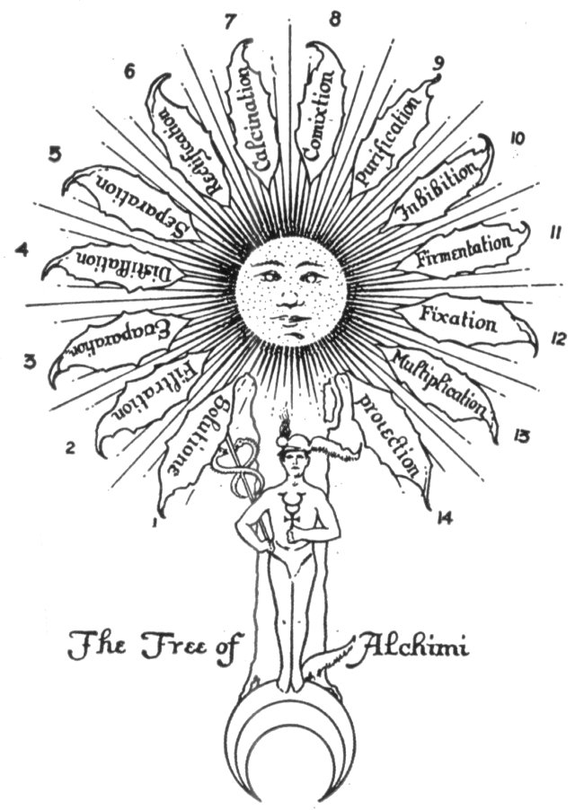
Alchemy?
The 14 words in the leaves of the tree represent the processes or states through which the alchemical substances pass.
Hermes is the god that manages Alchemy, he invented it, but when one takes a deeper look into what Alchemy is it all makes sense.
Hermes is also a symbol of that force of divinity that guides those who have died; he guides the dead to their next residence. He also guides souls out of the lower realms
Mercury is the foundation of the temple, the temple being yourself, your Being, the full development of ultimately what you should be

Slide 7
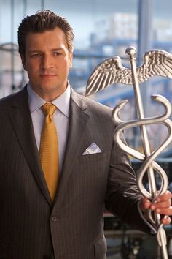
Hermes from Percy Jackson
Very helpful, doing what he can to help Percy Jackson and his friends to find the golden fleece.
Gives them the power to control wind from the four
corners of the earth to get them to the golden fleece.
He also tells them not to kill his son and he still love him.
2013
Notes:
https://www.google.com/search?q=hermes+from+percy+jackson&espv=2&biw=1920&bih=974&source=lnms&tbm=isch&sa=X&ved=0ahUKEwjck-CW9fTRAhVE6YMKHS_fCGIQ_AUIBigB#imgrc=wt9Koe3qdxIThM:

Slide 8
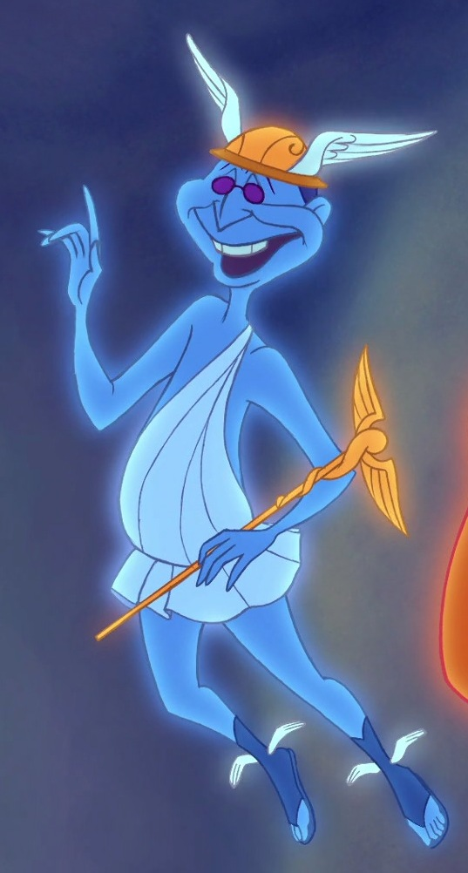
Hermes from Hercules
Modern version of Hermes (Mercury) from Disney’s Hercules.
Showing him as very helpful for the gods, a messenger
for gods, and an aid for Zeus.
For gods, and an aid for Zeus.
1997
Notes:
https://www.google.com/search?q=hermes+from+hercules+disney&espv=2&biw=1920&bih=974&source=lnms&tbm=isch&sa=X&ved=0ahUKEwjvvrTB9fTRAhWh24MKHeeUAowQ_AUIBigB#imgrc=zjNcadG5Gd1bPM:

Slide 9
Ancient Theories
Myths as allegory: Hermes as symbols of human qualities such as cunning, wit, and athletic.
Myth as instructive model: Hermes was the guide of dead and took them to their destination in Hades. If not then the shade would just wander earth, so it explained what the afterlife was.

Slide 10
THE QUESTION
People in the ancient times referred to Hermes as a god of death when there was already a god of death, Hades.
Where do you think this confusion came from, and/or why do you think he got this title?

Slide 11
Resources
http://web.uvic.ca/~athena/department_files/classical_myth/gods/hermes_i.html
http://www.theoi.com/Olympios/HermesLoves.html#Penelopeia

