Slide 1
Ares
Kasha, Hadley, and Tanner

Slide 2
Basic Information
Ares/Mars
Son of Zeus and Hera
God of war, “battlelust,” bravery, violence of combat
Symbols
Helm
Spear, shield, or sword
Serpent
Older vs. younger
http://www.theoi.com/Olympios/Ares.html

Slide 3
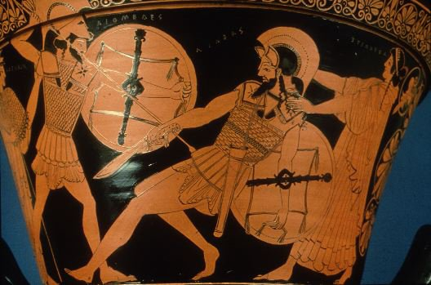
Ares vs. Giants Ares vs. Diomedes
“Ares-- God of War”
http://www.buzzle.com/articles/ares-greek-god-of-war.html
Painting on a krater, 490-480 BC
Boston, Museum of Fine Arts
http://ime.gr/chronos/03/en/gallery/cph36.html

Slide 4
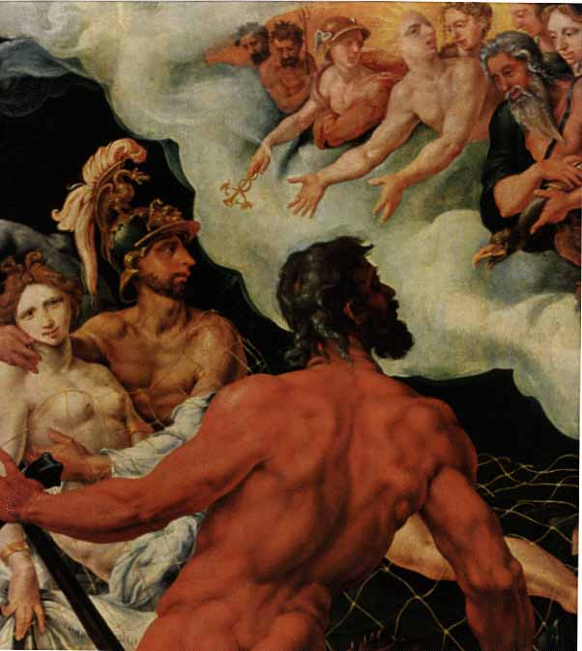
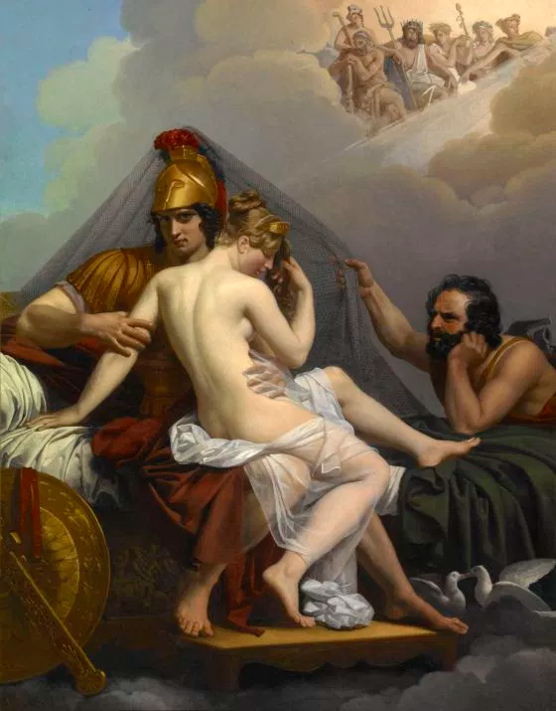
Ares and Aphrodite (Mars and Venus)
Vulcan, Venus, and Mars by Maarten van Heemskerck, 1540, oil on canvas
Kunsthistoriches Museum, Vienna, Austria
http://web.uvic.ca/~athena/department_files/classical_myth/images/haifa/h48.jpg
Mars and Venus Surprised by Vulcan by Alexandre Charles Guillemot, 1827, oil on canvas
Indianapolis Museum of Art, Indianapolis
https://www.artsy.net/artwork/alexandre-charles-guillemot-mars-and-venus-surprised-by-vulcan

Slide 5
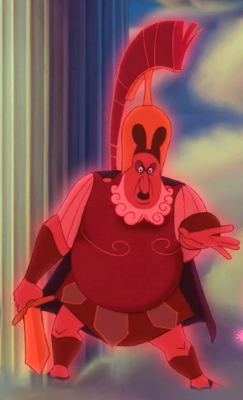
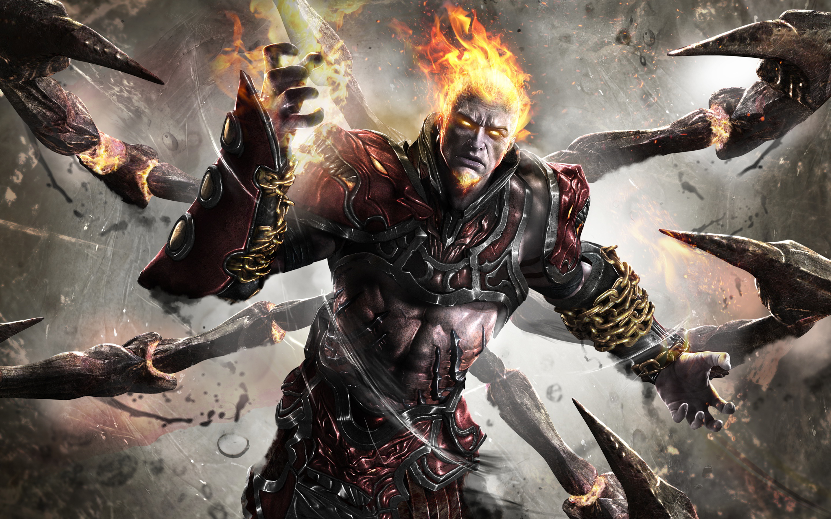
Ares in Disney’s Hercules vs. Ares in God of War

Slide 6
Myths as allegory (Gods as symbols of human qualities)
Study of wisdom and where it comes from
Anaxagoras of clazomenae: misdeeds illustrate evil
Ares was seen as the epitome of the Human Form
Having the qualities of Ares would be beneficial in war

Slide 7
Externalist Theory- Myths as products of the environment
-Constant battles and war going on in ancient times
-people needed something/someone to blame war on
-used Ares to explain war
-Ares persuaded many wars

Slide 8
Discussion Question
What do the myths and depictions of Ares demonstrate about Greek culture? Consider the fact that he represents the violent aspects of war.

