Slide 1
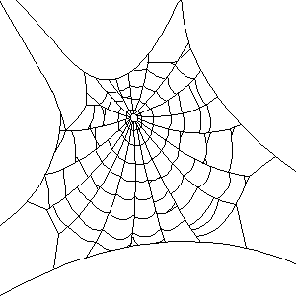
Arachne

Slide 2
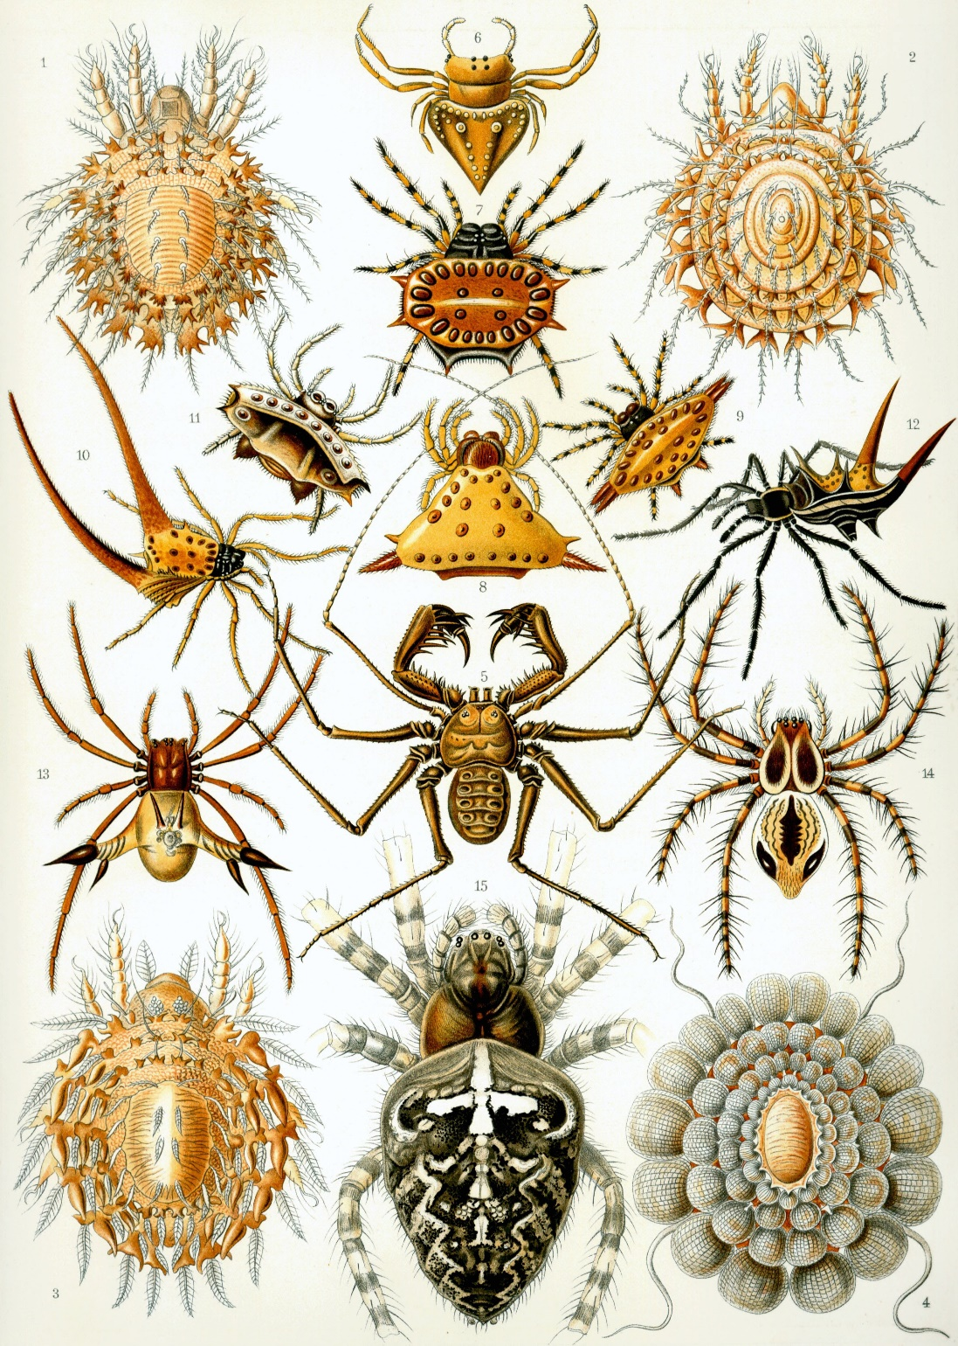
Arachnids

Slide 3
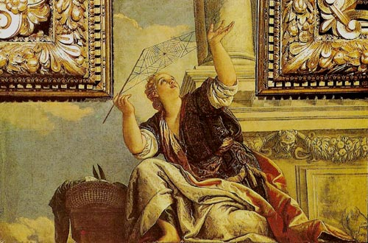
Archne, or Dialectics
Paolo Veronese . 1575-77
Palazzo Ducale, Venezia

Slide 4
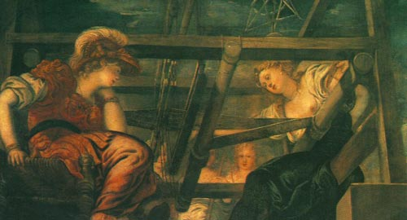
Minerva and Arachne
Jacopo Tintoretto . 1579
Palazzo Pitti, Florence

Slide 5
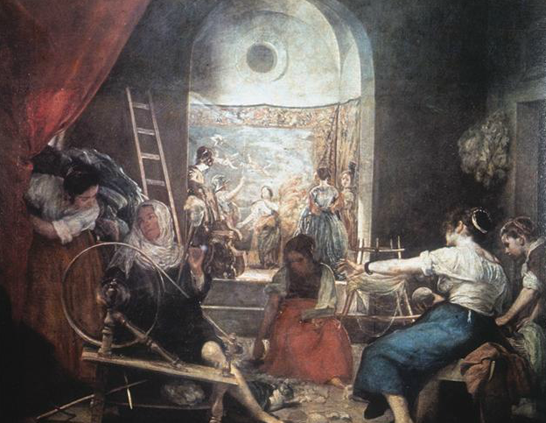
Diego Velázquez . 1657 The Tapestry Weavers, or the Fable of Arachne
Museo del Prado, Madrid

Slide 6
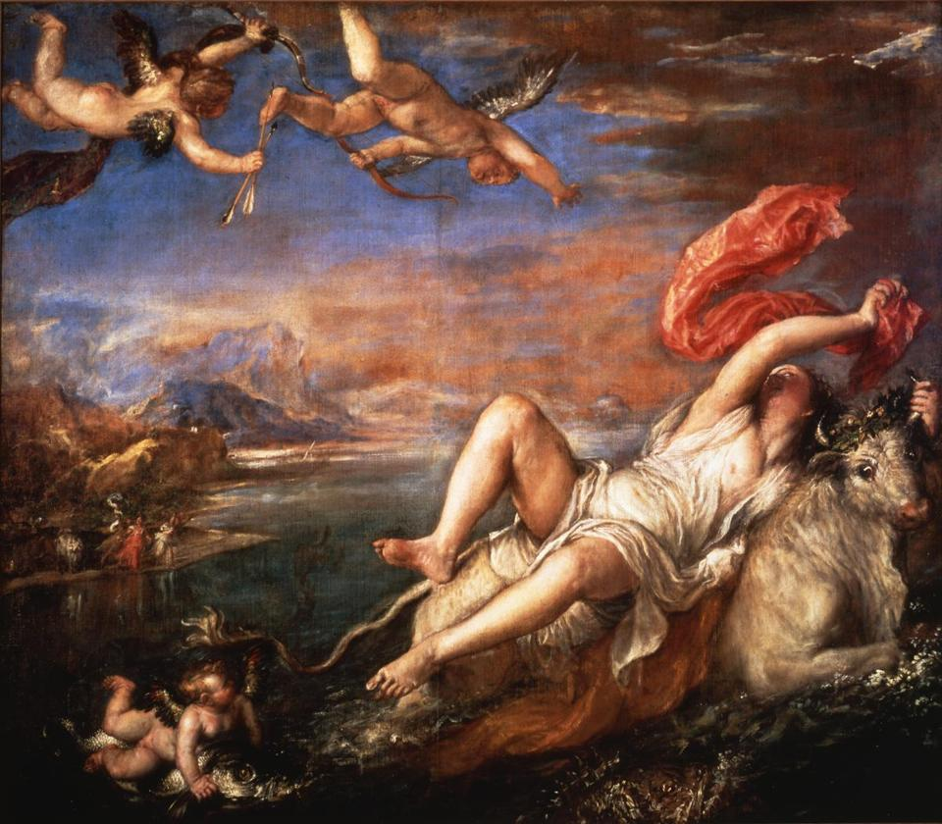
Titian. Rape of Europa. 1560-1562. Gardner Museum, Boston

Slide 7
The Maeonian girl depicts Europa deceived by the form of the bull: you would have thought it a real bull and real waves. She is seen looking back to the shore she has left, and calling to her companions, displaying fear at the touch of the surging water, and drawing up her shrinking feet.
Ovid. Metamorphoses 6.102-107

Slide 8
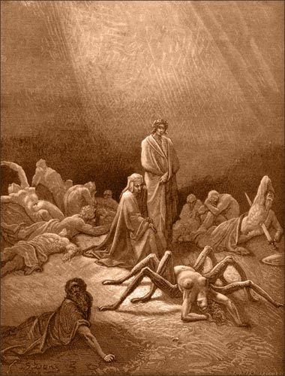
O foolish Arachne, already half spider, so I saw you, saddened, amongst the tatters of your work, woven by you to your own harm!
Arachne
La Divina Commedia
Purgatorio, Canto 12
Gustave Doré . 1861

Slide 9
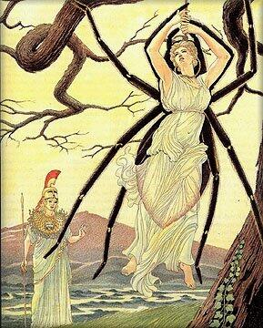
Athena and Arachne
The Illustrated Bulfinch's Mythology
Giovanni Caselli . 1997?

Slide 10
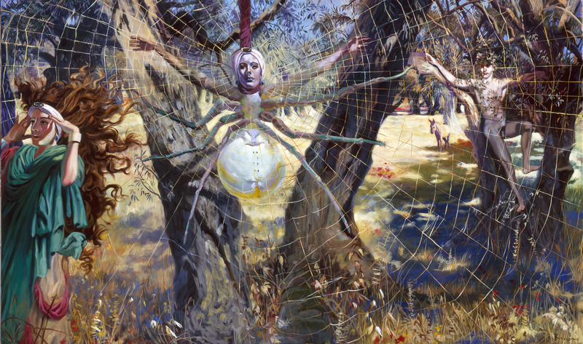
ANDRÉ DURAND

Slide 11

“Arachne Gives Thanks to Athena”
It is no punishment. They are mistaken –
The brothers, the father. My prayers were answered.
I was all fingertips. Nothing was perfect:
What I had woven, the moths will have eaten;
At the end of my rope was a noose’s knot.
Now it’s no longer the thing, but the pattern,
And that will endure, even though webs be broken.
I, if not beautiful, am beauty’s maker.
Old age cannot rob me, nor cowardly lovers.
The moon once pulled blood from me. Now I pull silver.
Here are the lines I pulled from my own belly –
Hang them with rainbows, ice, dewdrops, darkness.
A. E. Stallings
https://blog.stetson.edu/inkwell/2011/09/irony-and-immortality-an-explication-of-a-e-stallings%E2%80%99-%E2%80%9Carachne-gives-thanks-to-athena%E2%80%9D/

Slide 12

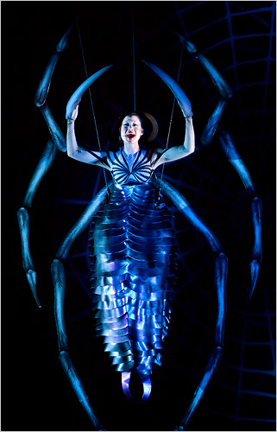
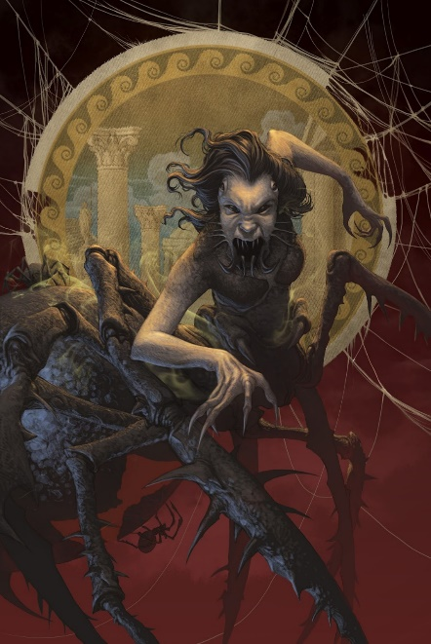
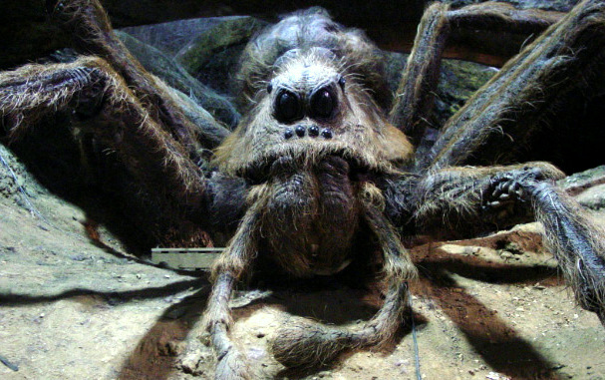
Arachne in Popular Culture
https://en.wikipedia.org/wiki/Arachne

Slide 13
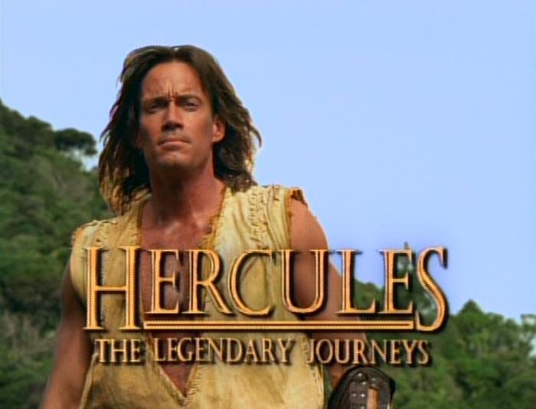
http://hercxena.wikia.com/wiki/Arachne

Slide 14
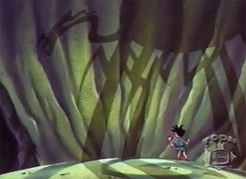
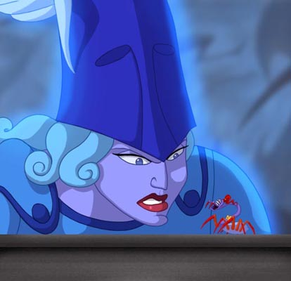
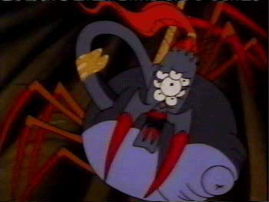
Hercules and Tapestry of Fate
http://www.bcdb.com/cartoon-characters/7132-Hercules-And-The-Tapestry-Of-Fate

Slide 15

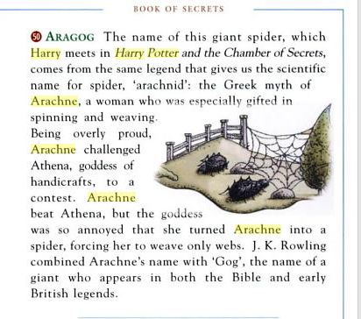

Slide 16


The Mark of Athena
Rick Riordan
http://rickriordan.blogspot.com/2012/09/holy-mother-of-spiders.html
http://riordan.wikia.com/wiki/Arachne

Slide 17
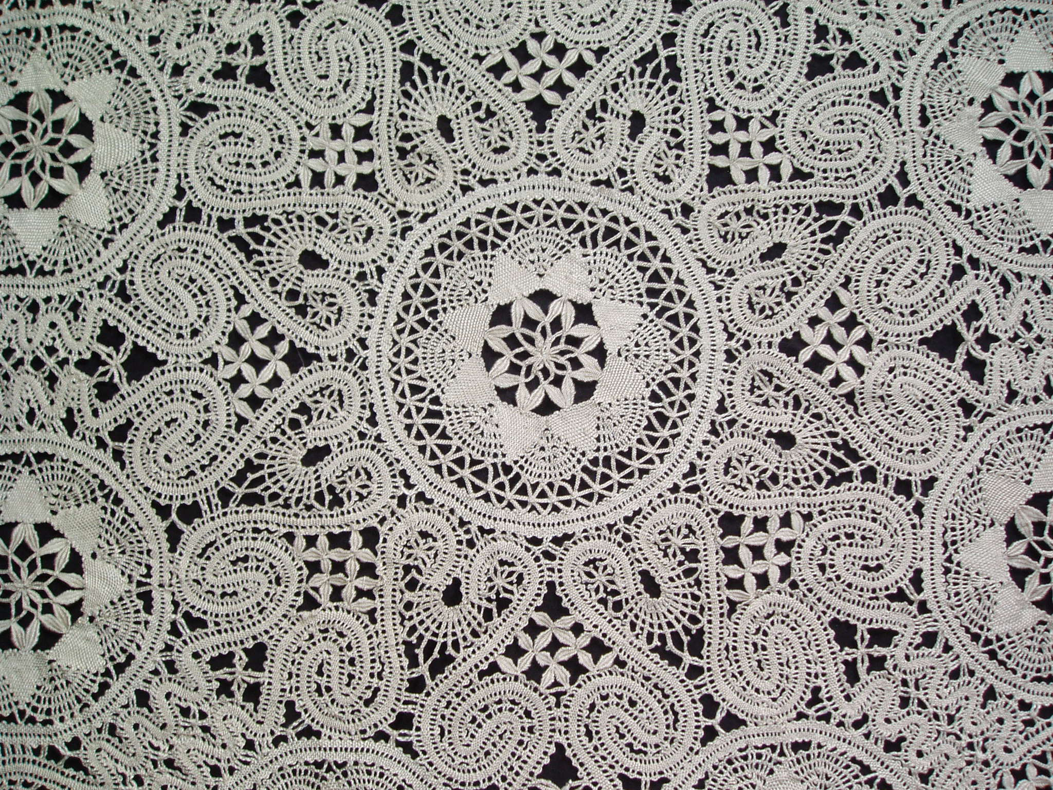
http://www.arachne.com/lace/

Slide 18
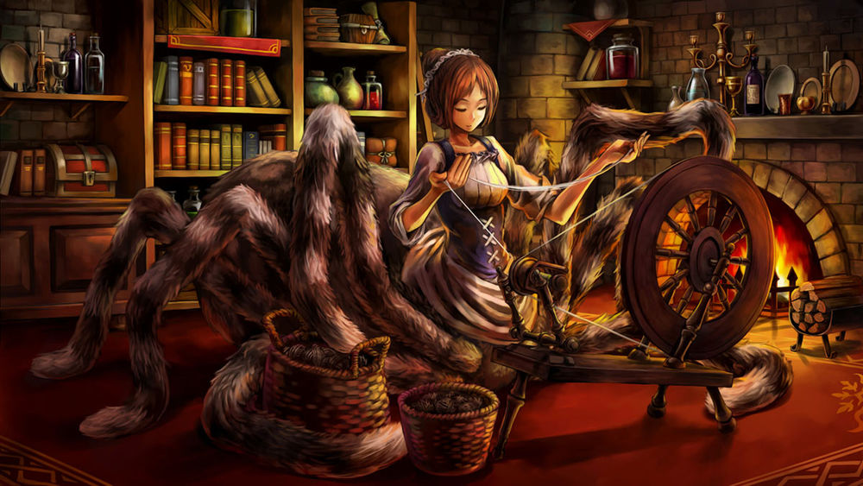
The Arachne in Iron Helix
http://iron-helix.wikia.com/wiki/Arachne

Slide 19

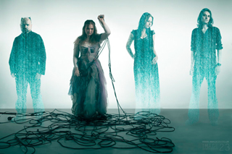
https://www.youtube.com/watch?v=Eqj2aSHRTTc
http://lyrics.wikia.com/wiki/Dyonisis:Arachne's_Song

Slide 20
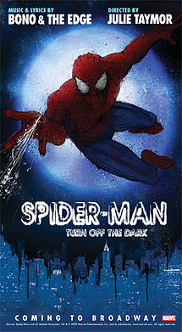
https://en.wikipedia.org/wiki/Spider-Man:_Turn_Off_the_Dark

Slide 21
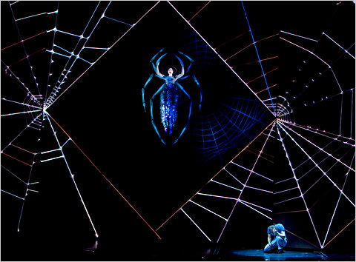
https://www.youtube.com/watch?v=P3jT6AtYIbw
Natalie Mendoza as Arachne

