Slide 1
Daedalus and Icarus

Slide 2
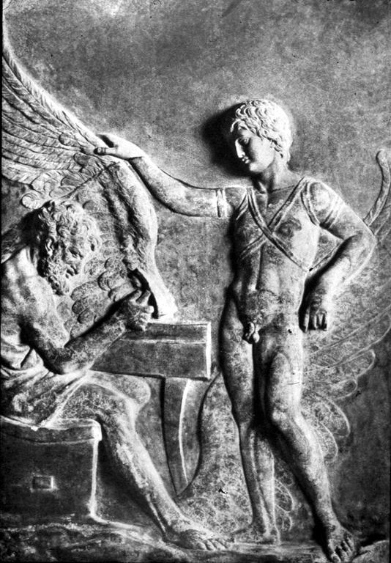
Bas-relief. Villa Albani, Rome.

Slide 3
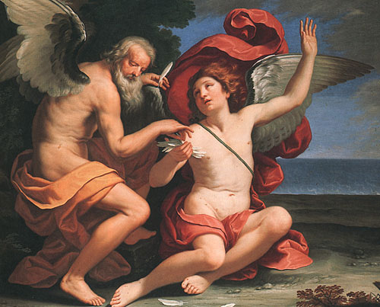
Ludovico Lana (1597-1646). Galleria Doria Pamphili, Rome

Slide 4
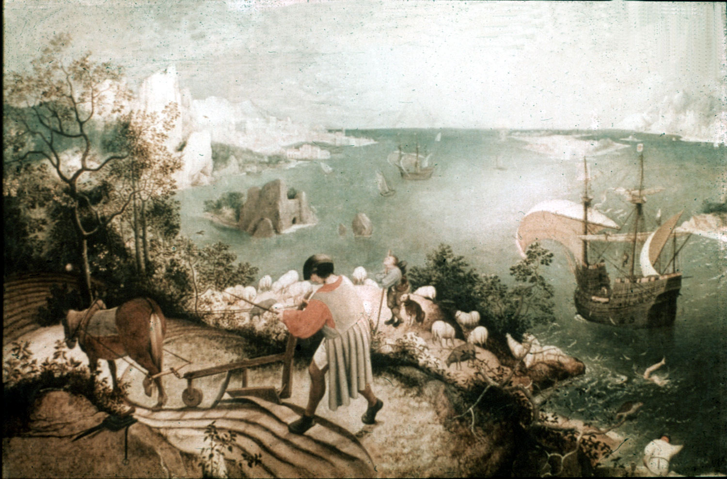
Pieter Brueghel, the Elder, c. 1558. Musées Royaux des Beaux-Arts, Brussels.

Slide 5

Henri Matisse. From the illustrated book, "Jazz", published 1947

Slide 6
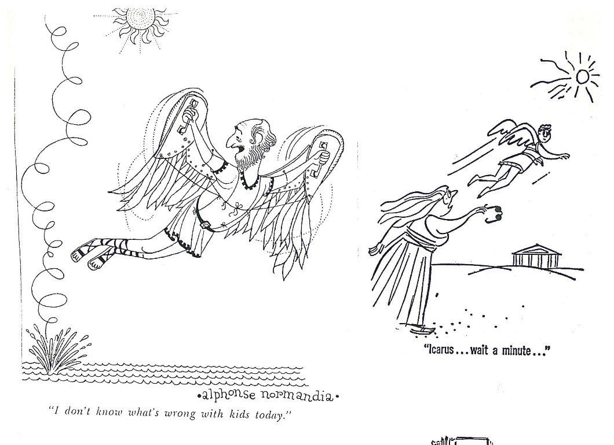


Slide 7
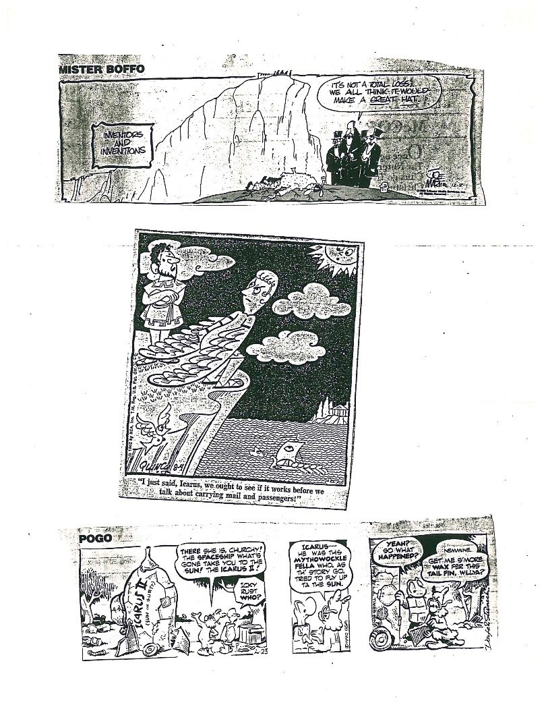

Slide 8
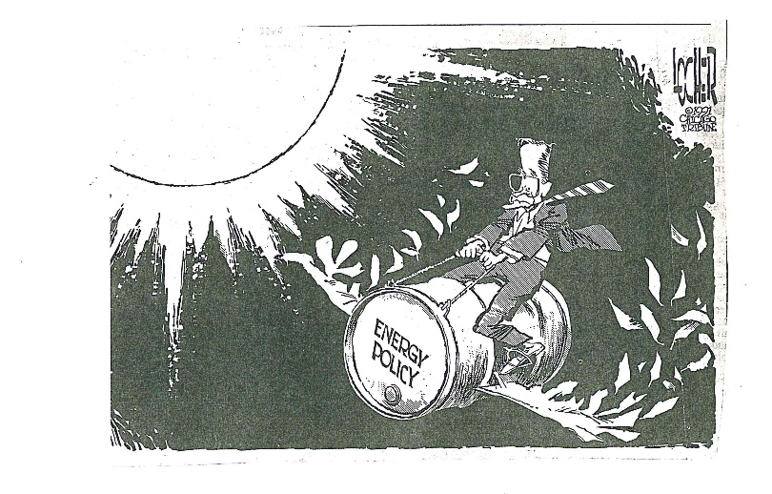

Slide 9
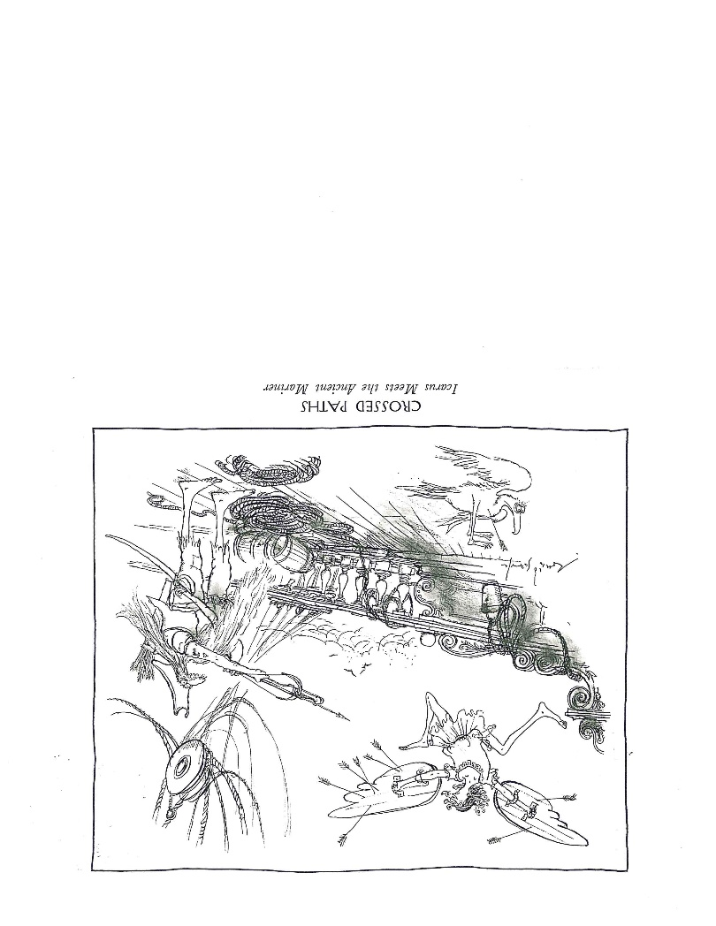

Slide 10
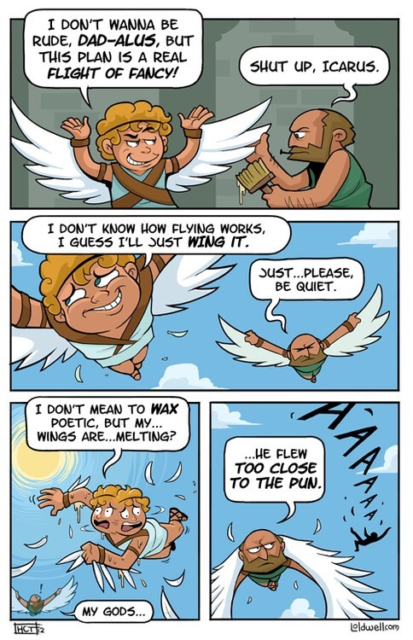

Slide 11

http://www.band-shirt.com/2013/03/09/history-of-the-led-zeppelin-icarus-logo/

Slide 12

http://www.azlyrics.com/lyrics/ironmaiden/flightoficarus.html
https://www.youtube.com/watch?v=b8qDz7K1nbU

