Slide 1
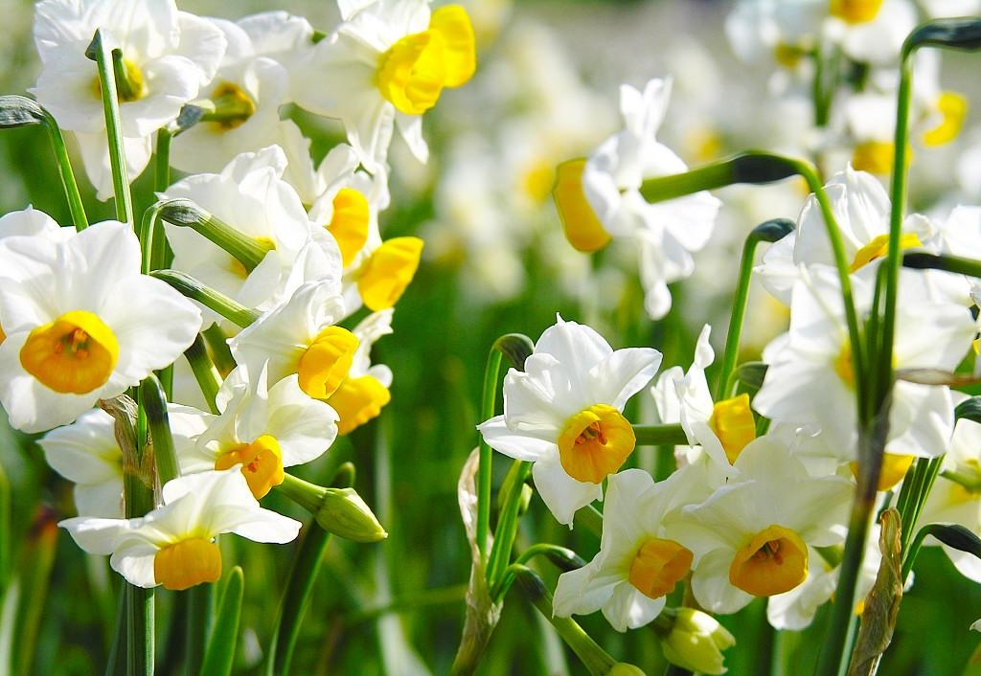
Echo and Narcissus
http://classictales.educ.cam.ac.uk/stories/metamorphoses/echo/weblinks/index.html

Slide 2
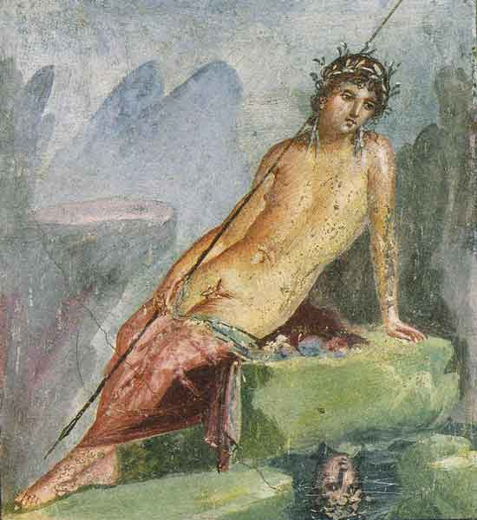
Narcissus fresco from Pompeii

Slide 3
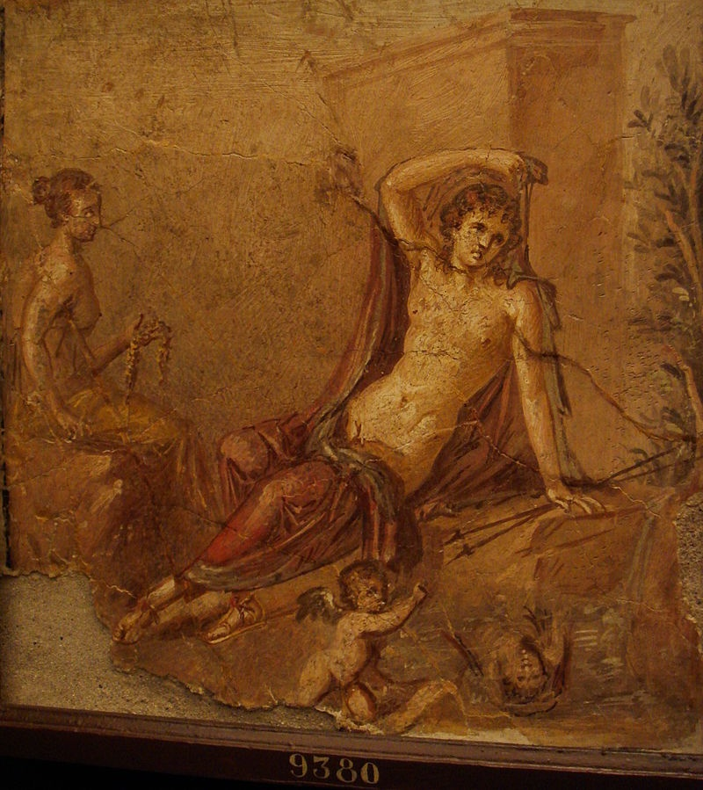

Slide 4
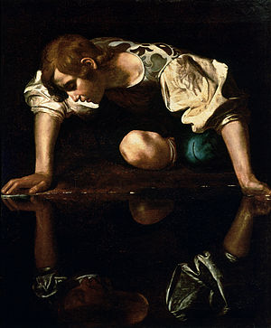
Caravaggio
1597-1599
Galleria Nazionale d'Arte Antica, Rome
Posèq, Avigdor W. G. “The Allegorical Content of
Caravaggio’s ‘Narcissus’” Source: Notes in the History of Art Vol. 10, No. 3 (Spring 1991), pp. 21-31

Slide 5
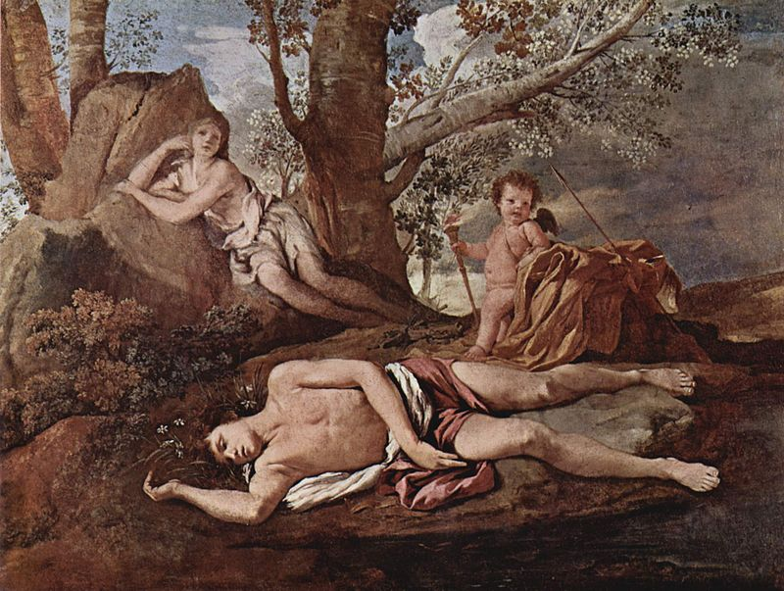
Nicolas Poussin, Écho et Narcisse (ca. 1629–1630)

Slide 6
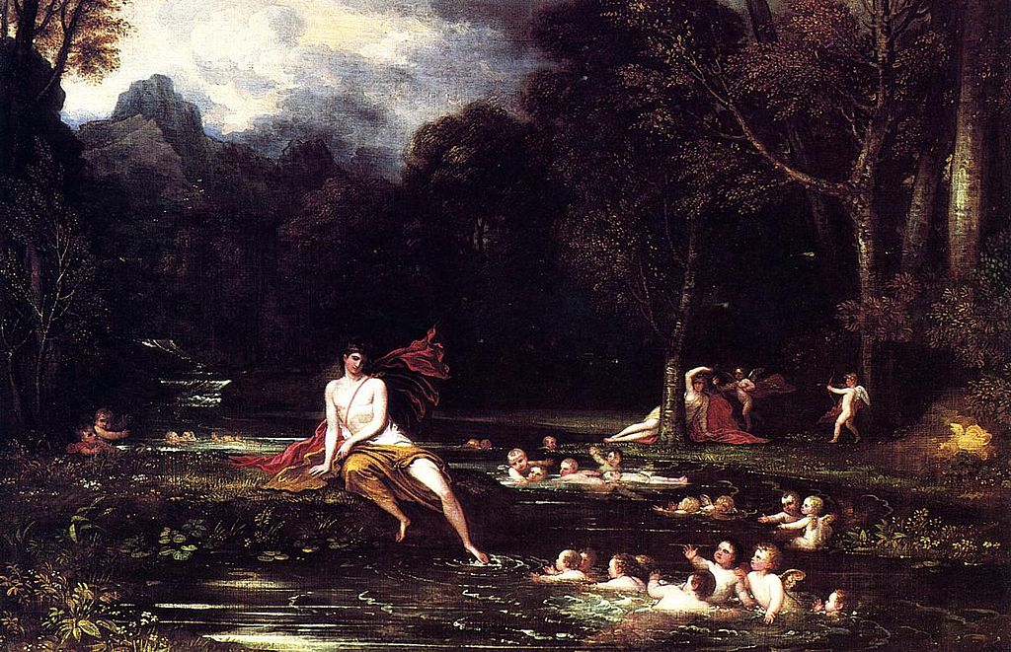
Benjamin West, Narcissus and Echo (1805)

Slide 7
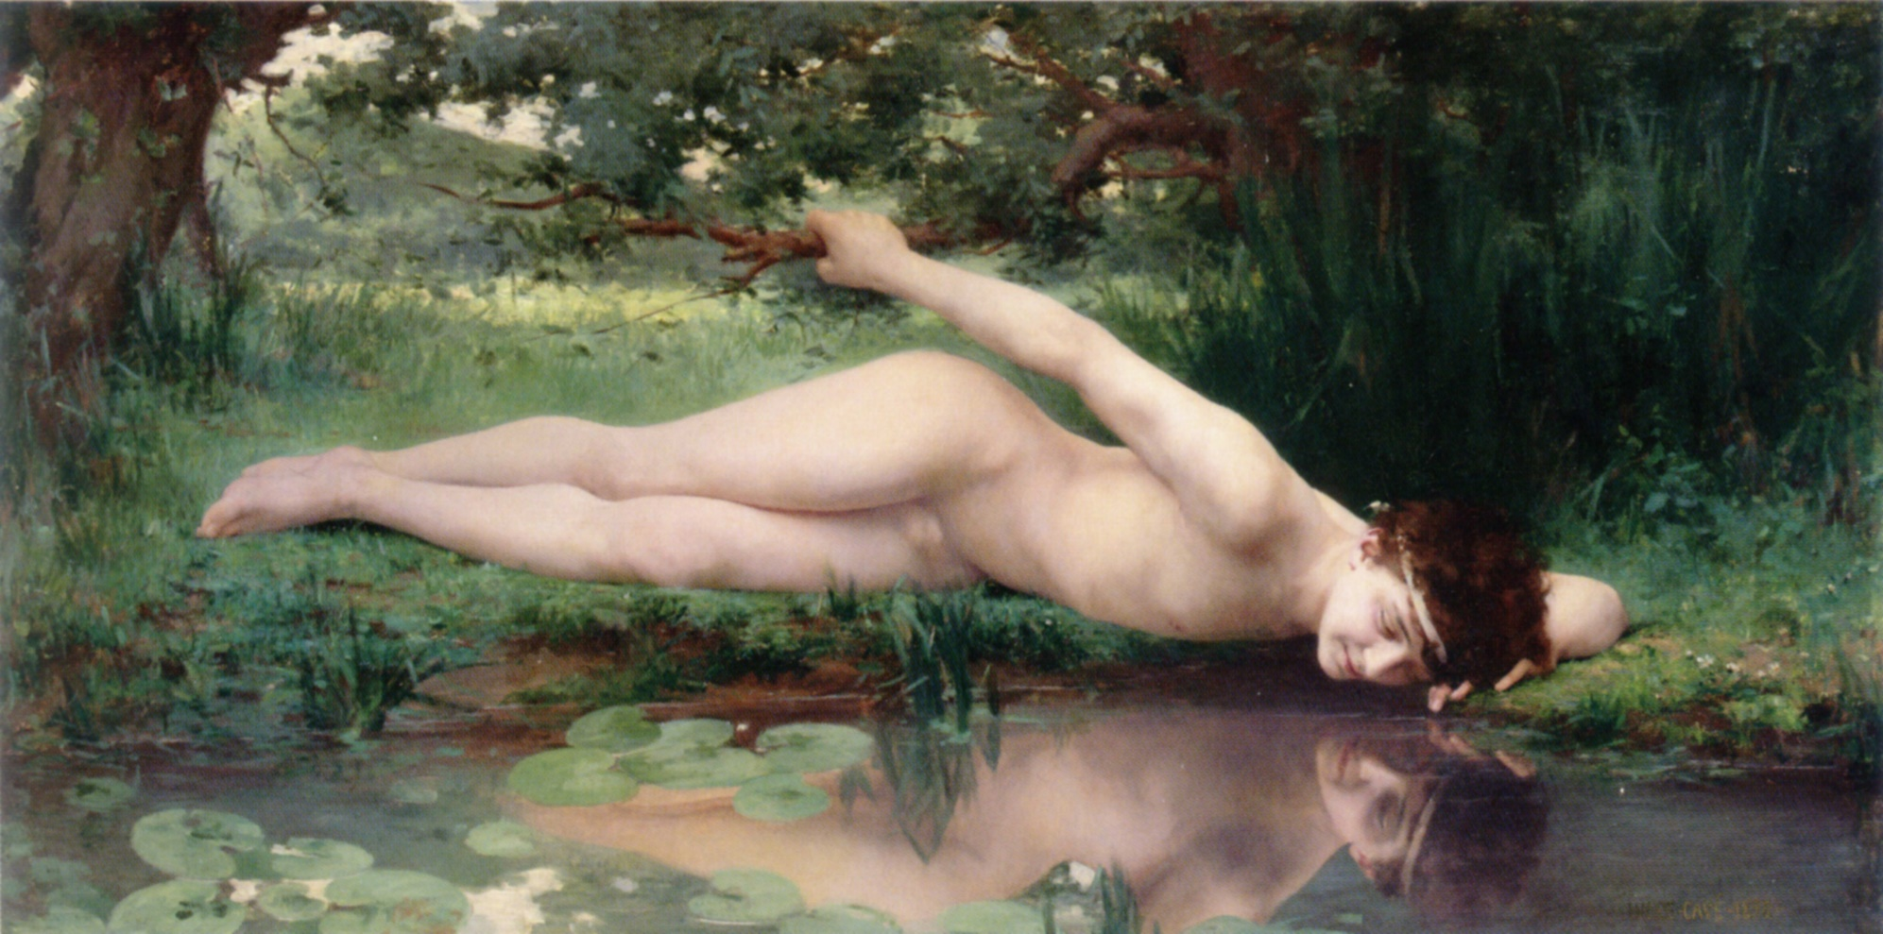
Jules Cyrille Cave 1890

Slide 8
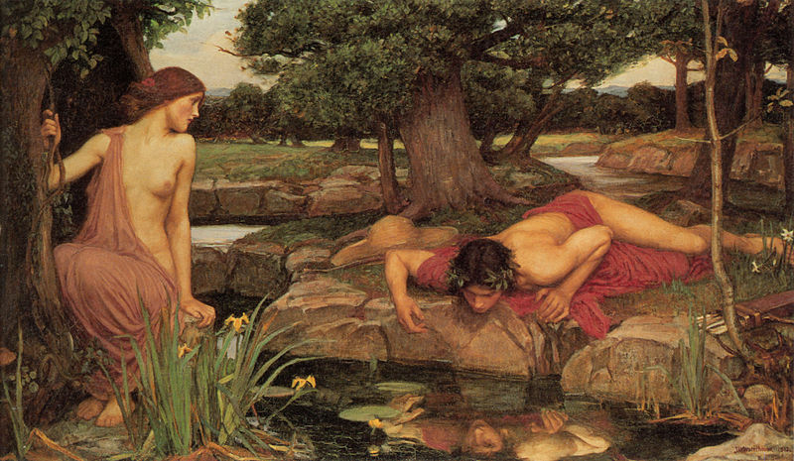
John William Waterhouse (1849–1917)
1903
Walker Art Gallery

Slide 9
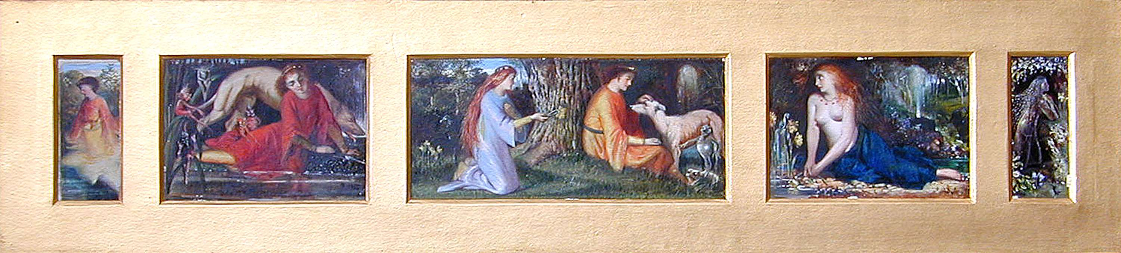
John Anster Fitzgerald {1832-1906)

Slide 10
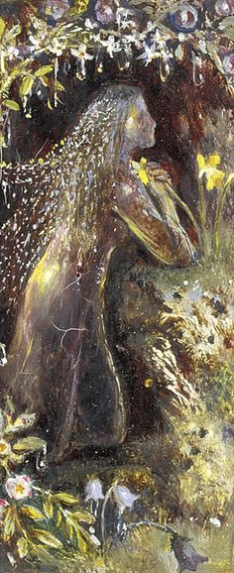
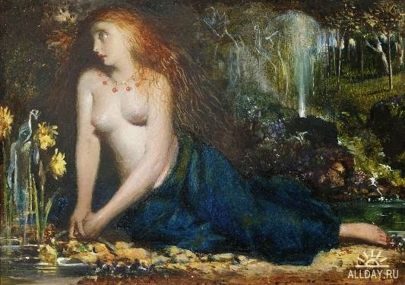

Slide 11
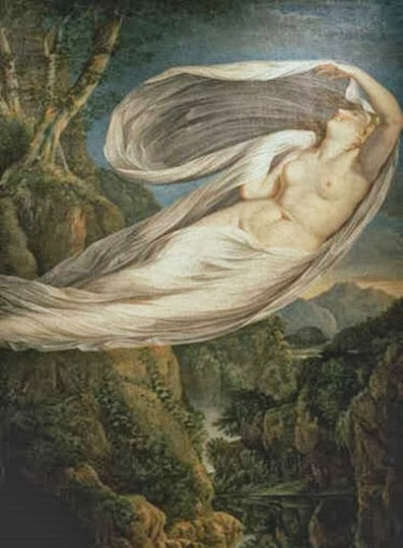
Guy Head
Echo Flying from Narcissus
1798

Slide 12
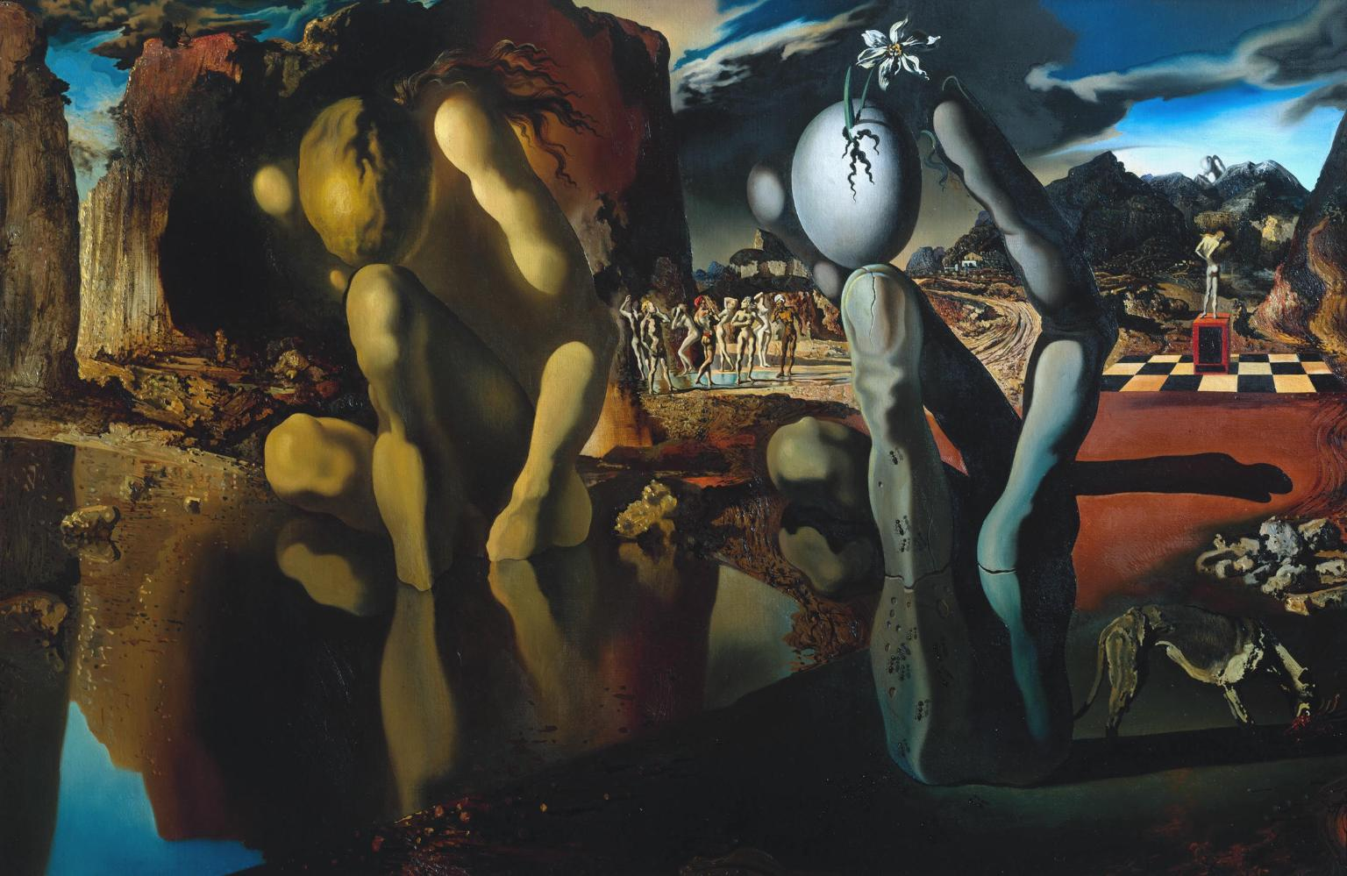
Salvador Dalí 1904–1989
1937
Tate

Slide 13
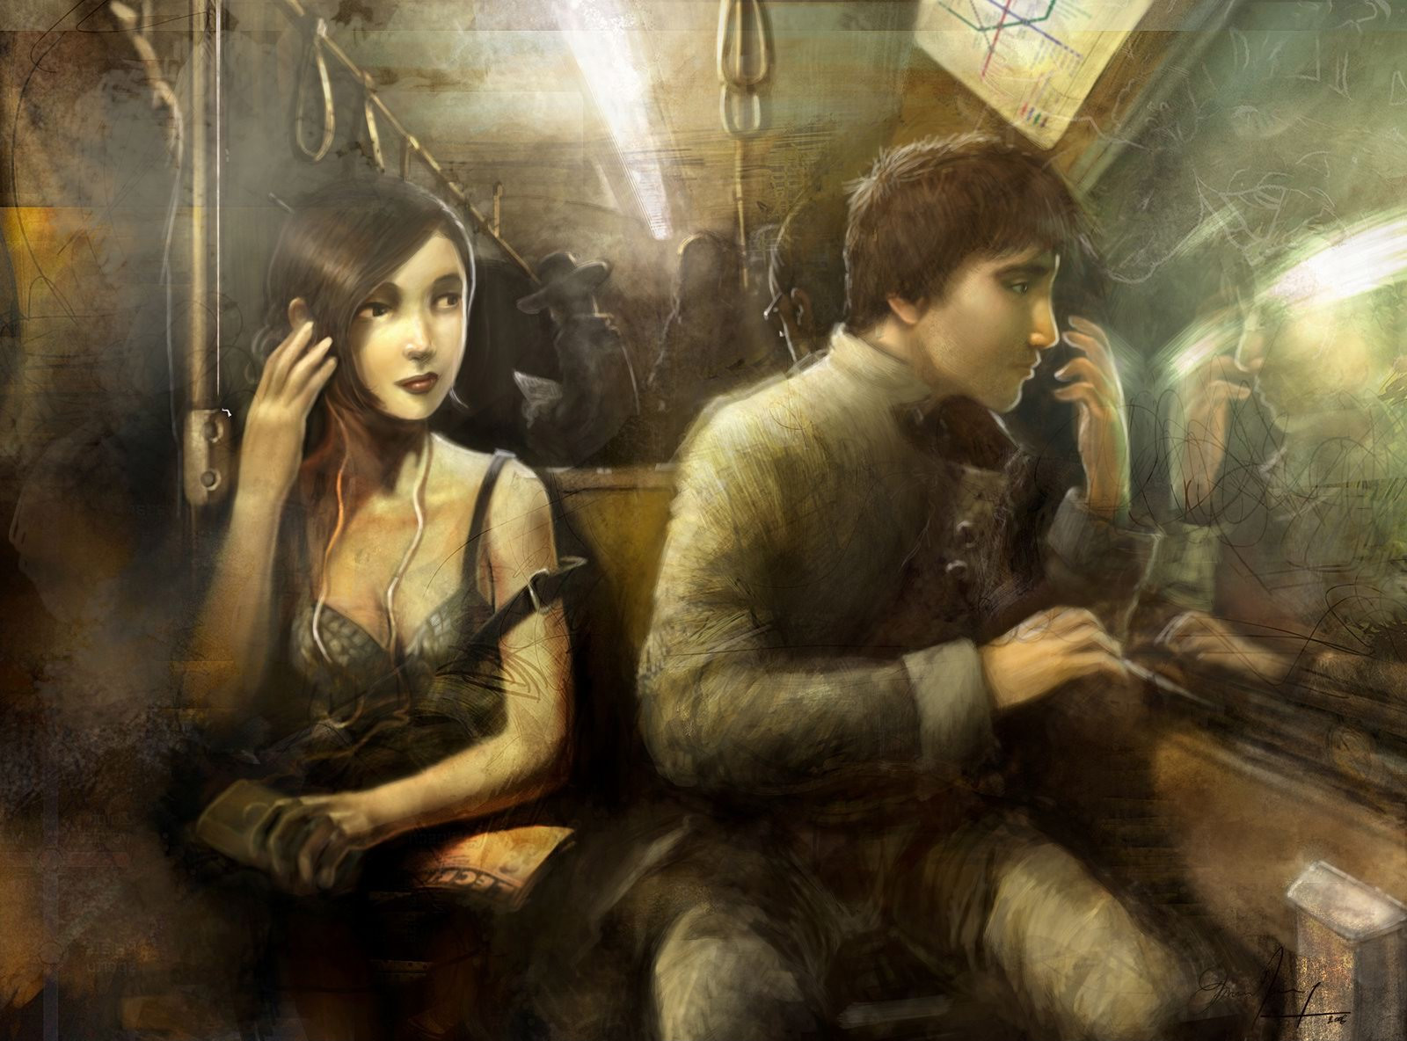
David Revoy

Slide 14
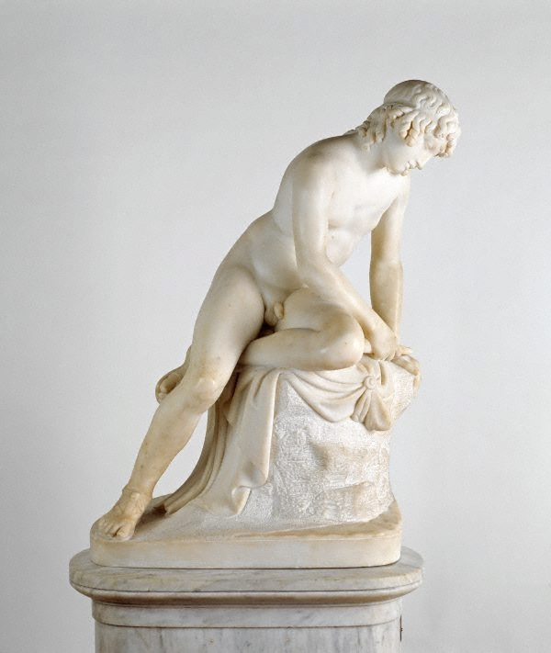
John Gibson RA
Wales, Italy, England
1791 - 27 Jan 1866
New South Wales

Slide 15
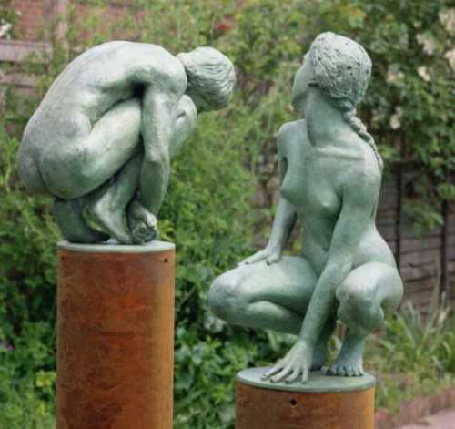
John McKenna

Slide 16
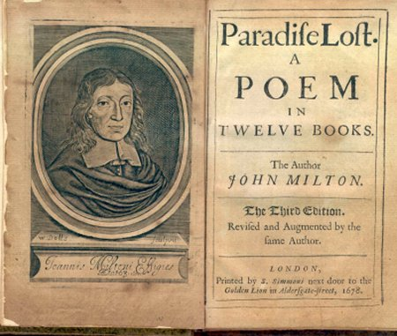
John Milton. Paradise Lost. 4.456-469
…I thither went
With unexperienc’t thought, and laid me downe
On the green bank, to look into the cleer
Smooth Lake, that to me seemd another Skie.
As I bent down to look, just opposite,
A Shape within the watry gleam appeard
Bending to look on me, I started back,
It started back, but pleas’d I soon returnd,
Pleas’d it returnd as soon with answering looks
Of sympathie and love; there I had fixt
Mine eyes till now, and pin’d with vain desire,
Had not a voice thus warnd me, What thou seest,
What there thou seest fair Creature is thy self,
With thee it came and goes…
And when she sees Adam, she compares him unfavourably to her own image! [4.477-480]
Till I espi’d thee, fair indeed and tall,
Under a Platan, yet methought less faire,
Less winning soft, less amiable milde,
Than that smooth watry image; …
For Narcissus in Dante see
http://users.clas.ufl.edu/ras/currency/dccw.html

Slide 17
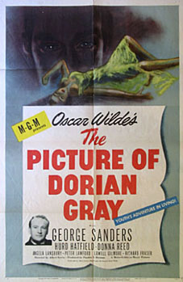
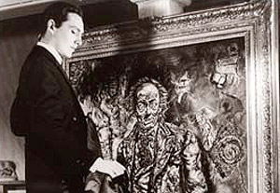
Oscar Wilde. Picture of Dorian Grey (1890)
(1945_

Slide 18
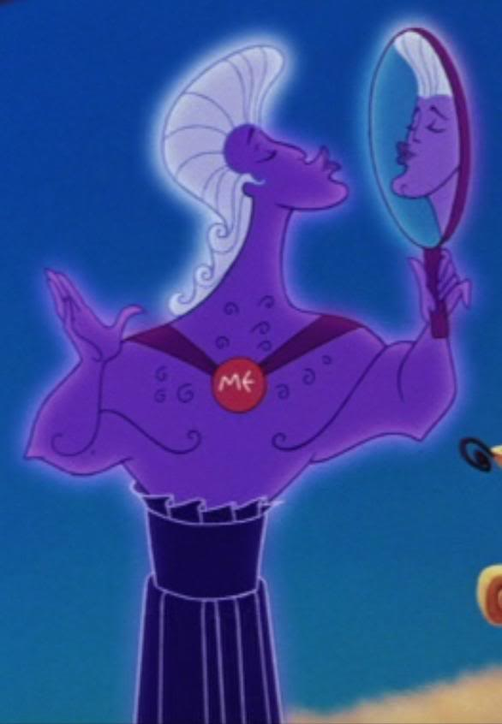
Disney’s Narcissus

Slide 19
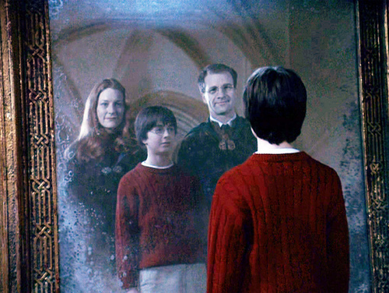

Harry Potter and Mirror of Erised
Narcissa Malfoy

Slide 20
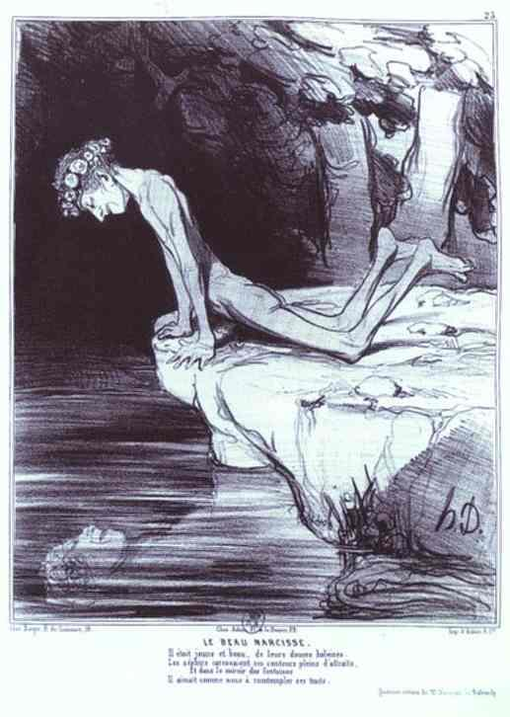
HONORÉ DAUMIER
1808-1879

Slide 21
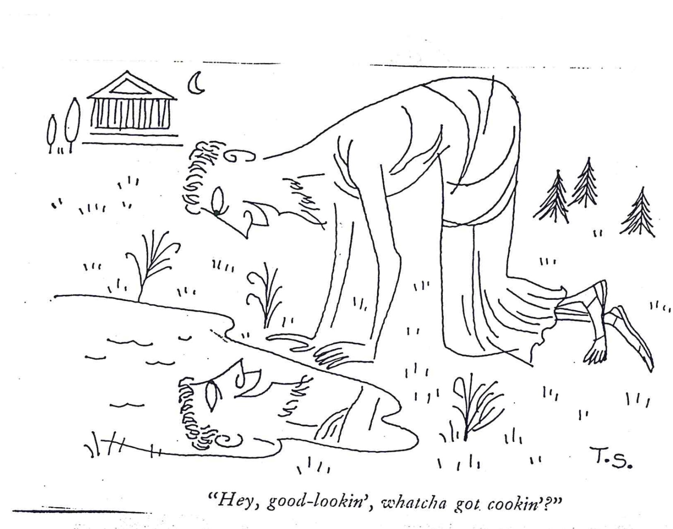

Slide 22
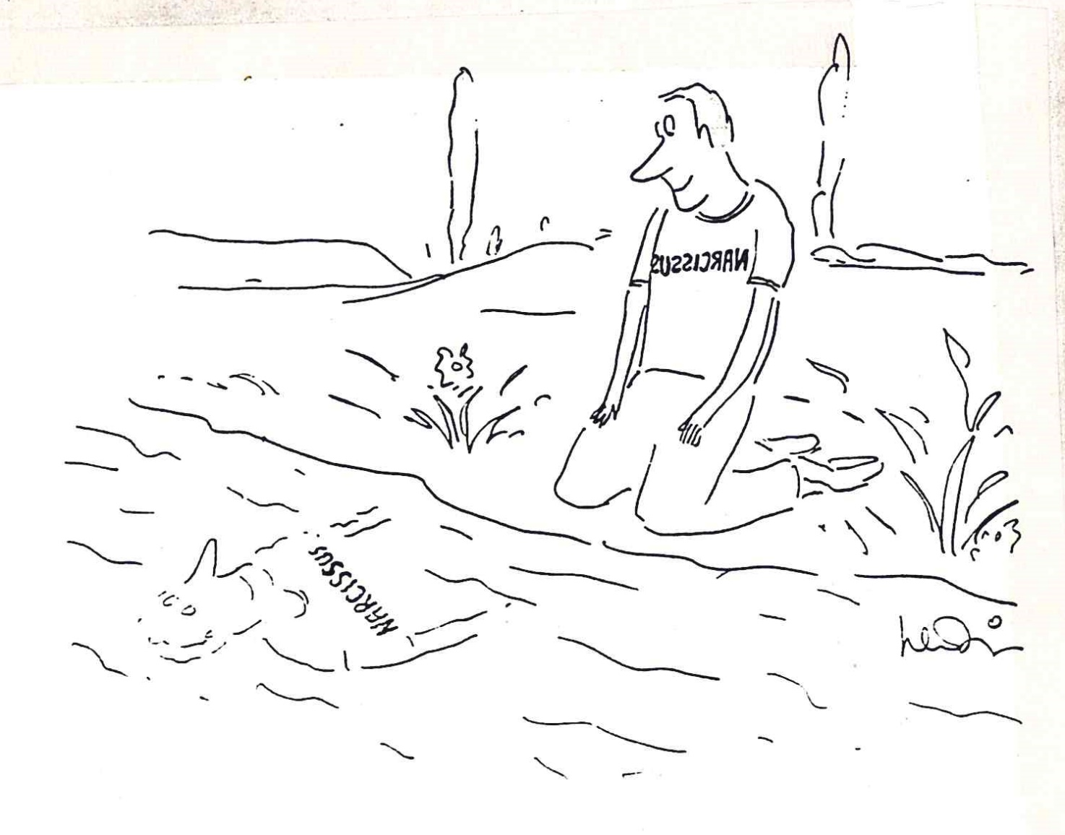

Slide 23
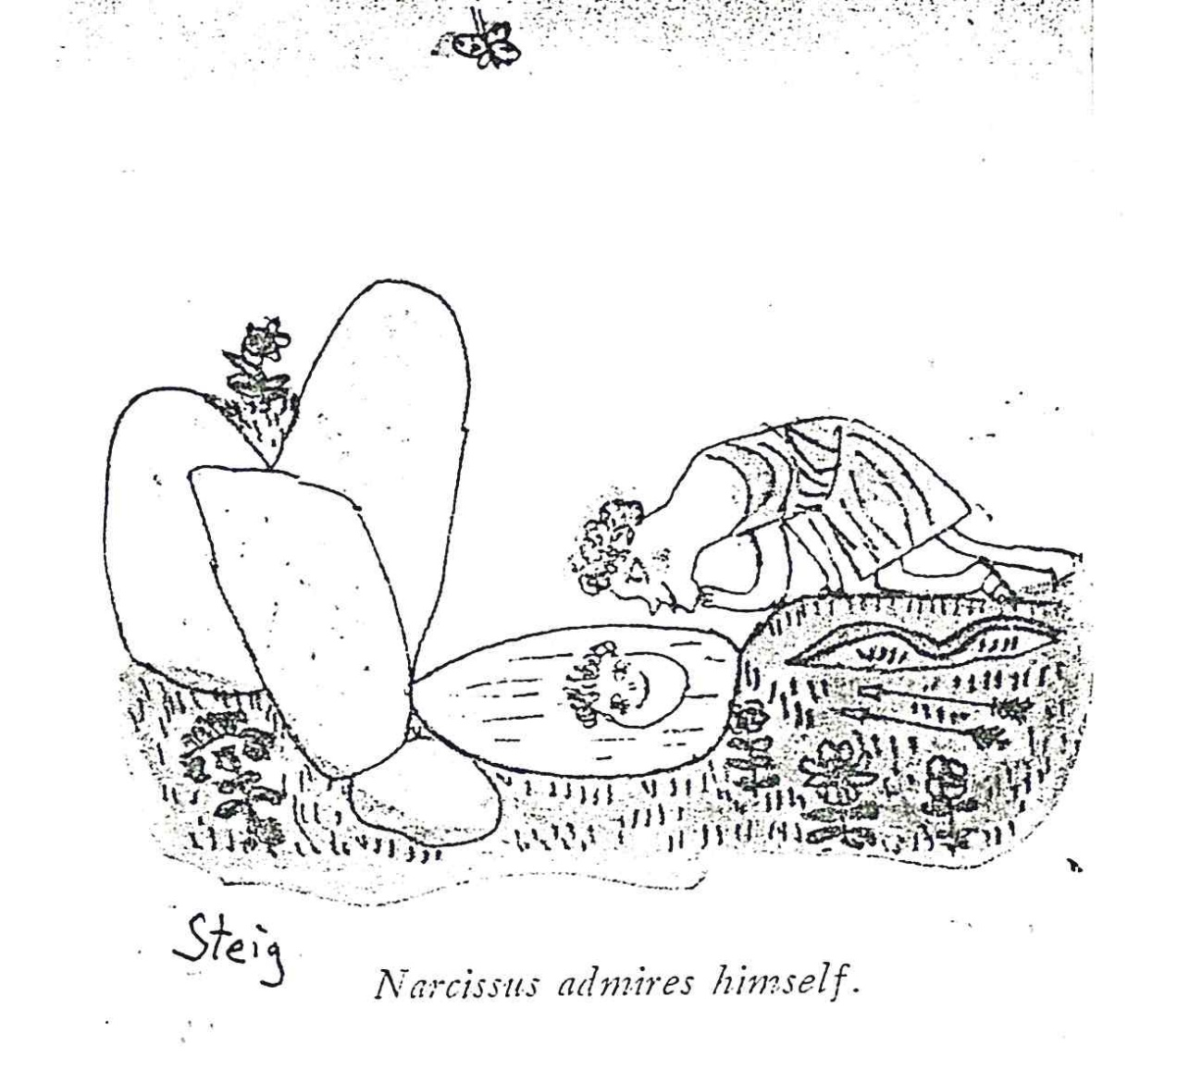

Slide 24
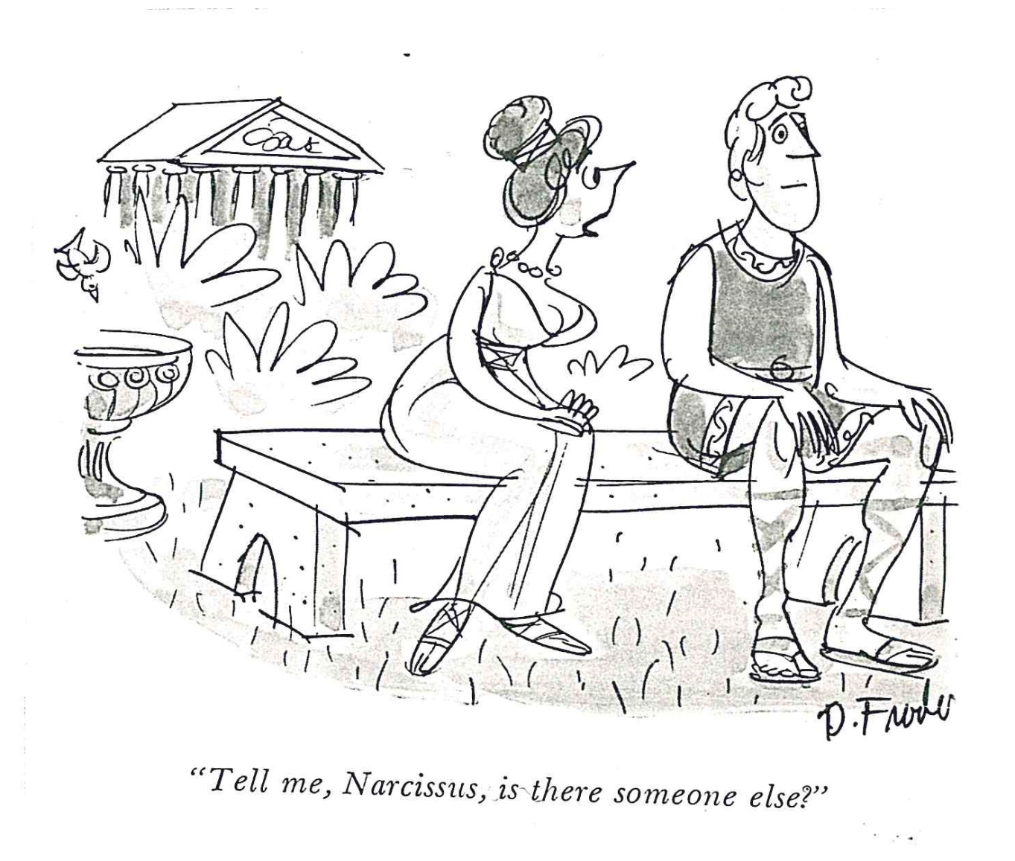

Slide 25
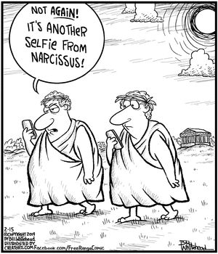

Slide 26
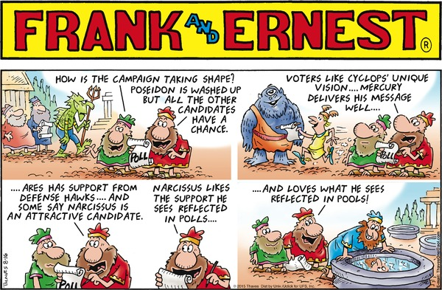

Slide 27
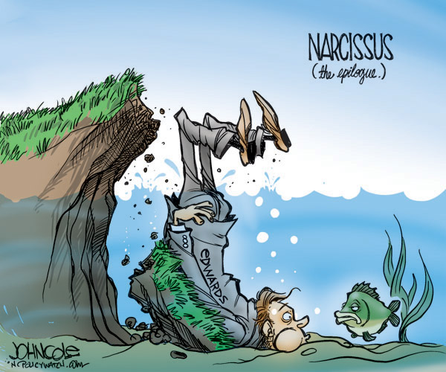
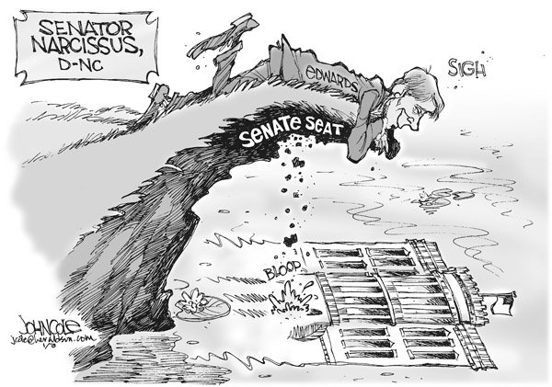

Slide 28
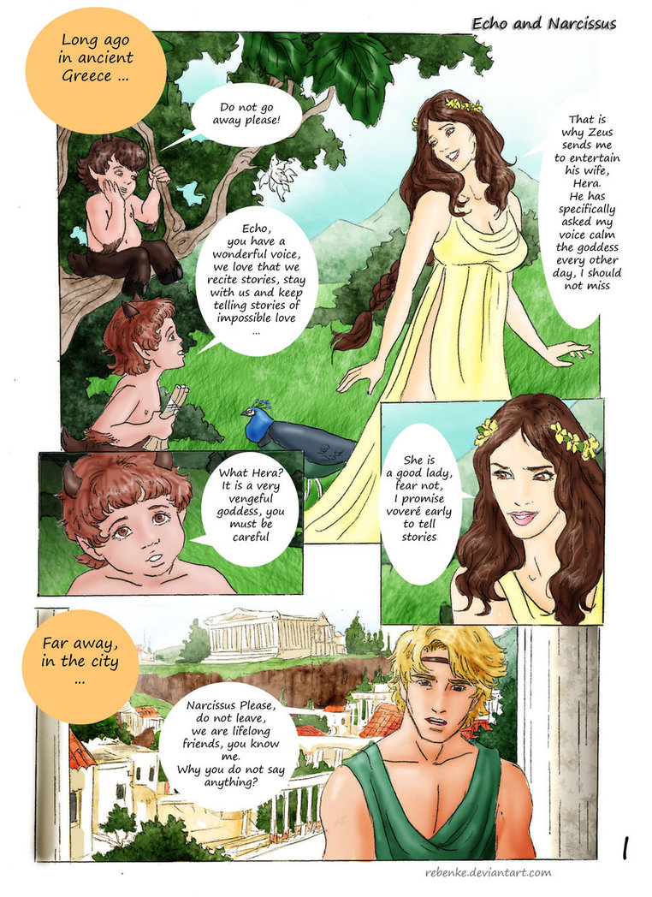
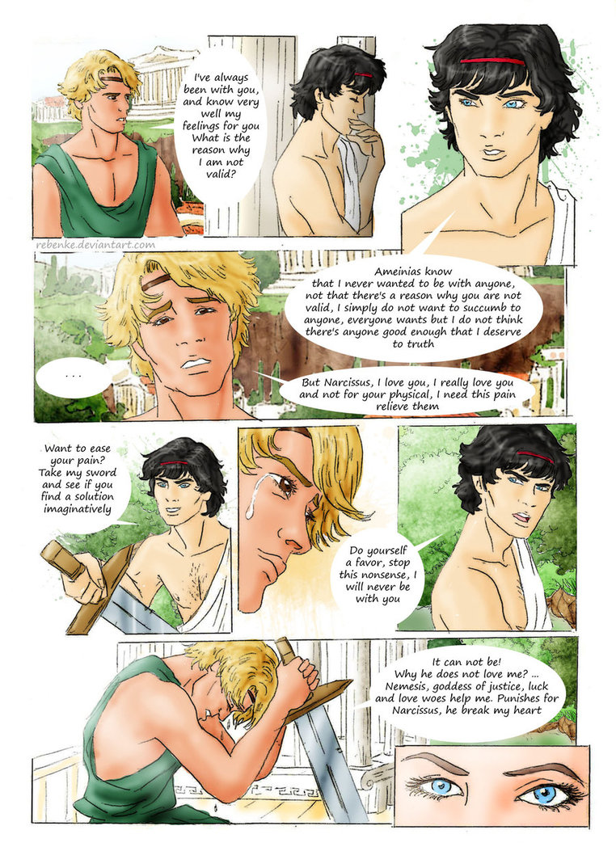

Slide 29
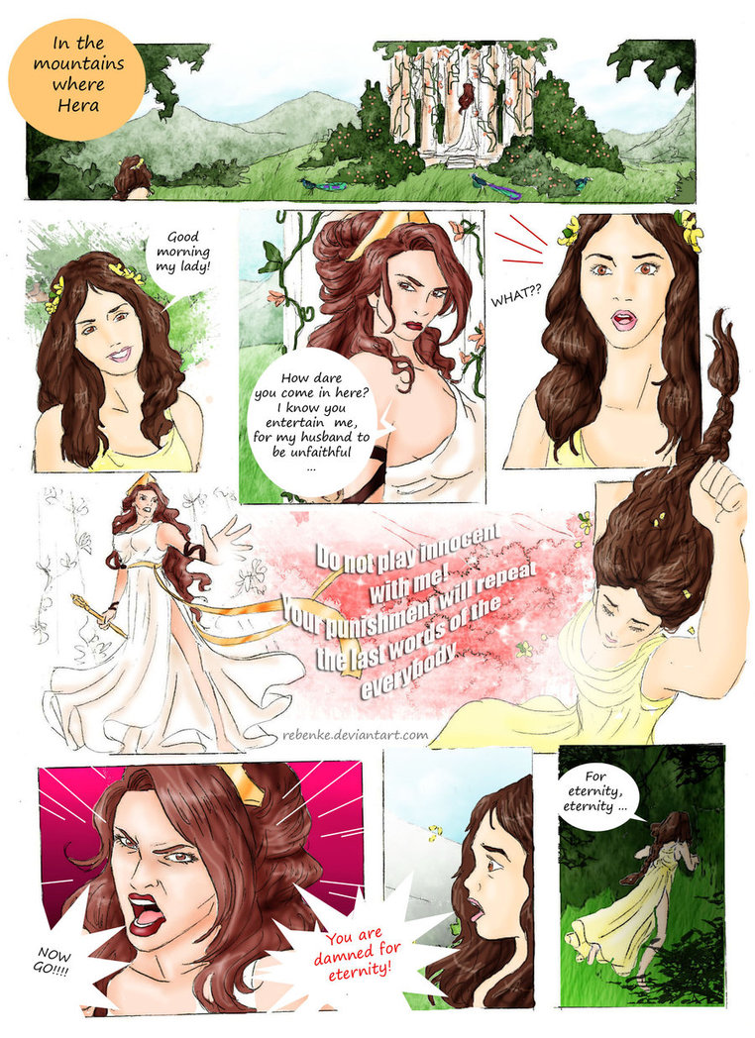
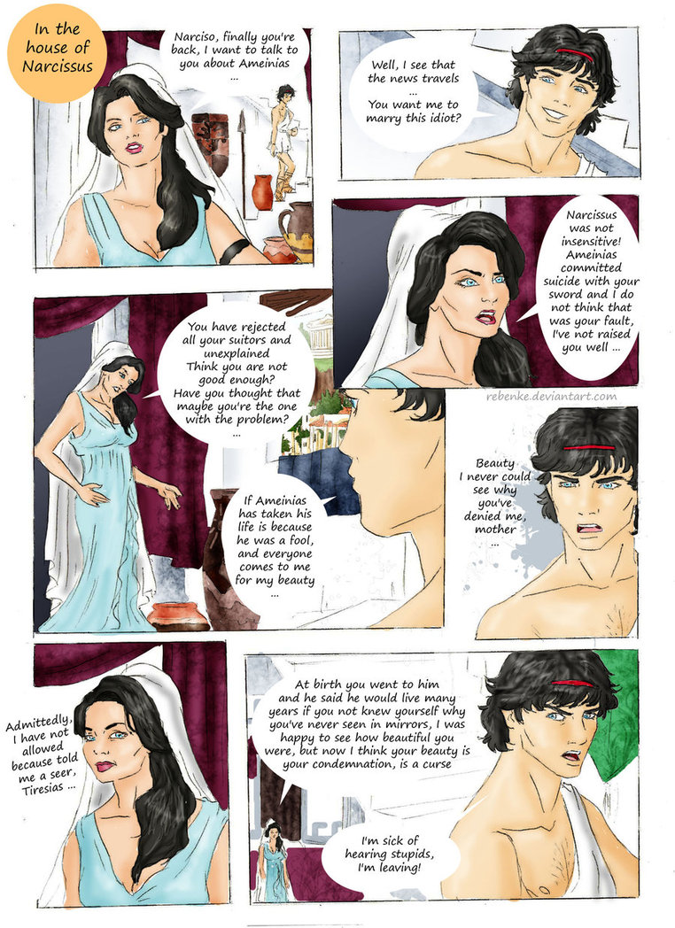

Slide 30
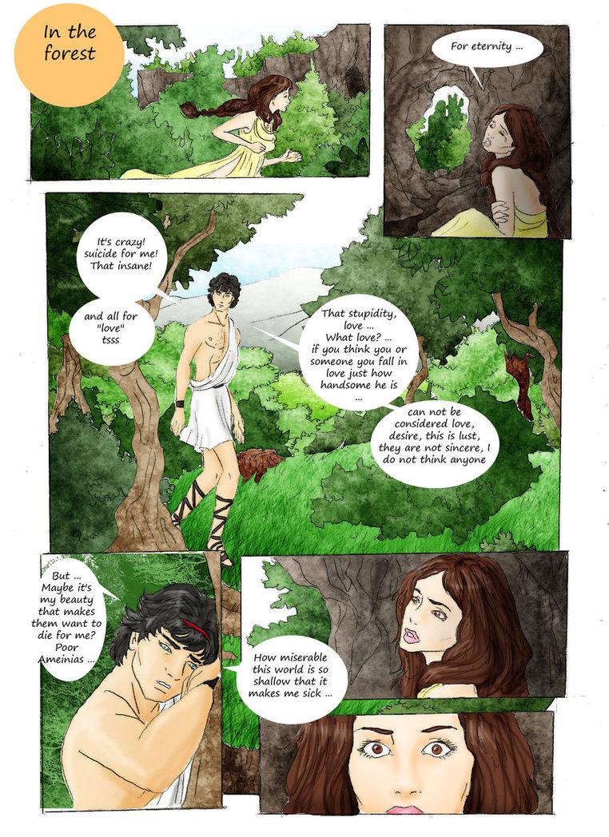
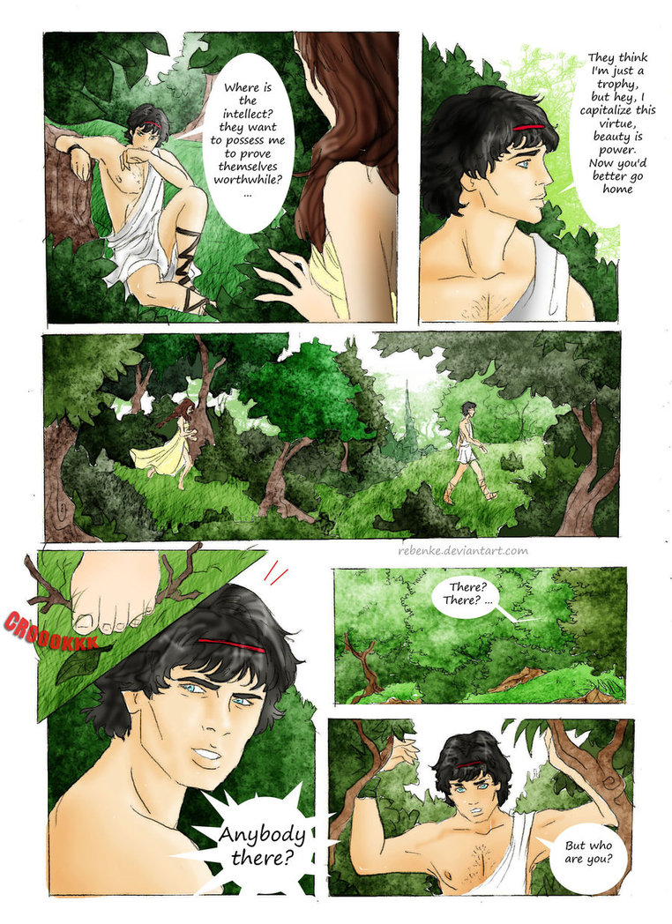

Slide 31
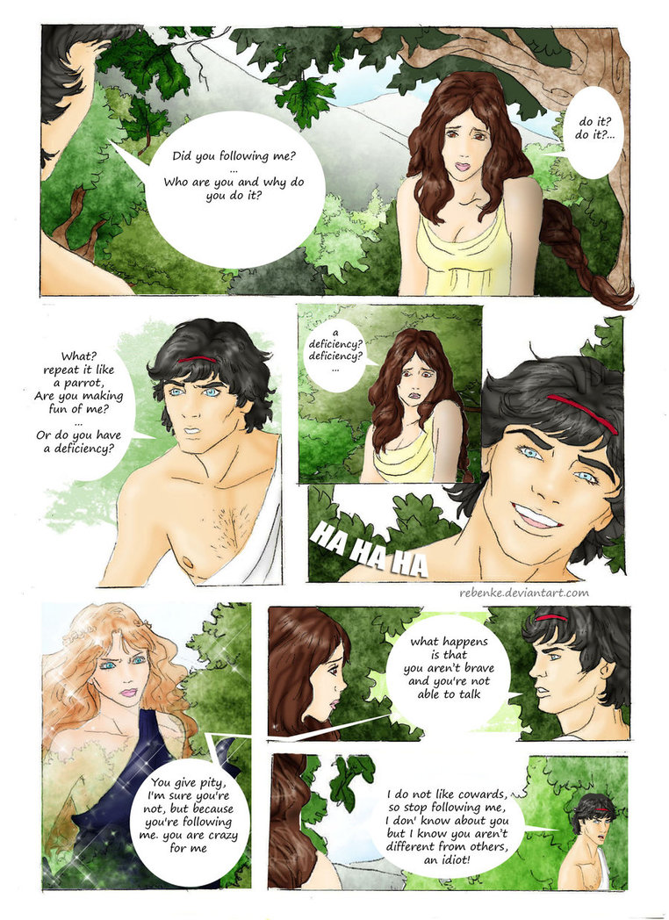
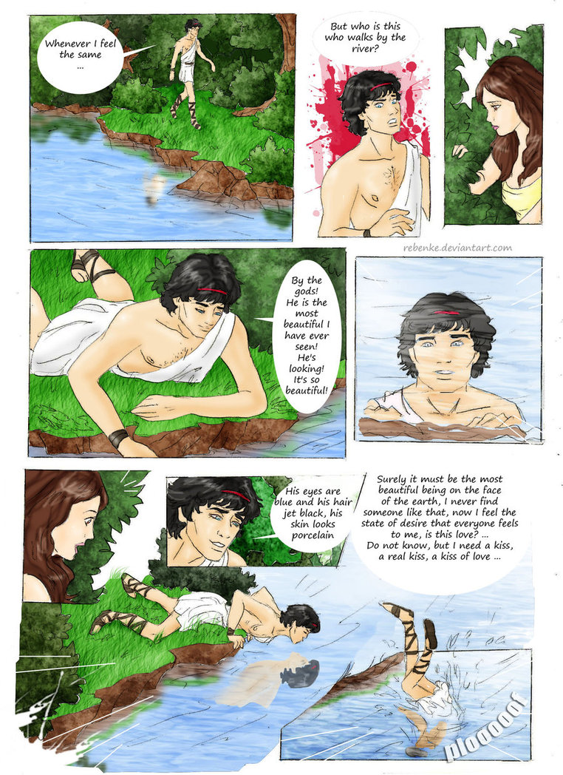

Slide 32
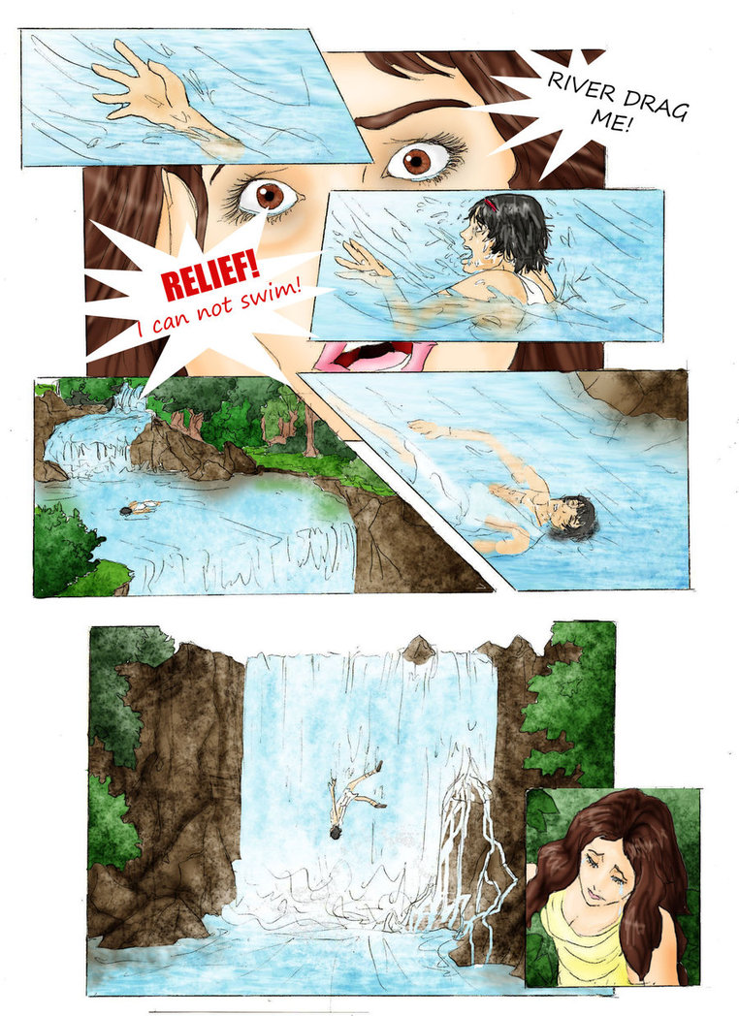
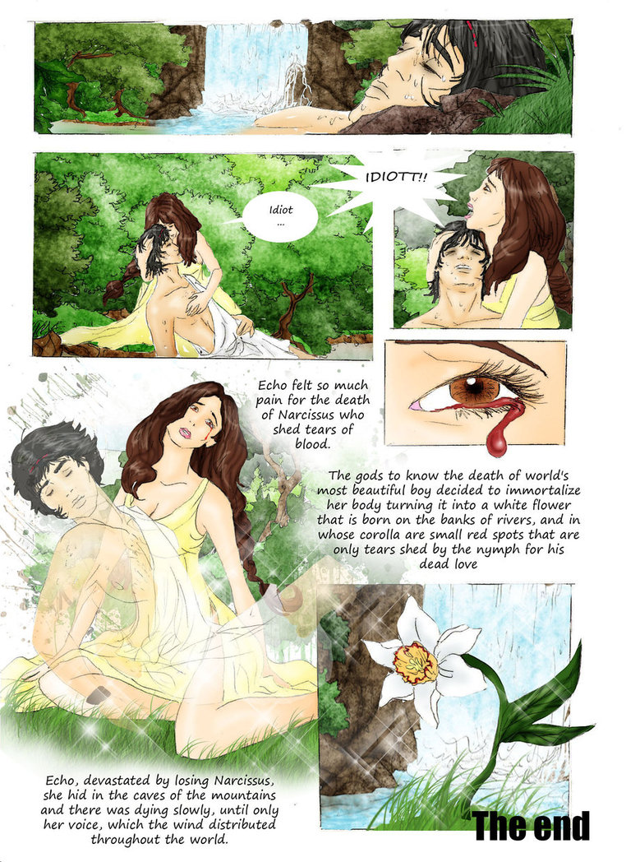

Slide 33

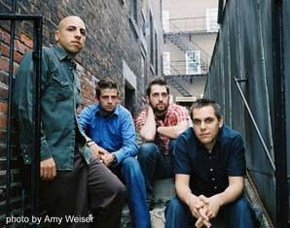

Slide 34
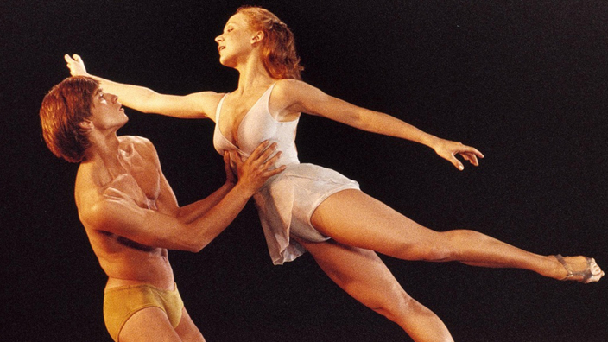
Narcissus
Norman McLaren, 1983, 21 min 47 s
https://www.nfb.ca/film/narcissus

