Slide 1
Labyrinth

Slide 2
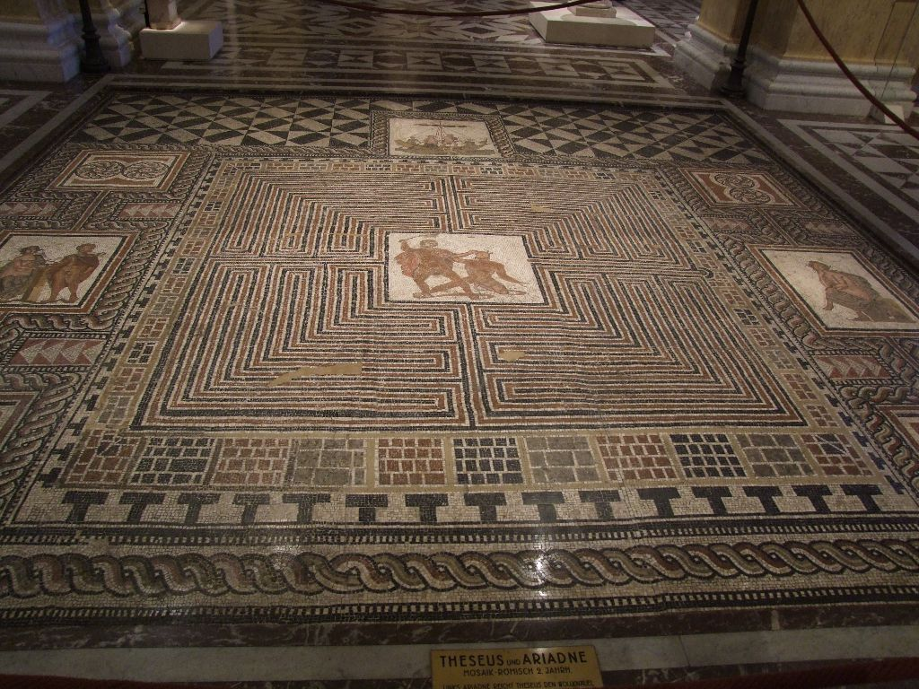
Kunst
“Theseus-Mosaic”, floor mosaic from a Roman villa, Loigersfelder near Salzburg, Austria. Kunsthistorische Museum.

Slide 3
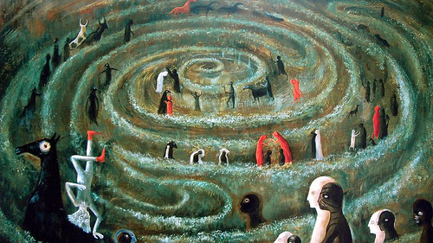
Leonora Carrington
Died 2011

Slide 4
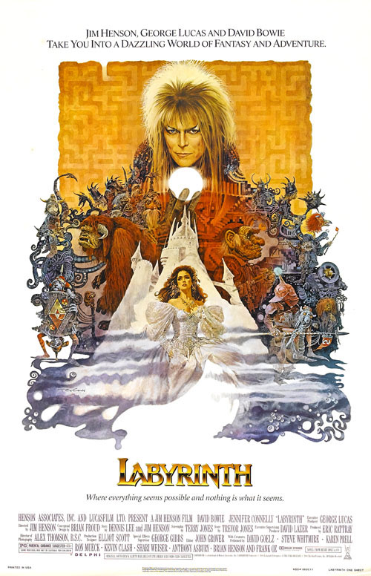

Slide 5
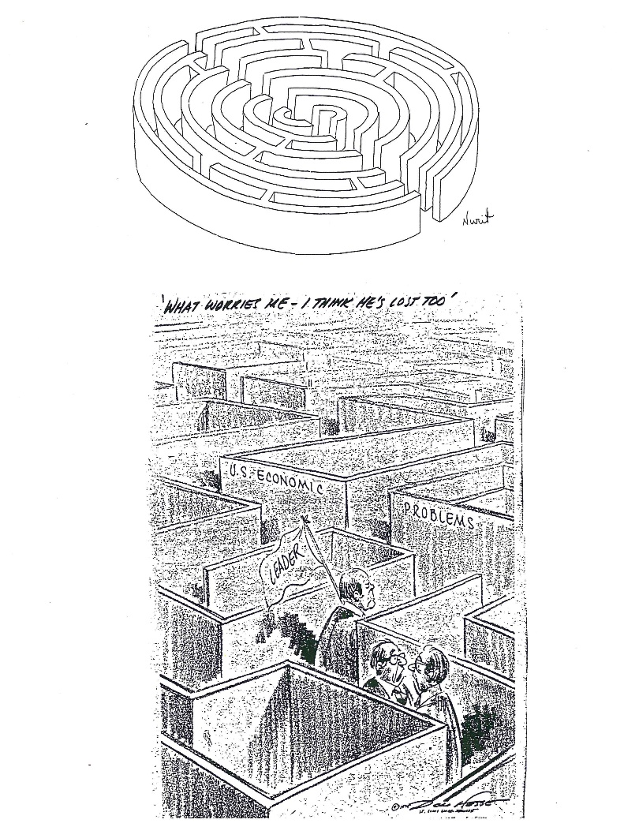

Slide 6
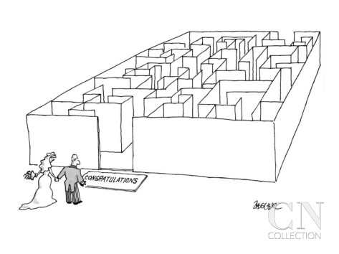

Slide 7
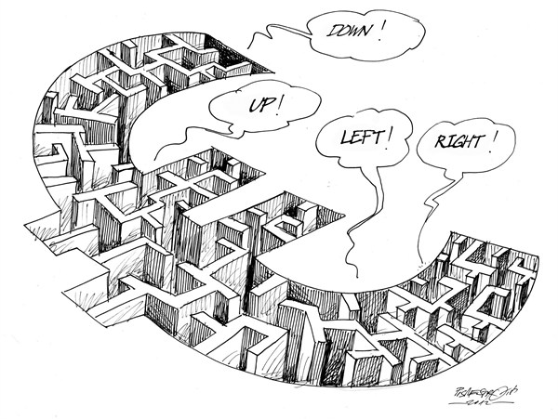

Slide 9
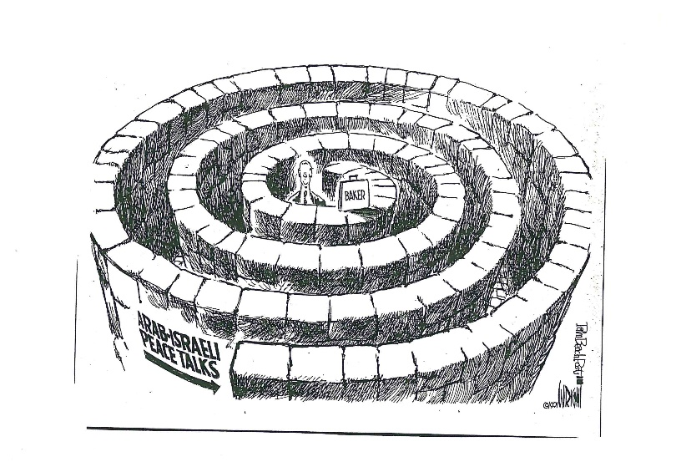

Slide 10
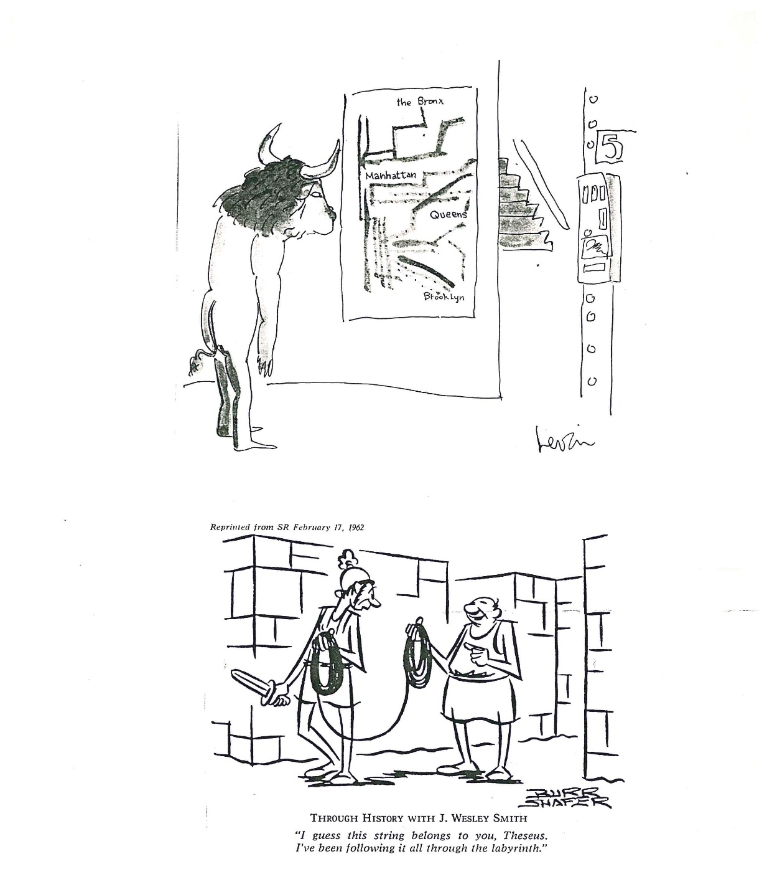

Slide 11
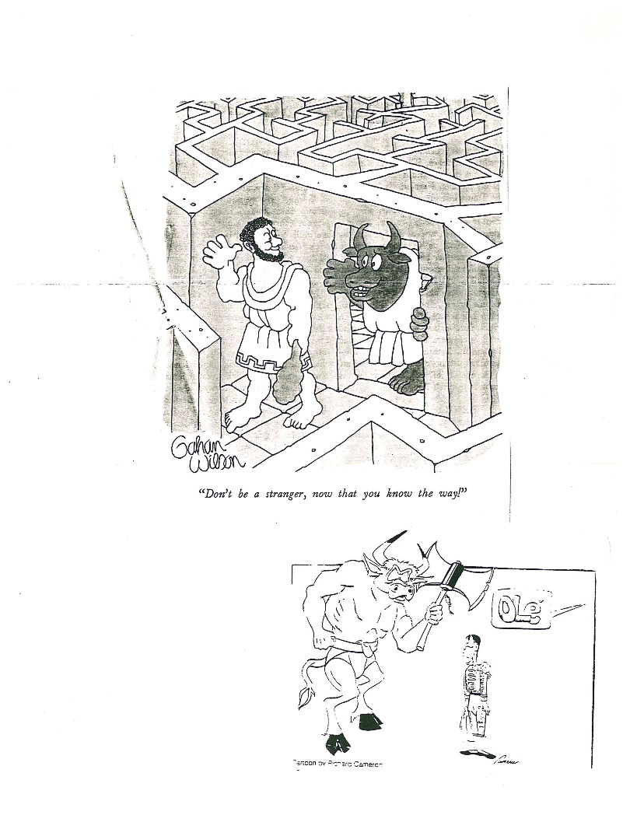

Slide 12
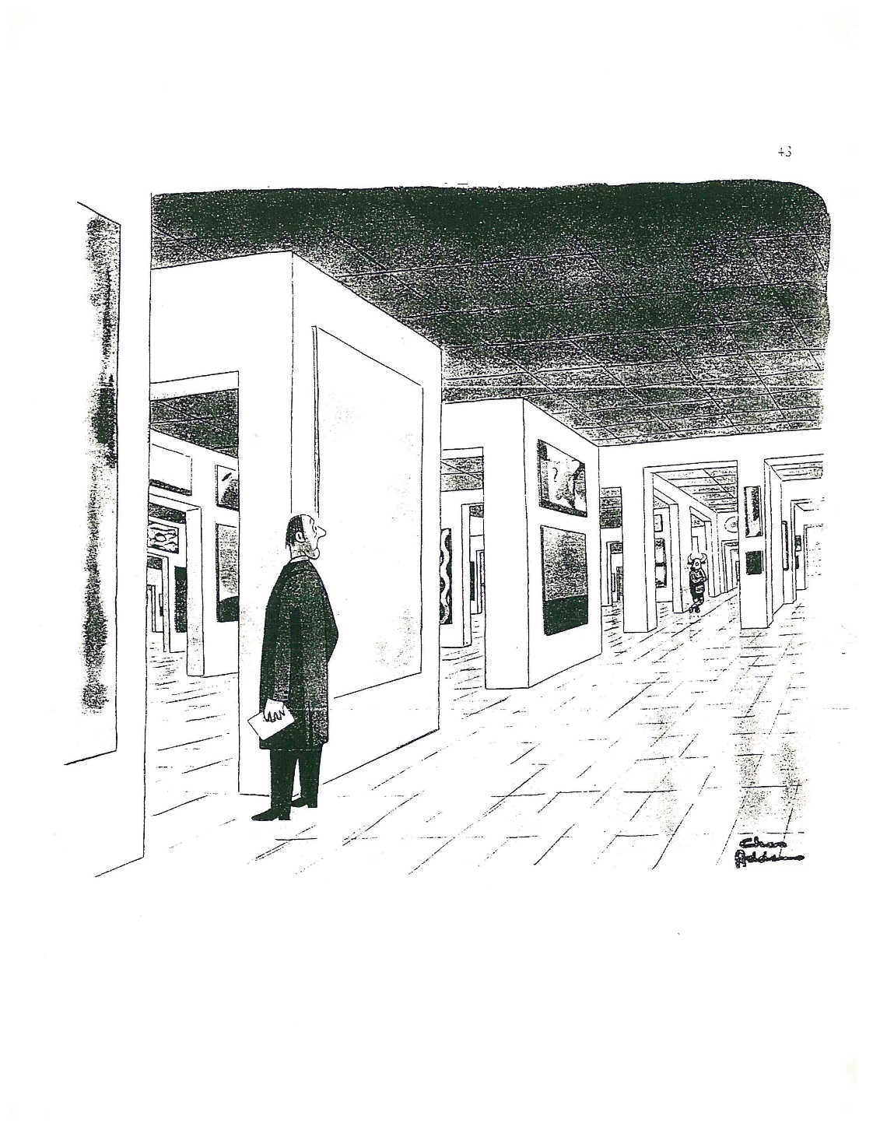

Slide 13
