Slide 1
Minotaur

Slide 2
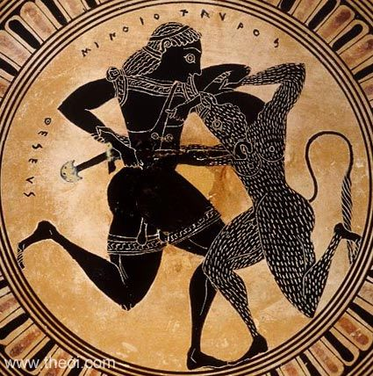
Museum Collection: Toledo Museum of Art, Toledo, Ohio, USA
Ware: Attic Black Figure
Shape: Kylix, lip
Painter: Attributed to the Tleson Painter
Date: ca 550 BC

Slide 3
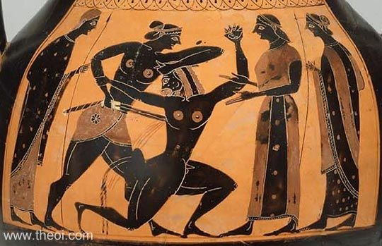
Museum Collection: Museum of Fine Arts, Boston, Massachusetts, USA
Ware: Attic Black Figure
Shape: Amphora
Painter: Attributed to the Nikosthenes Painter
Date: ca 540 BC
http://www.theoi.com/Ther/Minotauros.html

Slide 4
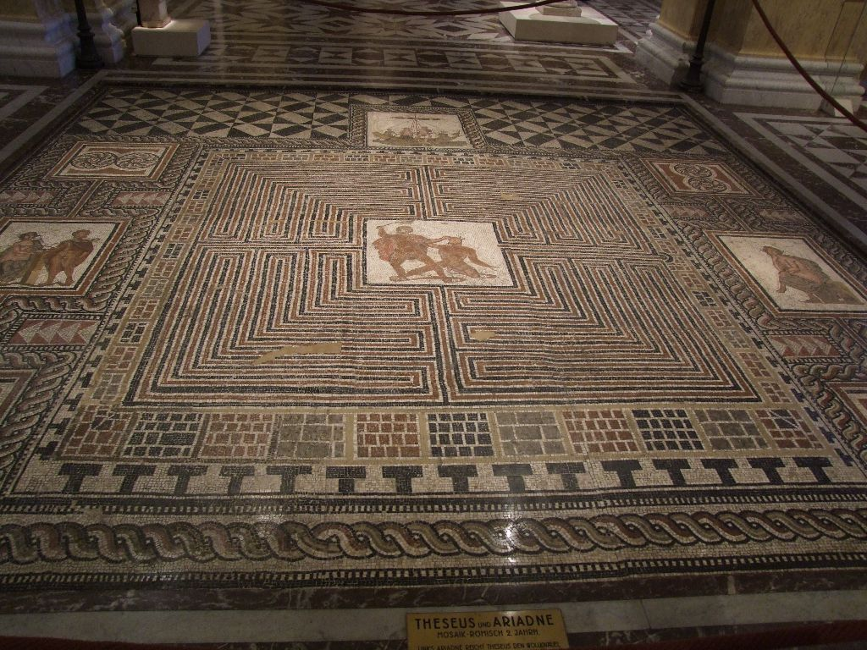
Kunst
“Theseus-Mosaic”, floor mosaic from a Roman villa, Loigersfelder near Salzburg, Austria. Kunsthistorische Museum.

Slide 5
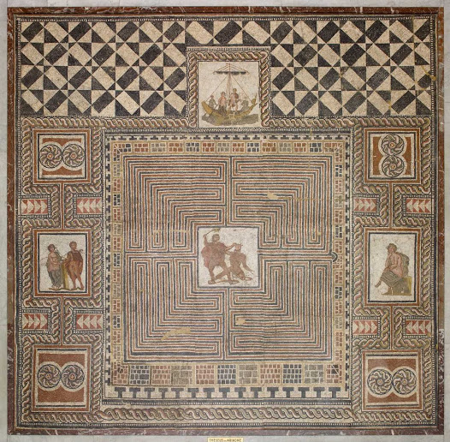

Slide 6
Dante. Inferno XII
Canto XII, lines 16–20 Lo savio mio inver' lui grido: "Forse tu credi che qui sia 'l duca d'Atene, che sú nel mondo la morte ti porse? Pártiti, bestia, ché questi non veneammaestrato da la tua sorella, ma vassi per veder la vostre pene." | My sage cried out to him: "You think, perhaps, this is the Duke of Athens, who in the world put you to death. Get away, you beast, for this man does not come tutored by your sister; he comes to view your punishments."

Slide 7
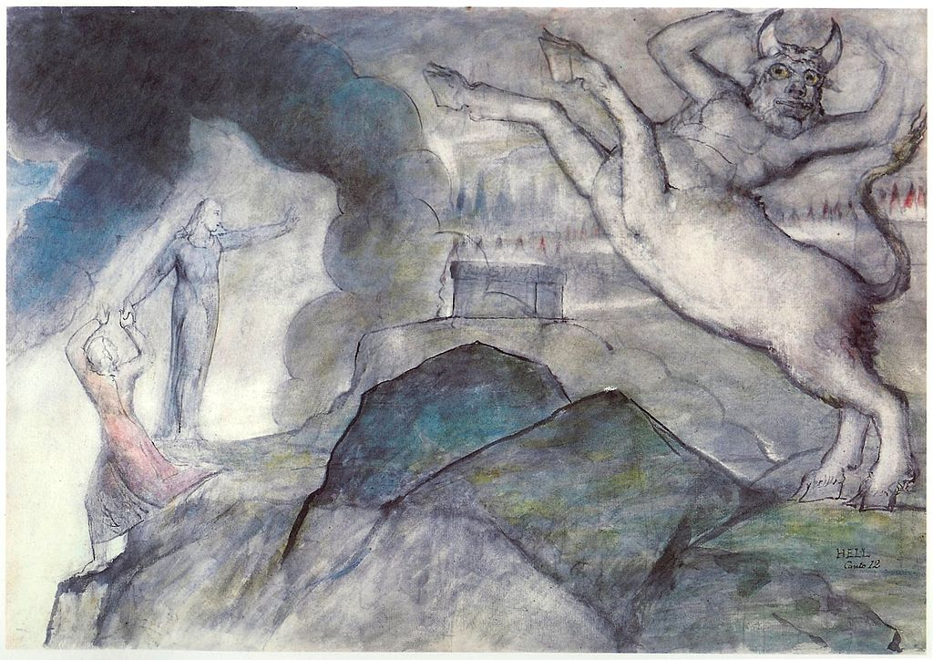
William Blake's image of the Minotaur to illustrate Inferno XII

Slide 8
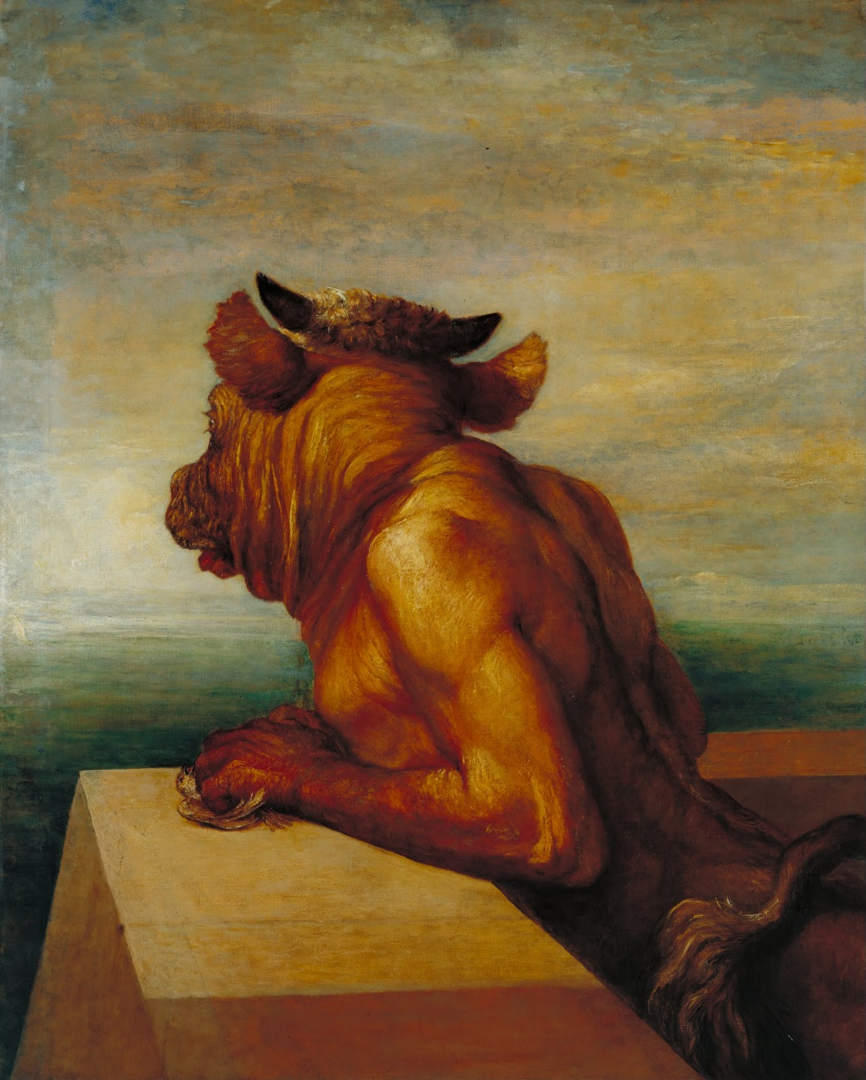
George Frederic Watts. 1885. Tate Gallery. London

Slide 9
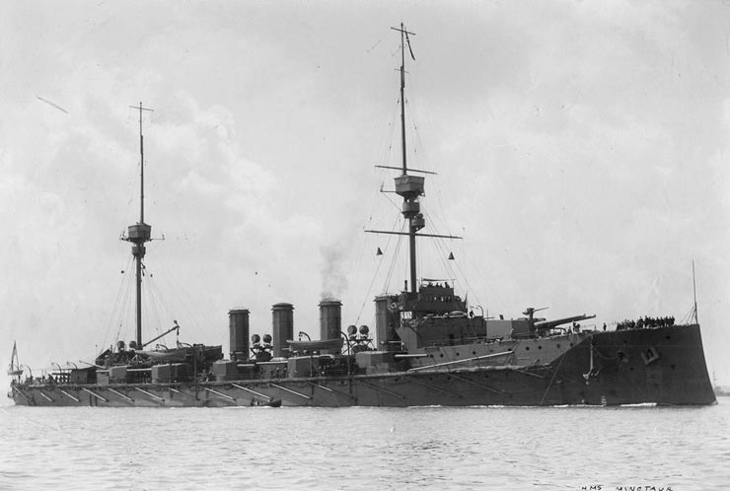
Minotaur-class cruiser (1906)
HMS Minotaur

Slide 10
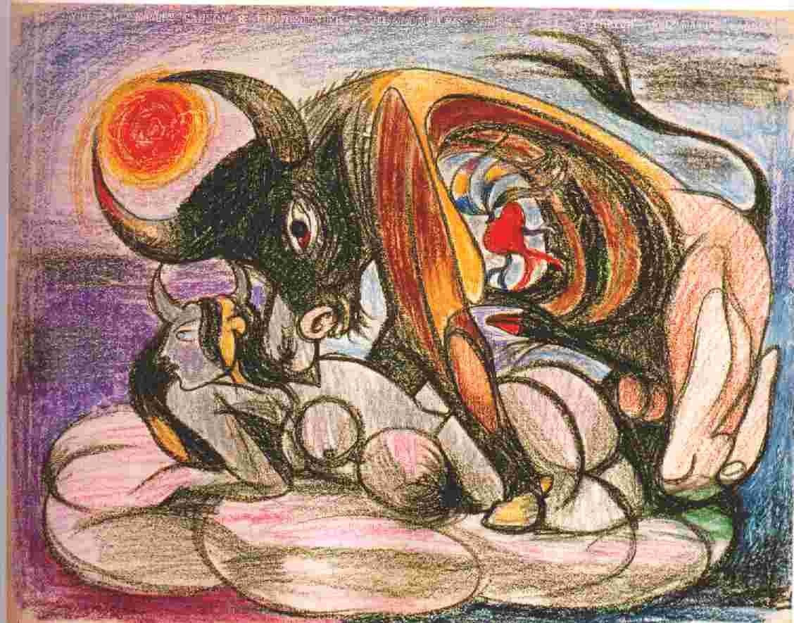
Picasso and the Myth of the Minotaur
Martin Ries. Art Journal, winter, 1972/1973, XXXII/2

Slide 11
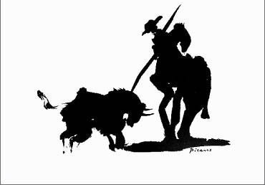
Picasso and Bullfights
http://www.theuntappedsource.com/blog/picassos-bullfighters/

Slide 12
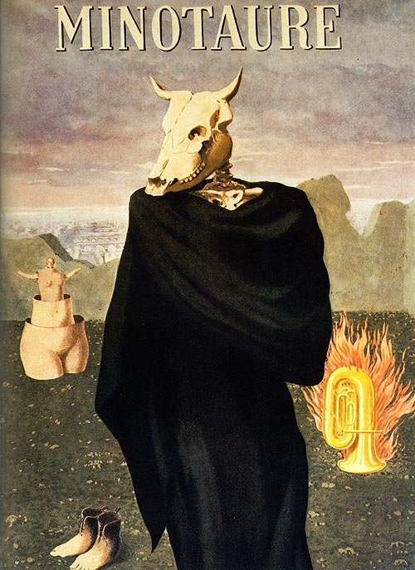
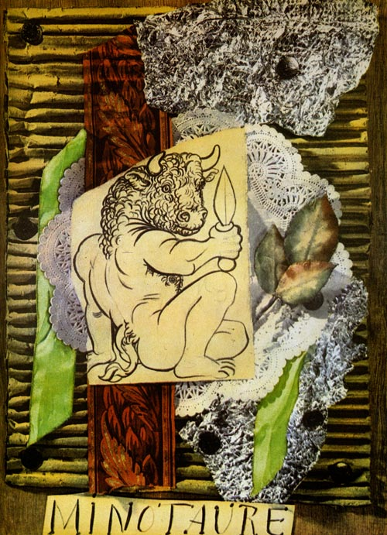
Minotaure (1933-1939)
Pablo Picasso, Minotaure no. 1, 1933
René Magritte, Minotaure no. 10, 1937
Albert Skira

Slide 13
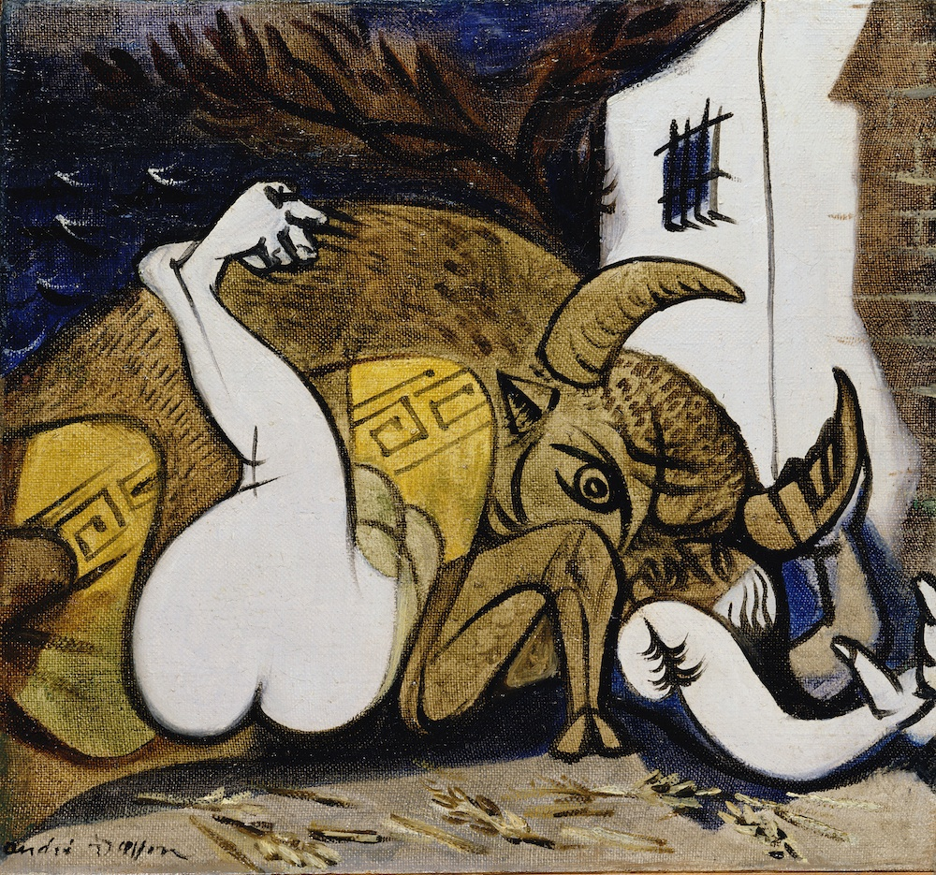
Andre Masson. Pasiphae. 1937

Slide 14
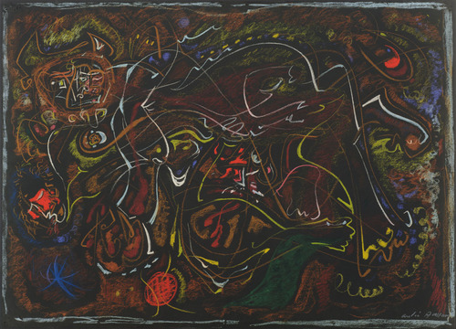
Andre Masson. Pasiphae. 1945

Slide 15
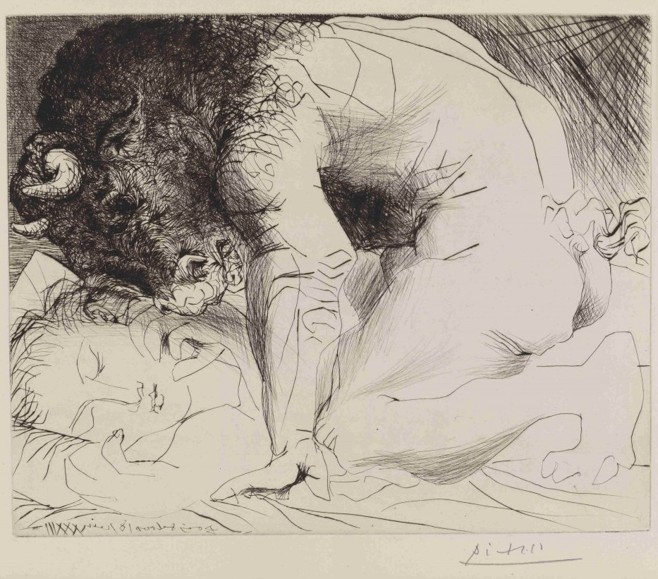
Pablo Picasso
Minotaur Caressing the Hand of a Sleeping Girl with his Face, second state
June 18, 1933, printed 1939. MOMA New York

Slide 16
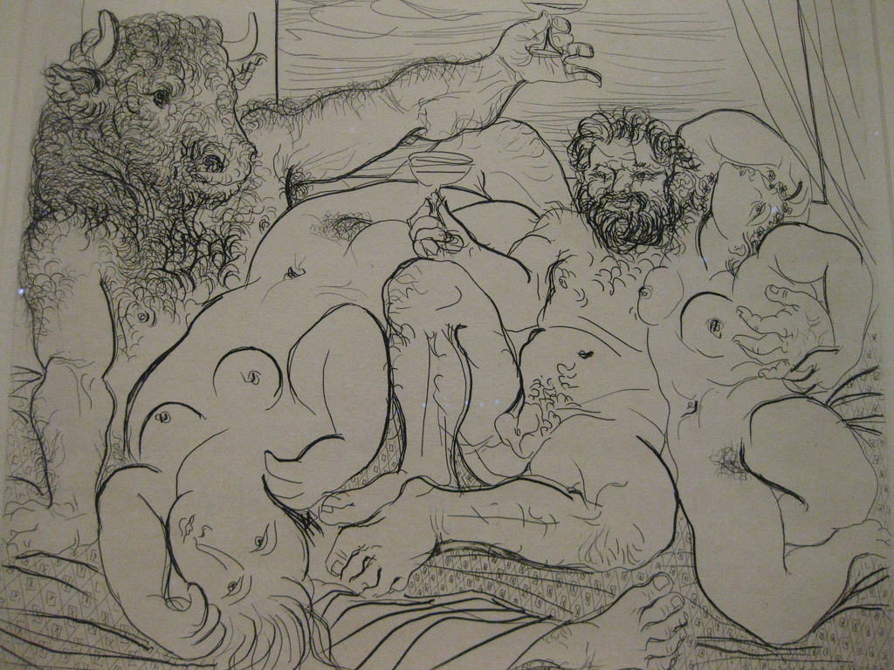
Pablo Picasso - Bacchanal and Minotaur - 1933

Slide 17
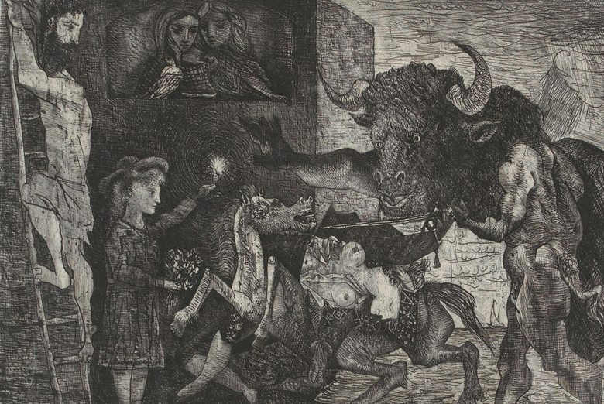
Pablo Picasso. Mintauromachy. 1935

Slide 18
POWER AND TENDERNESS IN MEN AND IN PICASSO’S MINOTAUROMACHY
By Chaim Koppelman
Reprinted from the Journal of the Print World

Slide 19
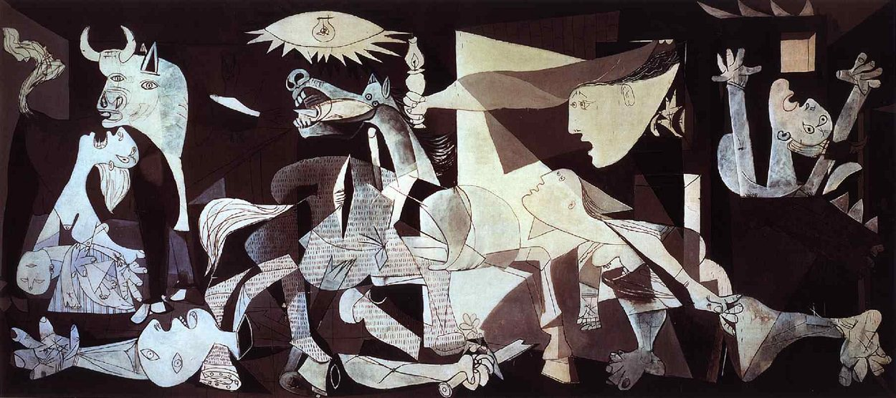
Picasso’s “Guernica” (1937)
http://www.pablopicasso.org/guernica.jsp

Slide 20
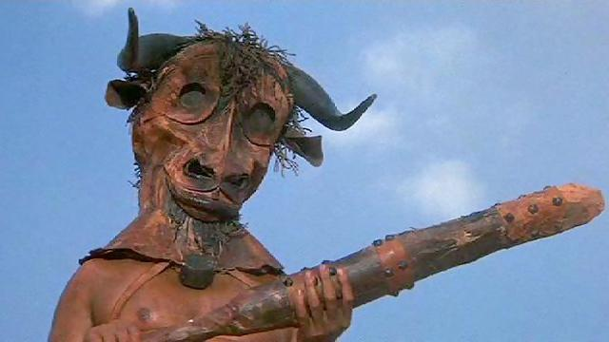
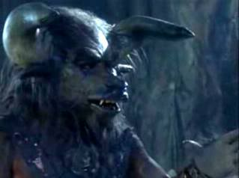

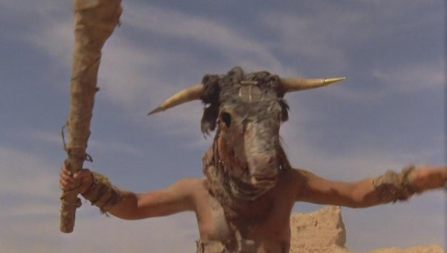
Minotaur in Popular Culture
https://en.wikipedia.org/wiki/Minotaur

Slide 21
Fellini. “Satyricon” (1969(\)
https://www.youtube.com/watch?v=KPbYzw-sTeI

Slide 22
Time Bandits1981)
Battle with Agamemnon (Sean Connery)
https://www.youtube.com/watch?v=wEiflMNQJ1o

Slide 23
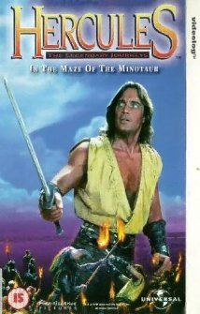
Hercules and the Maze of the Minotaur (1994)

Slide 24

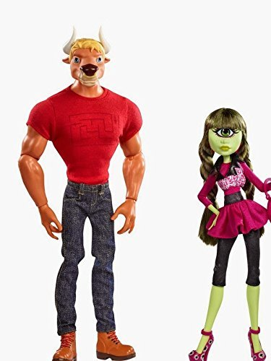
Manny Taur 2011 (Mattel Monster High)
Manny Taur and Iris Clops

