Slide 1
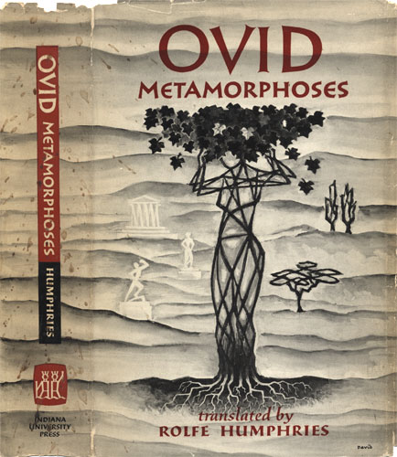

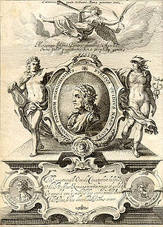
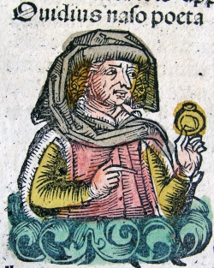

Ovid’s Metamorphoses

Slide 2
Cover of George Sandys's 1632 edition of Ovid's Metamorphosis Englished

Slide 3
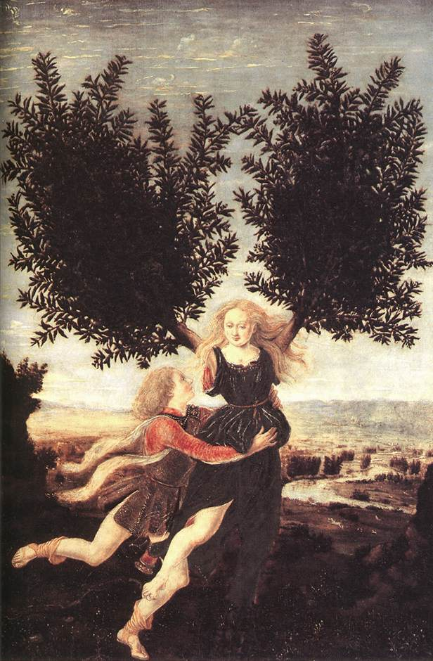
Metamorphoses
meta = change
morph = shape
Ovid’s poem (8 A.D.) is a chronological catalogue of myths about shape changing.
Chronological:
beginning with creation
ending with the apotheosis of Julius Caesar

Slide 4
Some Useful Ovid
Websites
http://www.uvm.edu/~hag/ovid/baur1703/baur1703b1.html
http://www.uvm.edu/~classics/ambrose/clas42art5.html
http://larryavisbrown.homestead.com/files/xeno.ovid1.htm
http://etext.virginia.edu/latin/ovid/
http://etext.virginia.edu/latin/ovid/ovidillust.html
http://www.summitcds.org/ashcraft/metamorphoses.htm

