Slide 1
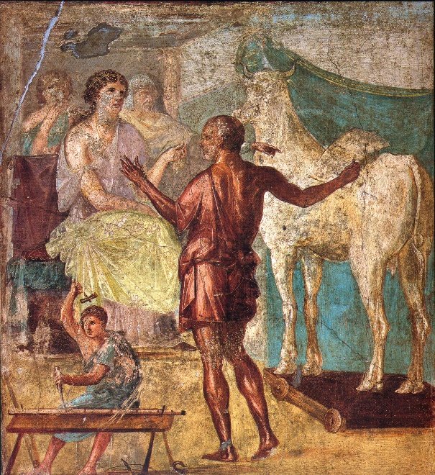
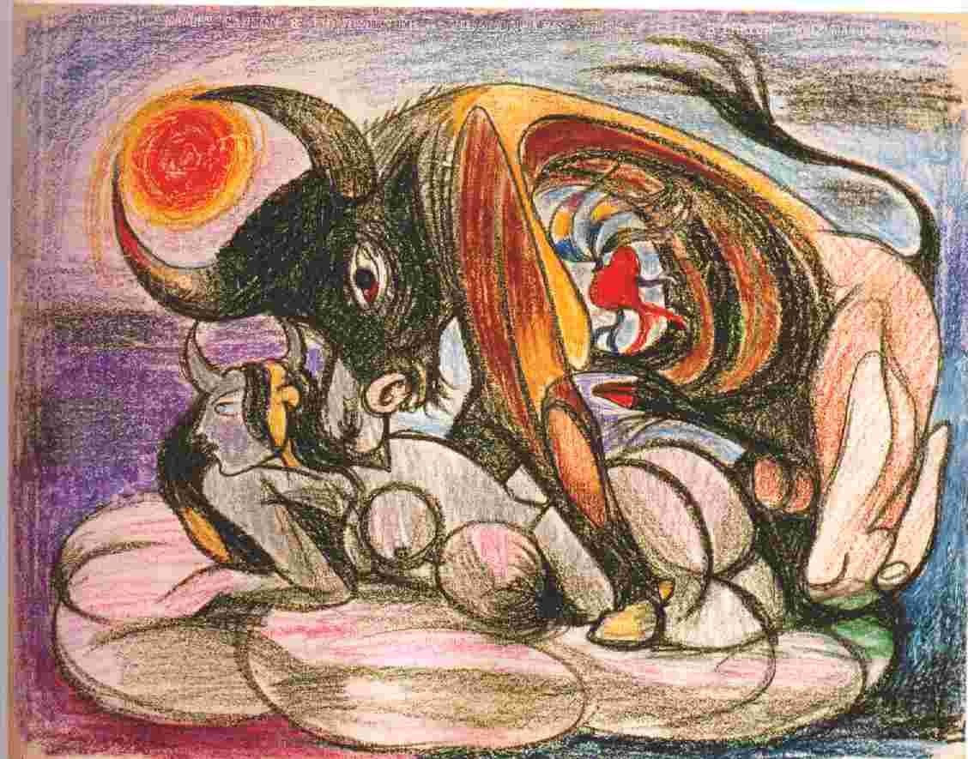
Pasiphae and the Bull

Slide 2
More on Pasiphae and the Bull
But angry at him for not sacrificing the bull, Poseidon made the animal savage, and contrived that Pasiphae should conceive a passion for it. In her love for the bull she found an accomplice in Daedalus, an architect, who had been banished from Athens for murder. He constructed a wooden cow on wheels, took it, hollowed it out in the inside, sewed it up in the hide of a cow which he had skinned, and set it in the meadow in which the bull used to graze. Then he introduced Pasiphae into it; and the bull came and coupled with it, as if it were a real cow. And she gave birth to Asterius, who was called the Minotaur. He had the face of a bull, but the rest of him was human; and Minos, in compliance with certain oracles, shut him up and guarded him in the Labyrinth Apollodorus, Library and Epitome 3.1.4

Slide 3

Daedalus presents the artificial cow to Pasiphaë: Roman fresco in the House of the Vettii, Pompeii, 1st century CE.

Slide 4
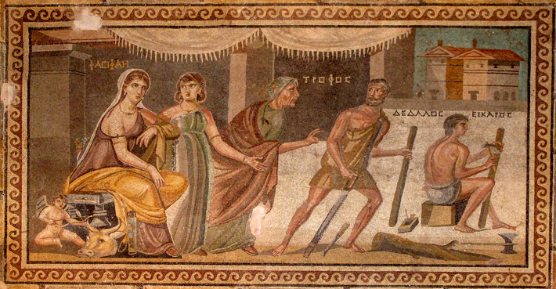
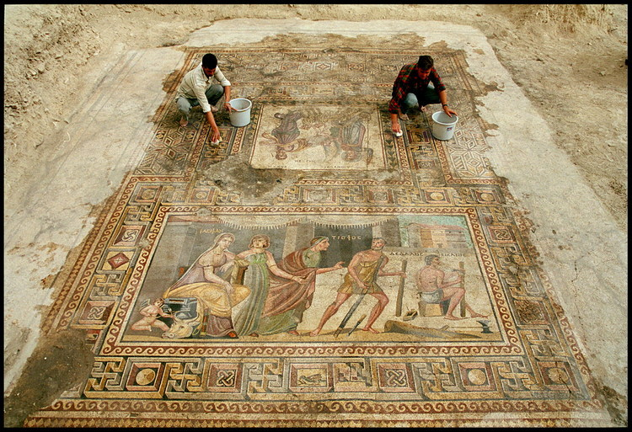
The Pasiphae Mosaic in Zeugma (Turkey)

Slide 5
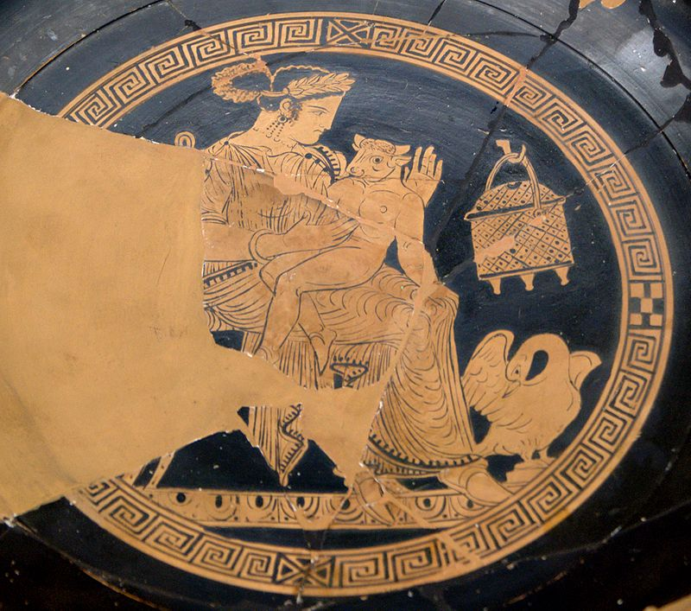
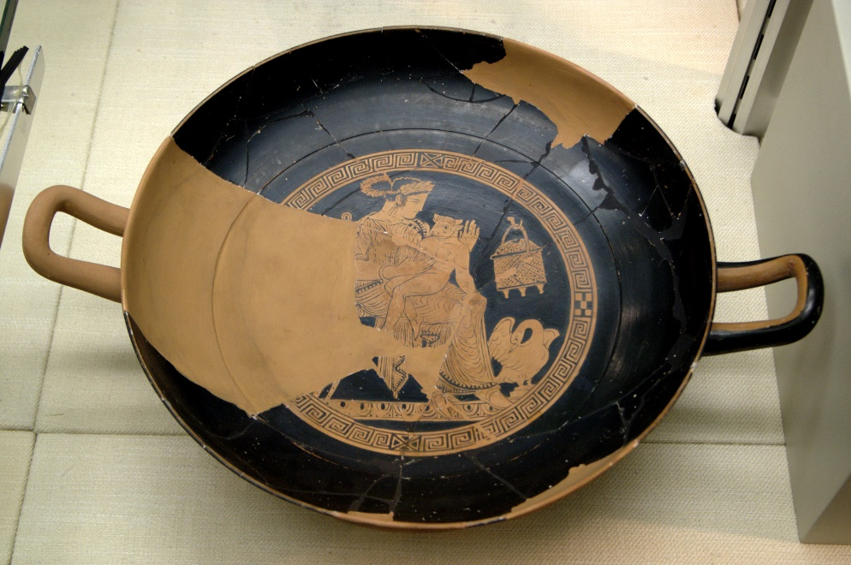
Pasiphaë and the Minotaur, Attic red-figure kylix, Cabinet des Médailles (Paris).

Slide 6
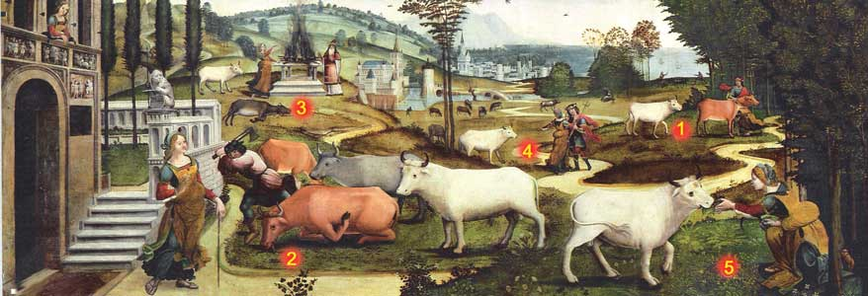
The History of the Minotaur from Cassone Paintings
1) King Minos of Crete is assumed to sacrifice a white Bull sent by Poseidon. 2) Minos thinks that it is better to sacrifice another bull which is killed 3) sacrificed. 4, 5 ) The punishment : Poseidon caused Minos's wife Pasiphae to fell in love with the bull. The result was her son Minotaur.
16th century, 0.69 m x 1.82 m, Musée du Petit Palais Avignon

Slide 7
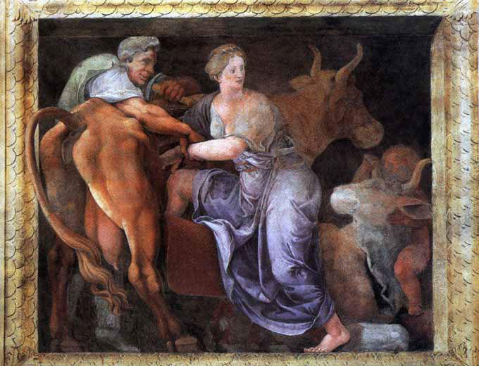
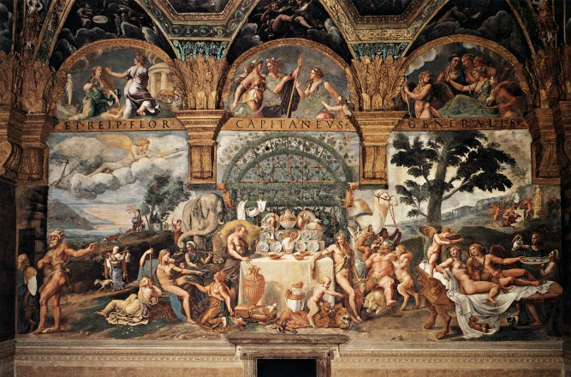
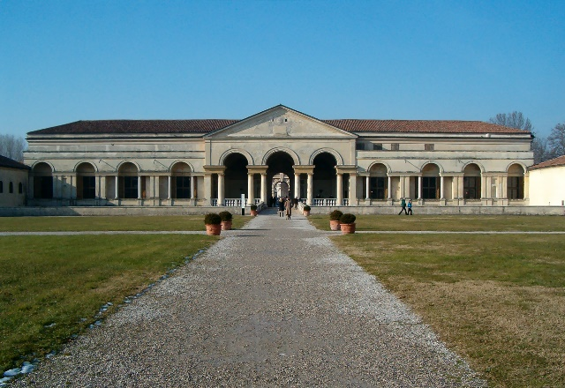
Giulio Romano. Salotto di Psiche, Palazzo del Tè, Mantua. 1524-34

Slide 8
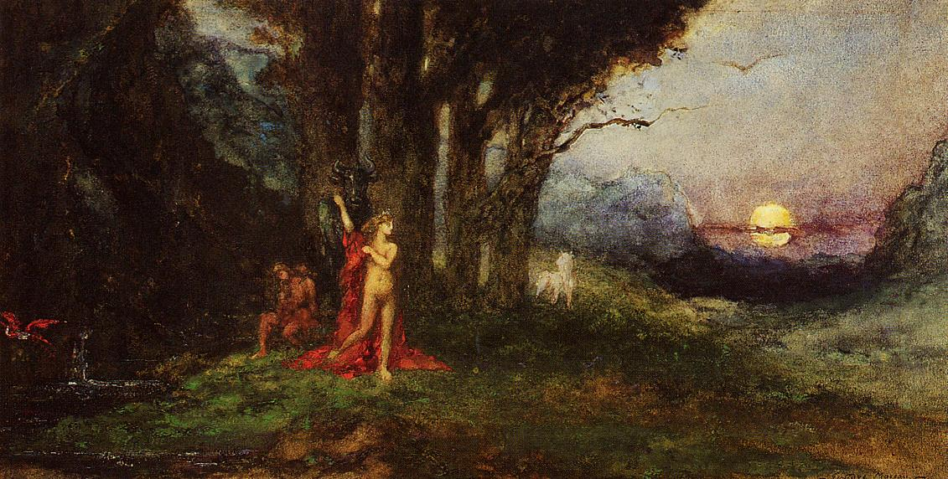
Pasiphae and the Bull
Gustave Moreau 1880

Slide 9
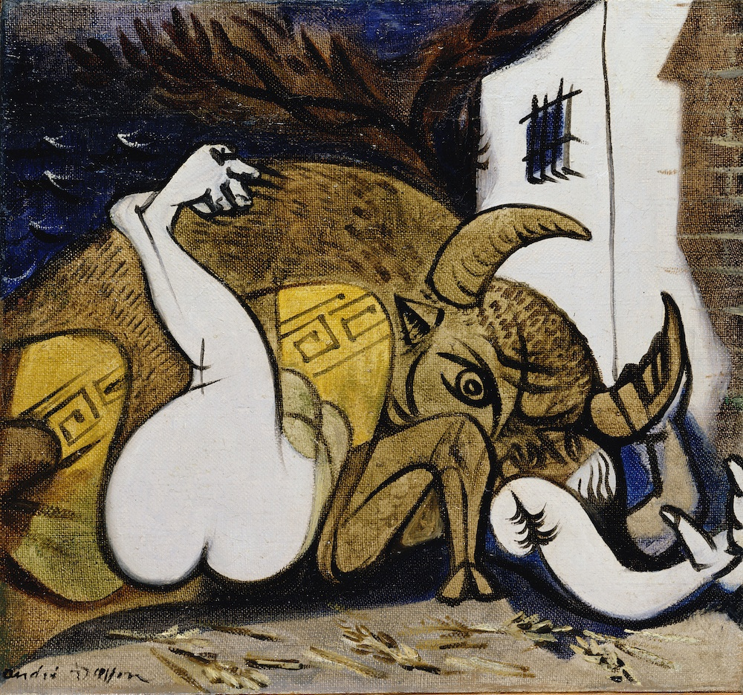
Andre Masson. Pasiphae. 1937

Slide 10
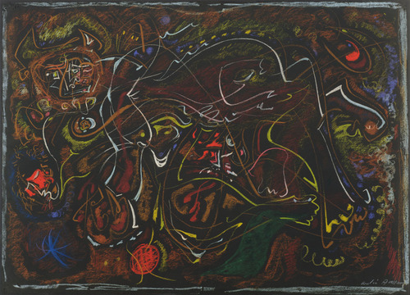
Andre Masson. Pasiphae. 1945

Slide 11
Pablo Picasso. Pasiphae
http://www.martinries.com/article1972-73PP.htm

Slide 12
Picasso and the Myth of the Minotaur
Martin Ries. Art Journal, winter, 1972/1973, XXXII/2

Slide 13
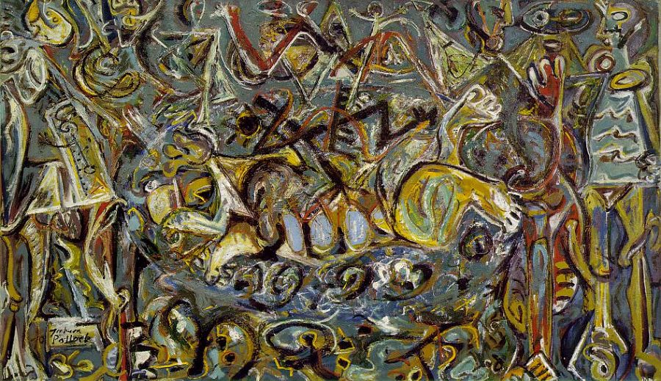
Jackson Pollock. Pasiphae. 1943
Metropolitan Museum of Art
http://www.metmuseum.org/collection/the-collection-online/search/482518

Slide 14
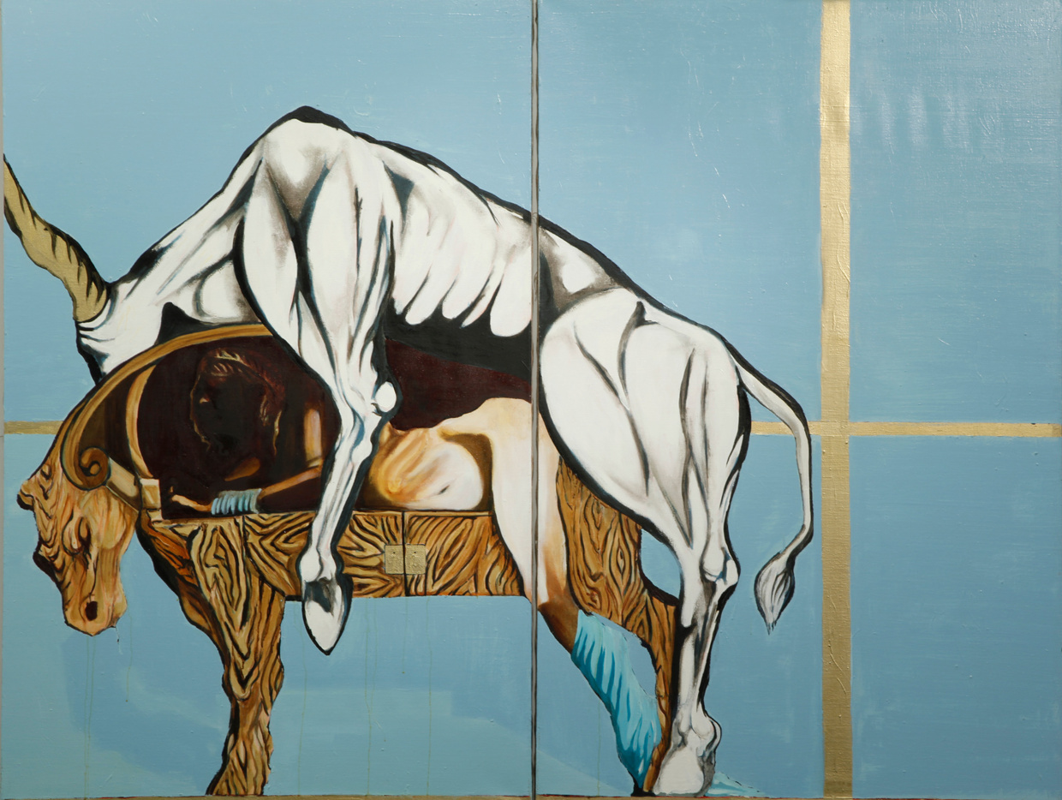
Jonathan Hirschfeld. “The Tragedy”

Slide 15
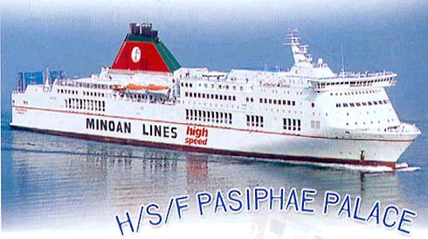

H/S/F Pasiphae Palace of the Minoan Lines, named after Pasiphae

