Slide 1
Phaethon

Slide 2
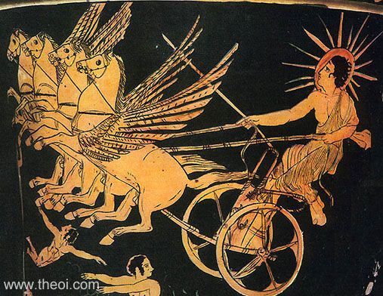
British Museum, London, United Kingdom London E466 Beazley Archive No.: 5967 Attic Red Figure Calyx krater, High Classical
http://www.theoi.com/Titan/Phaethon.html

Slide 3
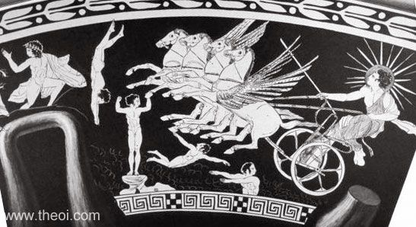
The Astra Planeta (gods of the five wandering stars) dive into the sea from their perches in heaven as the sun-god Helios rides into the sky, driving his four horse chariot. The fifth planet (not shown in this image) is Eosphoros, the star Venus, last of the Astra to leave the heavens. Side B: Eos chasing Kephalos (not shown)

Slide 4
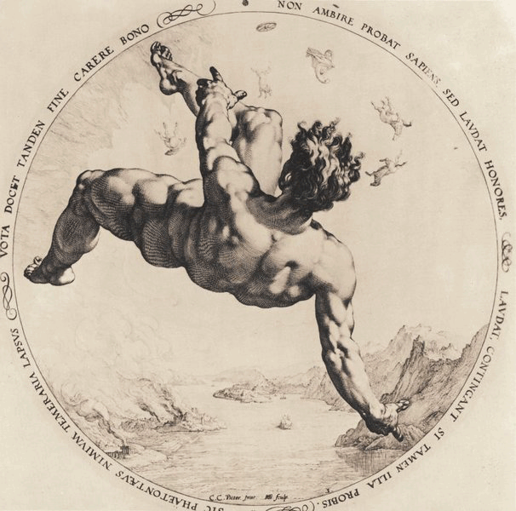
undated engraving by Hendrik Golzius (1558 - 1617) is now in the collection of the Fine Arts Museums of San Francisco

Slide 5
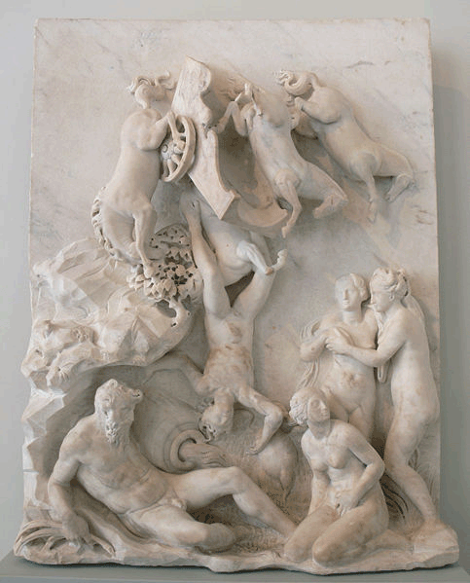
undated statue by Simone Mosca (aka Moschino) (c. 1523 - c. 1578) iBode-Museum in Berlin

Slide 6
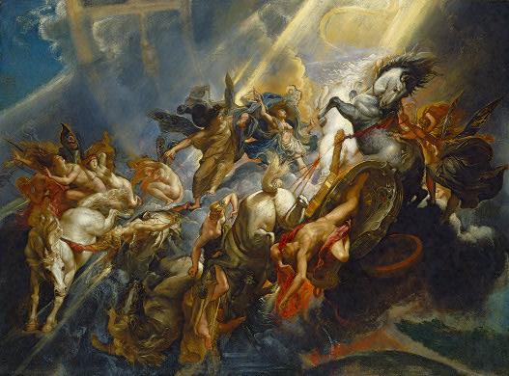
Peter Paul Rubens (1577-1640)
The Fall of Phaeton. Ca. 1604-1605. Oil on canvas. 98.4 × 131.2 cm. Washington, D.C., National Gallery of Art.

Slide 7
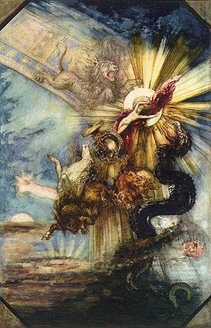
Gustave Moreau (1878) Louvre

Slide 8
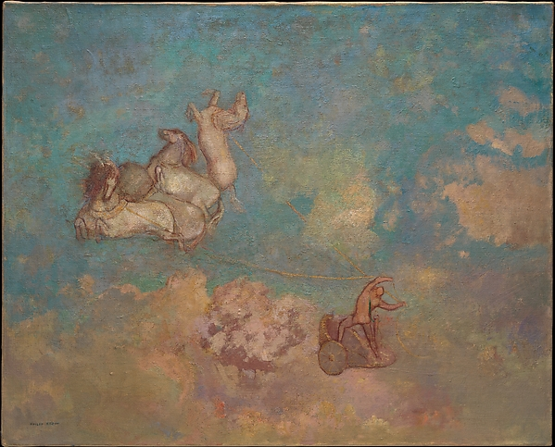
Odilon Redon (1840-1916) The Chariot of Apollo (1905-1916)
Metropoiltan Museum of Art, New York

Slide 9
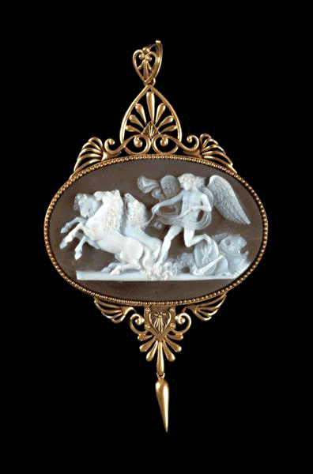
John Brogden's cameo (carved by Luigi or Tommaso Saulini) (Phaethon struggling to control the horses. c.1880,
Birmingham Museums and Art Gallery.

Slide 10
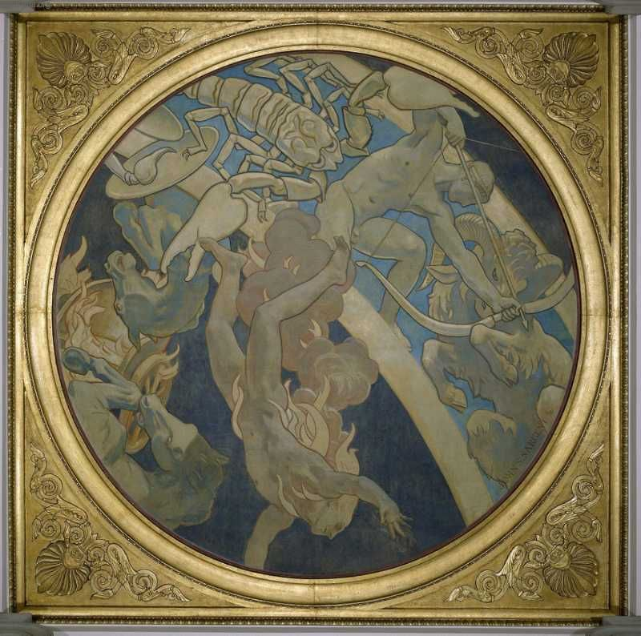
Phaethon John Singer Sargent -- American painter (1922-1925) Museum of Fine Arts, Boston Colonna, Stairway Side Aisle mural, Center mural, Oil on canvas Diameter, unframed: 307.3 cm (120 in.)
http://jssgallery.org/Paintings/MFA/Phaethon.htm

Slide 11
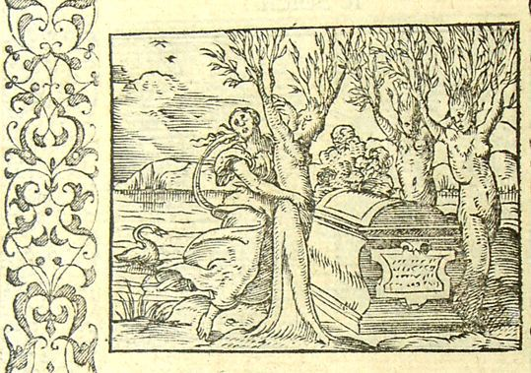
Heliades
Métamorphose Lyon 1557) - Bernard Salomon

Slide 12
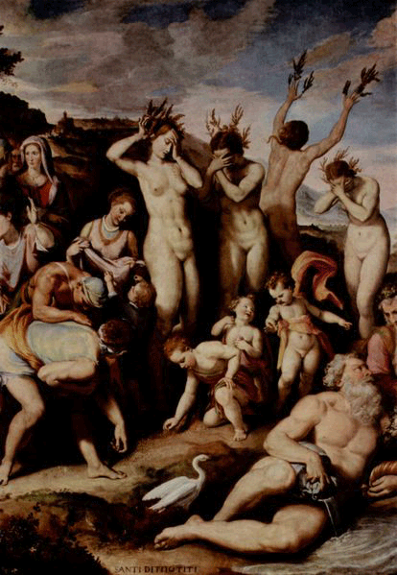
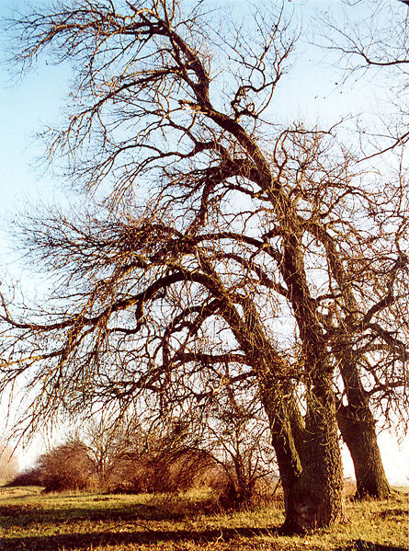
Heliades
Santi di Tito (1536 - 1603)
Studiolo di Francesco Primo
Palazzo Vecchio
Florence, Italy
poplar trees

Slide 13
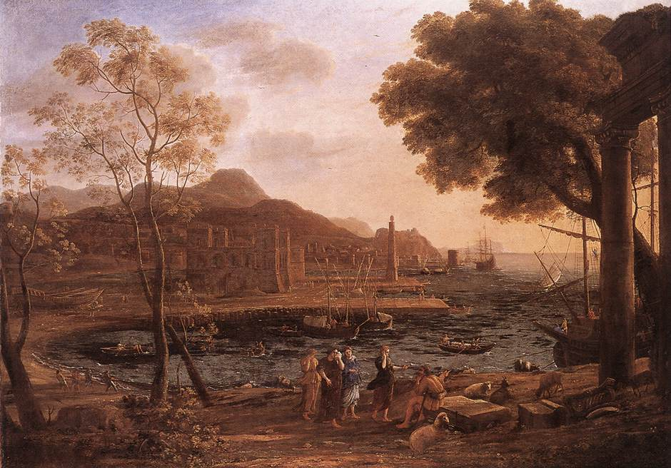
Claude Lorrain, Harbour Scene with Grieving Heliades, c. 1640 Oil on canvas, 125,5 x 175,5 cm, Wallraf-Richartz Museum, Cologne

Slide 14
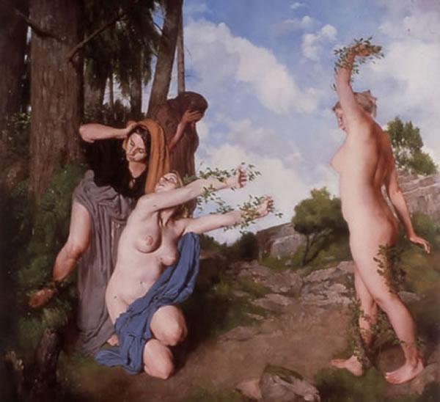
Paul Reid (born 1975), The Heliades Oil on canvas, 2002, 122 x122cm Private collection

Slide 15
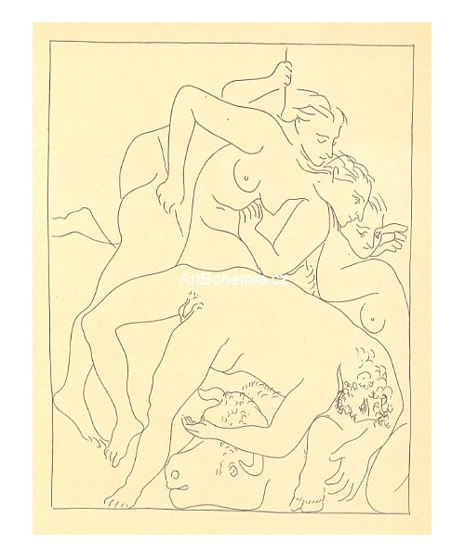
Pablo Picasso
“The Fall of Phaethon with the Sun Chariot” from the illustrated book Les Métamorphoses
(Print executed 1930)

Slide 16
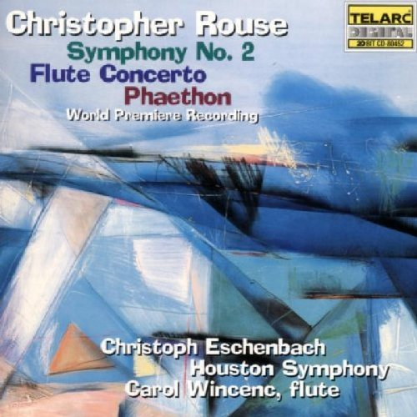
Other Media
Poetry: George Meredith (Victorian writer, 1828-1909) http://www.readbookonline.net/readOnLine/18400/
Classical Music: Christopher Rouse (American composer, 1949- ) “Phaethon” https://www.youtube.com/watch?v=loBE5_PrHAo
Rock Music: Ian Crause, “Song of Phaethon”
Zoology: Tropicbird

