Slide 1
Pyramis and Thisbe

Slide 2
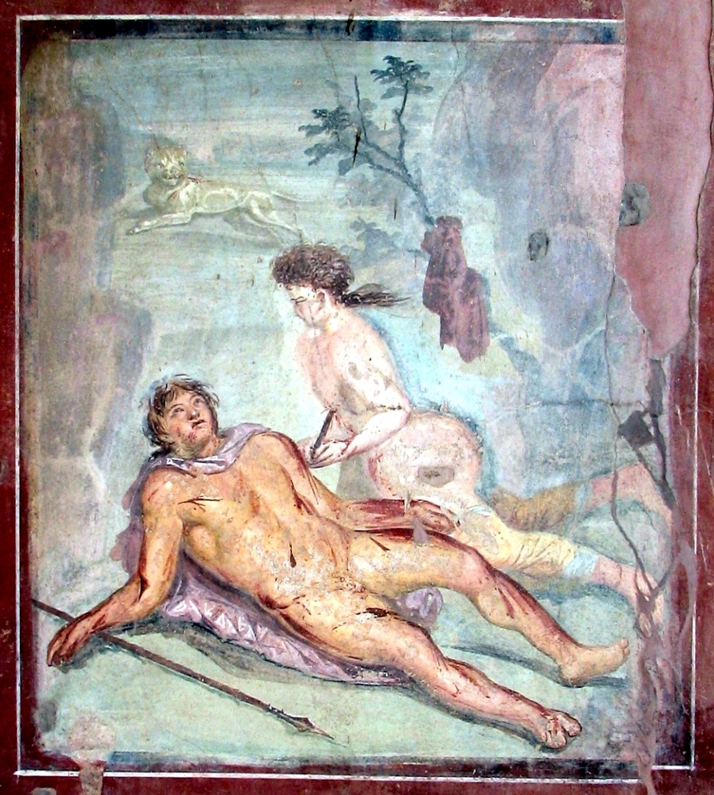

Slide 3
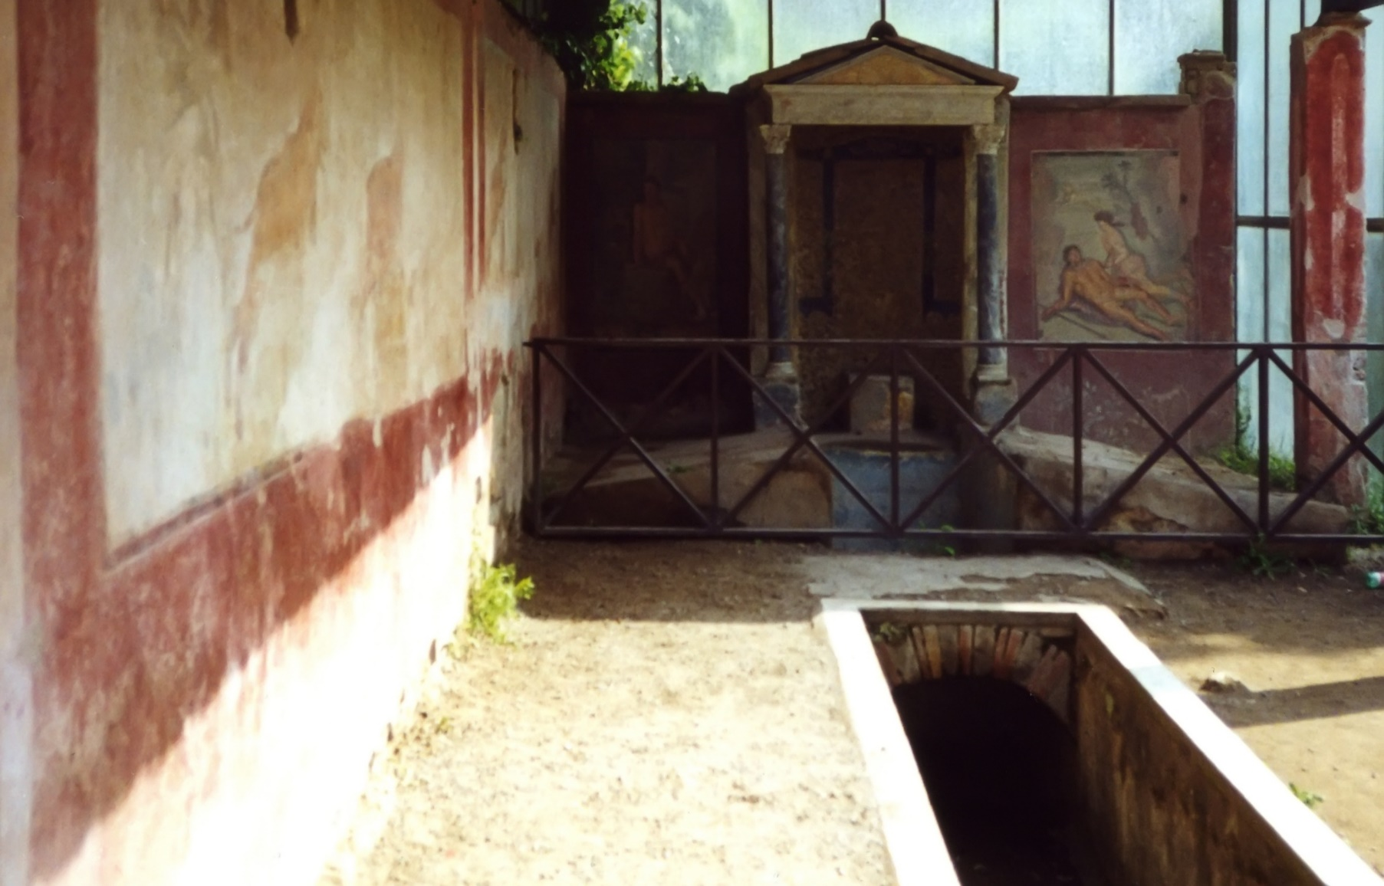
:Pompeii Casa Di Octavio Quartio

Slide 4
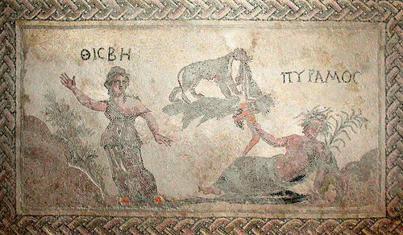

Slide 5
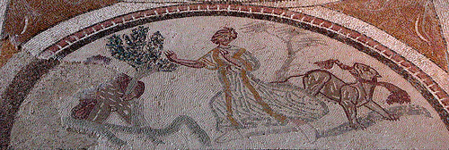
Pyramus and Thisbe Mosaic, Carranque, Spain

Slide 6
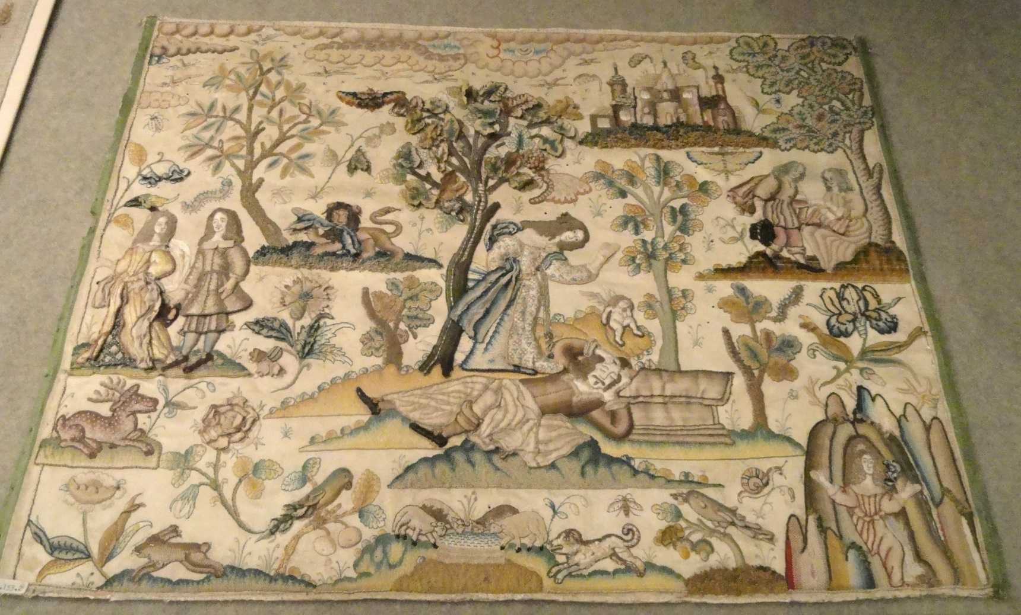
Needlework picture of Pyramus and Thisbe, England, 1650-1675, silk satin - Patricia Harris Gallery of Textiles & Costume, Royal Ontario Museum

Slide 7
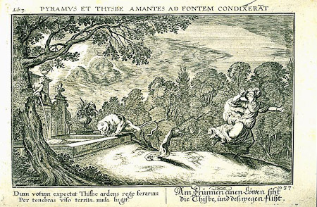
Artist Johann Whilhelm Baur (1600-1640), Nuremberg edition, 1703.

Slide 8
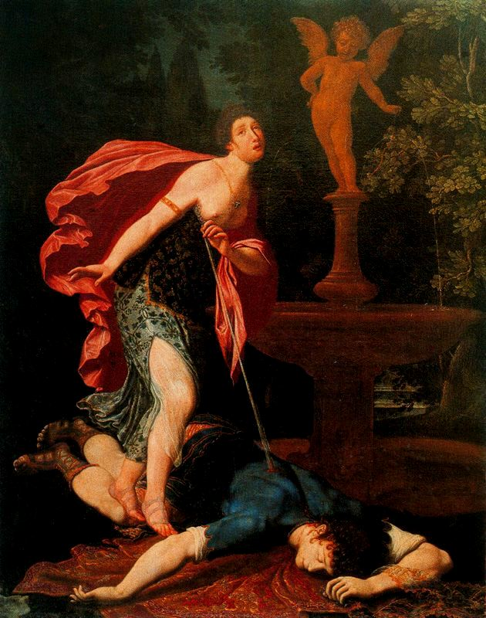
Pyramus and Thisbe by Gregorio Pagani. Uffizi Gallery.

Slide 9
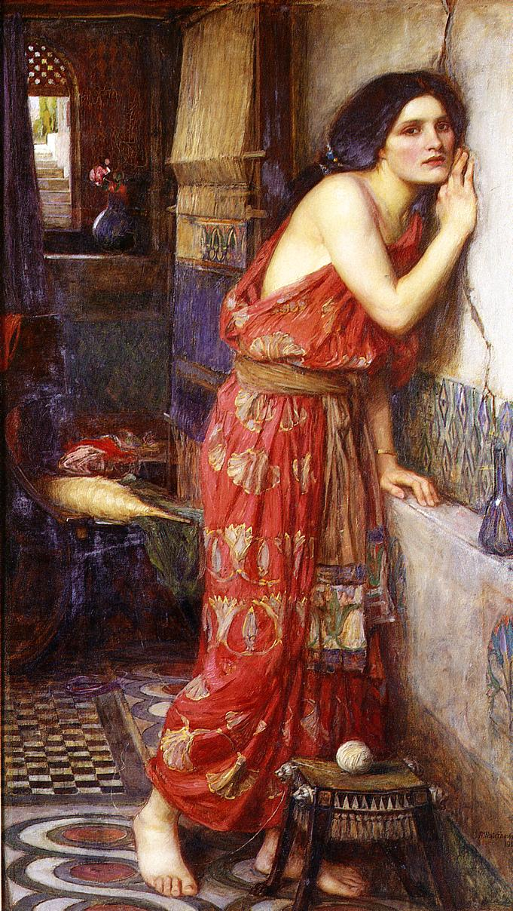
Thisbe, by John William Waterhouse, 1909.

Slide 10
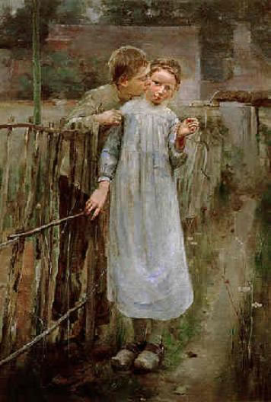
Theodore Robinson (1852-1896)
Pyramus and Thisbe or The First Kiss

Slide 11
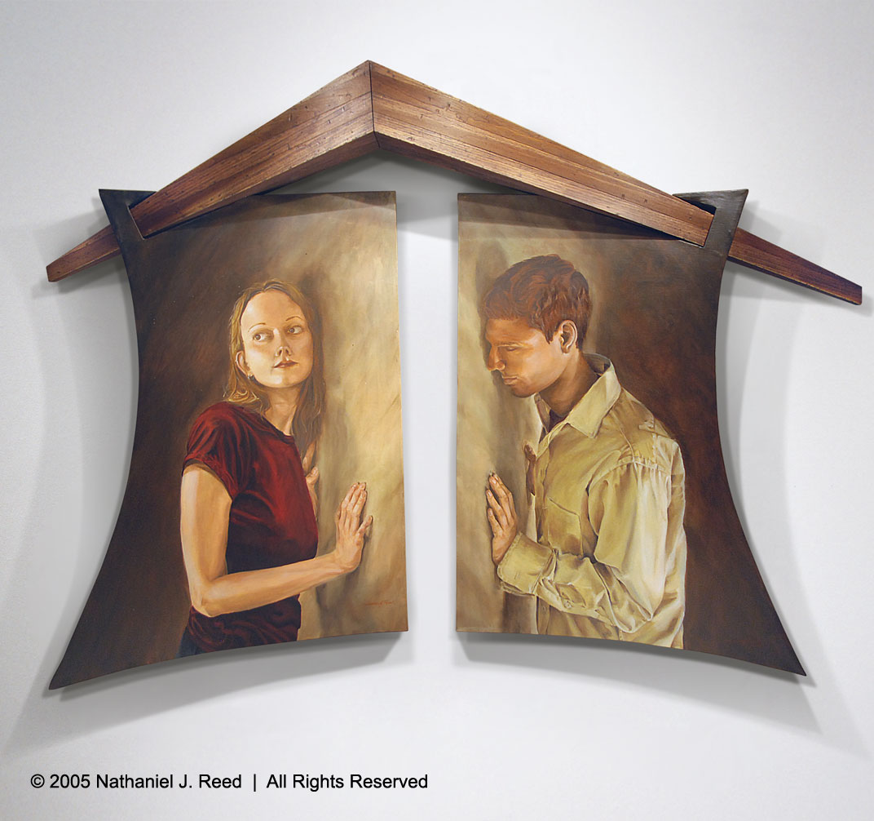
‘If not for this we could touch’

Slide 12
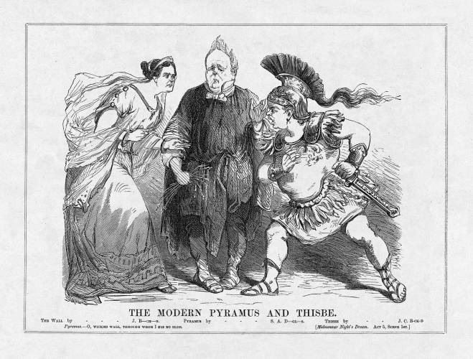
The Modern Pyramus and Thisbe
Cartoonist: Henry Louis Stephens
Source: Vanity Fair
Date: July 31, 1860, p. 43

Slide 13
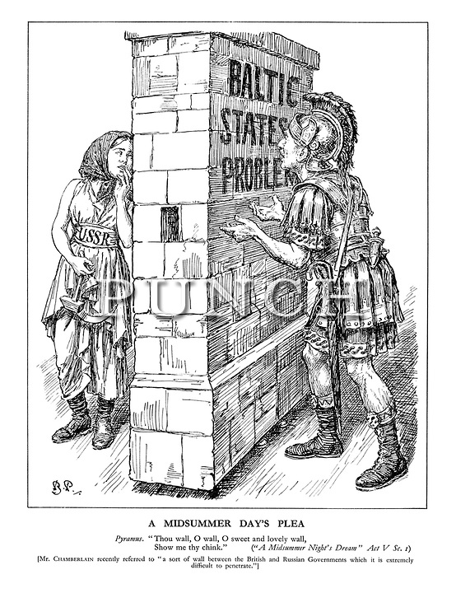

Slide 14
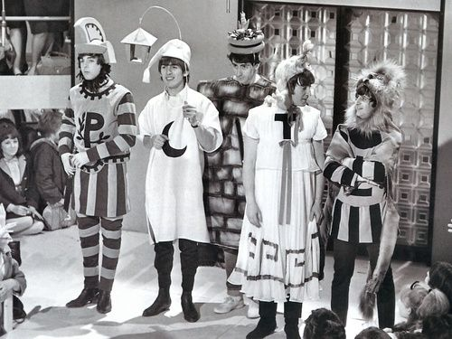
Around The Beatles! 1964
http://www.maniacworld.com/Pyramus-and-Thisbe.html

Slide 15

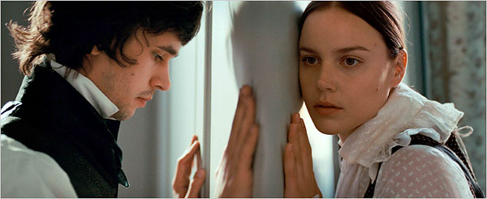
https://www.youtube.com/watch?v=BxbJq2x0D-w

