Slide 1
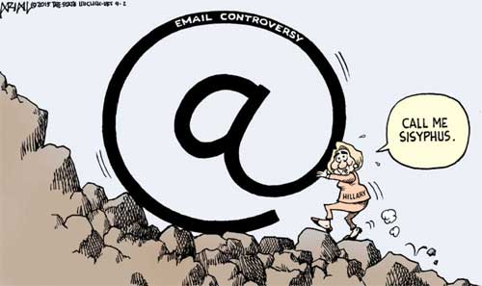
Classical Mythology in the Modern World
What is Myth?

Slide 2
What is a Myth?
A story about the past
Handed down from generation to generation (tradition)
About gods and heroes and the supernatural
Religious in context
Expression of cultural values (charter myth)
Teaches moral lessons
Explains natural phenomena and events
Essential human experience
Culturally true rather than historically accurate and factual
Entertainment

Slide 3
Some Questions to Ask about Mythology
What cultural Insights does a myth tell us about the society that tells a particular story?
What Roles do these myths play in this society?
What Functions do these myths serve in the modern world?
Answering these questions is a Sisyphean Task.

